Slide 1

Traffic Sign Recognition
Supervisor: Mr. Vishal Kanaujia
Presented By (Group): Harikesh Patel (1773613025)
Ankit Rajpoot (1773613009)
Balram Chand (1773613016)
Ranjay Gupta (1773613038)
RAJKIYA ENGINEERING COLLEGE, AZAMGRAH
DEPARTMENT OF INFORMATION TECHNOLOGY
(21/06/2021)

Slide 2
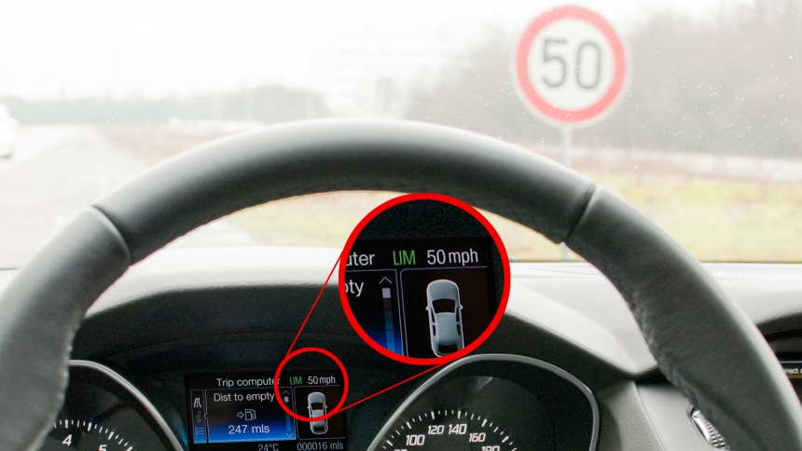
Contents :
1.0 Overview
1.1 Objective of Project
1.1 How does this works?
2.0 Why Traffic Sign Recognition?
2.1 Scope of Project
2.2 List of companies working on this automation
3.0 Data Source
3.1 Traffic Sign Classes
4.0 Tools & Technology
4.1 Libraries Used
5.0 Working Procedure
5.1 Neural Networks
6.0 Modules completed
7.0 Running Module
8.0 Conclusion
9.0 References

Slide 3
1. Overview
Object identification has many applications in various fields. This project aims to identify a traffic sign from a digital image. This would be useful in an autonomous vehicle application. These ideas and methods could also be used in other areas.

Slide 4
1.1 Objective of Project
The overall objective of this project is to write a program what will identify a traffic sign from a digital photograph.
Traffic signs appear in diverse background situations and, at times, may be partially obscured.
The software should be able to function in spite of these issues.

Slide 5
1.2 How does this works?
Block Diagram:

Slide 6
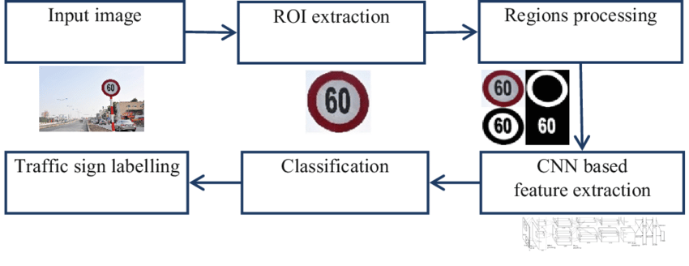
Visual diagram of working :

Slide 7
2. Why Traffic Sign Recognition?
2.1 Scope of the project
Highway Maintenance: Check the presence and condition of signs along major roads.
Sign Inventory: Creating an inventory of signs in city environments.
Driver Support Systems(DSS): Assist the driver by informing of current restrictions, limits, and warnings.
Intelligent Transport Systems(ITS): Any autonomous vehicles that is to drive on public/private roads must have a means of obtaining the current traffic regulations. This can be done through TSR model.

Slide 8
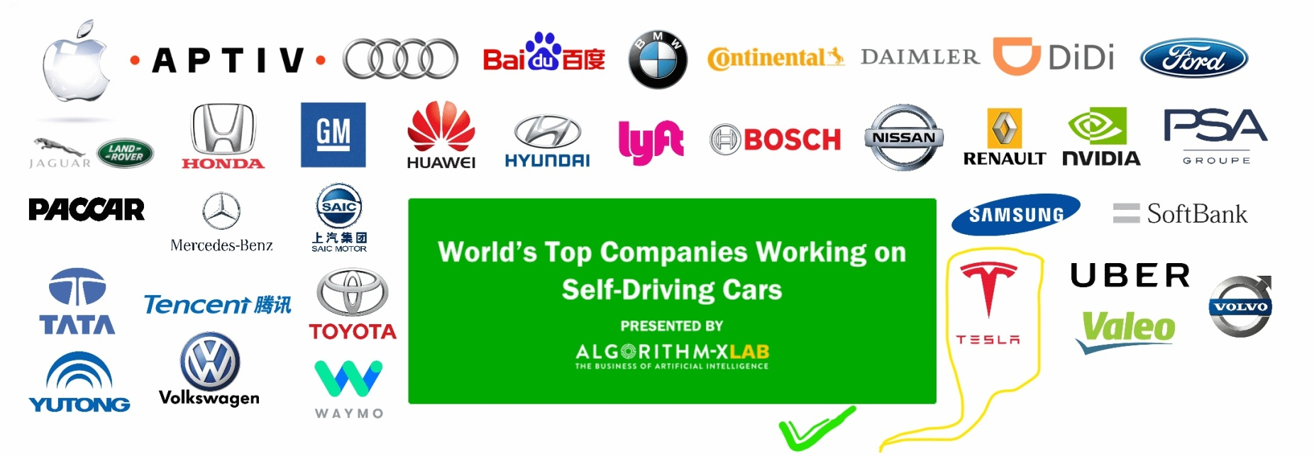
2.2 Popular Companies working on this Automation Technology

Slide 9
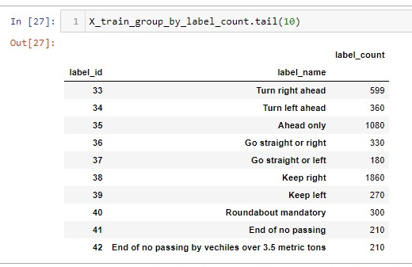

3. Data Source
For training our model we have considered German Traffic Sign Recognition Benchmark(GTSRB) image data set.
The image data set consists of 43 classes/labels like:
Used csv sign_name data as image labeling.

Slide 10
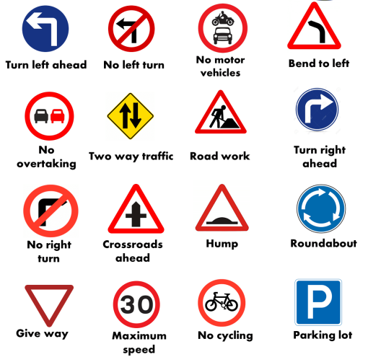
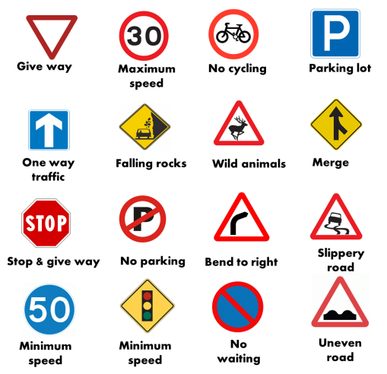
3.1 Traffic Sign Classes
Considered total 43 class of traffic sign images :

Slide 11


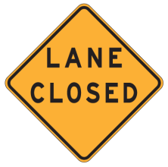

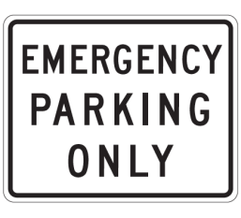
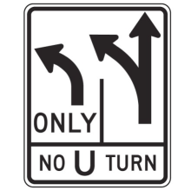


Traffic Sign Classes consisting types :
Guide and recreational traffic signs
Road construction traffic signs
Regulatory traffic signs
Warning traffic signs

Slide 12

4. Tools and Technology
Languages / Technologies Used :
Pythion 3
Machine Learning
Deep Learning

Slide 13

Editor Used :
JupyterNotebook
VS code
JupyterNotebook of Anaconda distribution.

Slide 14

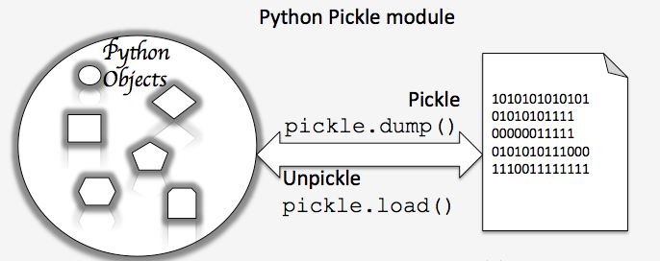




4.2 Libraries Used
Matplotlib
Scikit-learn
Numpy
Pandas
Pickle
Tensorflow
Keras

Slide 15
5. Working Procedure
Import libraries
& Load dataset
In the first phase, we have collected the
traffic sign samples to train our model.
In the second phase, we have trained our
TSR model for these traffic sign samples.
In the last phase, trainer data is used to
recognize the images.
If any sign is detected it will compare it with those stored in the
dataset for a match. And If a sign is recognized, it will simply
display appropriate actions to be taken.
Preprocessing
of dataset
Training of
model
Testing of
model

Slide 16
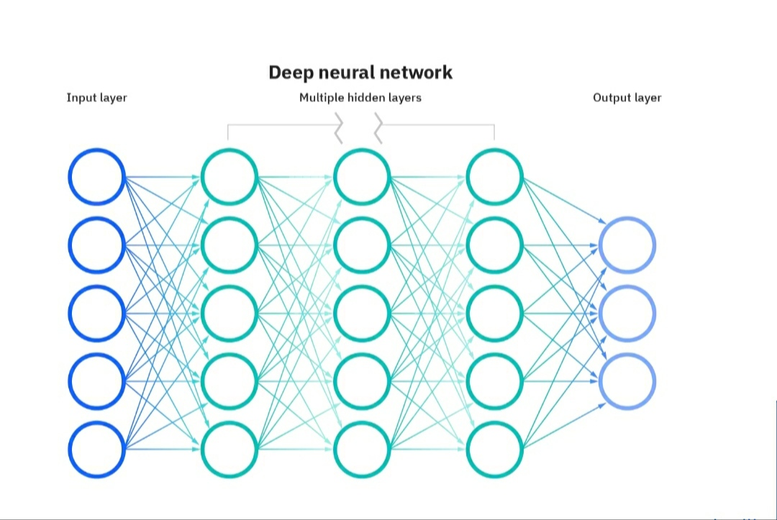
5.1 Neural Network
Components of Neural Networks:
1. Input Layer
2. Hidden Layer
3. Output Layer

Slide 17
6. Modules completed
Set up the Project
Imported the necessary modules of deep learning & machine learning
Loaded the data
Processed the data to make ready for training
Modeled the architecture
Trained and saved the model
Plotted the accuracy graph of the model
Tested the model
We find our model 82% accurate after plotting the accuracy graph of the model & needed to apply little more effort to achieve better accuracy.

Slide 18
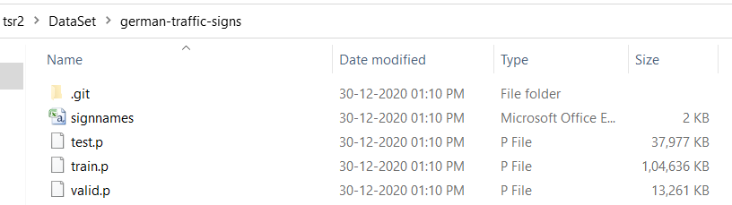
Set up the Project
Installed Jupyter Notebook of anaconda distribution & downloaded the necessary dataset to train our model.

Slide 19
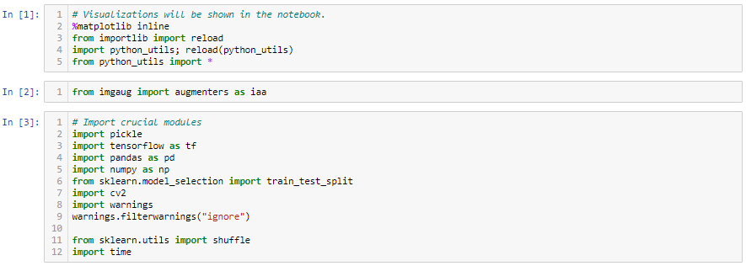
Necessary libraries of python Deep learning & Machine learning
Imported the necessary libraries of python Deep learning & Machine learning

Slide 20
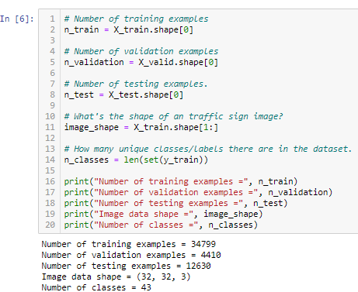
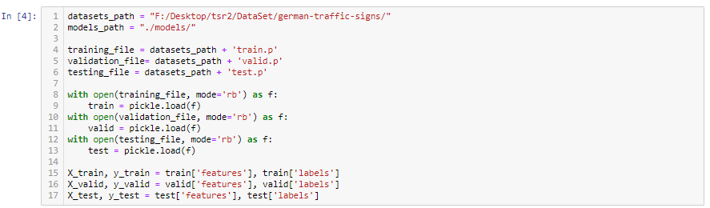
Loaded the data
Loading the dataset

Slide 21
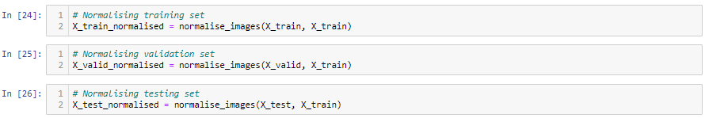
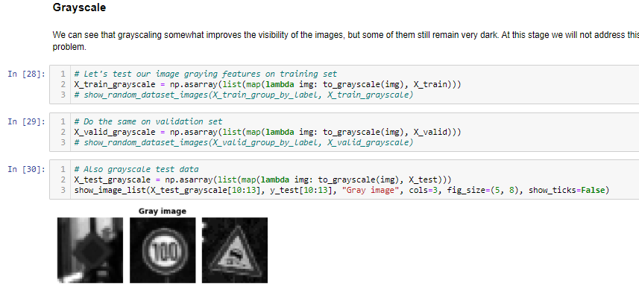
Preprocessing of dataset
Processing the data to make ready for training

Slide 22
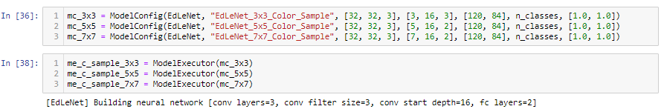
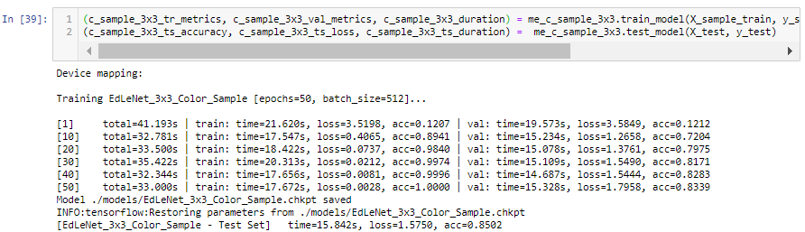
Training the model
Training and saving the model

Slide 23
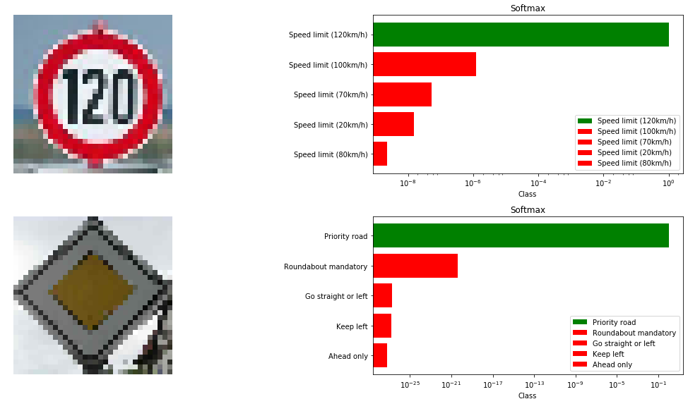
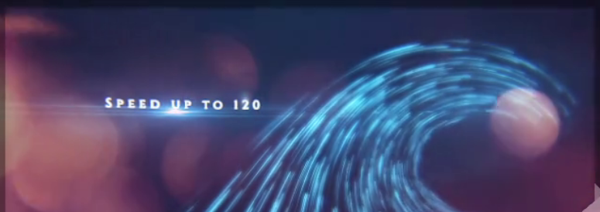
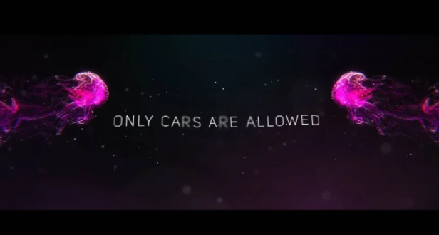
7. Running Module
This is how the running module of the project looks like after deployment.
Test Image Recognized Class Action Display

Slide 24
8. Conclusion
The algorithm that has been used for traffic signs it can be generalized to deal with other kinds of objects.
Difficulties that exist for object recognition in the environment like multiple traffic signs, parking vehicles, pedestrians, and other moving or background objects will be there. This way the system is immune to lighting changes, and object deformation being useful for Driver Support Systems(DSS).
Due to this knowledge of the sign considered status, it is believed that the system is useful for other applications such as maintenance and inventories of traffic sign in highways.

Slide 25
9. References
[1] https://internshala.com/
[2] https://github.com/
[3] Dask, [online] Available:
https://docs.dask.org/en/latest/
[4] https://medium.com/
[5] https://stackoverflow.com/

Slide 26
Thank You
.........

