Slide 1

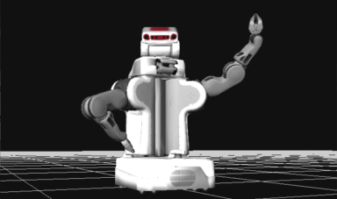
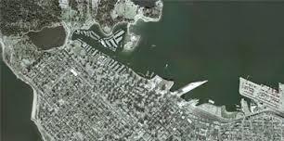
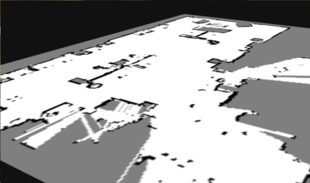
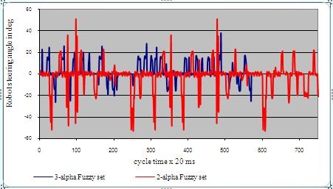
ROSDASH
Web-based Visual-programming-based Configurable Dashboard Platform for ROS
Notes:
Links:
http://laughingsquid.com/robot-power-poster-by-josh-ellingson/
http://robotwebtools.org/demos.html
http://www.sfu.ca/fs/Campus-Facility-Profiles/Campus-Maps.html
http://www.intechopen.com/books/evolutionary-computation/mobile-robot-navigation-using-alpha-level-fuzzy-logic-system-experimental-investigations

Slide 2
Why ROSDASH?
Love robots, but have problems visualizing the data behind them?
Use ROS, but tired of solving installation dependencies?
Need dashboards specific for your research?

Slide 3
Merits of ROSDASH
Web-based: Just open browser and work!
Visual programming: Drag and drop!
ROS: Support topic, service, and parameter!
Configurable: Change parameters and refresh the page!
Platform: Log in and create your own dashboard!
Extensible: Write your js code and link to it!

Slide 4
How to Run?
Roscore (talk with robots)
Rosbridge (ROS => websocket)
Roslibjs (websocket => js)
ROSDASH (specify IP of rosbridge)
Communication with robots works even off-line

Slide 5
How to Edit?
Login first
3 pages for each dashboard
Panel: Run widgets with ROS
Editor: Edit widgets
Diagram: Edit diagram representing connection between widgets and ROS topics

Slide 6
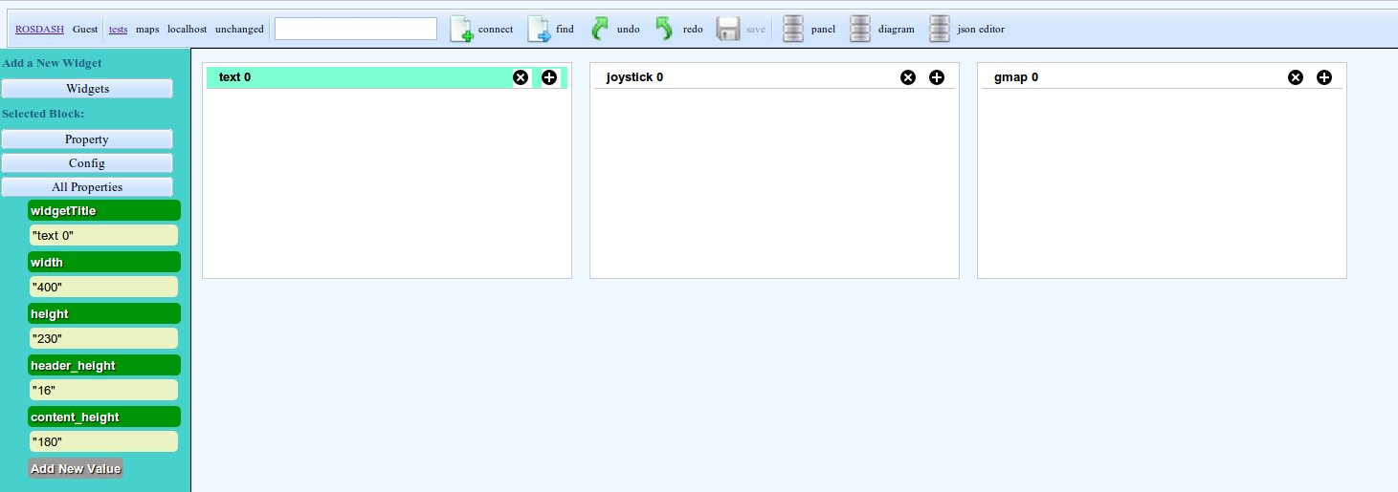
Editor
Add, move, or remove widgets
Change size of widgets

Slide 7
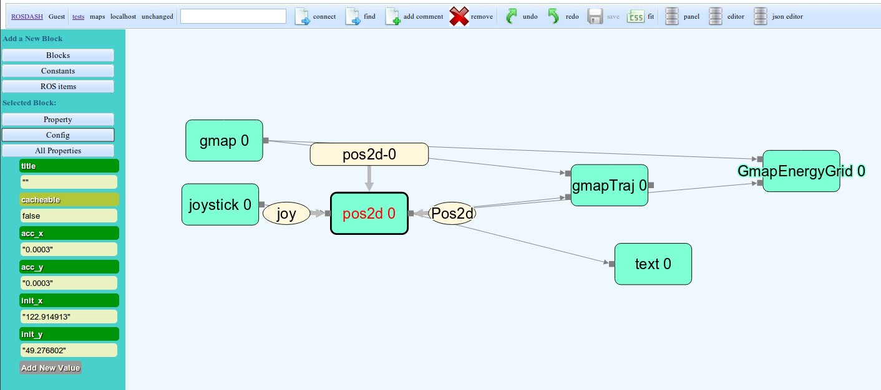
Diagram
Flow network representing connection
Add, move, or remove blocks
Change config of blocks

Slide 8
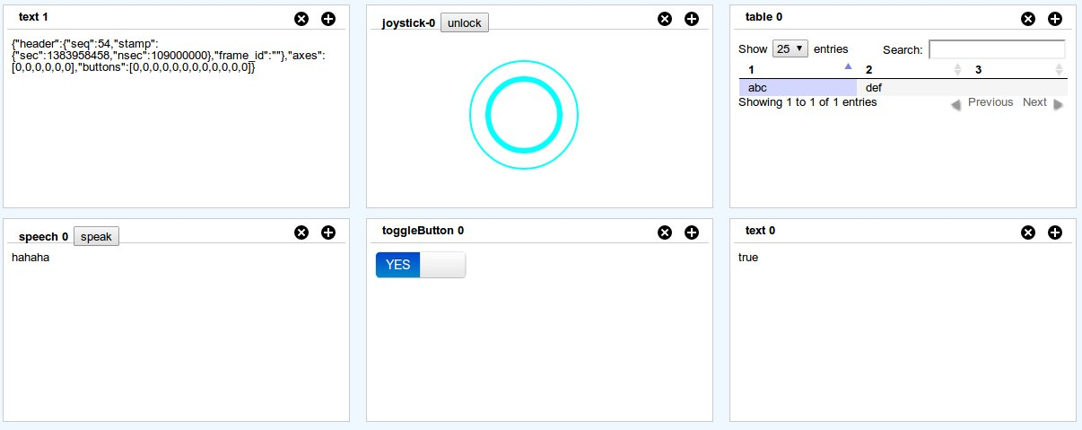
A List of Widgets (1)
Input: button, joystick
Output: textbox, speech, table, chart

Slide 9
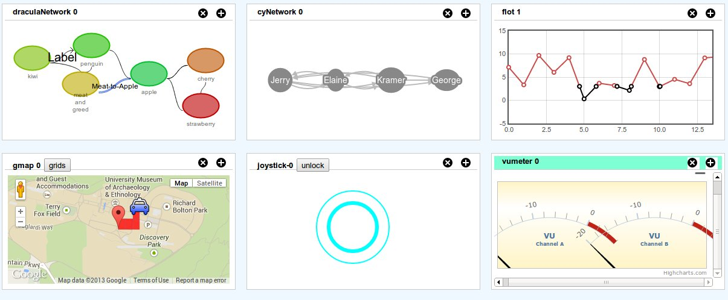
A List of Widgets (2)
Scientific: vu meter, network graph, Google maps, plot

Slide 10
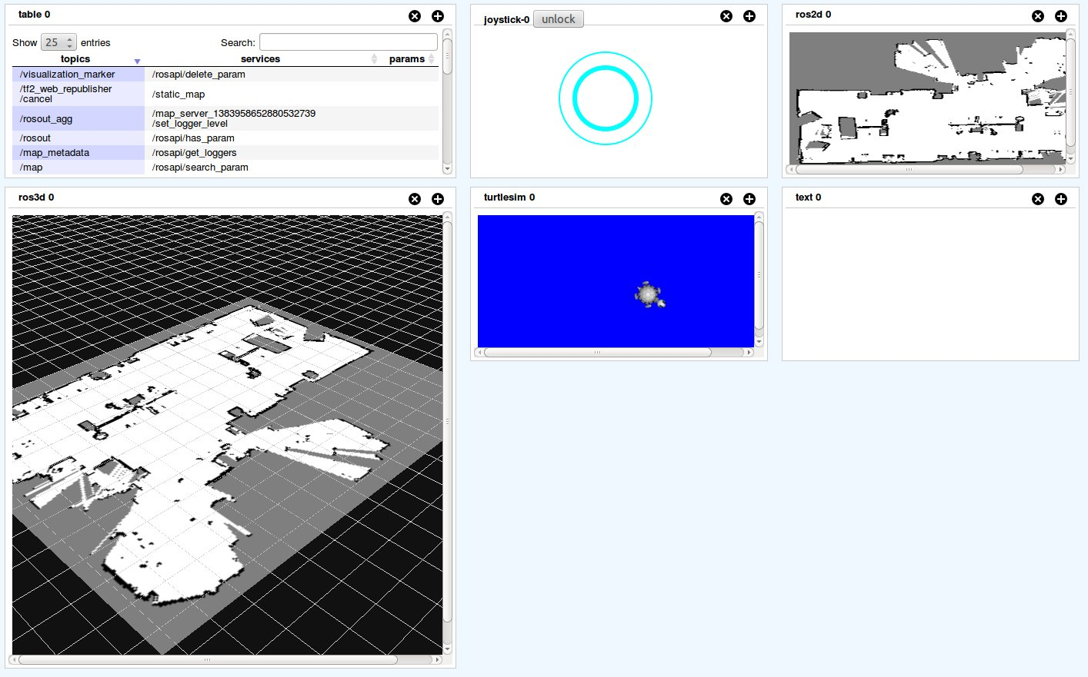
A List of Widgets (3)
ROS: 2D model, 3D model, mjpeg, turtlesim

Slide 11
Steps to Create a Dashboard
Login with email account;
Go to your personal page;
Add a new page;
Open diagram page;
Pick some blocks to add;
Add some ROS topics from ROS item list, and connect them with widget blocks;
Open editor page;
Change the position of each widgets;
Run roscore and rosbridge;
Open panel page, and connect with rosbridge;
Run robots and see

Slide 12
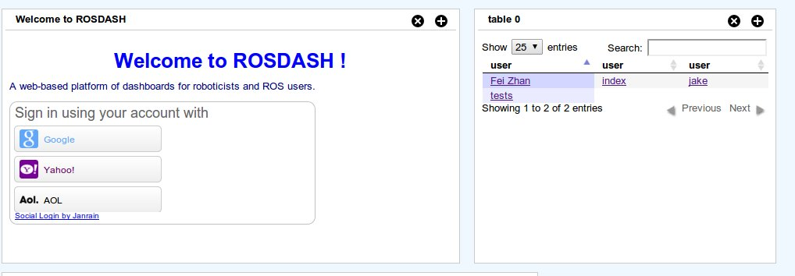
Steps to Create a Dashboard (1)
1. Login with email account;

Slide 13
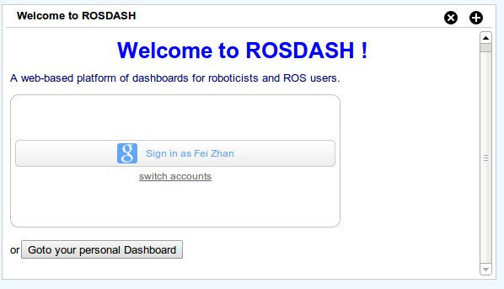
Steps to Create a Dashboard (2)
2. Go to your personal page;

Slide 14
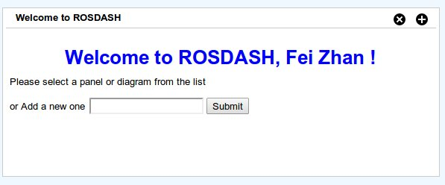
Steps to Create a Dashboard (3)
3. Add a new page;

Slide 15

Steps to Create a Dashboard (4)
4. Open diagram page;

Slide 16
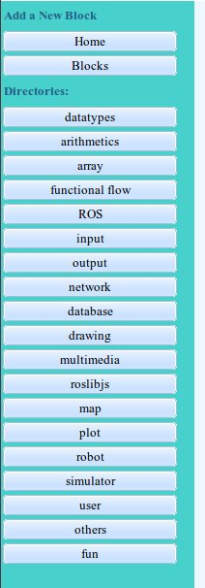
Steps to Create a Dashboard (5)
5. Pick some blocks to add;

Slide 17
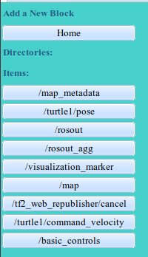
Steps to Create a Dashboard (6)
6. Add some ROS topics from ROS item list, and connect them with widget blocks;

Slide 18
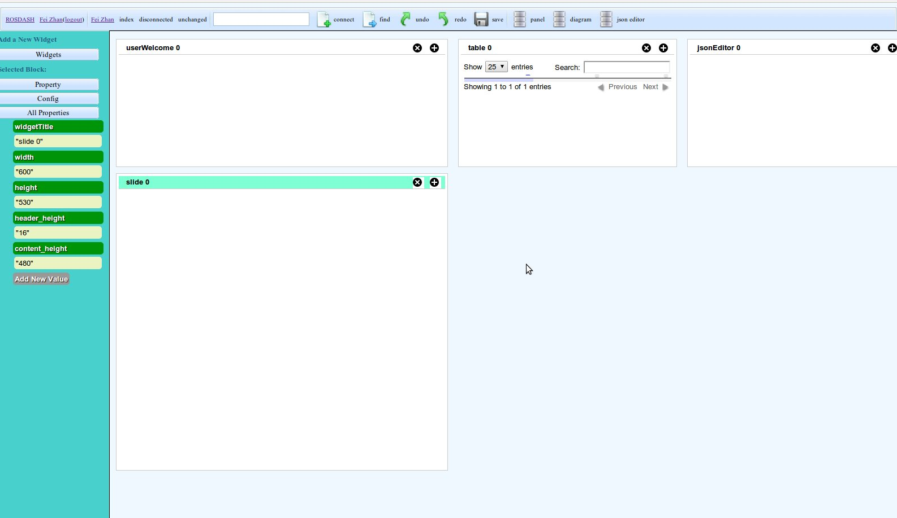
Steps to Create a Dashboard (8)
8. Change the position of each widgets in the editor page;

Slide 19
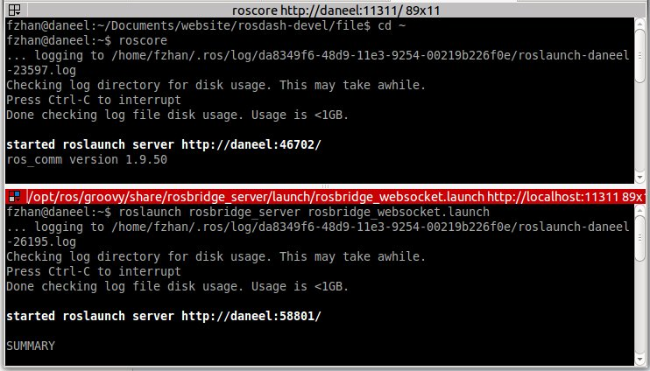
Steps to Create a Dashboard (9)
9. Run roscore and rosbridge;

Slide 20
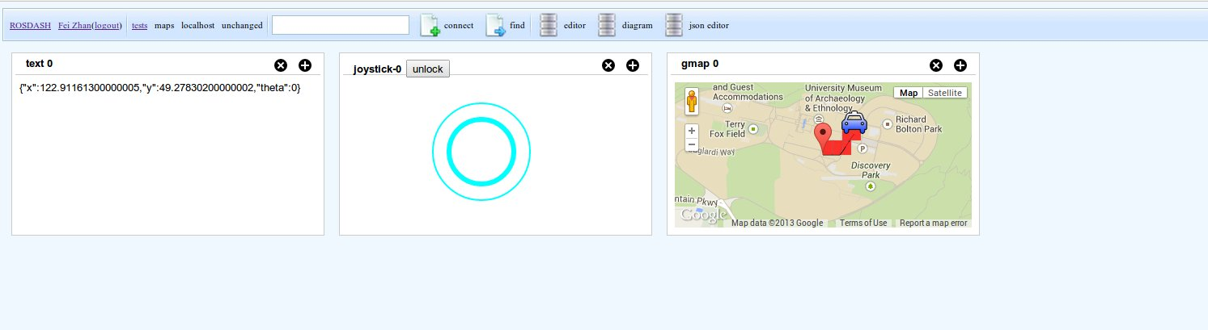
Steps to Create a Dashboard (10)
10. Open panel page, and connect with rosbridge;
11. Run robots and see

