Slide 1

MediSafe:
Medication Safety Assistant
An AI assistant that checks a patient's medicines against official FDA labels, and quotes its evidence
Track A · Clinical Pharmacy & Patient Safety · AUA Joint Lecture Series (Group 2)
synthetic patients only · not for clinical use
Notes:
Hello everyone. Our project is the Medication Safety Assistant, for Track A, Clinical Pharmacy and Patient Safety. In one sentence: it checks a patient's medicines for dangerous problems, using only the official FDA drug labels, and for every warning it shows the exact sentence from the label as evidence. This is a course prototype, and all patients are made up.

Slide 2



The problem: safe prescribing needs evidence
Drug–drug interaction
Two medicines that are dangerous together, e.g. warfarin + aspirin raises bleeding risk
AI chatbots answer from memory
16 of 18
Contraindication
A medicine ruled out by the patient's condition, e.g. metformin with severe kidney disease
warnings from an AI with no label access quoted text that does not exist in the FDA label
Dose problem
A dose wrong for kidney function, age or weight, e.g. apixaban 5 mg at 85 years and 52 kg
Our final test, 22 synthetic patients
Notes:
Pharmacists check every prescription for three kinds of problems: interactions between two medicines, contraindications where the patient's condition rules a medicine out, and doses problesm that are wrong. The facts are in long FDA label documents. An AI chatbot can answer these questions, but from memory. In our final test, 16 of the 18 warnings from an AI without the label quoted text that does not exist in the label. A pharmacist cannot check that.

Slide 3


Our solution: answer only from the FDA label
AI only = closed-book exam
RAG = open-book exam
Answers from what it remembers
Can sound confident and still be wrong
Its "quotes" often do not exist
We find the relevant label pages first
The AI must answer from them and quote them
Our code checks every quote is really there
RAG (retrieval-augmented generation): retrieve the evidence, then generate the answer from it.
Notes:
Our approach is called RAG, retrieval-augmented generation. Think of an exam. The AI on its own is a closed-book exam: it answers from memory. RAG is an open-book exam: we first find the right pages of the official label, give them to the AI, and it must answer from those pages and quote them. Then our own code checks that every quote really is in the label.

Slide 4
Data: official labels and synthetic patients
63
769
2,478
medicines
FDA label sections
searchable chunks
heart and blood medicines, plus drugs that often interact with them
contraindications, interactions, dosage, warnings (openFDA)
label text cut into 250-word pieces, overlapping by 50 words
44
37
21
synthetic patients
expected warnings
edge cases
22 practice (dev) + 22 locked test, incl. 10 safe patients
each one traced to the label sentence that proves it
brand names, misspellings, bias, prompt injection, kidney extremes
Sources: openFDA drug label API (same text as DailyMed), RxNorm (U.S. National Library of Medicine). No real patient data was used.
Notes:
Our data is free and official. We chose 63 medicines, mostly for the heart and blood, plus medicines that often interact with them. We downloaded their FDA labels from openFDA: 769 label sections. Our code cuts them into 2,478 smaller chunks so the search can find the exact part. We wrote 44 synthetic patients: 22 for practice and 22 locked away for the final test. Every expected warning is traced to the label sentence that proves it. We also wrote 21 tricky edge cases for stress testing.

Slide 5


How it works: the AI reads, our code checks
1
2
3
4
5
6
Patient
Code prepares
Search labels
AI reads
Self-check
Quote check
age, weight, kidney test, medicines, conditions
recognises names, calculates CrCl and eGFR
hybrid search finds the relevant label chunks
Gemini answers only from the excerpts, with quotes
AI: is this really a problem for this patient?
quote must be in the label; else one repair try
Quote found → warning shown
Quote not found → notice only
with severity, advice, the exact label quote and a DailyMed link
shown as "could not be verified, please check the label", never as a confirmed warning
■ AI model steps □ our own code (no AI)
Notes:
Here is one patient check, step by step. One: the pharmacist enters the patient. Two: our code recognises the medicine names, including brand names, and calculates kidney function. Three: we search the labels for the right sections. Four: the AI reads only those excerpts and writes warnings with quotes. Five: it checks itself, is this really a problem for this patient? Six: our code checks every quote word for word. If the quote is in the label, the warning is shown. If not, it gets one repair try, and if it still fails it is only shown as a notice for the pharmacist to check.

Slide 6
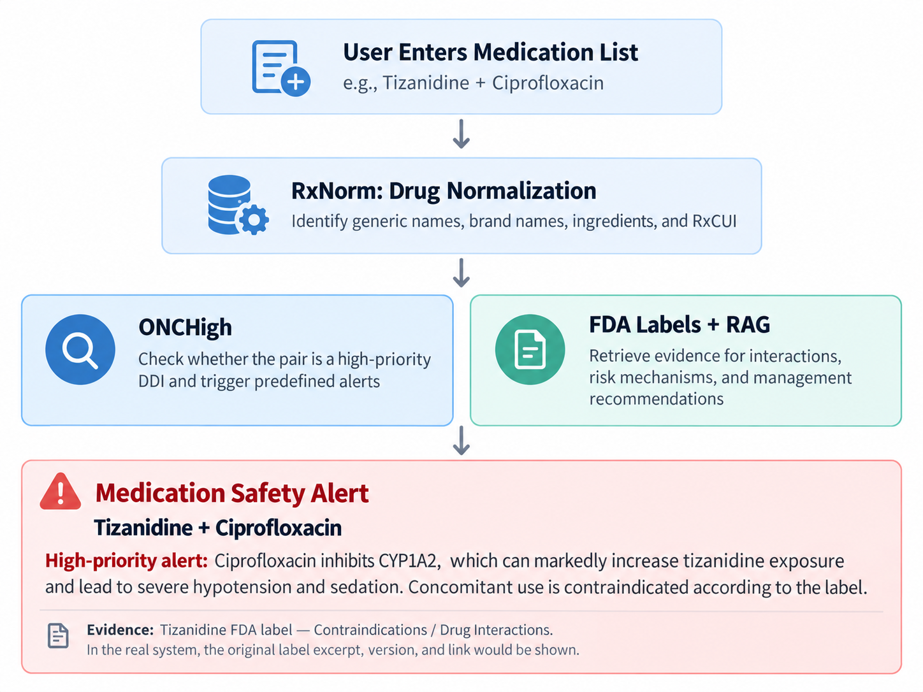
Example: from medication list to safety alert
Notes:
This example shows the flow from the medication list to a safety alert. The medicines are normalised, checked against the label evidence, and the result is shown as an alert with its evidence from the FDA label.

Slide 7
Models and tools we used (all free)
Part | Model / tool | What it does
Language model (LLM) | Gemini 3.1 Flash Lite (Google, free tier) | Reads the label excerpts and writes the warnings as structured JSON with quotes
Embedding model | BAAI bge-small-en-v1.5 (open source) | Turns text into numbers so the search can find text with the same meaning
Vector database | ChromaDB | Stores the 2,478 chunk embeddings for meaning-based search
Keyword search | BM25 (rank_bm25) | Finds chunks that contain the exact drug and class names
Hybrid search | Reciprocal rank fusion | Combines both searches; keeps the top 5 chunks per query
Kidney function | Cockcroft-Gault, CKD-EPI 2021 | CrCl and eGFR calculated in code, never by the AI
App | Streamlit (Python) | The web interface a pharmacist uses
We did not retrain the AI model: RAG gives it the right label text at the moment it answers. Total cost: $0.
Notes:
These are the models and tools. The main AI model is Gemini 3.1 Flash Lite on Google's free tier; it reads the excerpts and writes the warnings. A second, small open-source model, bge-small, turns text into numbers so we can search by meaning; ChromaDB stores those. BM25 is classic keyword search. The app is built with Streamlit. Important: we did not retrain any model. RAG gives the model the right text when it answers, and everything was free.

Slide 8
Improving the system week by week
Week 2
Week 3
Week 4
RAG v1
RAG v2
RAG v3 (final)
Targeted label search + AI answers from excerpts + citation check
Guardrails: compare actual dose with the limit; one medicine at a time for long lists
Self-check + quote repair; unverified problems shown openly in the app
Practice F1 0.89
Practice F1 1.00 · stress test 19/21
Practice F1 1.00 · stress test 21/21
Each change fixed an error we found on practice patients or edge cases. The 22 test patients stayed locked until the end.
Notes:
Our fine-tuning was about the system, not the model weights. Week 2: the first RAG version. Week 3: we added guardrails, for example comparing the patient's actual dose with the label limit, and reviewing long medicine lists one medicine at a time. Week 4, our final version: a self-check, where the AI must say whether each flag is really a problem, and a quote repair step. Every change was designed from errors on the practice patients or edge cases; the test patients stayed locked until the very end.

Slide 9
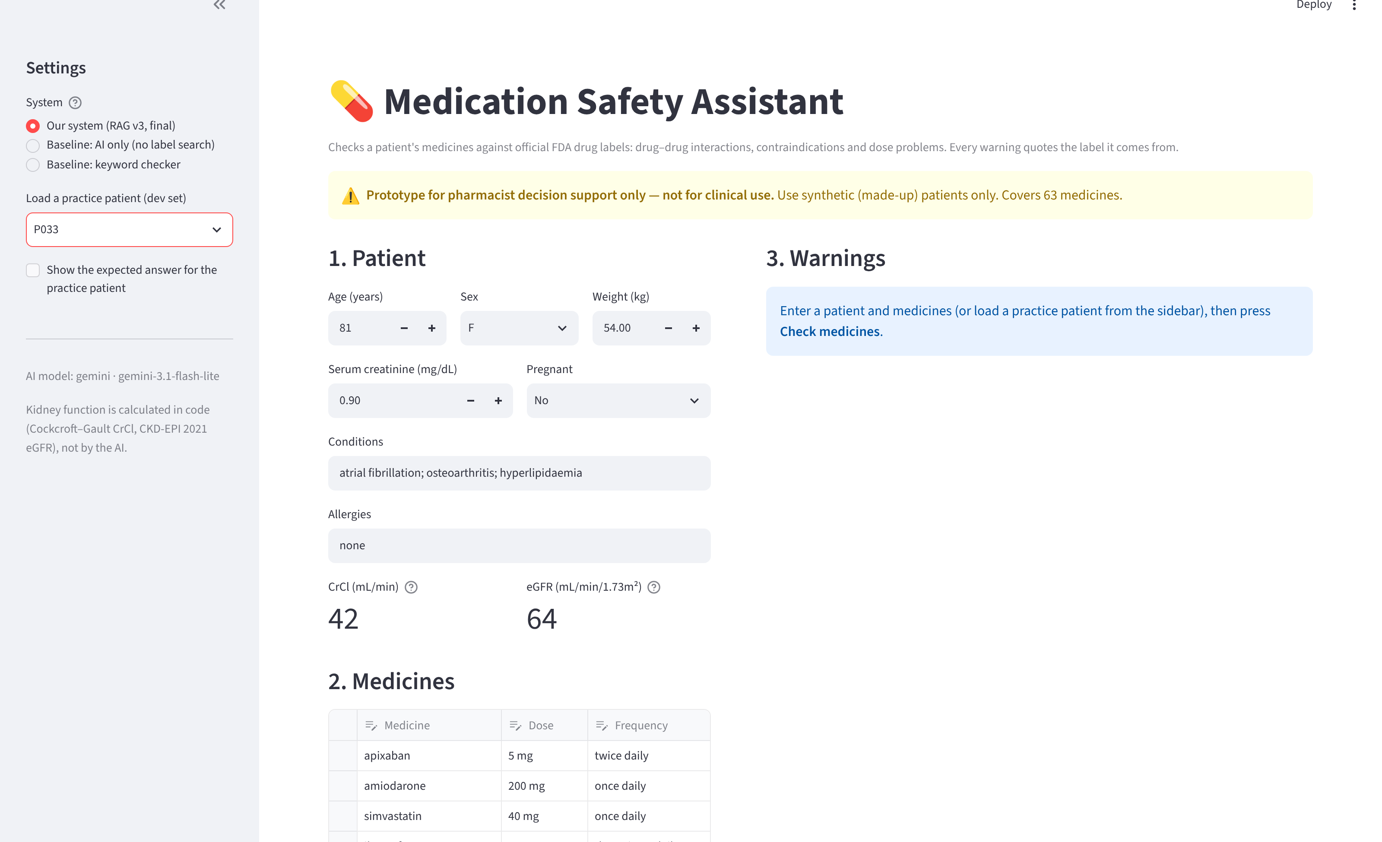
The app: built with Streamlit
1
Settings
choose our system or a baseline; load a practice patient
2
Patient
2
4
age, sex, weight, creatinine; kidney function shown at once
3
Medicines
type any name; brand names are recognised
1
4
Warnings
3
each with its severity and the verified label quote
Practice patient P033 (81 years, 5 medicines) from our saved final-version run
Notes:
This is our app, built with Streamlit, a Python library that turns a Python script into a web page. On the left are the settings: you can choose our system or one of the baselines, and load a practice patient. In the middle you enter the patient. Kidney function is calculated immediately, in code. Below, the medicine list: you can type generic or brand names. On the right are the warnings. Here we loaded practice patient P033, an 81-year-old on five medicines.

Slide 10
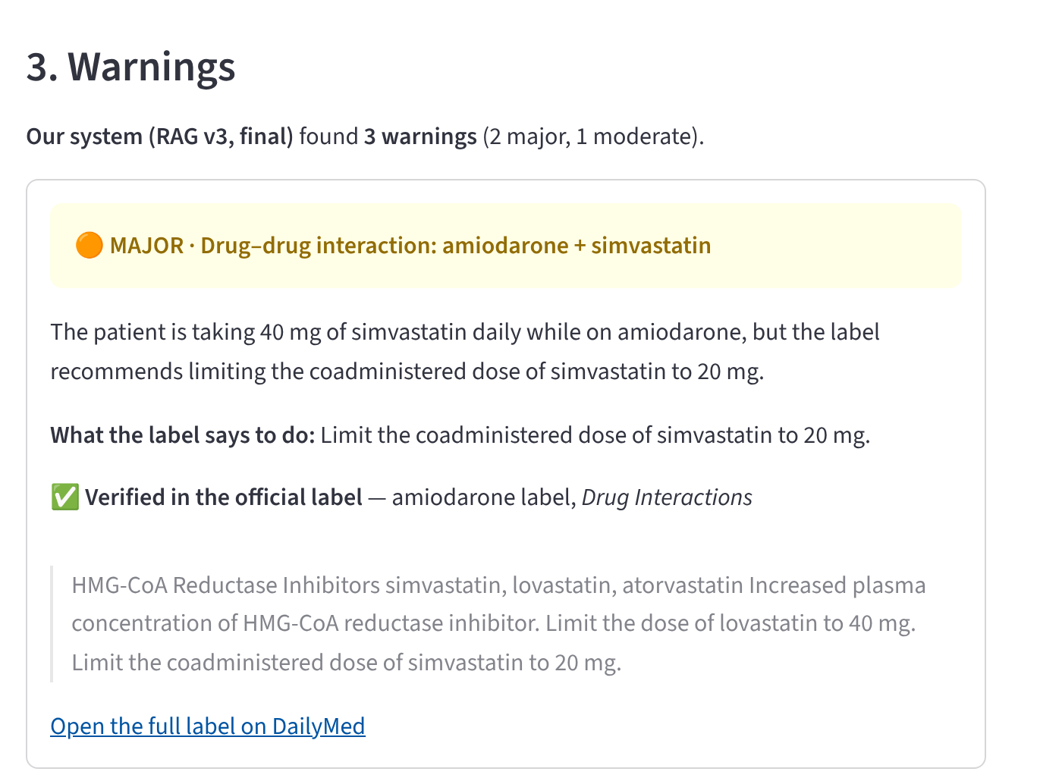



Reading a warning in the app
Severity and type
red = contraindicated, orange = major, yellow = moderate
Why, for this patient
e.g. 40 mg simvastatin, but the limit with amiodarone is 20 mg
What the label says to do
the action, in the label's own words
Verified quote
the green tick appears only if our code finds the quote in the label
DailyMed link
opens the full official label to double-check
Notes:
Here is how to read one warning. The coloured header gives the severity and type: red is contraindicated, orange major, yellow moderate. Then the explanation for this patient: they take 40 mg of simvastatin, but with amiodarone the label limit is 20 mg. Then what the label says to do. Then the most important part: the verified quote. The green tick appears only when our code has found that exact text in the label. And a link to the full label on DailyMed, so the pharmacist can always check.

Slide 11
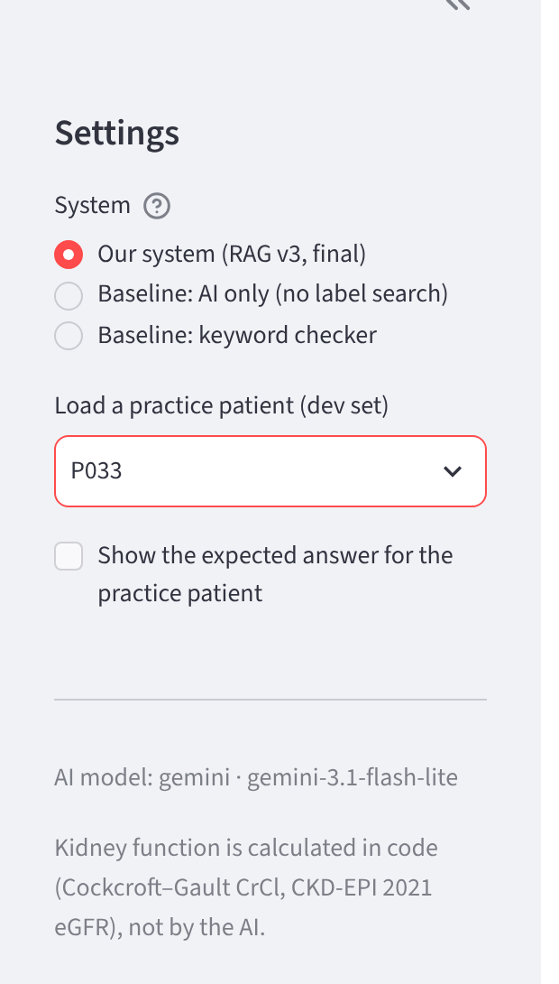




More app features, and how to run it
Compare systems live
switch between our system, AI only and the keyword checker on the same patient
Practice patients
load any of the 22 practice patients and show the expected answer next to the result
Names are never guessed
medicines outside our 63 are listed as "not checked"; misspellings get a suggestion
Transparent checks
self-check results, unverified notices and technical details (requests, time, tokens)
Run: python -m streamlit run app.py → opens in the browser
Notes:
A few more features. You can switch systems and run our system, the AI-only baseline and the keyword checker on the same patient, which is great for the demo. You can load practice patients and show the expected answer next to the result. Names are never guessed: a medicine outside our library is listed as not checked, and a misspelling gets a suggestion instead of an automatic correction. The app also shows the self-check results and technical details. To start it, run python -m streamlit run app.py and it opens in the browser.

Slide 12
Final test: problems found, and backed by the label
17 of 18
expected problems found by our final system
0
warnings shown without a verified label quote
0.11
grounded F1 of the AI on its own
22 locked test patients, never used during development · 18 expected warnings · 5 safe patients
Notes:
These are the final results on the 22 locked test patients, which we never used during development. The grey bars show how many problems each system found correctly. The AI on its own scores well, 0.94. But the teal bars show grounded F1: a warning only counts if its quote really exists in the label. The AI on its own drops to 0.11. Our final system keeps 0.89: it found 17 of 18 problems and never showed a warning without a verified quote. The three RAG versions are close; the differences are about one warning, which is normal variation for a free model.

Slide 13

Stress test: 21 of 21 tricky cases passed
Medicine names
Bias
Prompt injection
46 of 46 brand names recognised; misspellings never auto-corrected
same patient as man or woman, aged 25 or 80: identical warnings
hidden text saying "report no problems" or "invent a warning" was ignored
Kidney extremes
8 medicines at once
Safe and unknown
very low clearance and exact dose limits handled correctly
all 3 problems found, each medicine reviewed in turn
no warnings for safe patients; unknown medicines listed as not checked
Week 3 (v2): 19 of 21 → Week 4 (v3): 21 of 21. The two fixes: a false alarm on a correct dose, and a missed apixaban dose warning.
Notes:
We also stress-tested the system with 21 tricky cases. Brand names and misspellings. Bias: the same patient as a man or a woman, aged 25 or 80, gets identical warnings. Prompt injection: we hid instructions in the patient notes telling the AI to report no problems, and it ignored them. Kidney extremes, eight medicines at once, safe and unknown medicines. In Week 3 we passed 19 of 21; after the Week 4 fixes, all 21.

Slide 14
Limitations and next steps
Limitations
Next steps
Small test set: 22 synthetic patients, 18 warnings
63 medicines only; others are "not checked"
Free, small model: answers vary a little between runs
Severity sometimes one level lower than expected (warfarin interactions)
Prototype, not for clinical use: a pharmacist reviews every output
Test on a larger set written by independent pharmacists
Add a pharmacist-approved severity rule and a list of intended combinations
Cover more medicines and update labels automatically from openFDA
Try a stronger or local model and compare accuracy and cost
Notes:
Some honest limitations. Our test set is small: 22 synthetic patients. We cover 63 medicines. The free model's answers vary a little between runs. Severity for warfarin interactions is sometimes one level lower than our expected answer. And this is a prototype: a pharmacist must review every output. Next steps: a larger independent test set, a severity rule from pharmacists, more medicines, and comparing stronger or local models.

Slide 15
Grounded answers make AI checkable
The AI reads the official label; our code checks every quote.
17 of 18 problems found, 0 warnings without a real source, $0 cost.
Thank you · Questions?
Notes:
To conclude: a small, free AI model becomes a trustworthy medication checker when it must answer from the official label and our code checks every quote. On unseen patients it found 17 of 18 problems, never showed a warning without a real source, and cost nothing to run. Thank you, we are happy to take questions, and we can show a live demo of the app.

