Slide 1
DIGITAL INVESTFAIR · FIN 7870
Pricing an Option
from first principles
Hang Seng Index Options, the mathematics behind the trade

Slide 2
THE INSTRUMENT
What is an option?
A contract that gives you the right, not the obligation, to trade at a fixed price.
CALL
PUT
The right to BUY at the strike K.
You profit when the market rises ▲
The right to SELL at the strike K.
You profit when the market falls ▼
You pay a premium up front, the price of the choice.
Central Trader · Digital Investfair
2

Slide 3
THE VOCABULARY
Five words to own
S
K
P
T
M
Underlying
Strike
Premium
Expiry
Moneyness
the spot price right now
the locked-in price
what the option costs
when the choice ends
ITM / ATM / OTM
Central Trader · Digital Investfair
3

Slide 4
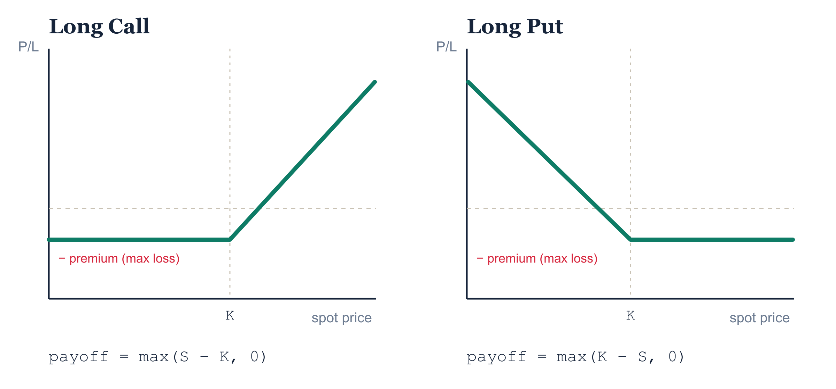
PAYOFF AT EXPIRY
Loss capped, upside open
A long option can lose only the premium, but its gains are unbounded. That asymmetry is the whole point.
Central Trader · Digital Investfair
4

Slide 5
WHERE THE STRIKE SITS
In, at, or out of the money
Call
Put
ITM spot above strike (S > K)
ATM spot at the strike (S = K)
OTM spot below strike (S < K)
ITM spot below strike (S < K)
ATM spot at the strike (S = K)
OTM spot above strike (S > K)
Premium = intrinsic value + time value. Time value pays for what spot might still do, and it fades to zero by expiry.
Central Trader · Digital Investfair
5

Slide 6
WHAT MOVES THE PRICE
Six inputs
Input (rises) | Call value | Put value
Spot price S | ▲ | ▼
Strike K | ▼ | ▲
Time to expiry T | ▲ | ▲
Volatility σ | ▲ | ▲
Interest rate r | ▲ | ▼
Dividend q | ▼ | ▲
Volatility is the
big one.
It is the only input you cannot read off a screen, and it drives the premium most.
These sensitivities are the Greeks.
Central Trader · Digital Investfair
6

Slide 7
THE GREEKS
Five sensitivities
Δ
Γ
Θ
ν
ρ
Delta
Gamma
Theta
Vega
Rho
value vs. spot price
how fast Delta moves
value lost to time decay
value vs. volatility
value vs. interest rates
Central Trader · Digital Investfair
7

Slide 8
HOW TO PRICE IT
Three models, one fair value
Binomial Tree
Black–Scholes
Monte Carlo
Step the price up or down, then fold the value back to today.
One closed-form equation for the price.
Simulate thousands of random paths, then average the payoff.
Best for: American & barrier options. Intuitive, what this project uses.
Best for: European vanilla options. Instant, exact.
Best for: complex, path-dependent exotics.
Central Trader · Digital Investfair
8

Slide 9
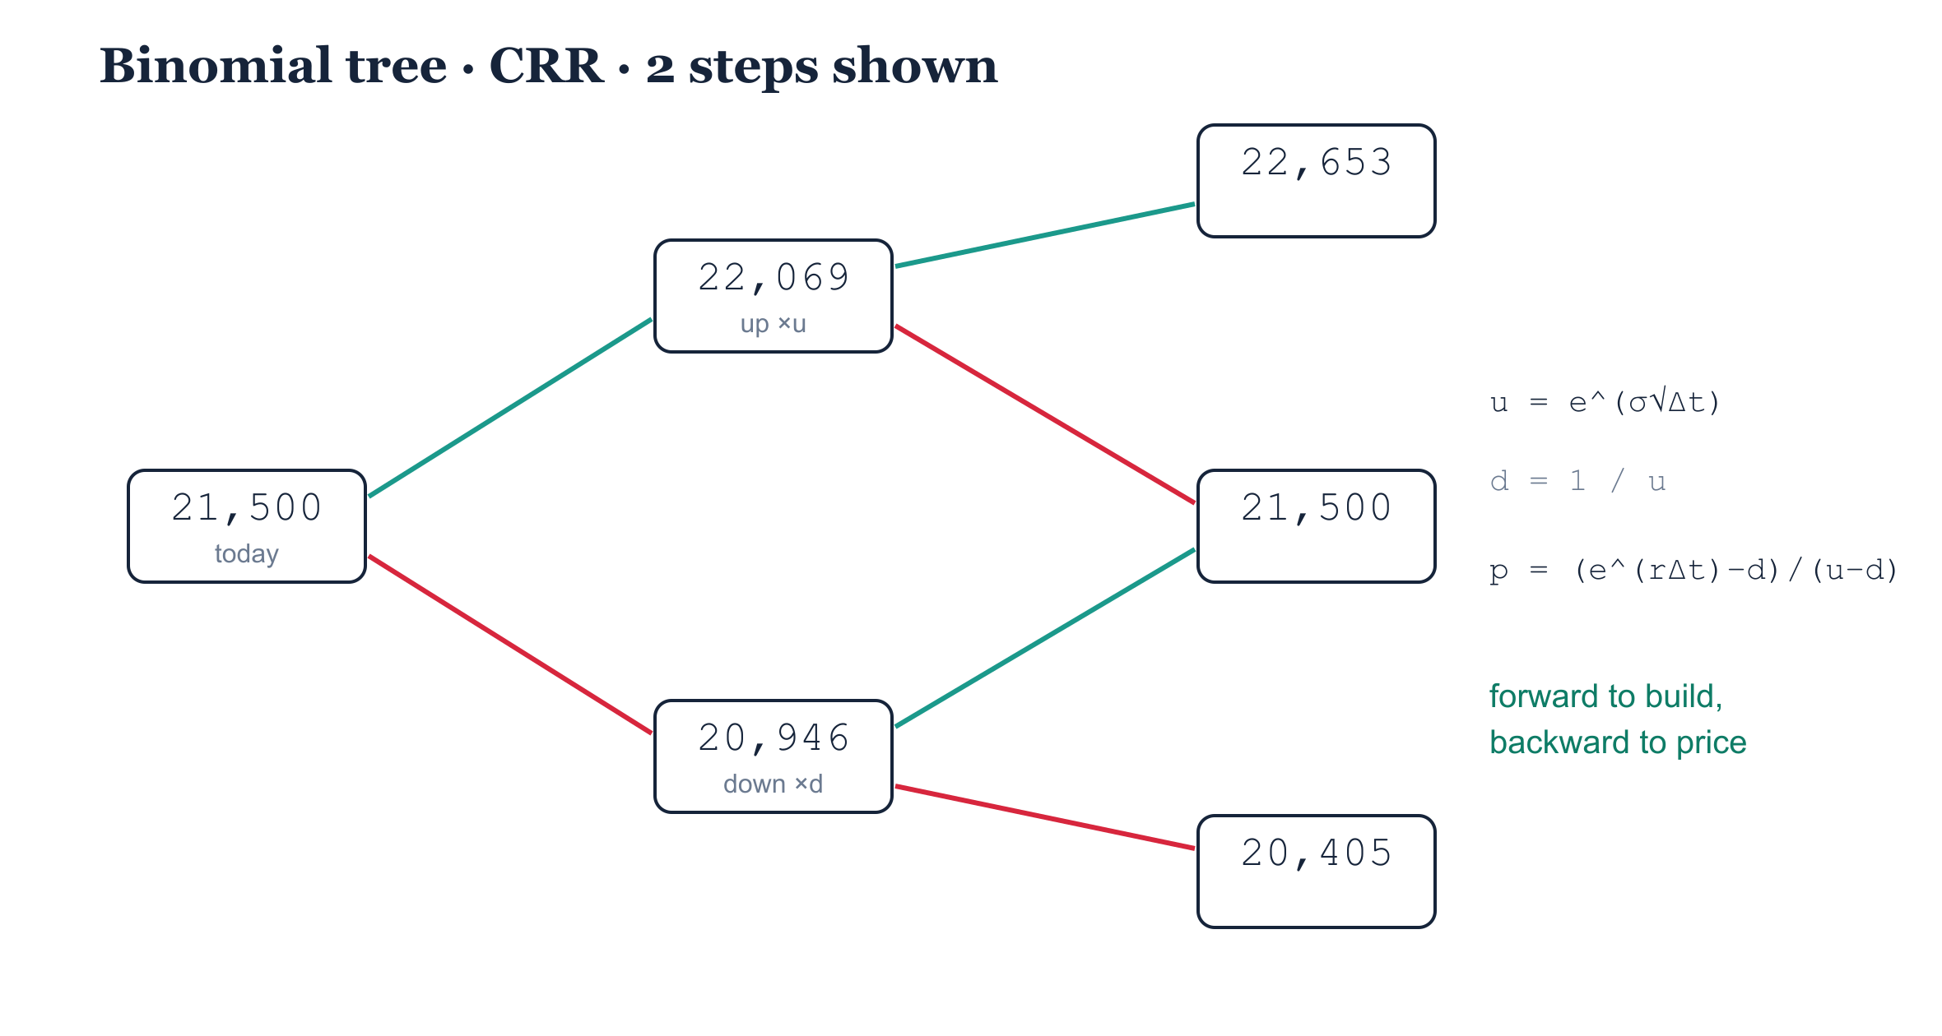
THE BINOMIAL TREE
Build forward, price backward
Backward induction
At expiry the payoff is obvious. Discount each step by
e^(−rΔt)
and fold back to today:
fair value = 186 pts
S spot · u up factor · d down factor · p risk-neutral prob · r rate · σ vol · Δt step · e^(−rΔt) discount
Central Trader · Digital Investfair
9

Slide 10
BINOMIAL, BY HAND
One node, worked out
1 · Two outcomes
2 · Risk-neutral p
S₀ = 21,500
up → 21,500 × u = 22,069
down → 21,500 × d = 20,946
p = (e^(rΔt) − d) / (u − d)
= 0.504 1 − p = 0.496
3 · Payoffs at K = 22,000
4 · Discount one node
Cu = max(22,069 − 22,000, 0) = 69
Cd = max(20,946 − 22,000, 0) = 0
C = e^(−rΔt) [ p·Cu + (1−p)·Cd ]
≈ 0.504 × 69 ≈ 34.7
One node of the 3-step grid ≈ 34.7. Same rule, finer grid: 3 steps → fair value 186.
Central Trader · Digital Investfair
10

Slide 11
THE KEY TRICK
Risk-neutral valuation
p is a pricing weight, not a probability
Why we discount at r
p = (e^(rΔt) − d) / (u − d)
A pricing weight, not the real chance of a rise.
Real-world drift never enters.
Pretend every asset grows at the risk-free rate r.
Then price = e^(−rT) × expected payoff.
No risk premium, no risk appetite needed.
The same risk-neutral logic sits under Black-Scholes too.
Central Trader · Digital Investfair
11

Slide 12
BLACK–SCHOLES
The continuous limit
C = S · N(d1) − K · e^(−rT) · N(d2)
d1 = [ ln(S/K) + (r + σ²/2) T ] / (σ√T)
d2 = d1 − σ√T
As the tree's steps shrink toward zero, it converges to this single formula. Same fair value, computed instantly.
Central Trader · Digital Investfair
12

Slide 13
DELTA HEDGING & REPLICATION
How the desk stays flat
Cancel the risk
Re-hedge as Δ drifts
Replication = price
Writing a call leaves you short the market.
Hold Δ units of the index to offset.
Net exposure → 0: the book is flat.
Δ moves when spot moves; that drift is Gamma.
Trim or add the underlying to stay flat.
Each adjustment locks in a small cost.
An index + cash portfolio copies the payoff.
Rebalanced each step, it tracks the option.
Its running cost IS the fair value.
Hedge Δ, fund Γ: the running cost of replication is the premium.
Central Trader · Digital Investfair
13

Slide 14
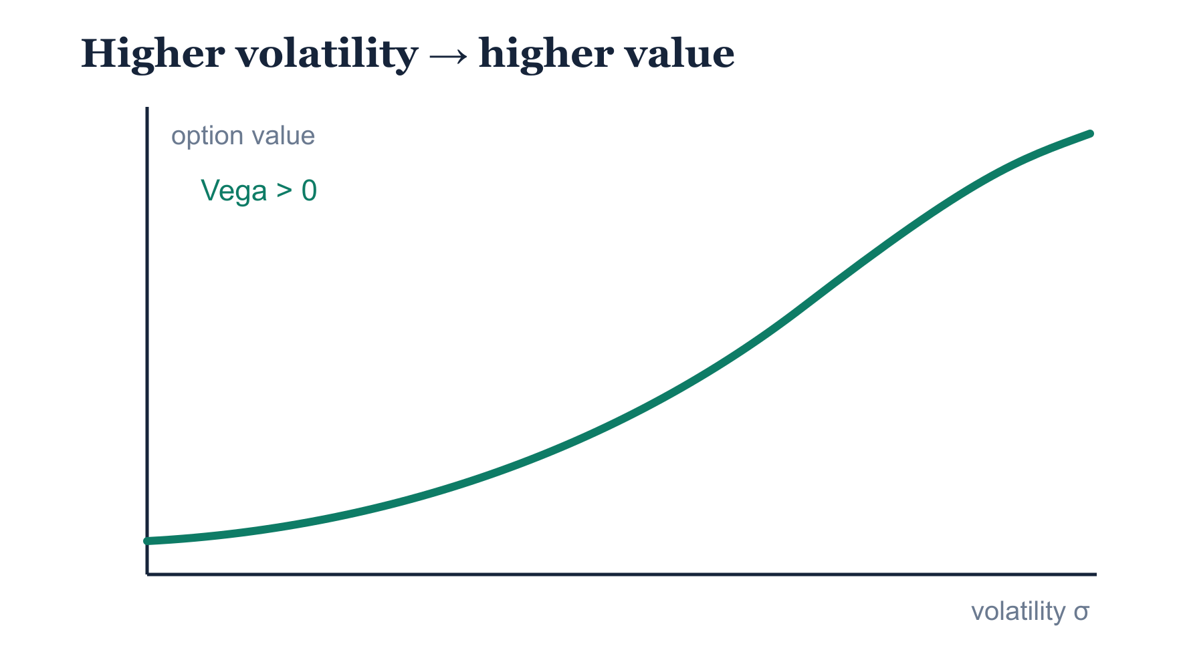
VOLATILITY
The only input you cannot see
Spot, strike, time, rate, all observable.
Volatility is the market's estimate of how violently the price will move, its fear. It drives the premium more than anything else.
Solve it backward from prices → implied volatility.
Central Trader · Digital Investfair
14

Slide 15
BEYOND ONE SIGMA
The volatility smile
One vol, all strikes?
The smile
Equity-index skew
Black-Scholes uses one σ for every strike.
Real option prices disagree.
The wings trade richer.
Plot implied vol against strike.
It rises away from the money.
Both wings curl up: a smile.
Indices tilt, they don't smile evenly.
Crash fear bids up the OTM puts.
Low strikes carry the highest vol.
One model, one σ. Real prices reveal many.
Central Trader · Digital Investfair
15

Slide 16
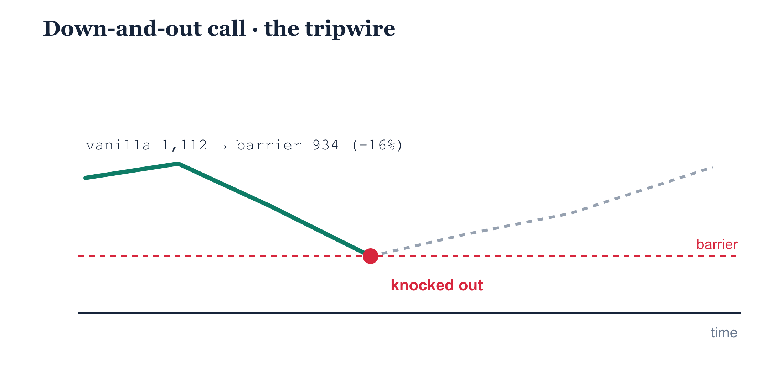
EXOTIC OPTIONS
Cheaper, with a tripwire
Knock-out
Touch the barrier once and the option dies, worthless, instantly.
Less protection,
lower premium:
1,112 → 934
Central Trader · Digital Investfair
16

Slide 17
BARRIER OPTIONS
The barrier family
Down-and-out
Down-and-in
Dies if spot falls to the barrier.
Barrier below the start (the deck's Day 3 trade).
Born only if spot falls to the barrier.
Dormant until that level is hit.
Up-and-out
Up-and-in
Dies if spot rises to the barrier.
Barrier above the start, usually paired with puts.
Born only if spot rises to the barrier.
No touch, no option.
Same strike, expiry and barrier: knock-in + knock-out = the vanilla option.
Central Trader · Digital Investfair
17

Slide 18
PUT–CALL PARITY
Calls and puts are linked
C − P = S − K · e^(−rT)
Hold a call and sell a put, and you have replicated the stock itself. Arbitrage forces this to hold, so knowing one option's price gives you the other's.
C call · P put · S spot · K strike · r rate · T time
Central Trader · Digital Investfair
18

Slide 19
THE PRODUCT
Hang Seng Index Option
Underlying | Hang Seng Index (HSI)
Contract multiplier | HK$50 per index point
Exercise style | European, exercised only at expiry
Settlement | Cash (no shares change hands)
Exchange | HKEX · listed since 1993
Asia's flagship equity-index derivative, and the contract priced throughout this project.
Central Trader · Digital Investfair
19

Slide 20

TRY IT YOURSELF
From theory to the trading desk
We built a game that runs this exact pricing engine: four trading days, real clients to quote, a grade at the end.
Best way to learn options? Trade them.
Step onto the desk
https://zeref007.github.io/trader-simulator
With thanks to Professor Martin, the inspiration behind this project.
Central Trader · FIN 7870
Central Trader · Digital Investfair
20

