Slide 1

Grove
A forest of voices. Every Wanderer is a tree in the grove.

Slide 2

The Philosophy
The internet used to be a place of personal expression.
Somewhere along the way, we traded that for algorithms and engagement metrics.
Grove is a return to something simpler: a place where people can plant their thoughts and watch them grow.
These names aren't just branding. They're the language of an ecosystem.

Slide 3
The Ecosystem
A forest of interconnected services, each named from nature
Lattice
Heartwood
Forage
Core Platform - the framework that holds everything up
Authentication - your verified identity across Grove
AI-powered domain discovery - search before you plant
npm: @autumnsgrove/groveengine
Google OAuth 2.0 + PKCE
DeepSeek v3.2 via OpenRouter
Passage
Meadow
Plant
Subdomain routing - the corridors connecting spaces
Community feed - where Wanderers gather
Onboarding - the seedbed for new users
Cloudflare Workers
Coming soon
Frictionless setup

Slide 4




Five Seasons
Spring, Summer, Autumn, Winter... and Midnight
Spring
Summer
Autumn
Winter
Midnight
Midnight is the queer fifth season
A purple/rose palette activated via a footer toggle easter egg.
Because some of us don't fit neatly into the standard four.

Slide 5
185 Components
A complete design system built for nature and warmth
8
Glass UI
Glassmorphism: Glass, GlassCard, GlassButton, GlassCarousel, GlassNavbar, GlassLogo, GlassOverlay, GlassConfirmDialog
64
Nature
SVG components for atmospheric forest scenes: trees, creatures, weather, botanical, structural, water, sky
20+
Typography
FontProvider for scoped fonts including OpenDyslexic, Atkinson Hyperlegible, Luciole, and Lexend for accessibility
40+
UI Core
Buttons, cards, forms, inputs, modals, toasts, tooltips, and more with full dark mode support

Slide 6
Why Grove?
Queer-friendly infrastructure
A safe digital space, especially valuable when physical environments feel hostile. Your corner of the internet, without surveillance capitalism.
Community-owned, solarpunk-aligned
Decentralized by design, built to be genuinely helpful rather than exploitative. No investor pressure to enshittify.
Portable by philosophy
Your content lives in markdown files. You can export and migrate anytime. We don't hold your data hostage.
Built for people, not engagement metrics
No dark patterns, no algorithmic manipulation. Just a place to Be.

Slide 7
Pricing
Free
Seedling
Sapling
Oak
Evergreen
$0
$8
$12
$25
$35
/month
/month
/month
/month
/month
Meadow access, 20 comments/week
50 posts, 1GB, 3 themes
250 posts, 5GB, 10 themes
Unlimited, 20GB, custom domain
100GB, domain included, 8hr support

Slide 8
Tech Stack
• Frontend: SvelteKit 2.5+, Svelte 5, TypeScript, Tailwind CSS 3.4+
• Markdown: Marked.js 17+, gray-matter
• Backend: Cloudflare Workers, D1 (SQLite), KV, R2 Storage, Durable Objects
• Charts: Chart.js 4.5+
• Payments: Lemon Squeezy with provider abstraction
• Icons: Lucide Svelte
• Auth: Heartwood (Google OAuth 2.0 + PKCE)
• Testing: Vitest 4.0+, Testing Library, happy-dom
• Email: Resend
• Build: Vite 5.4+, pnpm 9+ workspaces
100% Cloudflare Native
D1 database, R2 storage, KV caching, Workers deployment, Durable Objects for real-time coordination

Slide 9
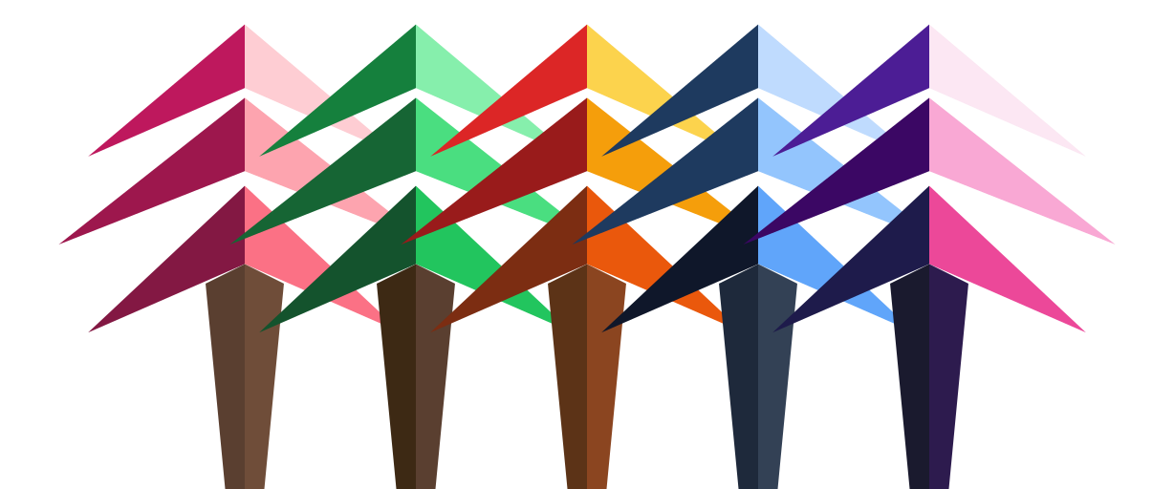
The Forest Ecosystem
19 specialized "animal skills" for development workflows
Panther — Strike single issues
Elephant — Build multi-file features
Beaver — Write tests
Chameleon — UI work
Bee — Collect TODOs into issues
Bloodhound — Track code through the forest
Fox — Hunt performance bottlenecks
Owl — Archive knowledge
Spider — Weave authentication
"When you need to write tests, call the Beaver. For UI work, summon the Chameleon."

Slide 10

grove.place
This isn't just a SaaS — it's about helping people have their own space online,
away from big tech algorithms.

