Slide 1
WDI Project 1
Color Memory Game
Emma Hou

Slide 2
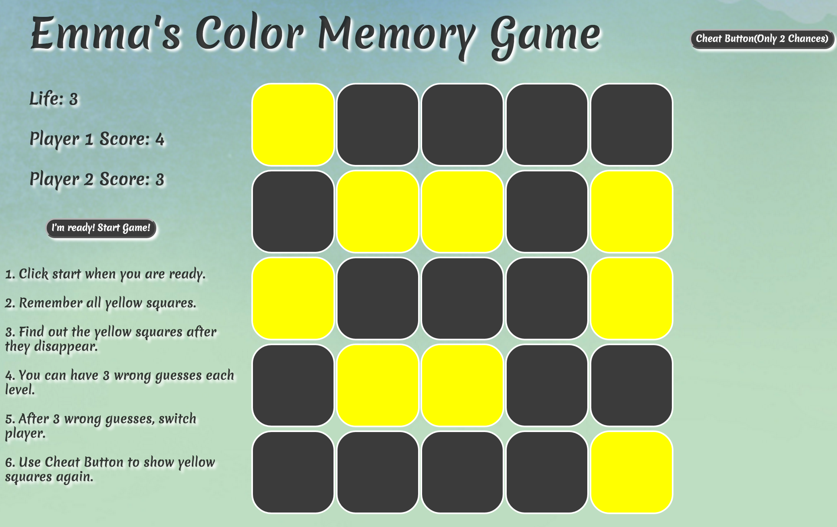
Score Board
Cheat Button

Slide 3
Project Structure
Language: jQuery
startGame(): create divs with row = 2 and col = 2
addEventToEachSq()
selectRandomColorSquare()
hideSelected()
showSelected()
isReadyForNext -> boolean
hideWrong()
nextLevel()
IsReadyToSwitchPlayer()
compareScore()
Button.on(‘click’…): Start and Cheat

Slide 4
Win
Build my first project by myself, YEAH!!!
Apply three weeks of knowledge to the project
Look for solutions online and solved my problem
Finish the project before deadline (Friday)
Get more familiar with github.com and how it works when building a new repo
Discuss problem with friends and solve it together.

Slide 5
Problems
selectRandomColorSquare()
At the beginning, I tried
If(sq has not been chosen){
if(sq+1 has not been chosen){
if(sq+1 has not been chosen){…}}}
Solution: jQuery.grep()
Delete an element from a node list.

Slide 6
Add event to button
$(‘#button’).on(‘click’,startGame())
$('#button').on('click',function(e){
if($isStartButtonEnable === true){
startGame($row,$col);
}else{
return;
}}

Slide 7
Things can be improved
Difficulty
DRY
Follow airbnb style guide
Find easier way to solve problem

