Slide 1





Timmerman Industries
Creative
Brainstorm
Designing the Future with Digital Brainstorming
DECEMBER 2027

Slide 2



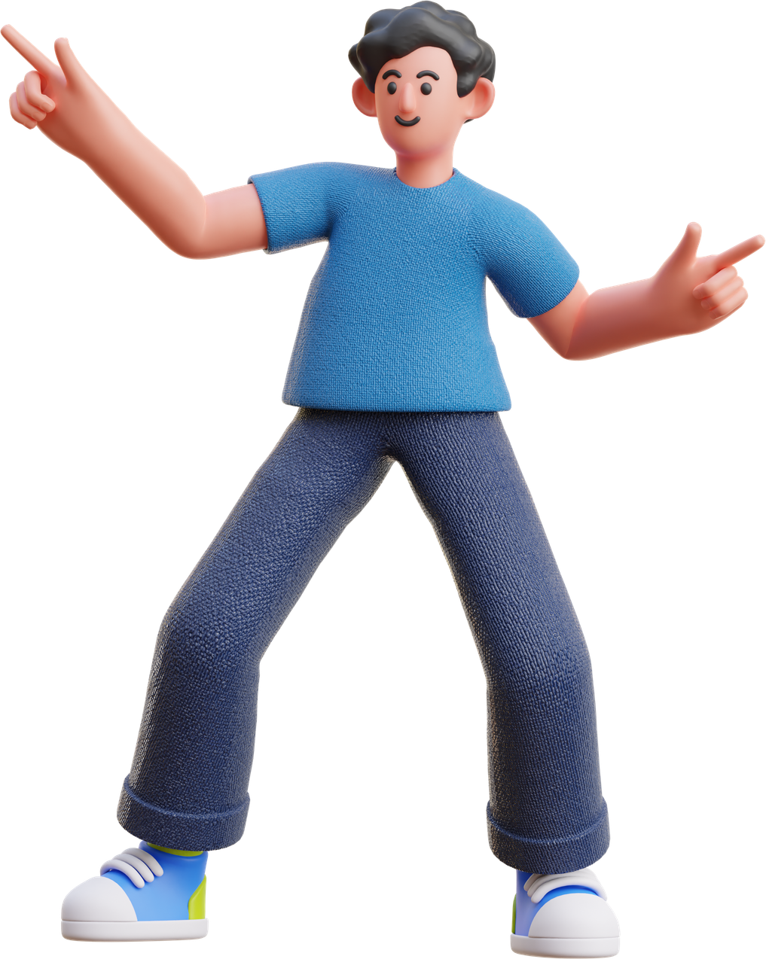



Today’s
Agenda
Introduction to the Session
Team Check-in and Icebreaker
Digital Brainstorm
Summary and Action Items

Slide 3




Introduction
Ketut and Cahaya will be our facilitators for this session.
Cahaya
The goal of our session is to turn chaos into clarity. As facilitators, our role is to keep the session on track and to ensure everyone participates in the discussion.
Ketut

Slide 4






Team Check-in
How are you feeling?
Click the More tab in the editor side panel
Select the Emoji
Browse and click the Emoji or GIF you want to use.
Choose an Emoji, GIF, or image from a mood meter that best represents how you feel at the moment.
Time : 5 Minutes

Slide 5




Icebreaker
Before we start with the session, let's warm up a little with this icebreaker question:
What's your favorite food?
What is your favorite hobby?
What is your favorite song?
What is your favorite movie?
What's your favorite dessert?

Slide 6

Get those creative
juices flowing!
Let’s Begin!

Slide 7







Digital
Brainstorm
Copy a sticky note, then we'll write our thoughts, ideas, and inspiration.
Starting on a new project begins with a curation of ideas. This digital brainstorm session will allow us to lay down and organize all our thoughts, ideas, and inspiration. Next, we will vote on ideas that are promising and add comments.
Add your
idea here
Add your
idea here
Use the stars to vote which ones we like to pursue.
Circle or comment on any promising ideas.

Slide 8
What's your brainstorm topic?
Brainstorm Area
Our Favorite Ideas
Copy a sticky note, then we'll write our thoughts, ideas, and inspiration.
Use the stars to vote which ones we like to pursue.
Circle or comment on any promising ideas.

Slide 9




Write action items in the boxes.
Action
Item
Add your
idea here
Add your
idea here
Let's go back to the previous pages and synthesize what next actions are appropriate for us to move forward as a group.
Drag your photo under the
action item you want to own.

Slide 10
Action 1
Action 2
Action item
Add your
idea here
Write action items in the boxes.
Add your
idea here
Add your
idea here
Action 3
Action 4
Drag your photo under the
action item you want to own.

Slide 11
Timmerman Industries
Thank you for participating!
DECEMBER 2027

