Slide 1
LOFISTACK HACKATHON 2026 · PROBLEM P01
Load-Shedding
Window Planner
Team Logarithm · LSH26-T033
Oitijya Islam Auvro · Md. Nafiz Ahmed · Dewan Salman Rahman Zisan

Slide 2
01 · THE PROBLEM
Load shedding wastes the working day.
A print shop runs on machines that need mains power. When the grid goes down mid-job, the work is lost — paper wasted, deadline missed, customer waiting.
Cuts are announced in advance. The information is there. What is missing is a way to plan the day around them.
3.2
4.0h
power cuts on an average day
of the day with no grid power
263
jobs across the 25 published cases we tested against

Slide 3




02 · WHAT THE PROBLEM ASKS FOR
Four required items.
Enter the cuts
Add the jobs
Place them automatically
Count generator minutes
Start and end time for each announced cut, drawn on a 24-hour timeline.
Name, duration, and what power it needs: grid, generator or none.
No job needing grid power may ever land inside a cut. Plan shown beside the cut bars.
The total the plan needs, updating the moment a job is added or removed.

Slide 4
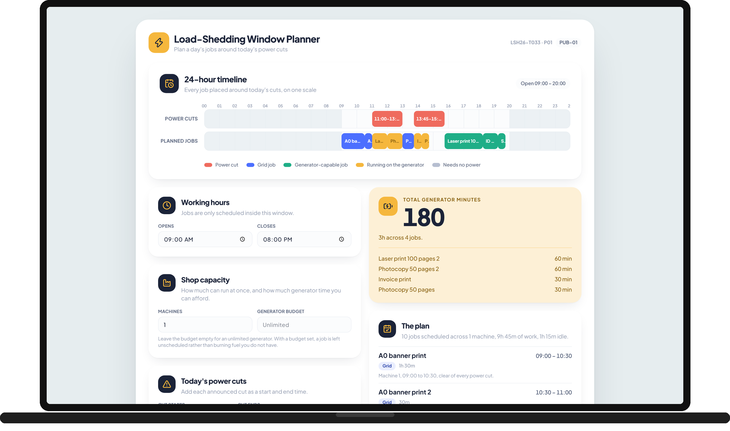
03 · OUR SOLUTION
One screen. The whole day.
Cuts on top. The plan directly beneath, on the same scale — so a judge can see at a glance that no blue grid job touches a red cut.
Amber marks the minutes a job actually spends on the generator.
Every placement carries a one-line reason in plain English.
No login. No database. No API key.

Slide 5



04 · HOW THE PLAN IS BUILT
Most-constrained first.
Grid jobs
Generator jobs
No-power jobs
Cut-free space only. A hard rule — if no gap is long enough the job is reported, never placed illegally.
The slot costing the fewest generator minutes, not simply the earliest — because that cost is exactly what R4 reports.
Parked inside the cuts on purpose. A cut costs them nothing, which keeps scarce cut-free time for the rest.
Within each group: rush orders first, then earliest promised time, then longest. The result is deterministic — the same input always gives the same plan.

Slide 6
05 · ARCHITECTURE
The rules are not in the interface.
src/domain/
src/components/
The plan
Pure TypeScript. No React.
React, presentation only.
Derived, never stored.
time · intervals · schedule · fixture
Every rule lives here, so it can be tested directly and read without running anything.
Timeline · Inputs · PlanPanel
Holds cuts, jobs and hours. Nothing else.
buildPlan(state) on every render
There is no second copy of the generator total to go stale — R4 cannot drift.

Slide 7
06 · BEYOND THE FOUR ITEMS
Built for a real shop.
Machines
Promised times
Rush orders
Fuel budget
The shop runs more than one job at a time. Set 1 to 8 lanes; every lane gets its own row on the timeline.
A customer collects at 5pm. A job that cannot make its promise is reported, never quietly placed late.
Mark a job urgent and it takes the front of the day, ahead of everything else in its class.
Diesel is bought by the litre. Cap the generator minutes and the planner will not exceed it.

Slide 8
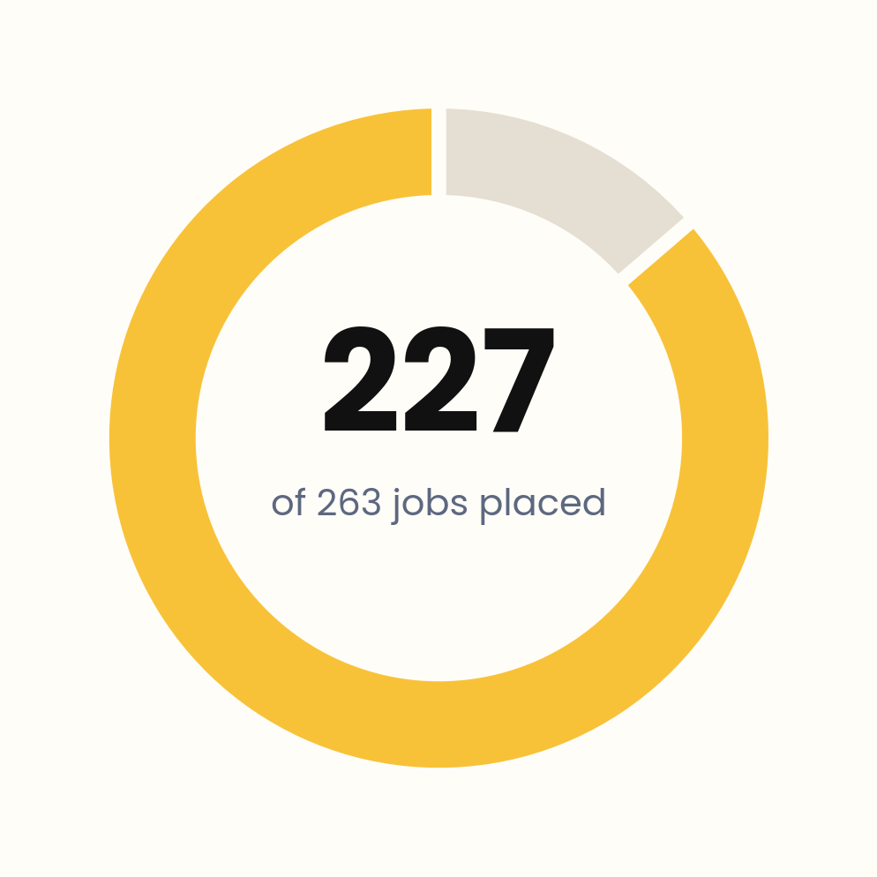

07 · PROOF
Proven, not claimed.
69 automated tests
Four rules are asserted for every plan, on hand-written cases and on all 25 published cases:
· a grid job never overlaps a cut, by even one minute
· no two jobs overlap on the same machine
· generator minutes equal the time actually spent inside a cut
· every placement respects its ready and promised times
Writing the tests first found a real defect: the planner had been giving generator jobs the earliest slot instead of the cheapest, inflating the R4 total.
The other 36 are genuinely impossible — jobs longer than the whole day, or needing more uninterrupted cut-free time than exists.

Slide 9
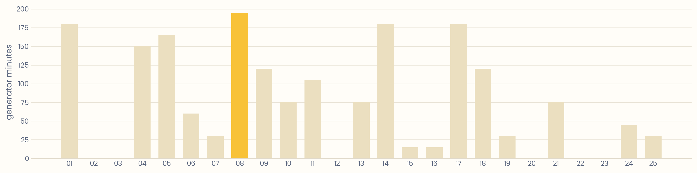
08 · MEASURED, NOT GUESSED
Generator minutes, case by case.
1,845 generator minutes across 25 cases. Every number here comes from running the real engine over the organisers' own fixture — no case was hand-picked.

Slide 10
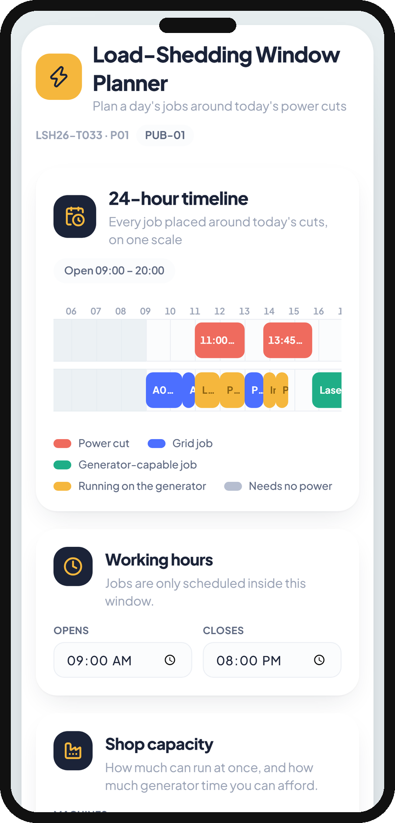

09 · LIVE
Try it yourself.
lsh26-t033-p01.vercel.app
github.com/AuvroIslam/lsh26-t033-p01
Opens with no account and no key. Press Load published sample data and all 25 cases load; upload any file in the same shape to try your own.
Works on a phone. State is kept in the browser, and Reset restores it.

Slide 11
Thank you.
Team Logarithm · LSH26-T033 · P01 Load-Shedding Window Planner
lsh26-t033-p01.vercel.app

