Slide 1
KHOROCH
KHOROCH
4 / 4
খরচ · Bengali for "expense"
REQUIREMENTS COMPLETE
A personal ledger that reads your receipts,
forecasts your month, and plans your savings.
27 tests · 25 sample cases · 0 API keys
TEAM LOGARITHM LSH26-T033
Problem P12 · Personal Ledger Manager · Tier 02
01

Slide 2
KHOROCH
THE PROBLEM
You know what you earn.
You have no idea what you spend.
RECEIPTS PILE UP
THE MONTH ENDS IN SURPRISE
Typing every bill by hand is the reason
nobody keeps a ledger for a whole month.
Spending feels fine on the 17th.
The shortfall only appears on the 30th.
ADVICE IS USELESS
SAVING HAS NO DEADLINE
"Spend less on food" helps nobody.
"Mobile is up ৳2,500" is actionable.
A target with no date — and no idea
whether this month can even afford it.
02

Slide 3
KHOROCH
OUR SOLUTION
One ledger. Four answers.
Everything runs in the browser — no account, no server, no API key.
R1
R2
R3
R4
READ THE RECEIPT
SEE THE MONTH
KNOW THE ENDING
PLAN THE SAVING
Photograph a bill. We show what
we read — and let you fix it
before anything is saved.
Spend against salary, by category,
the largest charges, and the
change since last month.
Where the month lands, and
insights that name real
categories and real amounts.
Pockets with completion dates
from the forecast, and a DPS
comparison at a stated rate.
03

Slide 4
KHOROCH
ARCHITECTURE
Strict layers. Pure engines.
SCREENS
One per requirement. Never computes money.
Dashboard · Expenses · Forecast · Pockets
▼
STORE
One source of truth, persisted locally.
Zustand · salary, expenses, pockets, audit trail
▼
SERVICES
Pure functions. No React. Directly testable.
forecast · insight · receipt · pocket · fixture
▼
PRIMITIVES
Every amount an integer. Never a float.
money.ts — integer paisa · dates.ts
Why it matters: services import nothing from React, so all 27 tests run on plain Node — no browser, no bundler, no mocking.
04

Slide 5
KHOROCH
R1 · READING A RECEIPT
We never guess silently.
OCR proposes. The user confirms. Nothing reaches the ledger in between.
PHOTO
›
PREPROCESS
›
OCR
›
REVIEW
›
SAVED
ZERO
WHAT A NAIVE PARSER GETS WRONG
external requests — engine, WASM core
and language data are all self-hosted
Subtotal
1505.50
VAT 5%
75.28
~2 sec
TOTAL
1580.78
✓ correct
to read a receipt photographed at an angle,
on grey paper, under directional light
Cash
2000.00
✗ larger — but tendered
EVERY FIELD
Change
419.22
editable, with a confidence badge and a note
saying how the value was chosen
05

Slide 6
KHOROCH
R3 · THE FORECAST
The obvious method was wrong.
Rent lands once, early. A flat daily rate divides it across the days elapsed, then projects it
again across the days remaining — charging it two or three times over.
PUB-17 · PROJECTED MONTH TOTAL vs ৳90,000 SALARY
6 of 25
published cases had their surplus-or-shortfall
verdict REVERSED by the flat method
FLAT RATE
৳111,204 → reported SHORT
৳46,000
FIXED CHARGES HELD OUT
the largest single over-projection
the old method produced
৳65,204 → in SURPLUS
3 days
salary
of average spending — the materiality floor that
stops a ৳486 lunch counting as a fixed charge
We measured our own forecast against all 25 cases, found it reversed the answer on a quarter of them, and rewrote it. The arithmetic is printed on screen so a judge can check it by hand.
06

Slide 7
KHOROCH
CORRECTNESS
Money is integer paisa. Never a float.
The fixture gives decimal strings. The DPS rule compounds monthly with half-up rounding at every step.
Floating point would drift in exactly the figures a judge recomputes by hand.
27 ASSERTIONS OVER THE PUBLISHED FIXTURE
1,200+
amounts round-trip to their exact
original decimal string
Money · paisa round-trip
3
DPS schedule & compounding
5
25 / 25
sample cases render every screen
with no crash and no NaN
Forecast & fixed charges
9
390 px
verified on mobile: no overflow,
no tap target under 40px
Receipt parser
10
0 KEYS
no secret, token or account
anywhere in the repository
07

Slide 8
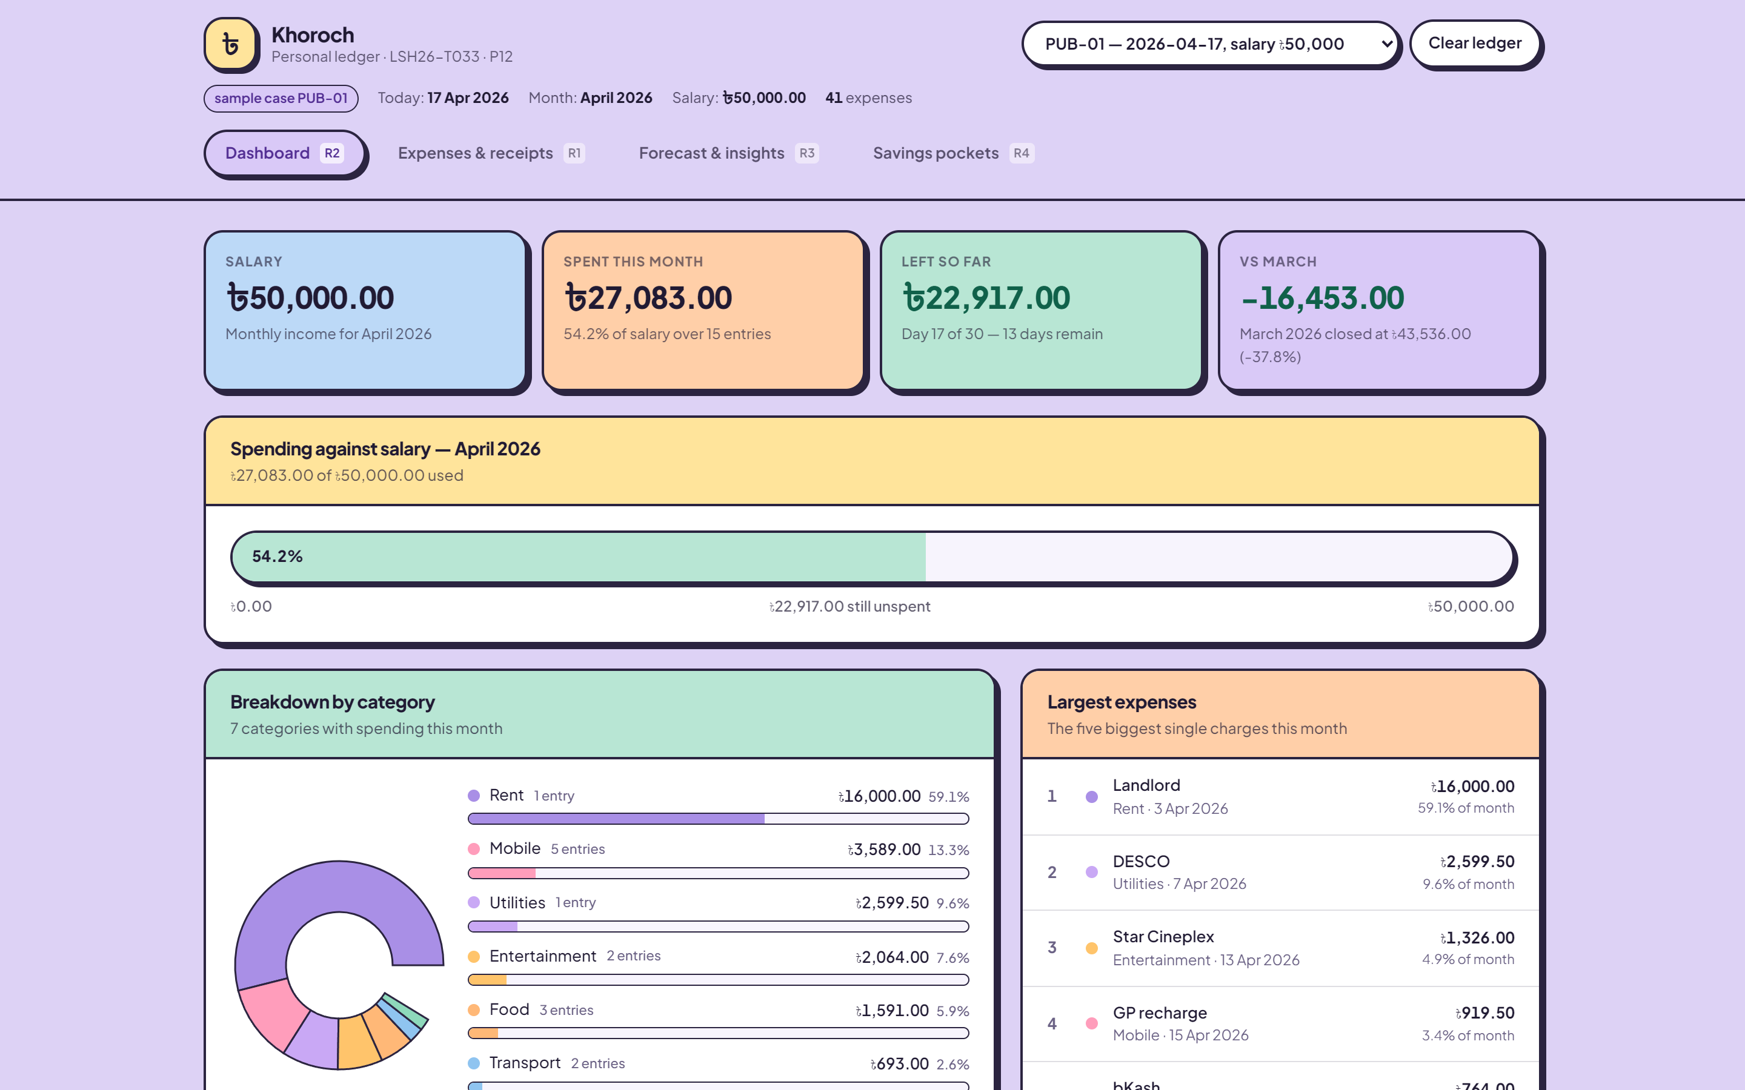
KHOROCH
THE PRODUCT
Load a sample case. Check every figure.
08
PUB-01 · 17 April 2026 · ৳50,000 salary · 41 expenses — dashboard, forecast, insights and DPS all from one loaded case

Slide 9
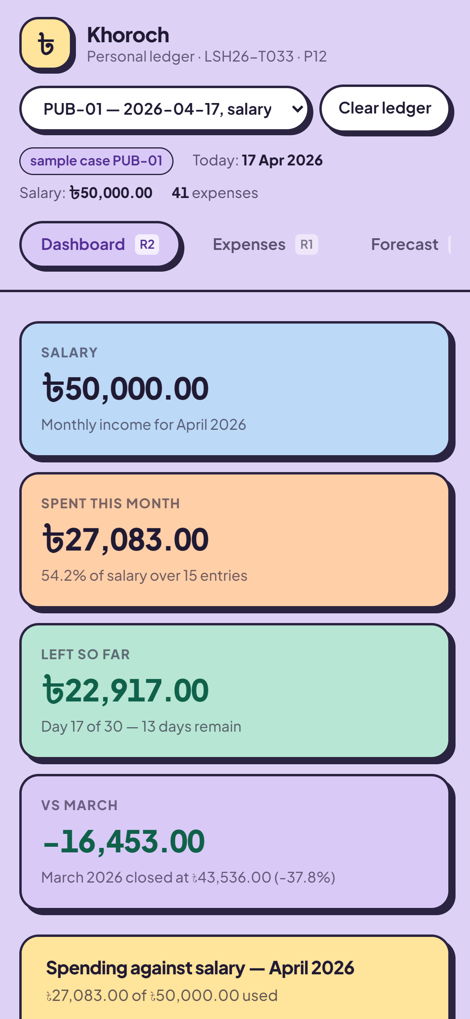
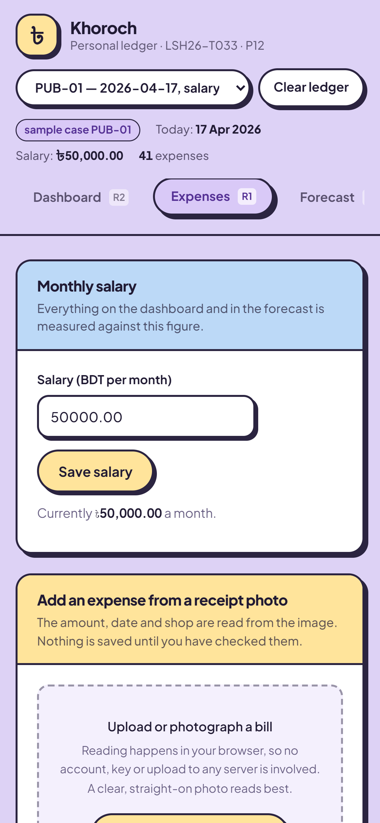
KHOROCH
ON A PHONE
Built for the device
people actually carry.
NO HORIZONTAL SCROLL
on any tab, verified at 390px
NO TAP TARGET UNDER 40px
Undo is 70×44 — it has a deadline
THE TABLE ADAPTS
the date rides under the shop name
instead of forcing the card wide
PHOTOGRAPH A BILL DIRECTLY
the camera is the natural input here
09

Slide 10
KHOROCH
WHAT THE JUDGES ASKED FOR
Every box, ticked.
✓
All four required items complete
✓
AI assistance disclosed in full
✓
Public repository, history preserved
✓
No key, token or personal data
✓
EVENT.md with the event start code
✓
Published fixture, unmodified
✓
evaluation-manifest.json completed
✓
README maps each requirement to proof
✓
LICENSES.md — every library declared
✓
Committer identities declared
Known limitations are stated plainly in the README — including where the forecast is weak and which receipts will not read. We would rather be trusted than impressive.
10

Slide 11
KHOROCH
THANK YOU
খরচ · Khoroch — a personal ledger you can actually check
TEAM LOGARITHM · LSH26-T033 · PROBLEM P12
Oitijya Islam Auvro · Md. Nafiz Ahmed · Dewan Salman Rahman Zisan
github.com/AuvroIslam/lsh26-t033-p12

