Slide 1
Avril Childs
Data and SQL
GLOBAL HEALTH DATABASE

Slide 2

Create new database Global_Health which will contain a database of health data.
For purposes of this project, this will only contain a list of 20 countries
Data retrieved from https://ourworldindata.org

Slide 3
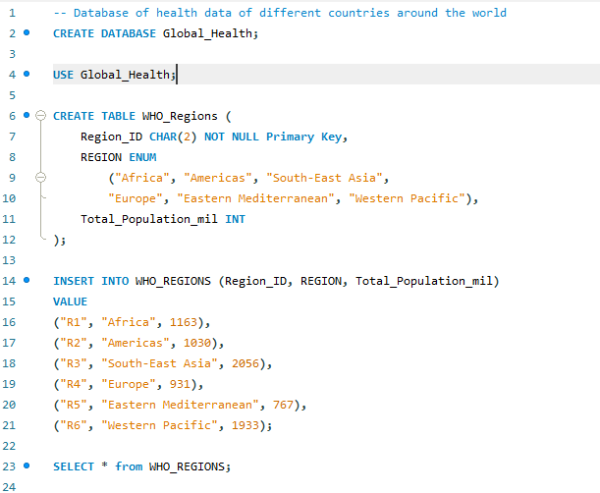
TABLE 1: World Health Organisation (WHO) Regions
Region_ID is Primary Key.
ENUM used to specify entry options
WHO_Regions: This table contains information about different regions defined by the World Health Organization (WHO). It includes the region ID, region name, and total population in millions for each region.

Slide 4
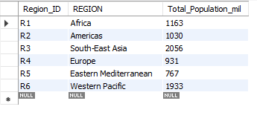
Table 1 – WHO_Regions

Slide 5
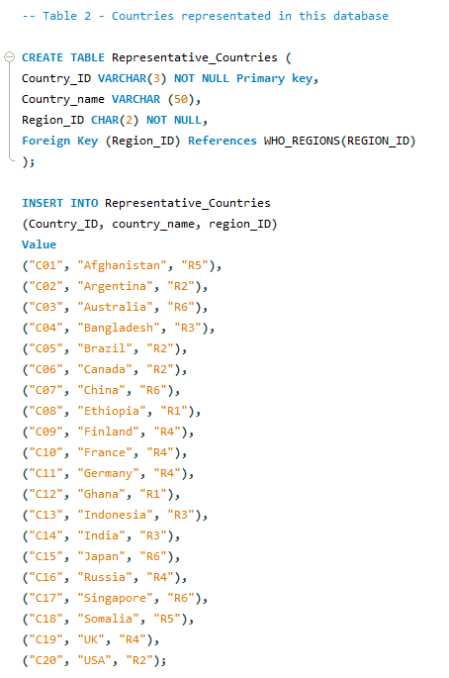
Foreign key to link with Table 1 Region_ID
Table 2: Representative Countries, with WHO Region
Representative_Countries: This table represents the countries included in the database and their respective regions. It has a foreign key reference to the WHO_Regions table.

Slide 6
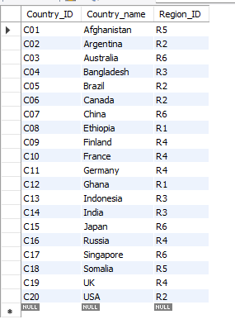
Table 2 Representative_Countries

Slide 7
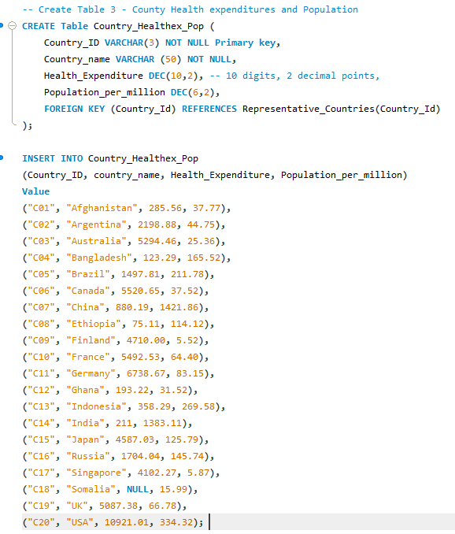
Foreign Key linked to table 2 for Country ID
Table 3: Health Expenditure ($ per capita) and Population (million) by Country

Slide 8
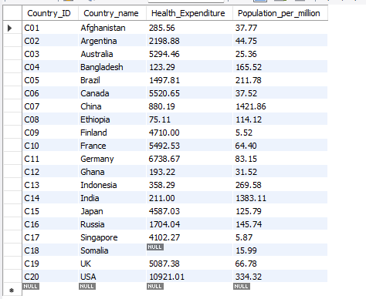
Table 3 - Country_Healthex_Pop

Slide 9
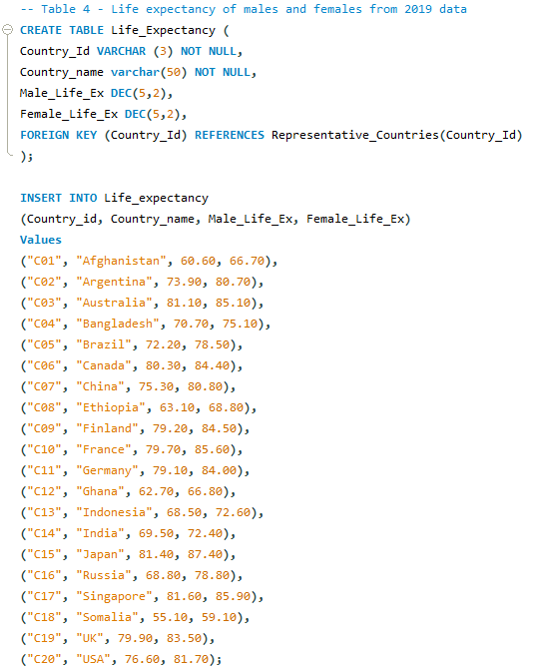
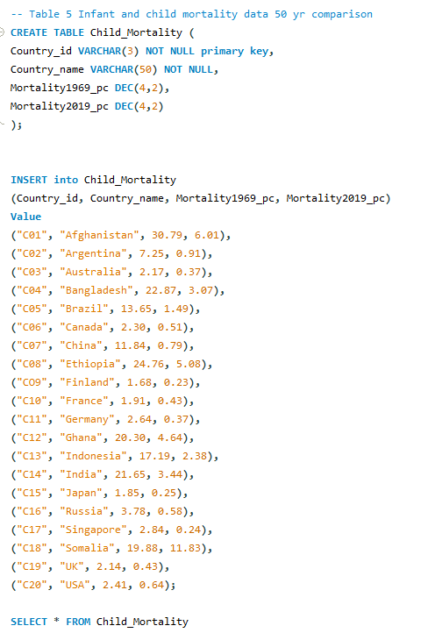
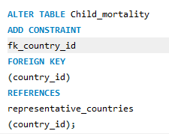
Table 5: Child mortality (%), comparing 1969 and 2019
Table 4: Life Expectancy (in yrs)

Slide 10
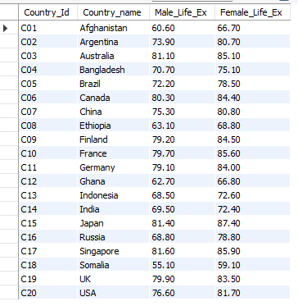
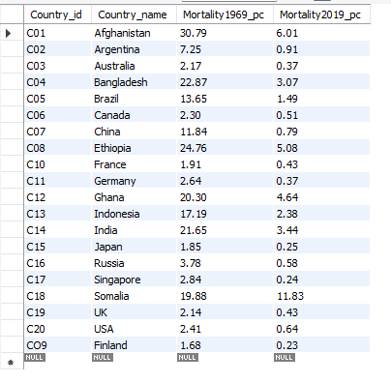
Table 4: Male and Female Life Expectancy (in yrs)
Table 5: infant and Child Mortality (in % births)

Slide 11
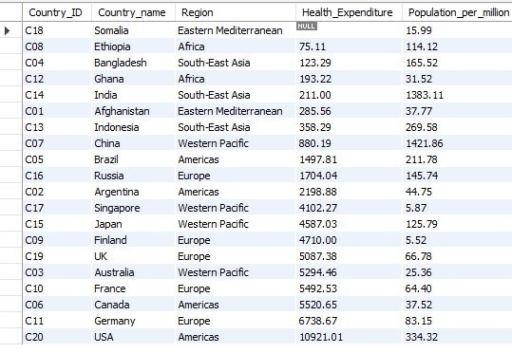
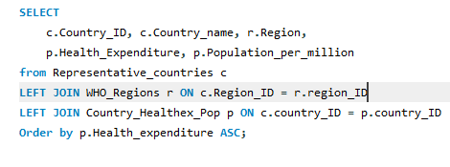
Left Join – combining data from 3 tables 1. Representative countries, 2. WHO Regions 3. Country_Healthex_Pop

Slide 12
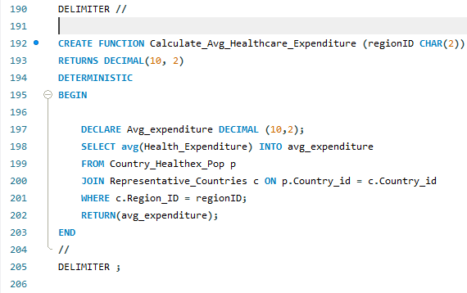
Stored Function
Aim is to Calculate Average Healthcare Expenditure of each region when the function is called up.
AVG function to calculate the average healthcare expenditure.
JOIN links “Country_Health_Pop’ table and ‘Representative_Countries” table and “Where” filters the result by the “regionID” that the user keyed in.

Slide 13
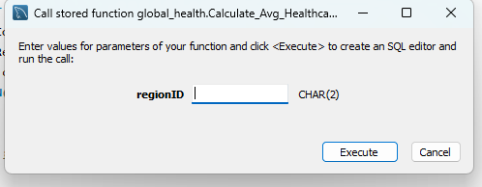
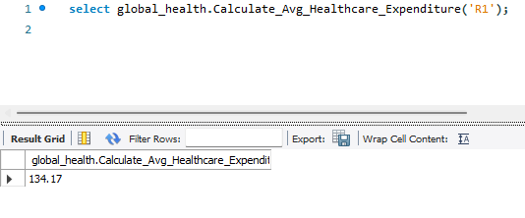
Result check R1 Countries :
Ethiopia – 75.11
Ghana – 193.22

Slide 14
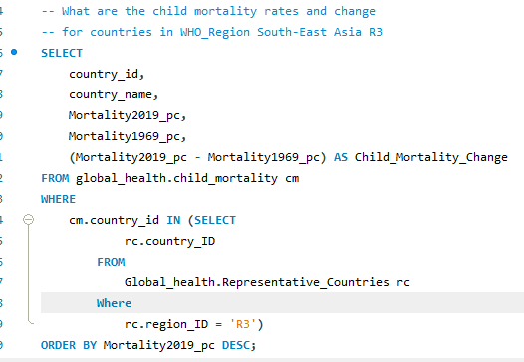
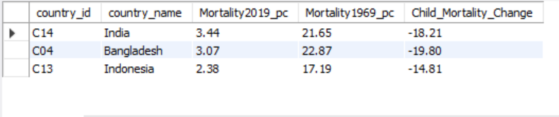
What are the rates of child mortality for countries in South-East Asia (WHO)?
Subquery used to filter and
display from region R3 using Representative_countries table

Slide 15
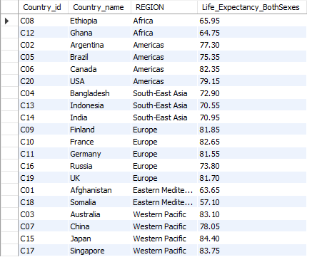
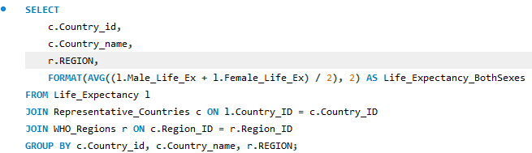
Qn: Based on the sample countries, which WHO region had the lowest life expectancy of both sexes combined?
Average calculation between 2 column per row, formatted to 2 decimal places
Inner Join used as need to have “Region” for this query so any entries with missing “Regions” will not be included.

Slide 16
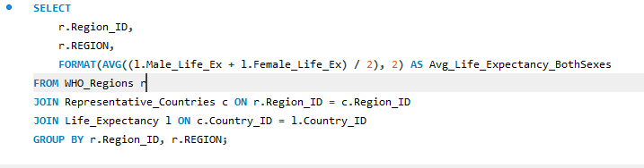
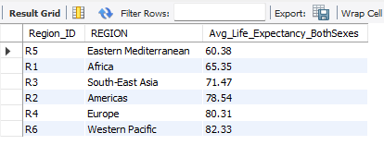

Slide 17
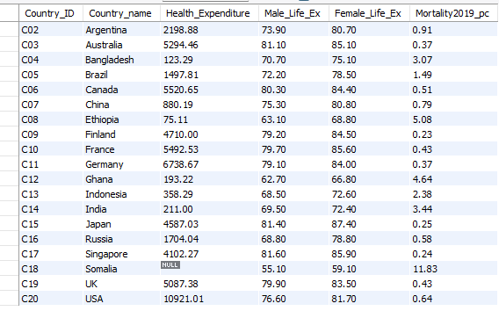
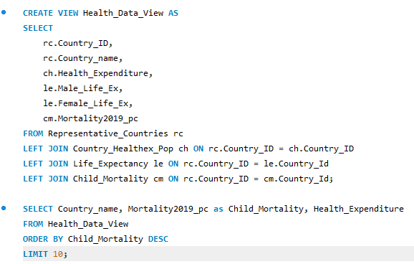
Creating a view of 3-4 base tables to provide a comprehensive health data summary for each country
Find the top 10 countries with the highest child mortality rate and see if there is a possible correlation with health expenditure.

Slide 18
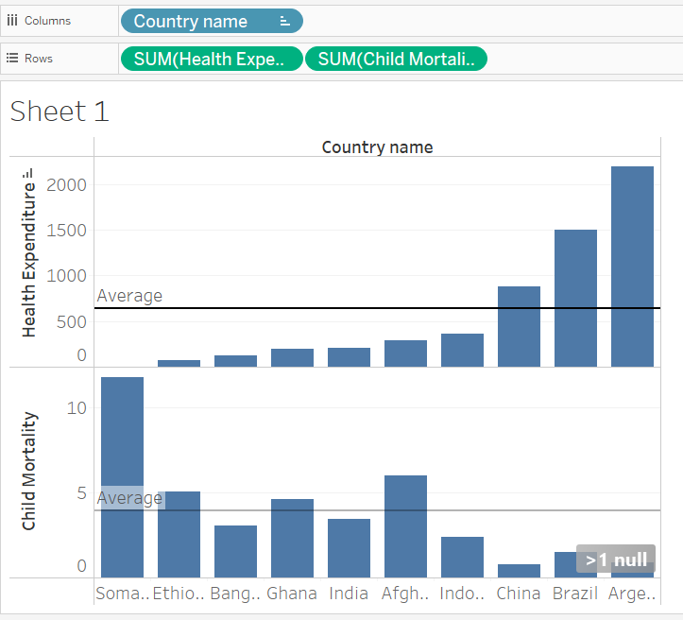
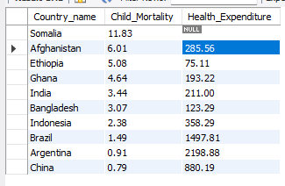
Using Tableau to visualise data:
Child mortality is inversely co-related with health expenditure –
countries which spend more on health show lower child mortality.

Slide 19
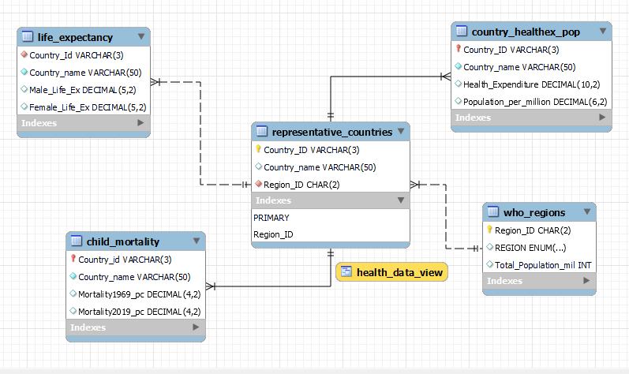

Slide 20

Thank you

