Slide 1
Solar Panel Maintenance System
Mentored by:
Mrs. Sugandha Sharma
Presented by:
Utkarsh Gupta
R177219194
500075374
Aradhya Singh
R177219206 500075358
Tanu Sharma
R177219207
500076765

Slide 2
Contents
Introduction
Literature Review
Objectives
Methodology
References

Slide 3

Introduction
Renewable energy sources such as solar panels have gained significant attention in recent years as a clean and sustainable alternative to traditional energy sources. However, the maintenance of solar panels is crucial to ensure their efficiency and longevity. The current manual maintenance approach is time-consuming, costly, and prone to errors, leading to reduced energy output and downtime.
The proposed AI-powered solar panel maintenance system aims to reduce the cost and time of solar panel maintenance and increase their efficiency and lifespan, ultimately contributing to the promotion of renewable energy sources as a sustainable and viable alternative to traditional energy sources. In conclusion, it has the potential to significantly enhance the performance and longevity of solar panels and reduce maintenance costs.

Slide 4
Literature Review
Nasib (2019) [1] proposed a cleaning robot with a rotating brush and water stream jets which can move on the rails mounted besides the solar panel array. The system cleans the solar panel array on a programmed time interval on its own.
Milan (2019) [2] created a simple solar panel cleaning system which consists of a viper and a water jet stream to clean the solar panel. The System can be triggered through an application.
Manju (2018) [3] proposed a similar solution to Nasib (2019) [1] which consists of a brush and a water jet stream to clean the solar panels.
Piotr (2013) [4] talks about the possibility of creating a system to clean the dust from solar panel surface through ultrasonic vibrations. The ultrasonic beams will hit the dust particles, which will make them vibrate and fall off the solar panels.
Xiaolong (2019) [5] talks about a cleaning robot which works on the basis of a piezoelectric actuator. The wiper on the robot will move based on the information received through a piezo electric actuator.

Slide 5
Objectives
Detect faults and abnormalities in solar panels accurately and efficiently.
Predict potential problems before they occur and take necessary action to prevent them.
Schedule maintenance activities based on data collected from the solar panels to minimize downtime.
Optimize the performance of the solar panels by analyzing and adjusting their settings based on environmental and usage data.
Provide real-time monitoring of the solar panels and alert maintenance personnel of any issues.
Reduce the cost of solar panel maintenance and increase their efficiency and lifespan.

Slide 6
Methodology
Data Collection
Training and analyzing of multiple different Machine Learning models.
Selection of the best performing model
Implementation of model In Django server
Development of Hardware prototype
Development of Monitoring Interface

Slide 7
Data
Collected our own data.
Collected between 31st Jan to 2nd March.
Data collected at Stanza hostel Kandoli.
A sensors used:
Photoresistor
Thermister
Barometer
Anemometer
Hygrometer

Slide 8
Dataset Columns
AirTemp (Recorded via Thermister)
CloudOpacity (Recorded via Solcast API)
DewpointTemp (Mathematically calculated)
Ghi (Recorded via Photoresistor)
PrecipitableWater (Mathematically calculated)
RelativeHumidity (Recorded via Hygrometer)
SurfacePressure (Recorded via Barometer)
WindDirection10m (Recorded via Anemometer)
WindSpeed10m (Recorded via Anemometer)

Slide 9
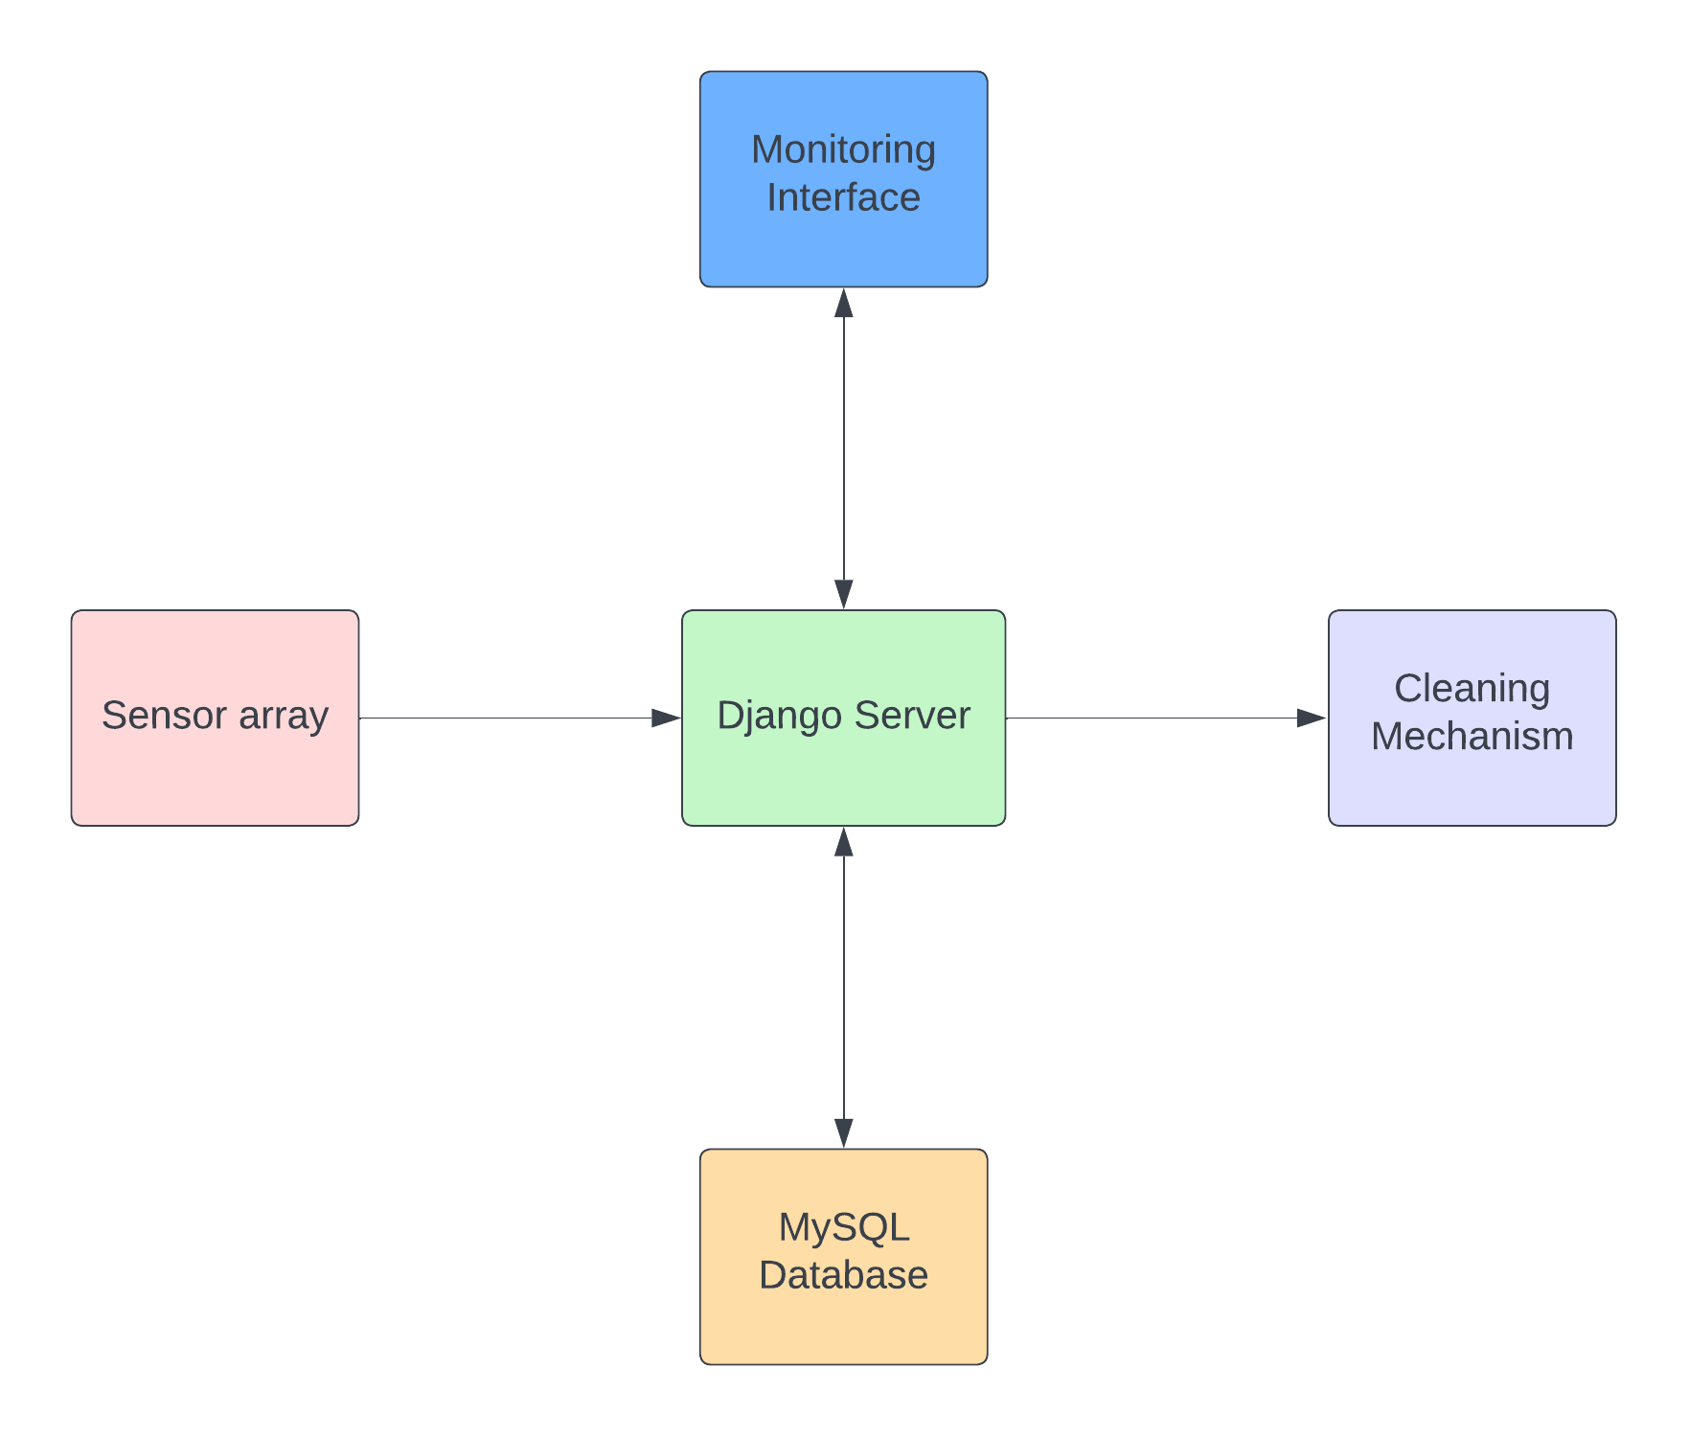
System Architecture

Slide 10
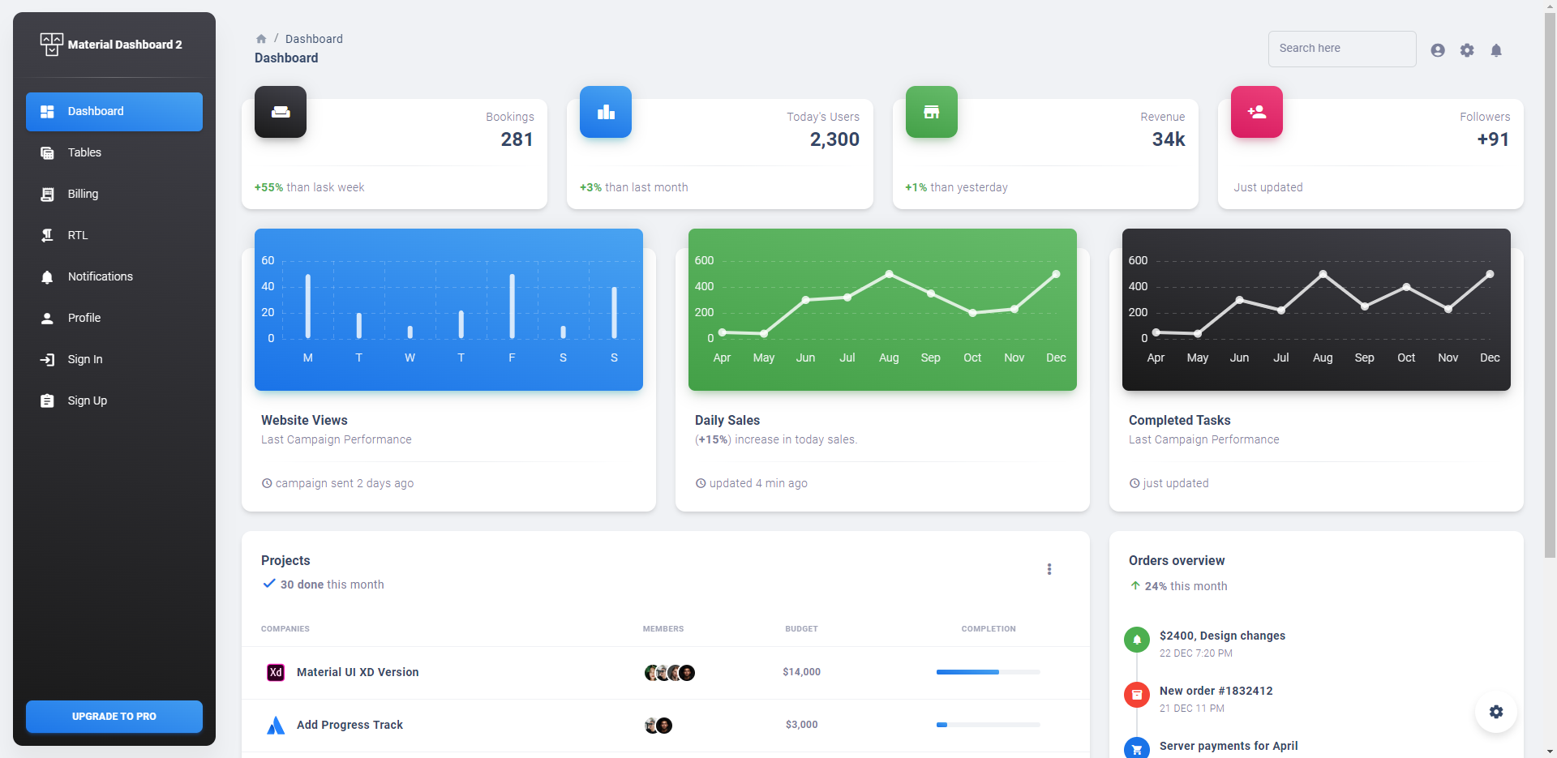
User Interface

Slide 11
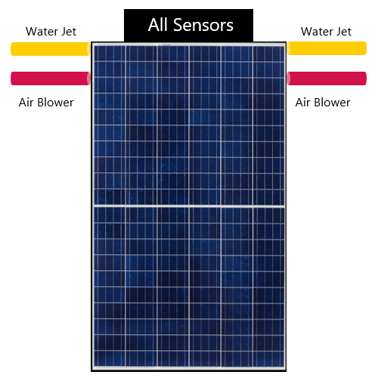
Hardware Design
All the sensors will be kept in a box properly and will be mounted at the top of the solar panel in order to collect most accurate real time data.
Water jets and air blower will be mounted at upper corners of the solar panel so that it can reach every corner of solar panel for cleaning.

Slide 12
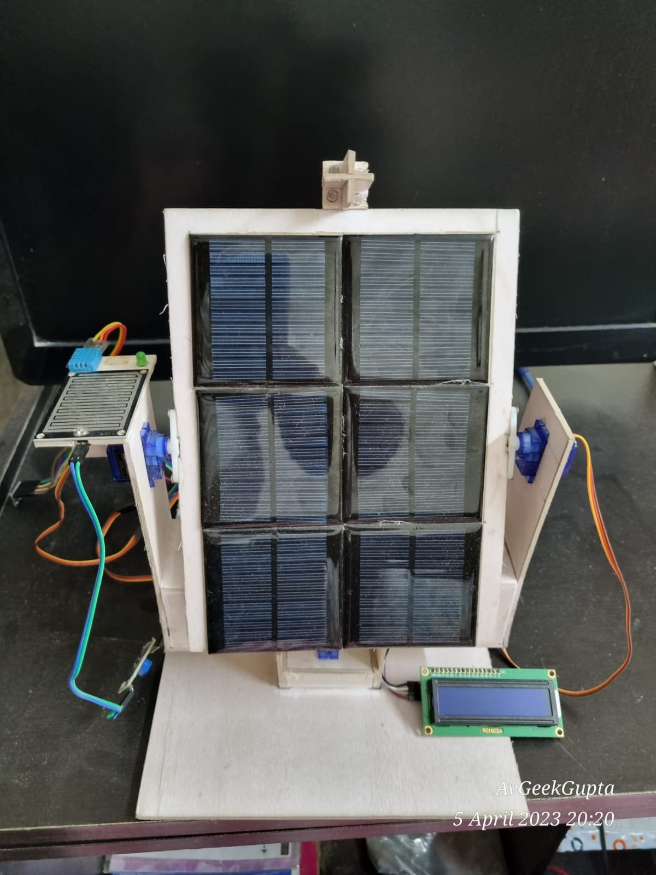
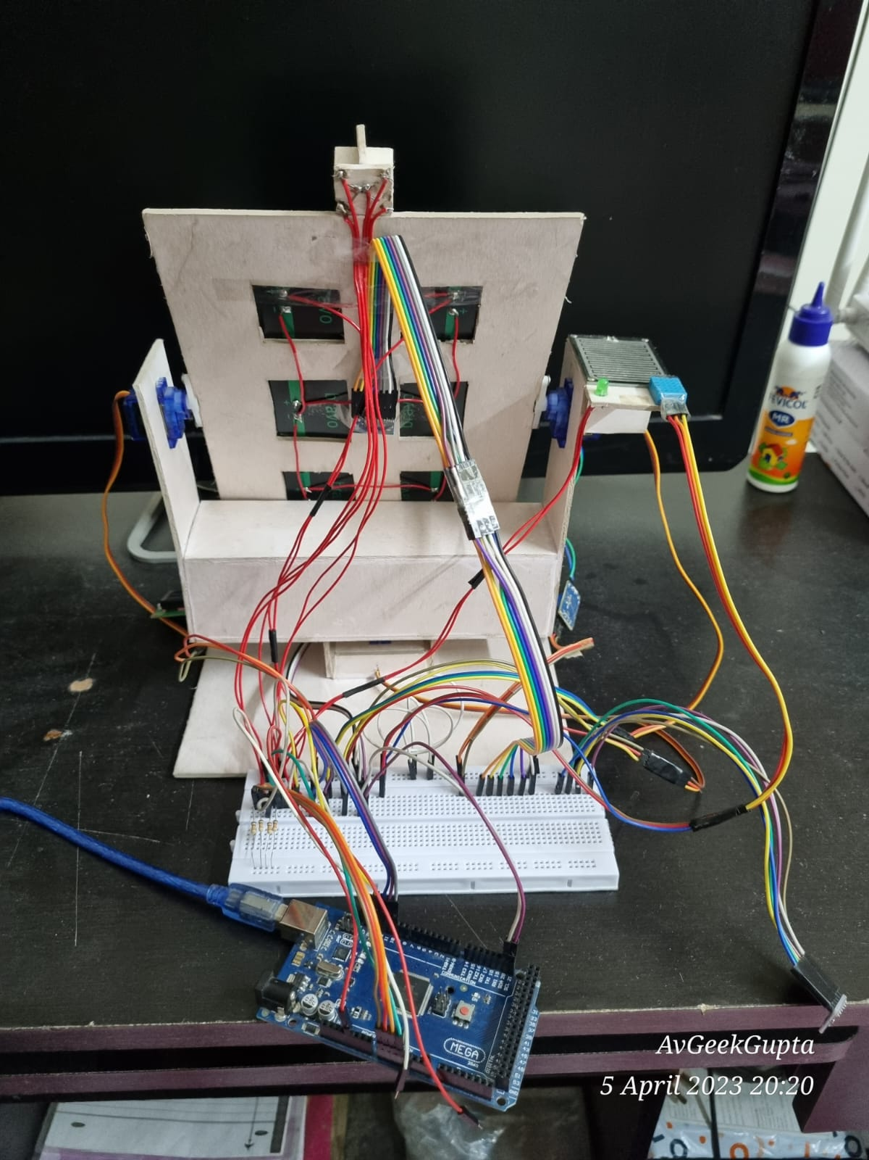
Constructed Hardware

Slide 13
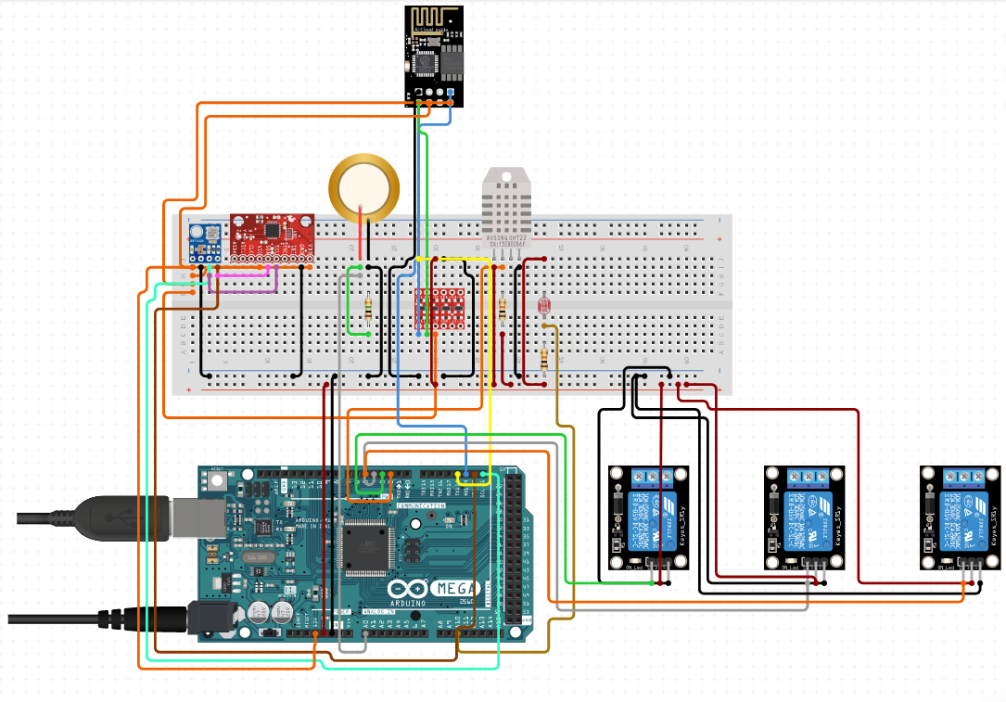
Circuit Diagram
Sensor module consist of ->
Microcontroller (Arduino Mega)
Wi-Fi Module
Gyroscope
Humidity Sensor
Photo Sensors
Rain Sensor
Barometer
Anemometer
Water Jet
Air Blower

Slide 14
References
[1] Nasib Khadka et al 2019 IOP Conf. Ser.: Earth Environ. Sci. 463 012121
[2] Milan Vaghani et al 2019 IRJET 2395-0056
[3] Manju B, Abdul Bari, & Pavan C M. (2018). Automatic Solar Panel Cleaning System. International Journal of Advances in Scientific Research and Engineering (IJASRE), ISSN:2454-8006, DOI: 10.31695/IJASRE, 4(7), 26–31
[4] Piotr Vasiljev, Sergejus Borodinas, Regimantas Bareikis, Arunas Struckas, Ultrasonic system for solar panel cleaning, Sensors and Actuators A: Physical, Volume 200, 2013, Pages 74-78, ISSN 0924-4247
[5] Xiaolong Lu, Qi Zhang, Junhui Hu, A linear piezoelectric actuator based solar panel cleaning system, Energy, Volume 60, 2013, Pages 401-406, ISSN 0360-5442

Slide 15



Our team
Utkarsh Gupta
Aradhya Singh
Tanu Sharma
R177219194 500075374@stu.upes.ac.in
B. Tech CSE AI&ML B6
R177219200
500075358@stu.upes.ac.in
B. Tech CSE AI&ML B6
R177219207
500076765@stu.upes.ac.in
B. Tech CSE AI&ML B6

Slide 16
Thank You

