Slide 1
Baymax
Team NUMBER - T207
THE SEMICOLONS;

Slide 2
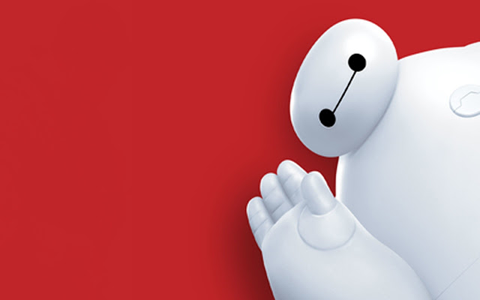
AI based MedBot to diagnose diseases and prescribe medicines in health care centers.

Slide 3
Overview
Considering the doctor to population ratio, the main objective of the medbot is to assist the doctors and lower their workload.
Along with helping the docs, it is capable of laying out a solution to an ailment of a patient on its own.
Extremely beneficial in rural areas
Competent of saving time, both for the doctor and the patient

Slide 4
Technologies used
Programming Language: Python
AI Framework: TensorFlow, Keras
GUI Framework: Kivy
Computer Vision: OpenCV
Language Processing: NLTK
Speech Processing – pyttsx3, PyAudio, SpeechRecognition
Database – Oracle MySQL

Slide 5
Approach
TensorFlow has been used to train the decision trees with the help of AdaBoost algorithm
Convolutional Neural Network has been trained using Keras for detecting gender of the patient.
In order to capture the video of the patient, OpenCV has been used.
NLTK, Natural Language Tool Kit has been used to process the basic details of the patient

Slide 6
Approach
NLTK has also been used for building an interactive chatbot.
User friendly Graphic User Interface has been created using Kivy framework
The major pro of using Kivy is that it allowed the developed application to run on multiple platforms.

Slide 7
Boosted Tree
Boosted Tree algorithm is a decision tree algorithm attached with AdaBoost algorithm.
Beneficial with data consisting of more number of columns as compared to rows.
Maximum accuracy obtained – 97.65%
Maximum depth – 7 nodes
Learning rate – 0.5 (for each iteration)

Slide 8
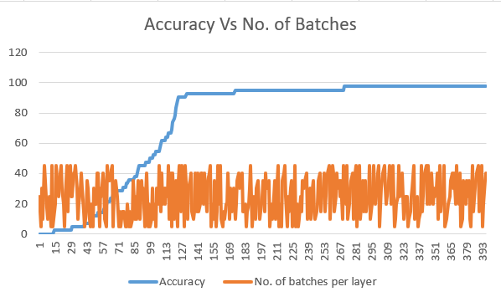
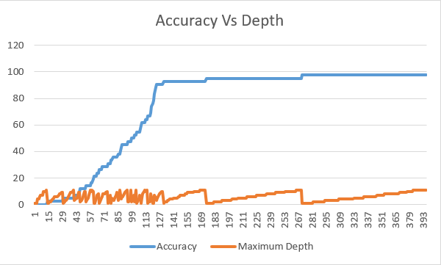
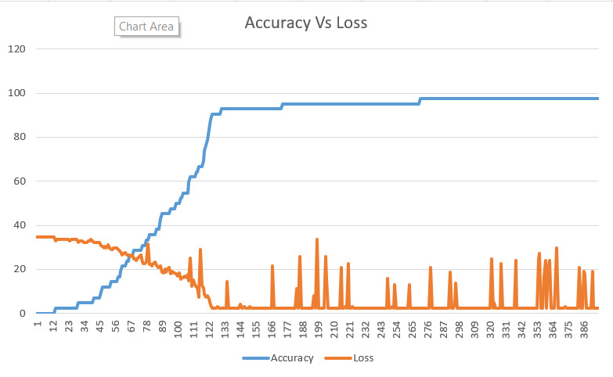
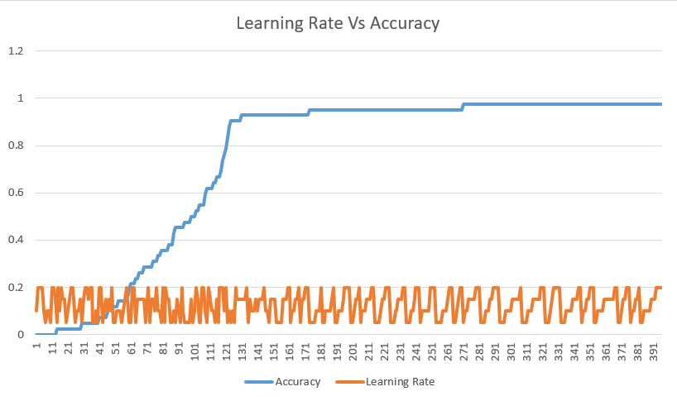
Boosted Tree

Slide 9
Language Processing
NLTK, Natural Language Tool Kit has been used for Language Processing.
It cleans the user input for obtaining useful data that can be used for processing the model’s input.
Used Tokenization and Stopwords for cleaning process.

Slide 10
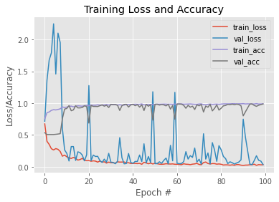
Gender Recognition
Gender recognition model has been trained using Keras, TensorFlow and OpenCV on a dataset of 5000 different images.
On initiating the application, the gender of the patient is detected.
Baymax thus changes its voice according to the predicted gender of the patient.

Slide 11
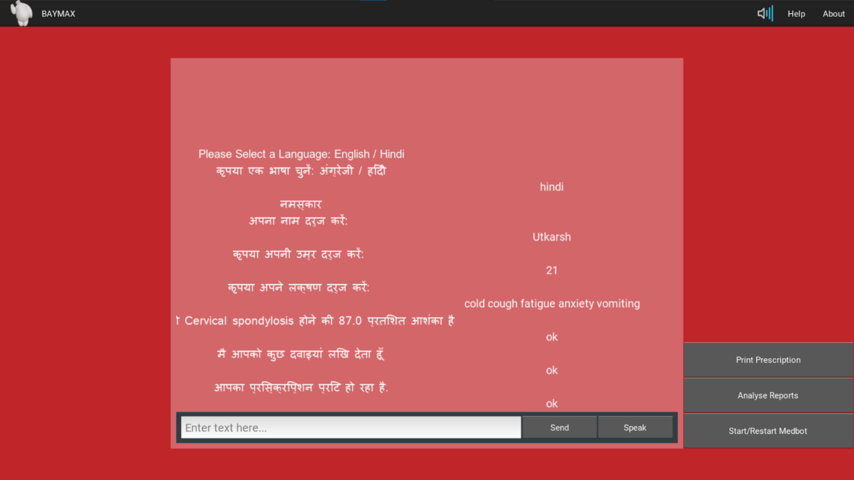
Graphical User Interface
User friendly Graphic User Interface has been created using Kivy framework
The major pro of using Kivy is that it allowed the developed application to run on multiple platforms.

Slide 12
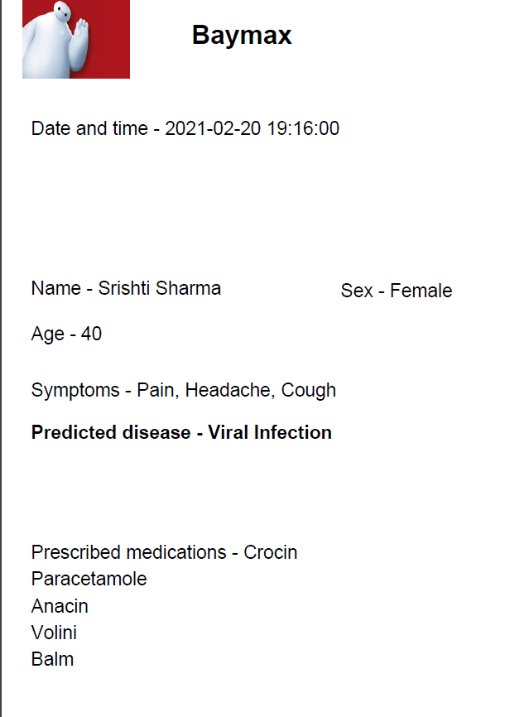
Prescription Printing
After the diagnosis of disease and suggesting medicines to the patient, the prescription is printed.
The format used for printing is .pdf
The PDF would contain the primary details of the patient along with the predicted disease and the prescribed medicines.

Slide 13
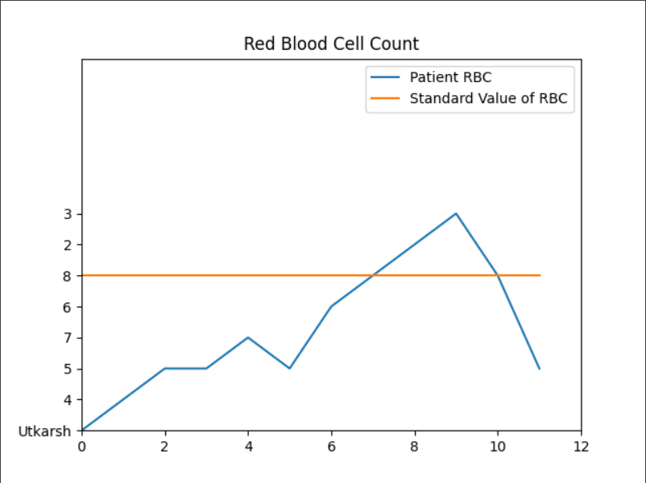
Report Analysis
Analysis of report is done after comparing it with patient’s previous medical report.
The data has been obtained from mysql database.

Slide 14
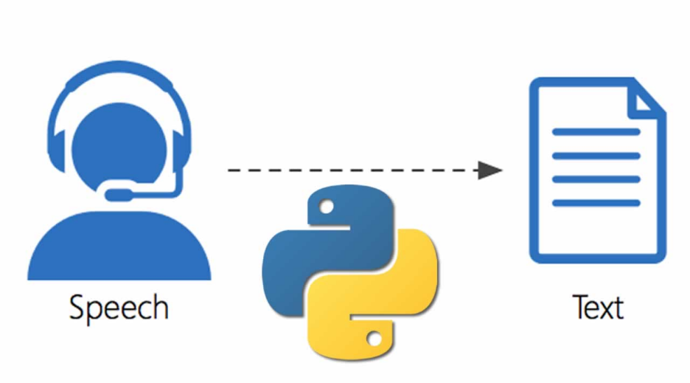
Voice Recognition
Google API has been used for conversion of text to speech.
The voice of the user is recorded and processed resulting in recognizable text.

Slide 15
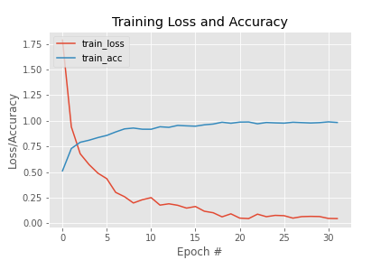
Sign Language detection
Trained a CNN model with an accuracy of 97%
Acts as one of the uniqueness of the model
Useful for people with hearing and speech impairment.

Slide 16
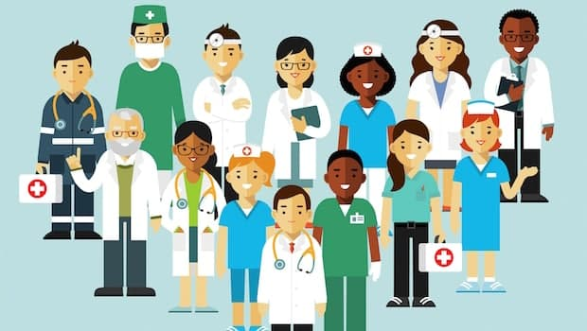
Use Case
Health care centers
Rural areas
WhatsApp API
Web based deployment
Accessible in multiple languages
Cross platform application
Voice/Text input
Gender recognition
Sign Language

Slide 17
Thank You
Team members - Utkarsh GUPTA GARVIT KHURANA TANYA MALHOTRA VANSHAJ GOEL

