Slide 1
IoT for Smart Home Security
Enhancing Home Security through IoT-Based Systems
Team member names:
Avhishek Nandi(12022002016039)
Barnali Paul(12022002016050)
Deblina Maji(12022002016024)
Sayan Bardhan(12022002004048)

Slide 2
Objectives:
Design and implement an intelligent Smart Home Security System using IoT technology and machine learning algorithms
Enhancing Security via:
PROJECT OVERVIEW
Detect and respond to intruders in real-time.
piezo sensor for pressure changes caused by footsteps.
Trigger an camera to capture images or videos.
Image Recognition and Alerts
Camera call API and Analyze images to recognize objects, especially human faces.
Trigger alarms and send real-time notifications to homeowners and security services for unfamiliar faces or suspicious activities
:

Slide 3

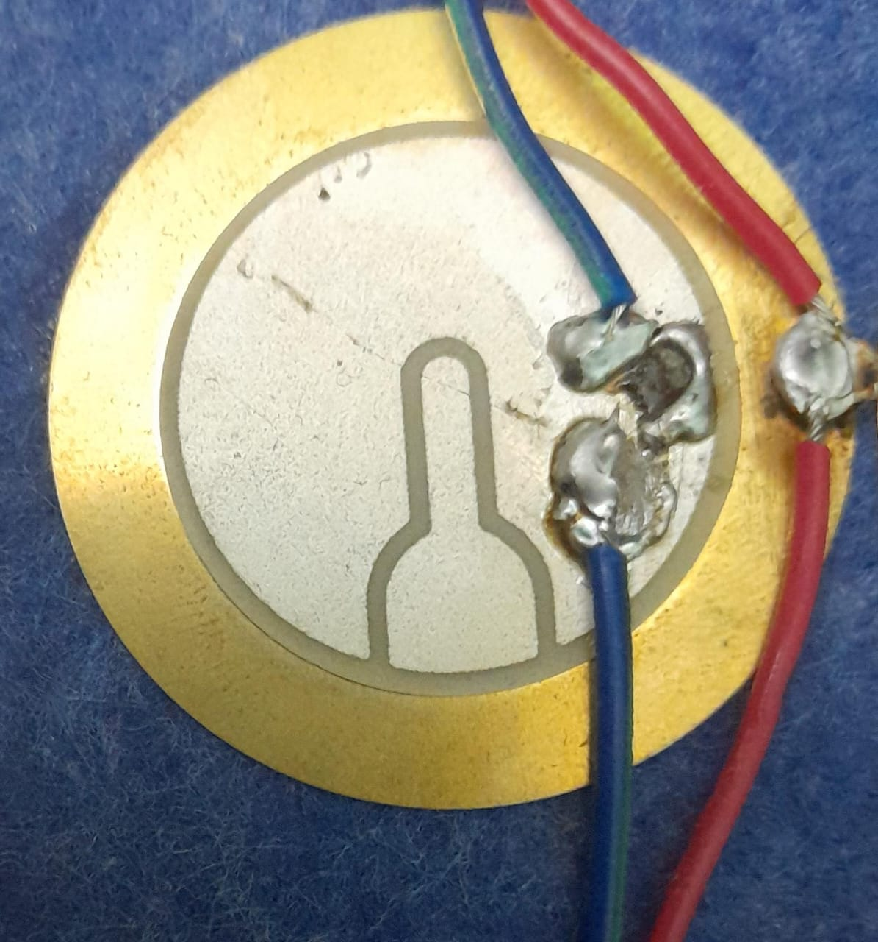
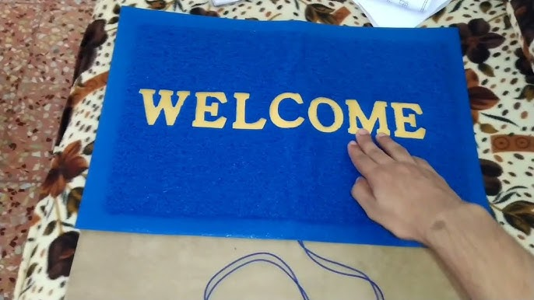
Door mat with piezo Sensors
electrical voltage signals
ESP32 communicates with camera over the same Wi-Fi network
camera detect motion and recognize face
Door mat with piezo Sensors
piezo Sensor
Piezo sensor orientation on mat surface

Slide 4
Motion-Based Multiple Object Tracking and Face recognition
Camera Action: Configure the camera to capture an image when it receives the trigger signal
from the Arduino.
Image Capture by Camera: After receiving the trigger from Arduino, the camera captures an image.
API Call from Camera: The camera, upon capturing the image, uses the image data to construct an API call and
makes the call to the API for face recognition and multiple object tracking.
API Response and MATLAB Integration: Once the API call is made and the response is received by the camera, the camera forwards
this information to MATLAB.MATLAB processes the data for face recognition and multiple object tracking.

Slide 5
Future Prospect :
To enhance the accuracy of initial detections, we will integrating a deep learning based object detection model instead of basic foreground detection.
For improved face detection accuracy and robustness, we will consider replacing the cascade object detector with a deep learning-based face detection model.
We will optimize the KLT algorithm by integrating more advanced tracking algorithms or incorporating deep learning-based face landmarks detection for better tracking accuracy.
Enhancing security and privacy through advanced encryption protocols and privacy-focused AI algorithms for secured data transmission and user identity protection.

