Slide 1
Counting number of one’s and zero’s in a given sequence
Under the guidance of
Mr. Syed Shameem
Project Associates
G.V. Sri Sai Latha - 13004422
V.Akhil - 13004427
Ch.Av.Manikanta Kumar - 13004429
G. Latha Sai Sri - 13004453

Slide 2
Objective
The main objective of this project is to design a circuit that counts the number of 1’s and 0’s in the given bit stream.

Slide 3
Abstract
In this project the number of one’s and zero’s in the given binary sequence are counted. Generally a binary sequence contains either 0 or 1. As counters are used to count the occurrence of an event, we are using two counters one for counting the occurrence of 1 and other for counting 0. The counters contains flip-flops. Flip-flops are 1 bit memory storage devices. So for an n bit sequence n flip-flops are used. First the inputs are loaded and then shifted to the respective counters. The loading and shifting operations are done using a Parallel in – Serial out Shift Register. The counters increment their values based on the register output. The output of the two counters gives the count of number of one’s and zero’s in the given bit stream.

Slide 4
Contents
Introduction
(i) Flip-flops
(ii) Shift Register
(iii) Ripple Counter
(iv) BCD to 7-Segment Display Decoder
Circuit Diagram
Advantages
Dis- advantages
Conclusion

Slide 5
Introduction
A binary digit can only be 0 or 1.
A binary sequence is a sequence of bits (either 1 or 0).
example: 12 bit sequence
101011101010
In order to store the input binary sequence we are going to use a series of flip-flops.
To count the occurrence of one’s and zero’s we are using Ripple Counters

Slide 6
Flip-flops
Flip-flops are 1 bit memory storage devices.
In this project we are using flip-flops to store the input binary sequence.
For an n-bit input binary sequence n flip-flops are used .
A series of flip-flops are said to be a register.
A Shift Register shifts the data that is stored in flip-flops.
In this project a Parallel in – Serial out Shift Register is used for loading the input data and shifting that data

Slide 7
Shift Regsiter
In digital circuits, a shift register is a cascade of flip flops, sharing the same clock, in which the output of each flip-flop is connected to the data input of the next flip-flop in the chain, resulting in a circuit that shifts by one position the bit array stored in it, shifting in the data present at its input and shifting out the last bit in the array, at each transition of the clock input.
Shift registers can have both parallel and serial inputs and outputs. These are often configured as 'serial-in, parallel-out' (SIPO) or as 'parallel-in, serial-out' (PISO). There are also types that have both serial and parallel input and types with serial and parallel output.

Slide 8
Parallel-in Serial-out (PISO) Shift Register
The inputs to the register are given in parallel and the outputs are taken in a serial order. So the name Parallel-in Serial-out Shift Regsiter.
In this type of shift register , first the input has to be loaded to the register and then the shifting operation has to be done.

Slide 9
Parallel-in Serial-out (PISO) Shift Register
This configuration has the data input on lines D1 through D4 in parallel format, being D1 the MSB. To write the data to the register, the Write/Shift control line must be held LOW. To shift the data, the W/S control line is brought HIGH and the registers are clocked. The arrangement now acts as a PISO shift register, with D1 as the Data Input. However, as long as the number of clock cycles is not more than the length of the data-string, the Data Output, Q, will be the parallel data read off in order.

Slide 10
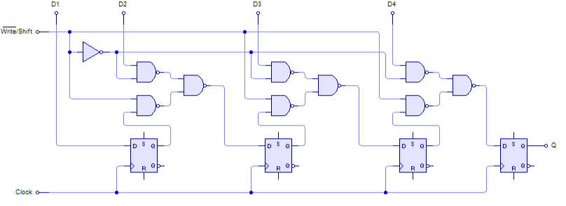
Parallel-in Serial-out (PISO) Shift Register

Slide 11
Ripple Counter
A ripple counter is an asynchronous counter where only the first flip-flop is clocked by an external clock. All subsequent flip-flops are clocked by the output of the preceding flip-flop. Asynchronous counters are also called ripple-counters because of the way the clock pulse ripples it way through the flip-flops.
The MOD of the ripple counter or asynchronous counter is 2^{n} if n flip-flops are used. For a 4-bit counter, the range of the count is 0000 to 1111 (2⁴-1)

Slide 12
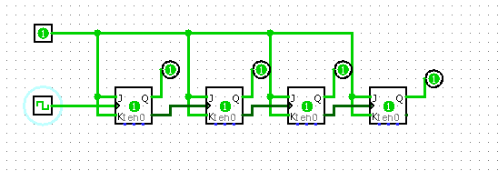
Ripple Counter
4- bit Ripple Counter

Slide 13
Ripple Counter
As we are going to count the number of one’s and zero’s in the given sequence, two counters are used one for counting the occurrence of one’s and other for zero’s.
The outputs of the counters gives the occurrence of one’s ad zero’s.

Slide 14
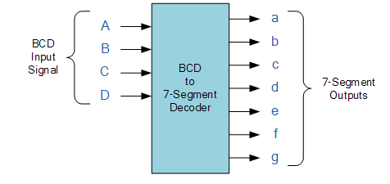
BCD to 7-Segment Display Decoder
A binary coded decimal (BCD) to 7-segment display decoder have 4 BCD inputs and 7 output lines, one for each LED segment. This allows a smaller 4-bit binary number (half a byte) to be used to display all the denary numbers from 0 to 9 and by adding two displays together, a full range of numbers from 00 to 99 can be displayed with just a single byte of 8 data bits.

Slide 15
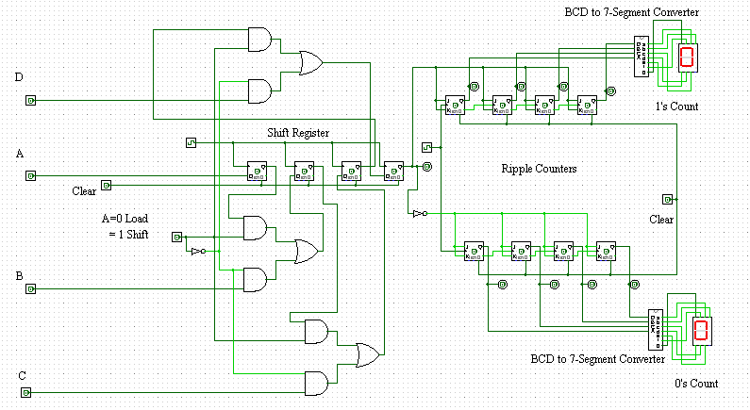
Circuit Diagram

Slide 16
The input bit sequence is given to the inputs of the shift register. First this sequence has to be loaded to the register and then shifting has to be done. Once loaded (by setting Mode to Load), the bits are to be shifted by changing the mode to shift and by using clock. The output of the shift register i.e., the shifted bit goes to the respective counter based on its value. The counter counts the occurrence of bits and the count is displayed in the 7-Segment Display by using BCD to 7-Segment Decoder.

Slide 17
Advantages
Counting the number of one’s and zero’s can be used for error detection techniques. If we use this counting circuit both at transmitting end and receiving end then we can detect the error. If the count at transmitter end and receiver end are not equal then we can say that there is an error in received signal.

Slide 18
Dis-advantages
By using this technique we can detect the errors but we cant rectify the errors.
Asynchronous counter is slow, as the propagation delays of the flip-flops add together to produce the overall delay. Hence, the more bits or number of flip-flops in an asynchronous counter, the slower it will be

Slide 19
Conclusion
A circuit which the counts the occurrence of one’s and zero’s in the given bit stream is designed using shift register and ripple counter.

Slide 20
THANK YOU

