Slide 1
SOBIget sober
BY
R&R

Slide 2
OVERVIEW
Sobi is an application developed in Android Studio using flutter and dart.
The primary objective of this app is to giving a helping hand to the people who are struggling to get rid of their smoking habits.
We assure you significant results , provided that the user stays honest to himself and follow the directions and rehabilitation techniques provided by the app.
It analyses the users smoking patterns and devices a method most optimal to get rid of the habit in the shortest time possible.

Slide 3
KEY FEATURES
As we know smoking can’t be quit overnight . So the app first needs to know how many cigarettes do you smoke on daily basis.
Depending on your entry,(which will be there in the beginning of the app), it will show you an estimated time you will take to get better.
It ensure to bring down your smoking numbers by actually allowing you to smoke in the first stage of the process; but slightly reducing the number as time flies.

Slide 4
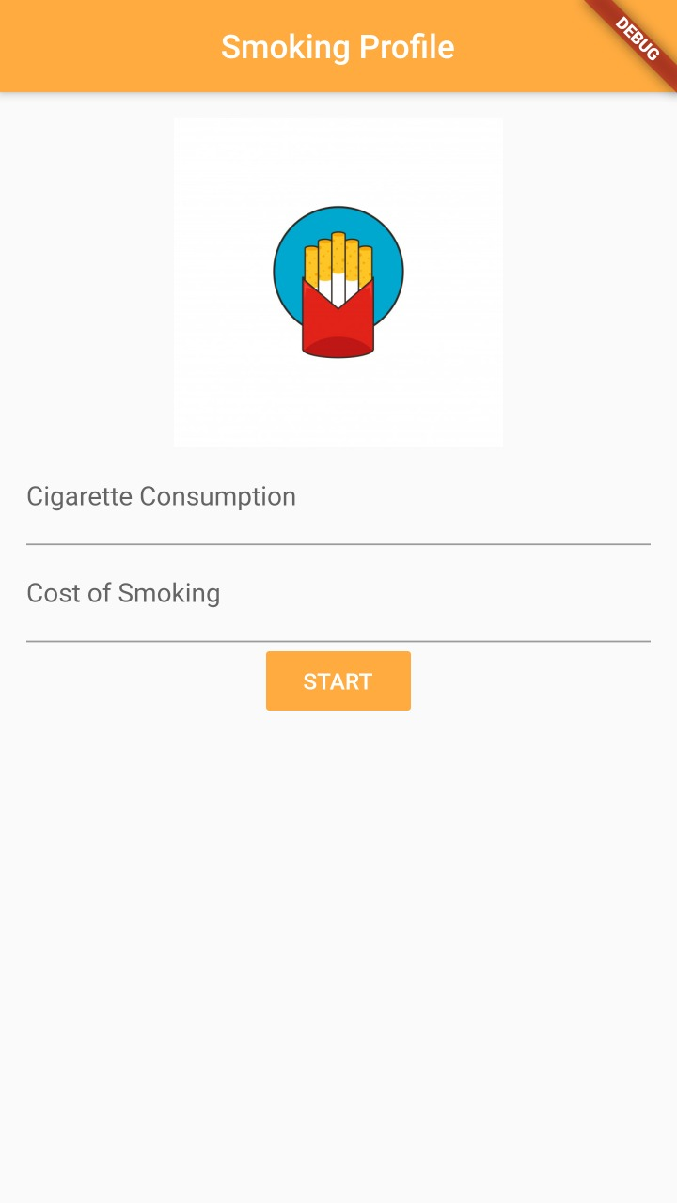
Initial page
This is the page where the user has to enter the details regarding his current smoking status.
It is according to this that the app puts forth the procedures to get rid of smoking for each user.

Slide 5
As an additional bonus we will be showing you the following in the homepage:
Money saved during the process.
Cigarettes avoided during the process.
Time remaining for the process.
Lifetime gained during the process.
Achievements page showing the users progress.
Bonus tips will be provided to spread awareness among the people using this application.

Slide 6
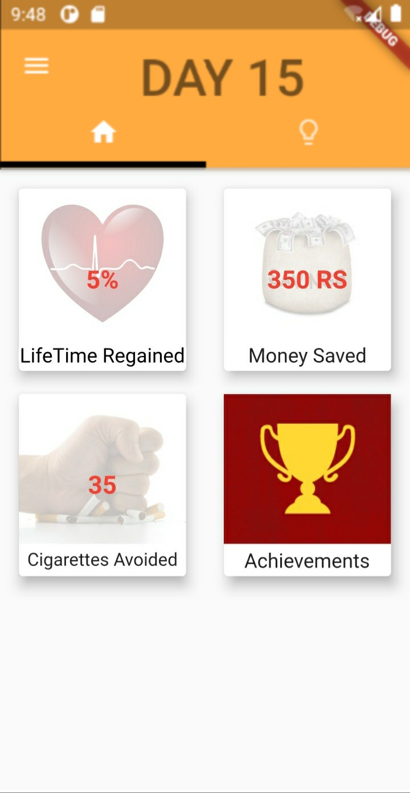
HOMEPAGE
Here we can see that the app is quite user friendly.
Wide range of options are available within a small region.

Slide 7
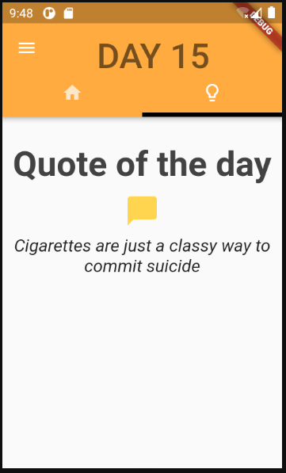
QUOTES PAGE
Here we share enlightening thoughts and quotes to provide awareness and some motivation to the users of the app.

Slide 8
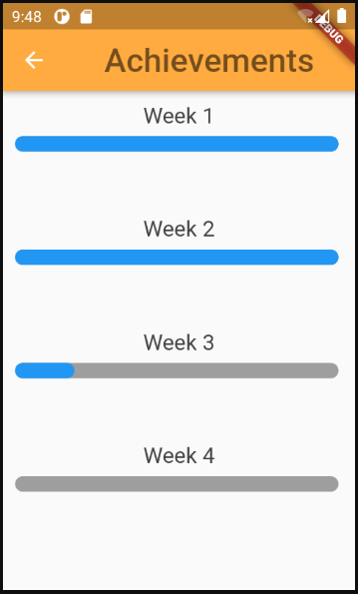
Achievements page
Here, the progress of the users daily routine completion is shown as a percentage bar.

Slide 9
Accessibility and security
The app has minimum requirements for installation and can be run on any android or iOS device.
The app requires accessibility to the device’s calendar so as to sync the daily activities of the user with the rehabilitation procedures mentioned in the application.
It also reminders the user of the activities so that they don’t miss a single day of the program.

Slide 10
conclusion
This application is very useful for people having troubles sticking to their plans of getting rid of cigarette smoking.
The app gives you a consistent aid irrespective of how a heavy smoker the user is.
The procedures listed down in the application are in such a way so that the user does not suffer from any severe withdrawal symptoms.
It also has a feature asking for certain symptoms , which if are recognized by the app to be due to withdrawal , will advice the user to consult a physician immediately.

Slide 11
REFERENCES
Youtube
Github
Team Mentor, Miss Megha.

Slide 12
THANK YOU

