Slide 2
Data Compression and Decompression with Image Steganography using api
Submitted to:
Department of Computer Science and Engineering

Slide 3
Supervised by: Prof. Priyanka
Jangde
Team Members
1. Aadesh Garg
2. Amisha Linjhara
3. Amisha Prajapati
4. Ananya Shrivastava

Slide 4
Project Presentation Outline
Introduction
Project Objectives
Proposed Methodology
Requirement Analysis
Solution Proposed
The Outcome Discussion

Slide 5
Introduction
The “Data Compression and decompression with image steganography” is a web based application which provides user friendly interface to automate the process of
Serving towards the welfare of the user.
It is a place where we can compress or decompress the image as per our requirements.
It is a place where we can hide or embed the secret information inside the image so no intruder can get the hold of our secret message
Steganography is the art of hiding information in such a way that prevents the detection of hidden messages

Slide 6
2. Introduction
We can use gray images, videos, sound files, and other computer files that contain perceptually irrelevant or redundant information as a cover image.
It is important to note that the hidden data is not detectable in the stego-image.

Slide 7
Objectives
The main objective object of the project is to automate the process of serving towards the welfare of the user by providing them with the facility of compression or decompression of file as per their requirement.
The second main objective of this project is to hide or embed the secret or confidential data in a image so that only receiver can detect the stego-image.
Generally, the project aimed to develop a system Image Steganography of Multiple File Types with Encryption and Compression Algorithms.

Slide 8
Objectives
Specifically, this study aimed to: accept secret file to be hidden; compress secret file using an Algorithm; encrypt and decrypt secret file using Data Encryption Standard Algorithm; embed and extract data file in stego-image using LSB Algorithm; and evaluate the system using a specific standards: functionality, usability, reliability, portability, efficiency, and maintainability.

Slide 9
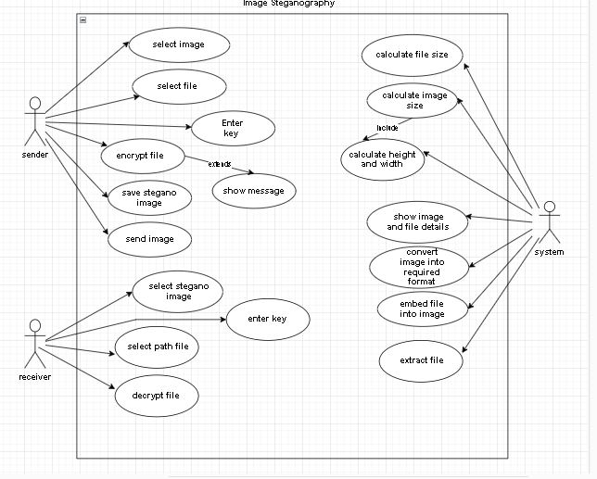
Proposed Methodology

Slide 10
Requirement Analysis
Hardware Requirement :
Processor : Intel ® Pentium ® or above
CPU Hard disk : 500 GB HDD
RAM : 4 GB RAM
Software Requirement :
Operating System : Windows 7 or above
Frontend : HTML5 , CSS4
Backend : Java, JDBC, Swing

Slide 11
Outcome Discussion
Mathematically relating the security and the limit: Security and Capacity exchange off is an imperative issue in steganography. It has been seen that expansion in the limit prompts giving up the security to some degree.
Development of Algorithms dependent on items in pictures: As the steganalysis techniques are getting more grounded and in the end most steganographic calculations are falling prey to them, there is a pattern in creating calculations which targets specific parts of pictures for installing.

Slide 12
Outcome Discussion
Improving the steganographic calculations: It is seen that all steganographic calculations, be that in the spatial area or the change space (recurrence area), eventually adjust factual properties of pictures and because of which they fall prey to measurable steganalysis techniques. In this manner, it is obvious that there still stays sufficient degree for research in creating calculations in picture steganography that will have the capacity to give increasingly anchor highlights to data stowing away.
We can arrange the conceivable upgrades that may be received to assemble future steganographic frameworks as:

Slide 13
Outcome Discussion
• Increasing implanting proficiency
• Decreasing installing mutilation
• Choosing substitute shading spaces
• Choosing alternate colour spaces

Slide 14
Q&A

Slide 15
THANKS

