Slide 1

Hit Predictors: Forecasting Song Popularity with Machine Learning
Presented by: Ava Allen, Lana Doronkina, Allison English, and Otto JeckerByrne
SUNY New Paltz: BUS461 – Independent Project
May 12, 2025

Slide 2
Contents
Dataset Introduction (3)
Research Objectives (4)
Literature Review (5)
Model Introductions (Random Forest & XGBoost) (6)
Methodology (7-9)
Results (10-14)
Conclusion (15)
Business Implications (16)
Resources (17)

Slide 3

Dataset Overview
Dataset: Spotify 1 Million Tracks
Source: Kaggle
Size: Over 1 million songs (2000-2023)
Features: 19
Audio: Danceability, key, loudness, tempo, etc.
Metadata: Genre, year, artist name
Key feature: Popularity (0-100)

Slide 4

Research Objectives
Goal
Identify key audio features that predict song popularity to inform marketing, promotion, and production decisions in the music industry.
Supporting Questions
Which audio features most influence a song’s popularity on Spotify?
Does genre significantly impact popularity?
Can we develop a model to classify “high potential” tracks to guide promotional strategy?
Notes:
Goal: Identify key audio and metadata features that predict song popularity to inform marketing, promotion, and production decisions in the music industry.
Support Questions:
Which audio features most influence a song’s popularity on Spotify – What makes a song perform well? (e.g., Tempo, danceability, energy, etc)
Can we develop a model to classify “high potential” tracks to guide promotional strategy? – “this song has a high chance of becoming a hit”
Machine learning: transform target into binary label: Popularity >75 -> “high potential” (Random Forest classification model)
3. What feature combinations or song types are more likely to become hits? – Looks at the synergy between variables (e.g., high danceability + fast tempo + high energy = “party song”)
4. How can we cluster songs into commercially meaningful categories? – Find natural groupings in the data (e.g., “chill”, “party”, “workout”, “sad vibes”)
Enables audience targeting and playlist curation
Can help segment marketing strategies by listener mood or use-case
Machine learning: use a clustering algorithm (k-means or hierarchical clustering to label clusters based on audio features and visualize PCA. Analyze which clusters contain the most popular songs.

Slide 5
Literature Review
North & Hargreaves (1995): People’s music preferences (and popular music consumption) are strongly linked to age and contemporary musical trends (younger listeners prefer newer songs – recency matters)
Pachet & Roy (2007): Found that popular songs tend to have higher energy, higher danceability, and positive valance.
Herremans et al. (2014): Genre and release period (year) are significant predictors of hit potential (used Random forest and Boosting)

Slide 6
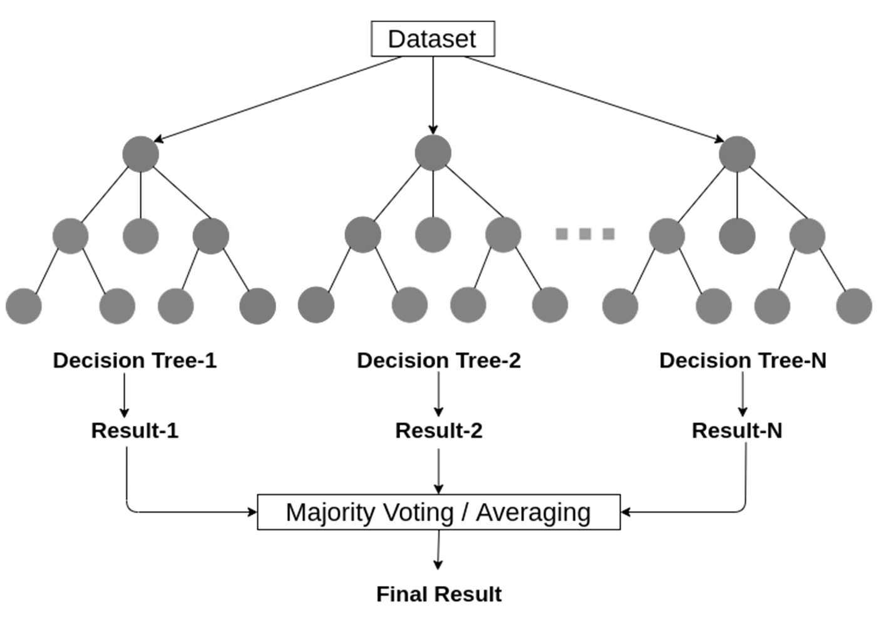
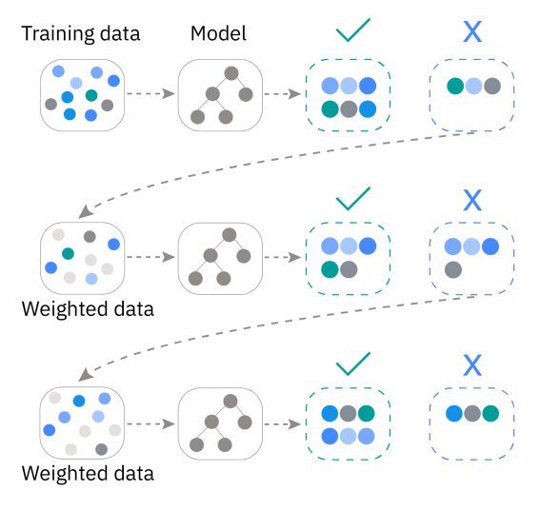
Model Overview
Random Forest
XGBoost
(For feature importance)
(For model accuracy)
Notes:
Random Forest and XGBoost are chosen for this project because of their high model accuracy and insights into feature importance
Random Forest: interpretable and robust to noise. This will help us to understand which song traits matter most
Ensemble of decision trees
Focused on feature importance and prediction
XGBoost: Gradient boosting method
Focused on improving prediction with boosting
Handles complex feature interactions

Slide 7
Methodology: Data Preprocessing
Dropped irrelevant features (e.g., track name, artist name, track ID)
Converted “year” into a factor variable
Created binary target variable: High Potential (top 25% & top 30%)
Partitioned the data: 60% test & 40% train
Set random seeds

Slide 8
Methodology: Random Forest
Used ranger package: Designed for speed, memory efficiency, and can handle large datasets
Random Forest Model Set 1: All numeric variables + year as a factor + genre unfactored
Random Forest Model Set 2: All numeric variables + year & genre as factor variables
2 Models per set:
Top 25% popularity threshold
Top 30% popularity threshold
*Each model trained using 500 trees & evaluated using in/out-of-sample AUC and Convergence Curves

Slide 9
Methodology: XGBoost
XGB: handles complex feature interactions, prevents overfitting (boosting + early stopping, and scales to large or evolving datasets
2 Models:
XGBoost Model 1: All numeric variables + year as a factor (excluding genre)
XGBoost Model 2: All numeric variables + year & genre as factor variables
Each model trained using:
500 trees
Controlled model complexity:
Max tree depth = 6
Learning rate = 0.1
Early stopping to prevent overfitting (stopped if no AUC improvement after 10 rounds)
Evaluation Metric: AUC

Slide 10
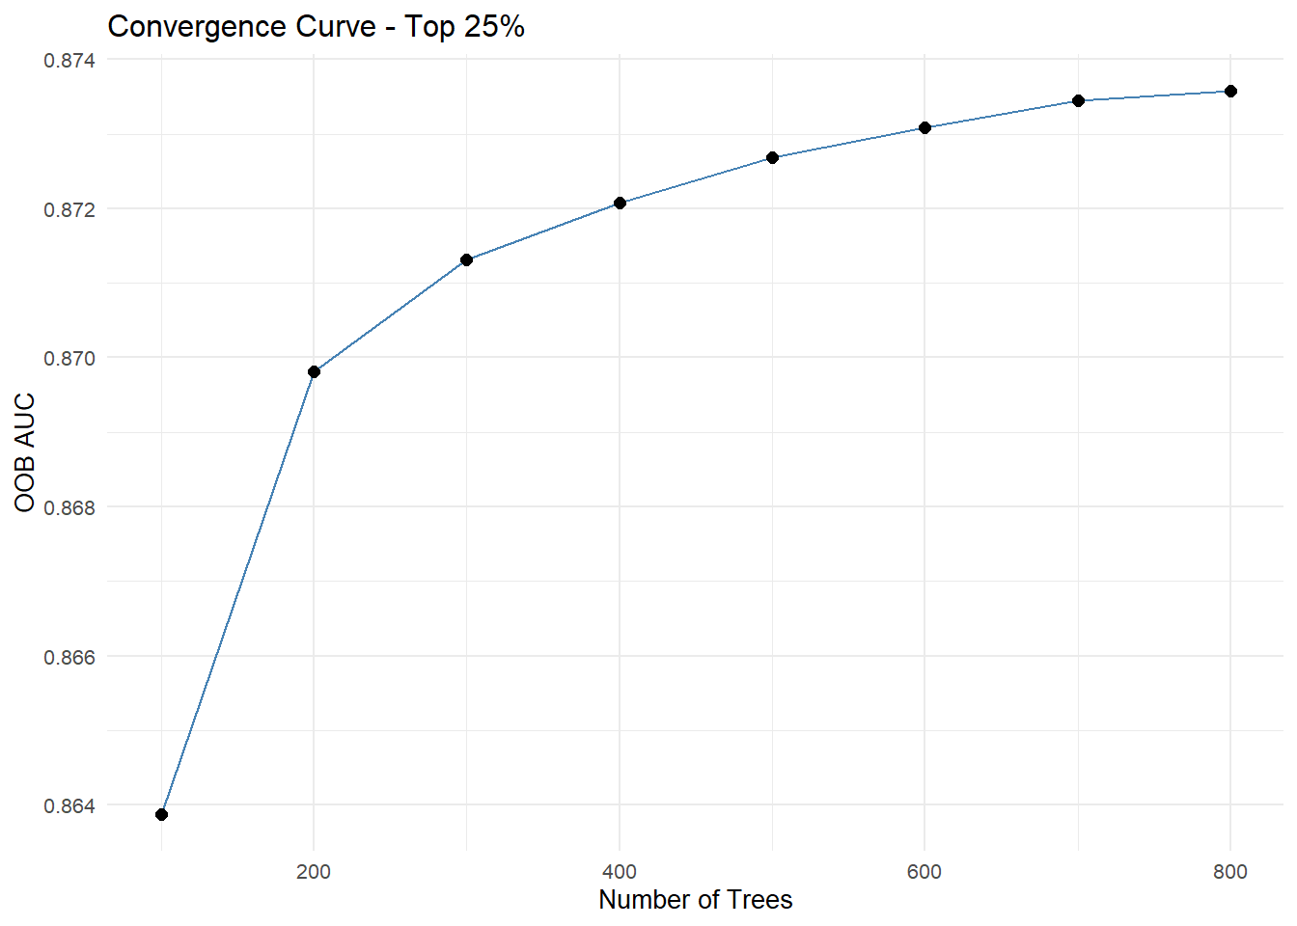
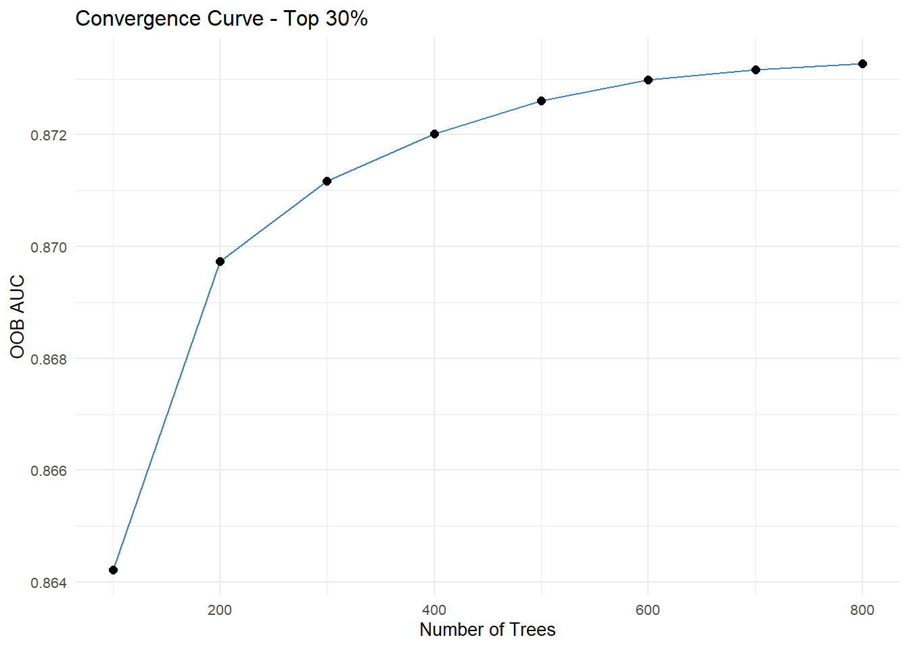
Results: AUC & Convergence Curves
Random Forest Model Set 1
(All numeric variables + year as a factor + genre unfactored)
Top 25% Threshold
In-Sample AUC: 0.873
Out-of-Sample AUC: 0.875
Top 30% Threshold
In-Sample AUC: 0.873
Out-of-Sample AUC: 0.874

Slide 11
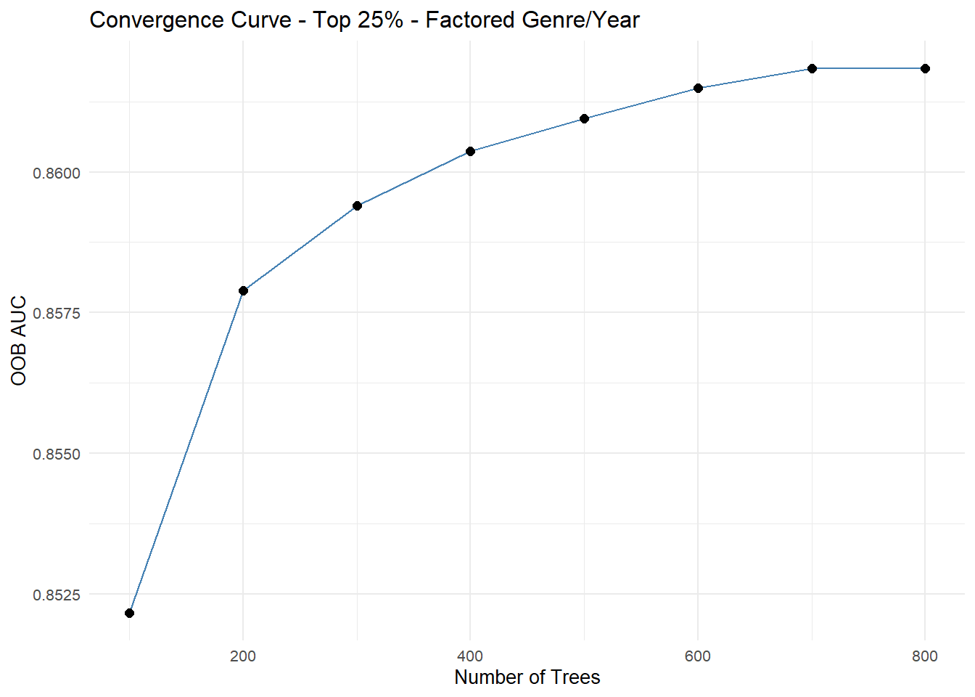
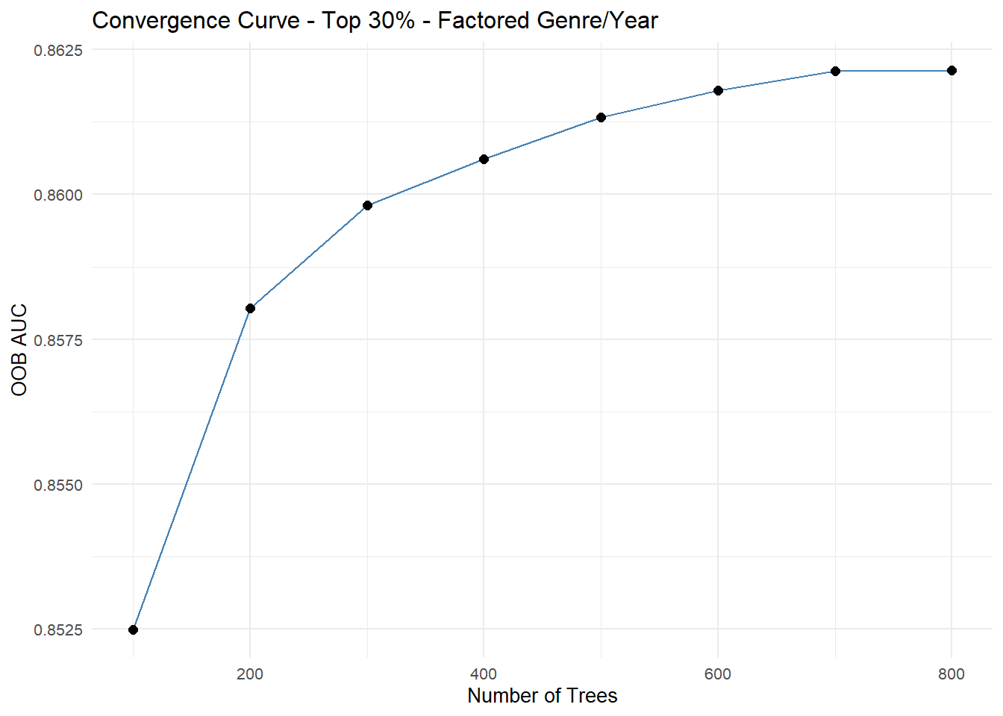
Results: AUC & Convergence Curves
Random Forest Model Set 2
(All numeric variables + year & genre as factor variables)
Top 25% Threshold
In-Sample AUC: 0.861
Out-of-Sample AUC: 0.863
Top 30% Threshold
In-Sample AUC: 0.861
Out-of-Sample AUC: 0.862

Slide 12
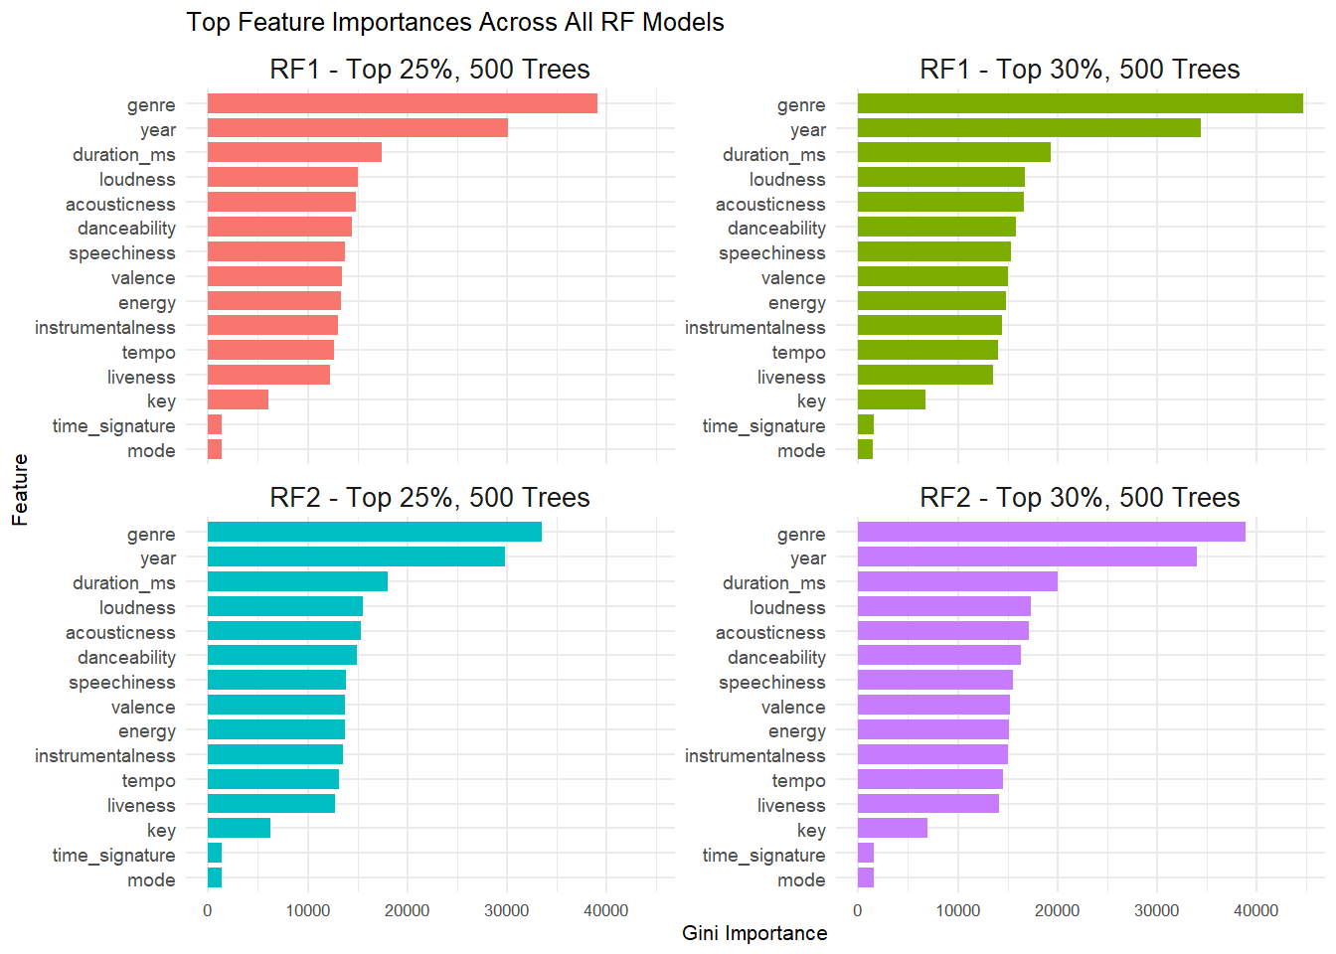
Results: RF Model Feature Importance Comparison
Random Forest Model Set 1
(All numeric variables + year as a factor + genre unfactored)
Random Forest Model Set 2
(All numeric variables + year & genre as factor variables)

Slide 13
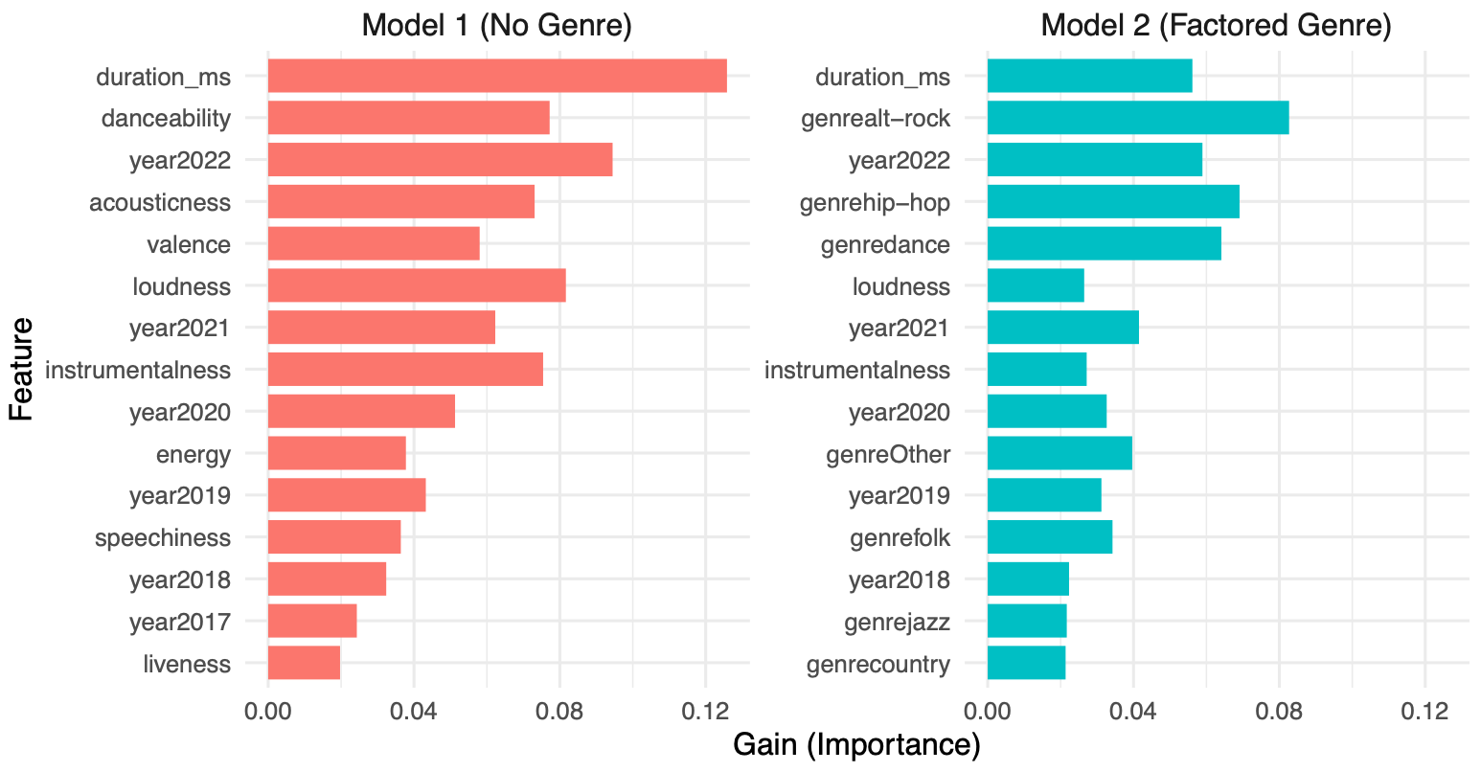
XG Boost Results: Performance & Feature Importance
Model | Features Included | In-Sample AUC | Out-of-Sample AUC
Model 1 | All numeric + year factored (genre excluded) | 0.788 | 0.779
Model 2 | All numeric + year & genre factored | 0.867 | 0.864
Feature
Gain (Importance)

Slide 14
Results: All Model AUC Comparison
Model | In-Sample AUC | Out-of-Sample AUC | Notes
RF 1: 25% | 0.873 | 0.875 | Strongest overall performance, genre not factored, yet still top results
RF 1: 30% | 0.873 | 0.874 | Similar performance to 25%; showing stable prediction threshold robustness
RF 2: 25% | 0.861 | 0.863 | Genre factored in; slightly lower AUC suggests possible overfitting
RF 2: 30% | 0.861 | 0.862 | Consistent with RF2: 25%; genre & year included as categorical
XGB 1 (All numeric + year factored) | 0.788 | 0.779 | Weaker performance; genre excluded may limit model context
XGB 2 (All numeric + year & genre factored) | 0.867 | 0.864 | Significant performance gain with genre and year included
Notes:
Top AUC Performance: RF models (Set 1) performed best overall with the highest out-of-sample AUC scores (~0.875), showing excellent generalization and stability
XGB Model 2 while slightly behind RF1, showed strong performance (0.864 AUC) and benefited clearly from including genre as a feature

Slide 15
Conclusion: Key Drivers of Song Popularity
Genre
Single most important predictor across all models that included it
Strongly associated with popularity: Genres: alt-rock, hip-hop, dance) appear frequently among top features
Year
Reflects trends bias: newer releases had higher chances of being in the top 25-30%
Congruent with the relevant literature
Duration
Strong numeric predictor in all models
Suggests there’s an optimal song length range for popularity
Loudness
Songs with higher overall volume tended to perform better (may correlate with more polished, professional production)
Acousticness
Represents the confidence that a track is acoustic (i.e., not electronic or heavily synthesized)
Suggests that acoustic or semi-acoustic qualities (e.g., singer-songwriter, lo-fi, indie pop) may also appeal strongly to listeners
Danceability
Measure of how suitable a track is for dancing (based on tempo, rhythm stability, beat, etc.)
Highly predictive of popularity Indicates that listeners are drawn to rhythmically engaging, energetic songs

Slide 16
Business Implications
Genre & Audio features matter
Models consistently showed that audio properties (loudness, acousticness, danceability) + genre are critical predictors
Predictive accuracy can guide music production and marketing
Machine learning models can help recording labels/artists produce music that aligns with high-potential future profiles
Feature insights can be used to target promotions towards genres and song types most likely to perform well
Notes:
While the Random Forest model achieved the highest AUC (0.873), the XGBoost model provided a more scalable, flexible, and generalizable approach, particularly after including genre features
For practical business applications where adaptability and future data trends are important, XGBoost (with genre) could be the preferred model

Slide 17
Resources
Herremans, D., Martens, D., & Sörensen, K. (2014). Dance hit song prediction. Journal of New Music Research, 43(3), 291-302.
North, A. C., & Hargreaves, D. J. (1995). Subjective complexity, familiarity, and liking for popular music. Psychomusicology: A Journal of Research in Music Cognition, 14(1-2), 77–93.
Pachet, F., & Roy, P. (2007). Hit song science is not yet a science. Proceedings of the 8th International Conference on Music Information Retrieval (ISMIR)

