Slide 1
ICS 26011 Project Delubyocation Mock-up Prototype
Members: Norada, Ava Julia L. Mariano, Joshua Rene M Rabelas, Ryu L. Cedo, Aaron R. Wong, Richard M.

Slide 2
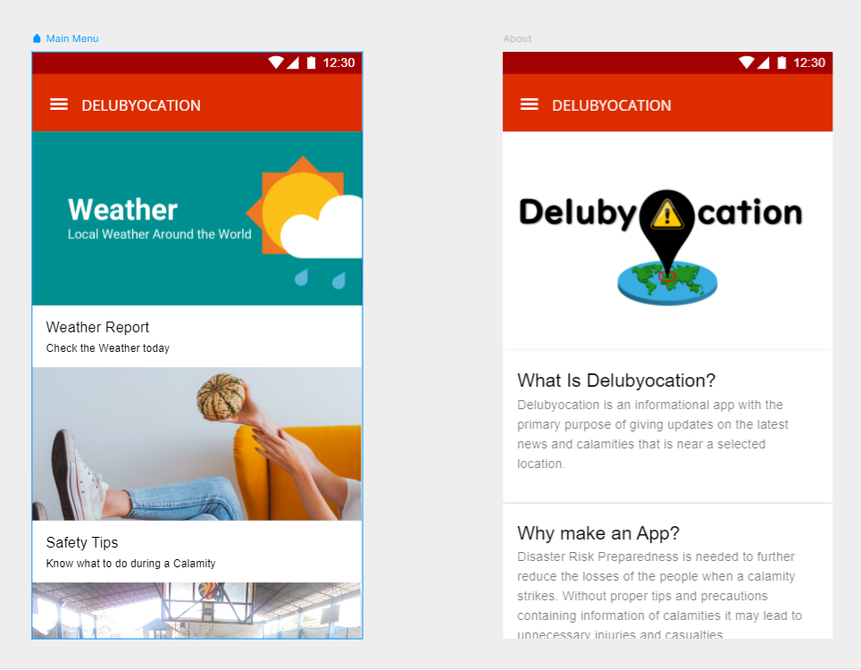

Slide 3
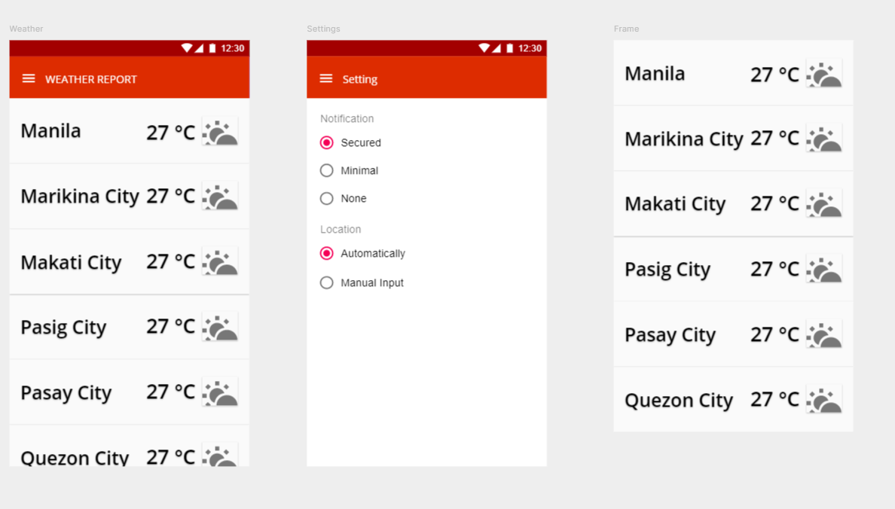

Slide 4
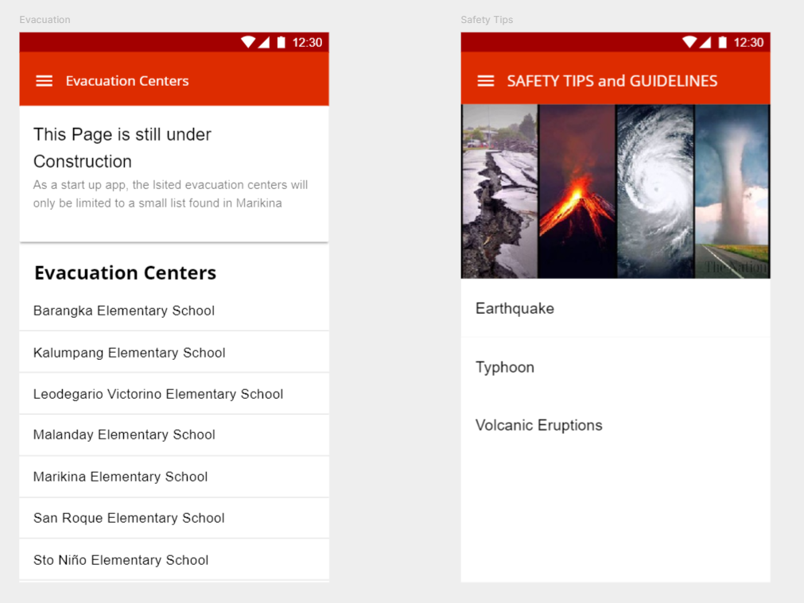

Slide 5
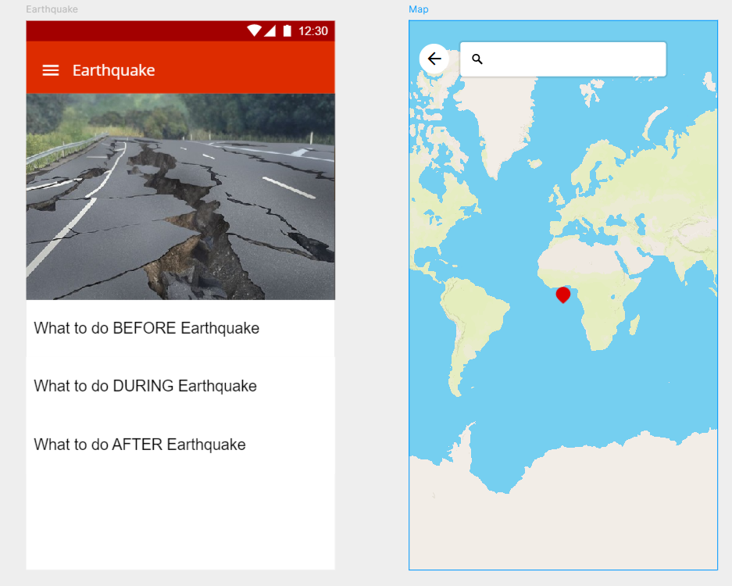

Slide 6
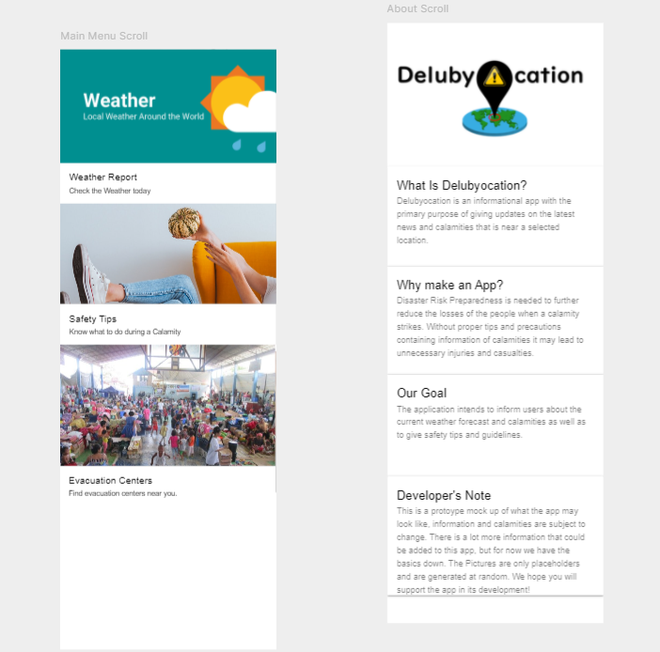
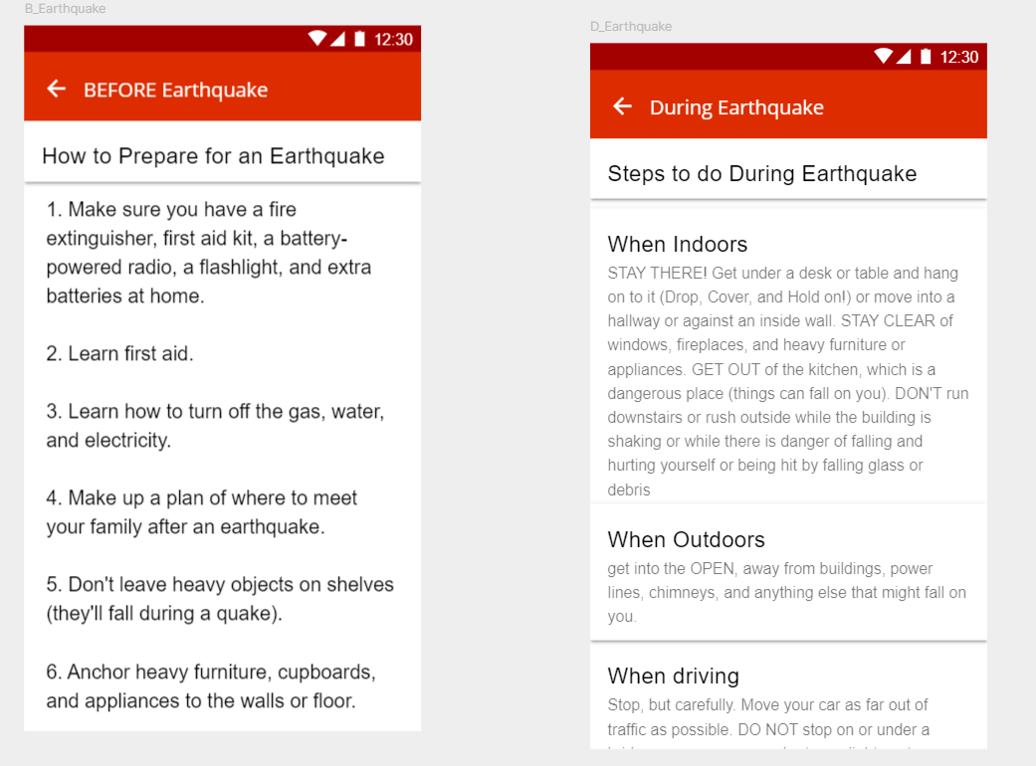

Slide 7
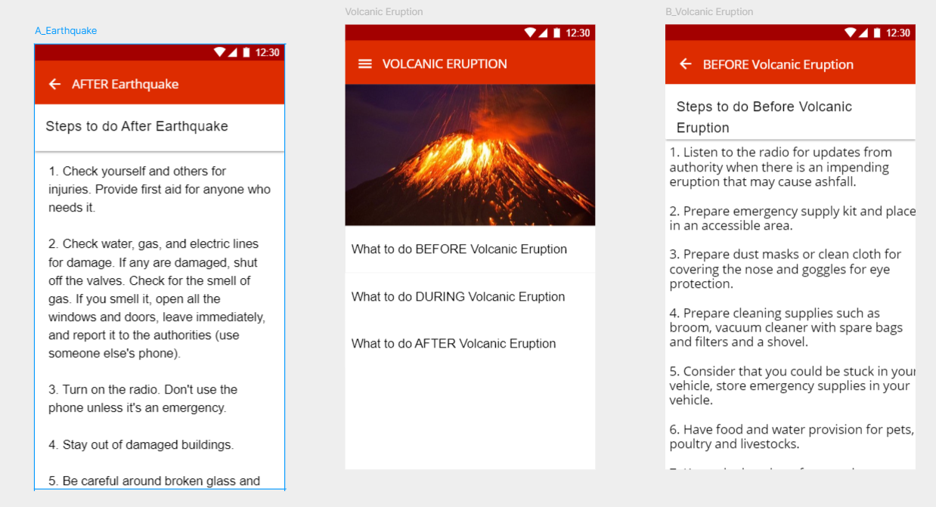

Slide 8
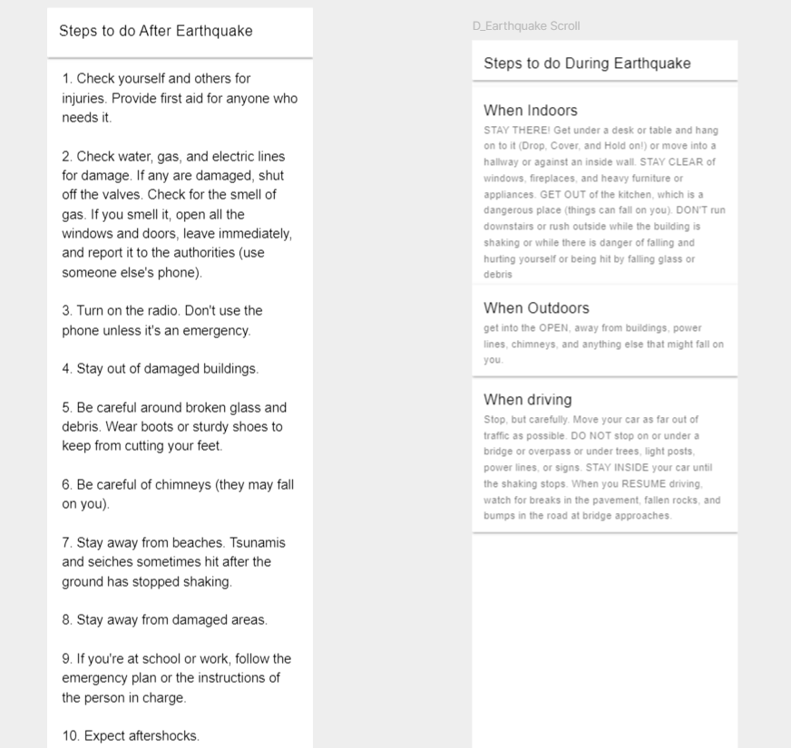
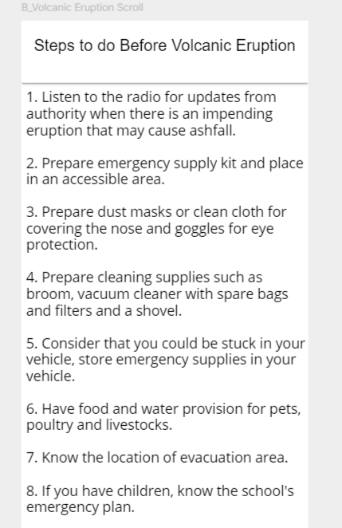

Slide 9
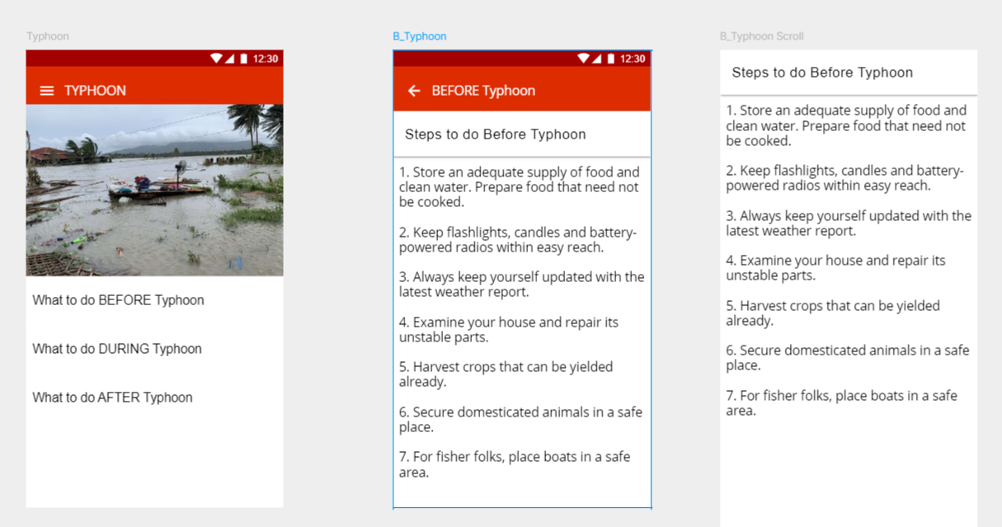

Slide 10
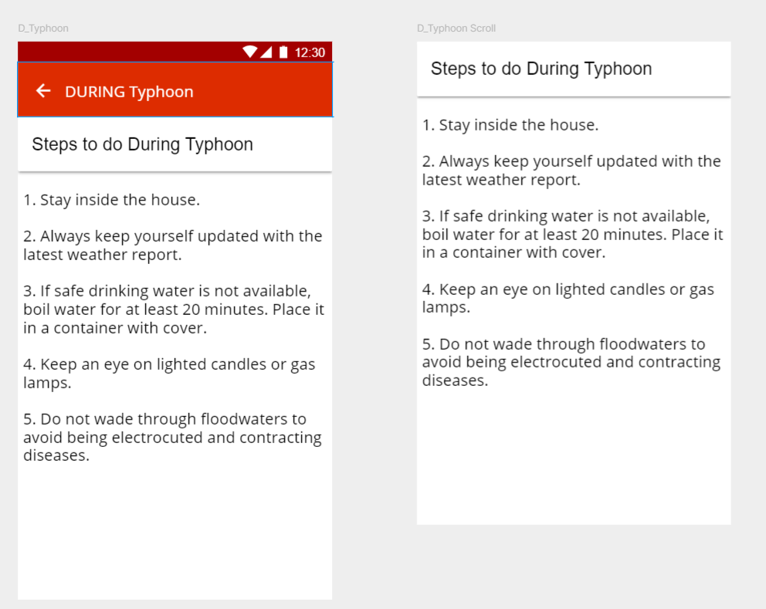

Slide 11
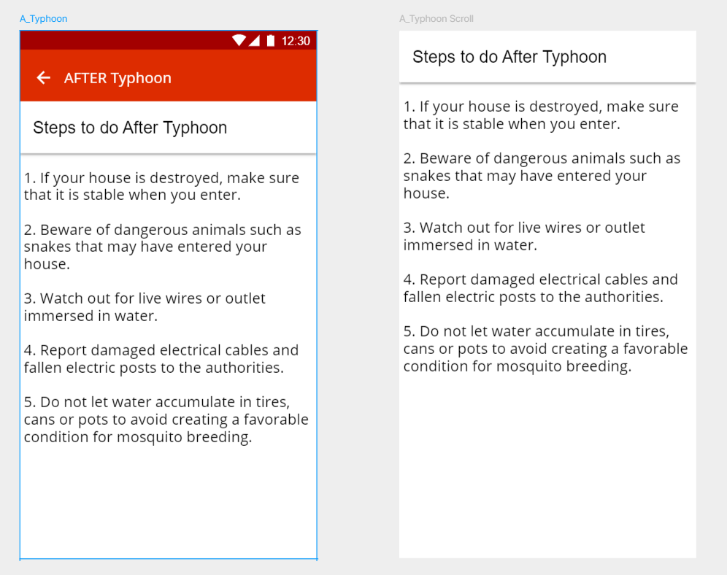

Slide 12
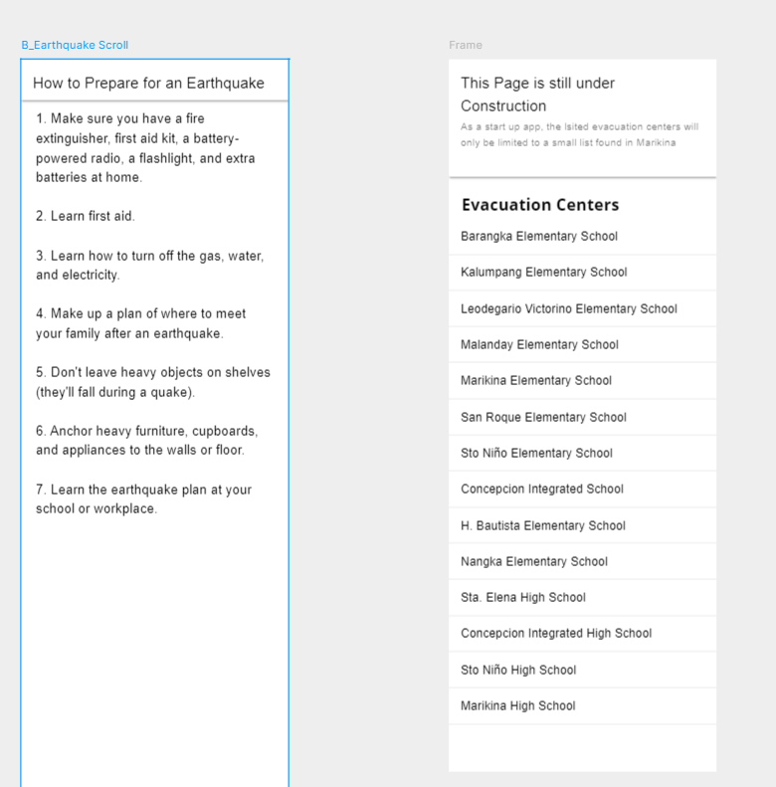
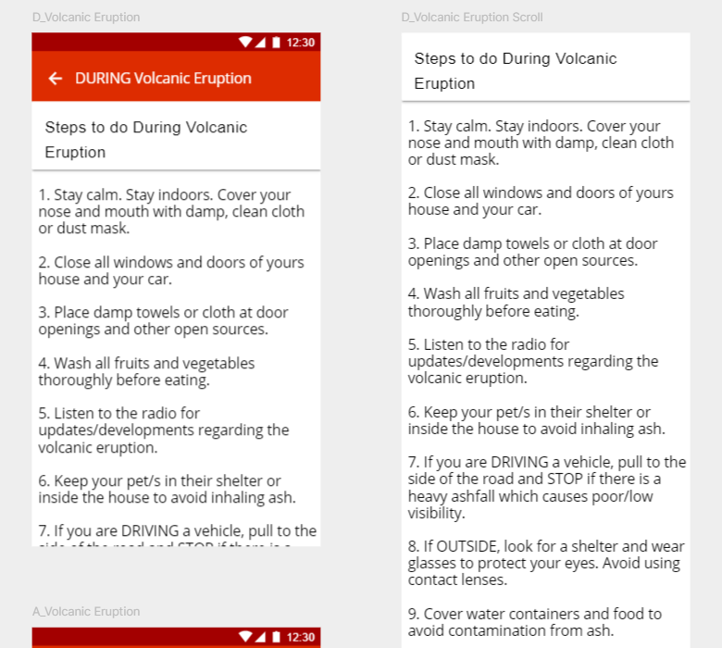

Slide 13
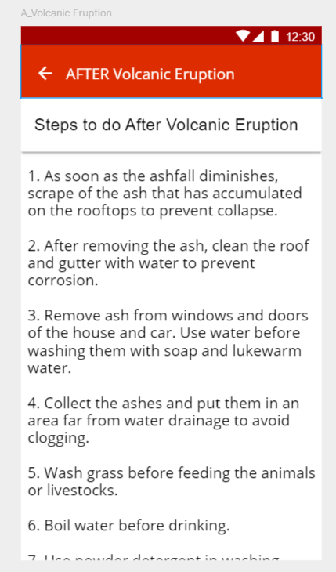
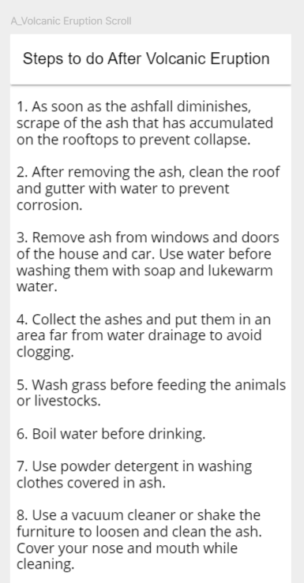

Slide 14
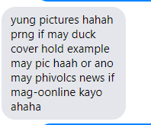
Sharlene Danica Sy
Comments by Respondents
Karla Marie Suelto * do not use all caps yung app title or yung mga nakalagay dun sa appbar kasi mukhang hindi formal * 'Settings' dapat not Setting
*uh, lagyan nyo ng parang description (or parang pop-up to verify) yung dun sa notification like, anong meaning ng 'secured' or yung 'minimal' kasi bka hindi kaagad magets ng user
* liitan yung font size ng mga cities ng weather report na part kasi mukhang hnd sya proportional * kung kaya, lagay kayo pics para dun sa tips para hindi masyadong stoic ung itsura * kung kaya lagay kayo ng additional features para matrack mo yung relatives or other people para malaman mo kung nasan sila in case na magkahiwahiwalay kayo
"Good UI design but it doesn't stand out from the rest.“ - Robbie "I also liked the design although it missed some of the functionality. However, since it's still a mockup, it's fairly simple to read and easy to use." - Viany Manuel Jr. "Ako nagandahan ako kasi simple lang and gusto ko yung color haha, tapos madali i-navigate kasi common yung layout ng UI na ganun" - Kyle Nicole Sacriz

Slide 15
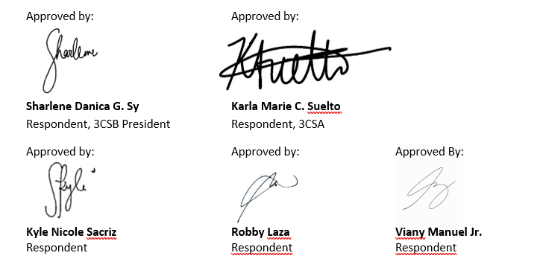
Approval by Respondents

Slide 16
Link to our Framer Mockup Prototype - https://framer.com/projects/Mock-Up-Prototype--t5uRe7anaZncKumDrelW-93Ubn?node=qnLNS7_Z_-page

