Slide 1
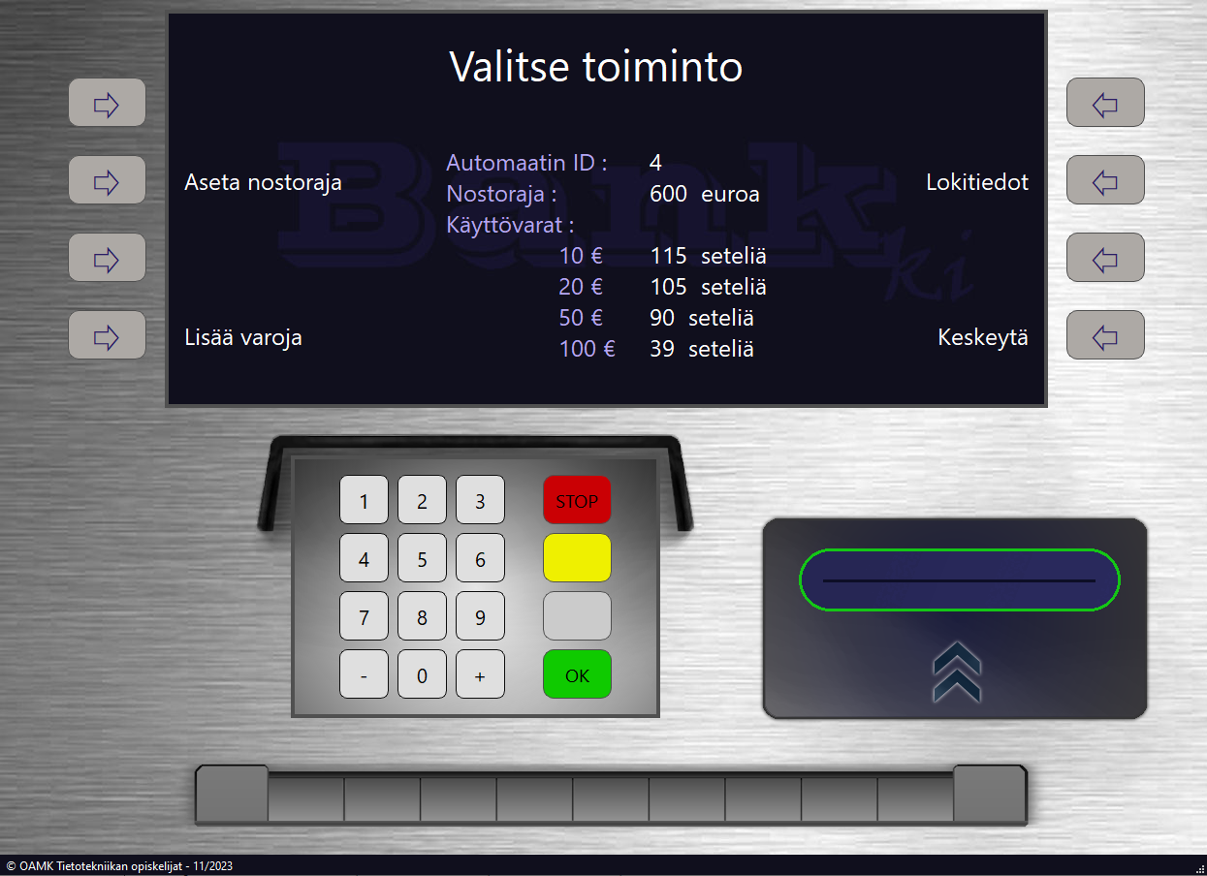
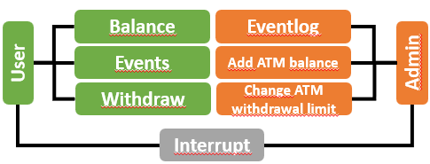
Bankautomat (ATM) – Perspectives for Users and Administrators​
Juho Hietala, Juha-Matti Huhta, Minna Leppänen, Rebecca Soisenniemi TVT23KMO​
Information Technology, Software Development
Introduction​
The purpose of this project was to create a bank ATM where Qt application communicated with a REST API using the HTTP protocol. The REST API interacted with a database.​
​
Objectives​
The aim was to implement a debit card for ATM access, requiring users to use the card's ID and PIN code. Users could check balances, withdraw funds and review transaction history (FIGURE 1.). The REST API covered all ATM functions. Database requirements included multiple accounts per user, one owner per account, flexibility for cardless or multiple cards (each accessing one account). The database included customer details: first name, last name, account balance, card ID, and a 4-digit PIN, which was encrypted with the bcrypt algorithm.​
Aiming for an excellent grade, the goal included a dual card system, user-selected accounts, and Admin-level access to transaction logs and settings (FIGURE 1.). The credit card extension allowed a credit limit and access to multiple accounts.​
​
​
​
FIGURE 1. User and Admin interface​
Methods​
The project utilized programming languages C++, JavaScript, and SQL for coding tasks. Programming was implemented using QT and Visual Studio Code development environments, along with the MySQL Workbench tool. GitHub's Git version control system was employed for code management.​
Each team member utilized their own computer equipped with necessary additional devices as work tools. Internal communication within the team during the project was facilitated through Discord and Teams platforms. All documentation was stored in the team created on the Teams platform, accessible and editable by all team members.​
In the project planning and documentation preparation, Microsoft Office's Word and PowerPoint software were utilized. Additionally, browser-based tools such as Miro were used for initial project planning, and Lucidchart for creating diagrams.​
​
Results​
The software operated in accordance with the plans and our objectives. The application presents the user with a view of the map, from which they select the desired ATM. After the selection, the user logs into the system using the card ID and PIN code.
Users can check their balance, browse their account transactions, and withdraw money. The administrator has the capability to review the operational log of the ATM, add cash, and adjust the withdrawal limit of the ATM.​
​
​
​
​
​
​
​
FIGURE 2. Admin menu​
​
Conclusions​
During the writing of the poster, it was observed that the project progressed exceptionally well, and teamwork proceeded excellently. The set objectives were achieved and even surpassed as the project concluded approximately a week ahead of schedule. Upon completion of the project, it was noted that the code could have been constructed in QT using a different approach, potentially enhancing its readability even further.​
​
References​
1. Tutorials about Computer Programming by Pekka Alaluukas:​
https://peatutor.com/​
​
Software Application Project,
ECTS Credits: 15
Date of Publication: 2023, Autumn
Instructors: Pekka Alaluukas, Teemu Leppänen

