Slide 1
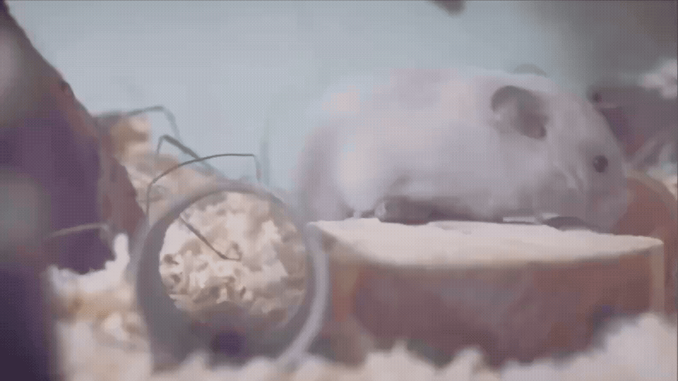
UMB PEAII Applied AI Hackathon
Team: The United Nations of UMB
Live Tracker
Group members:
Syed Mahbub (Team lead), Ava Sajjadi, Igor Ten, Sadaf Hamidy, Karla Schallies, Niyazi Daveli, Nandini Jain, Nasser Al Thani, and Asya Sezgin

Slide 2
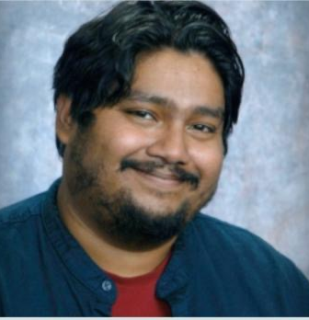
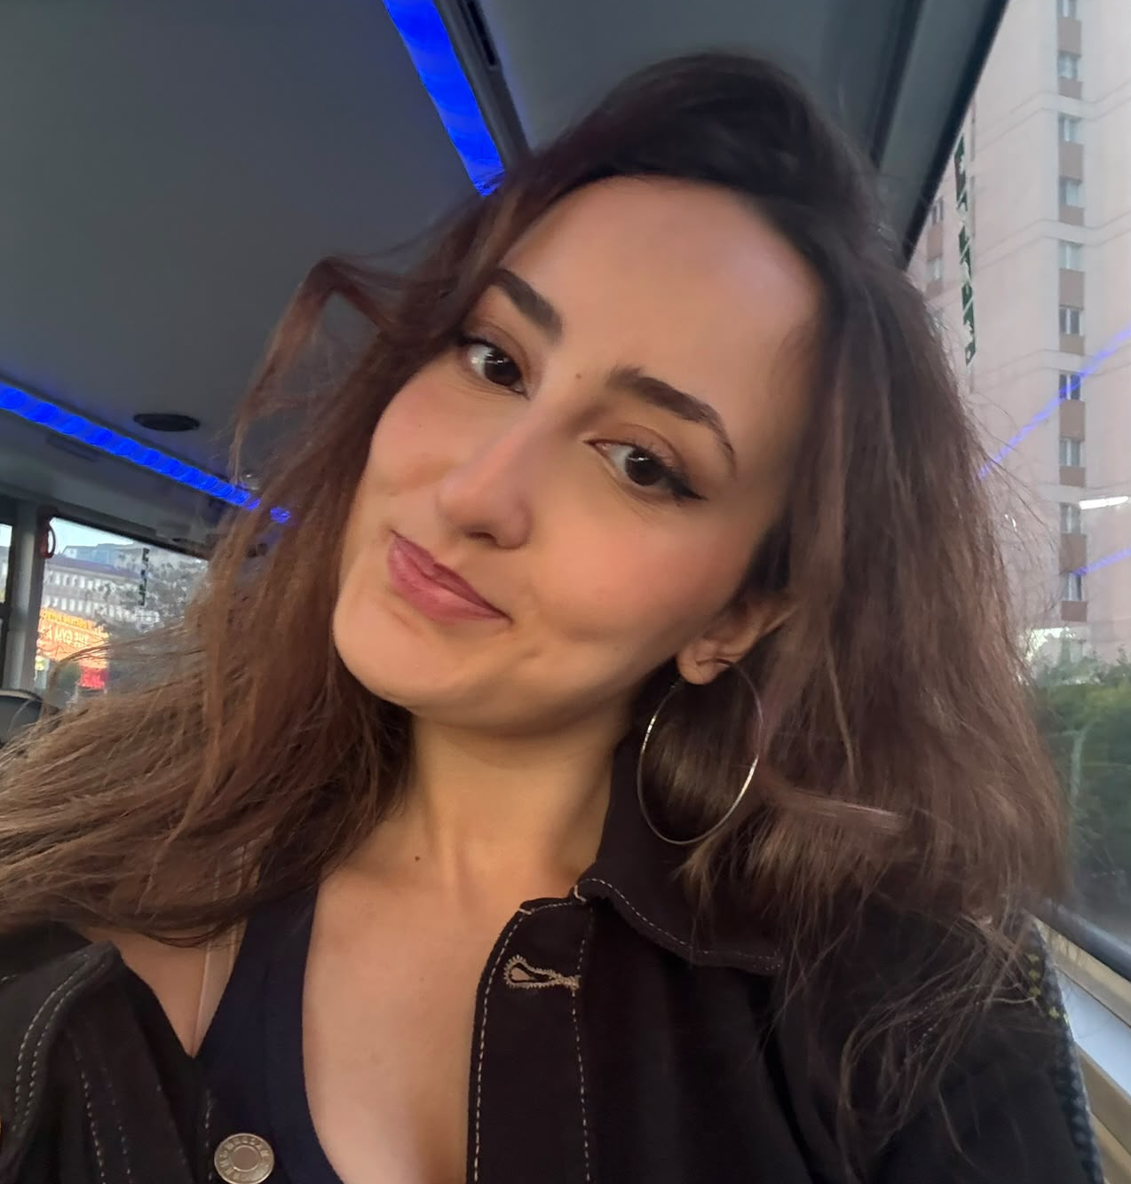
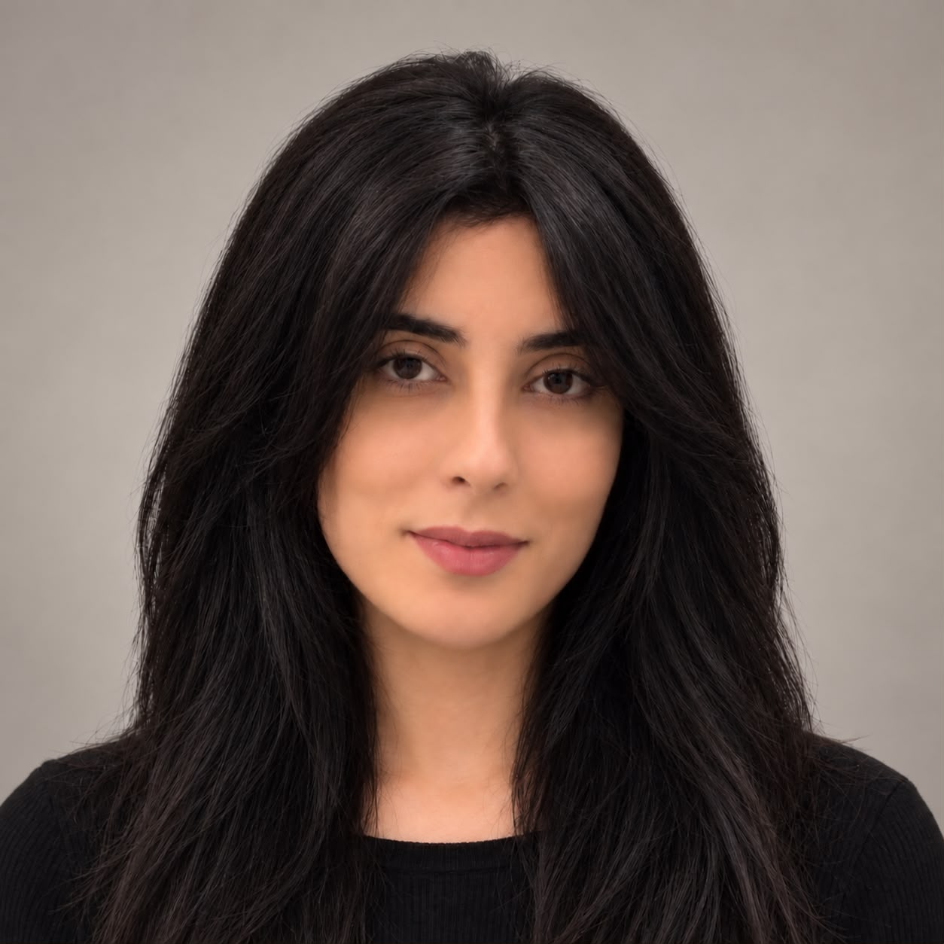

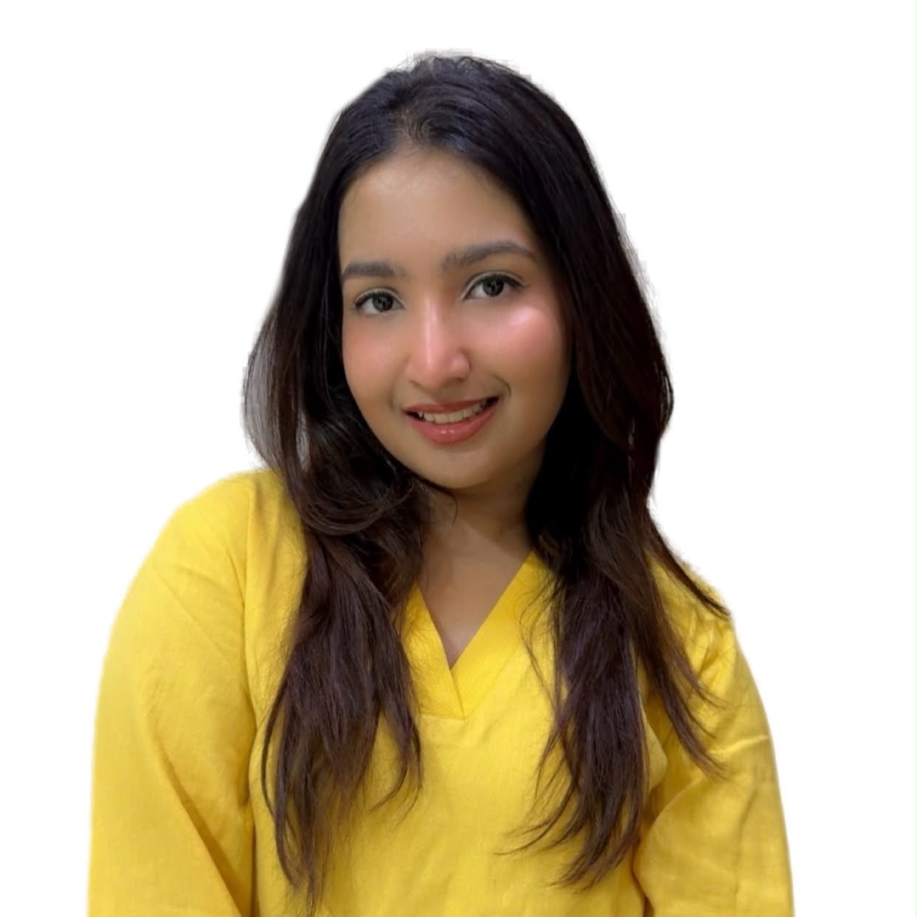


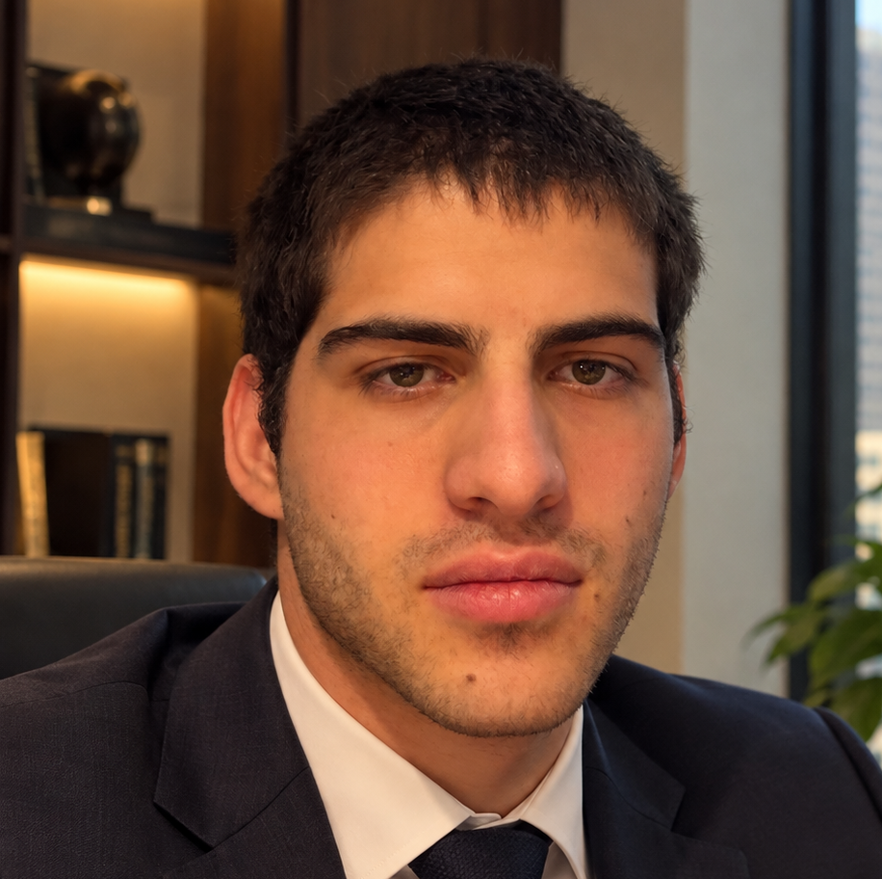
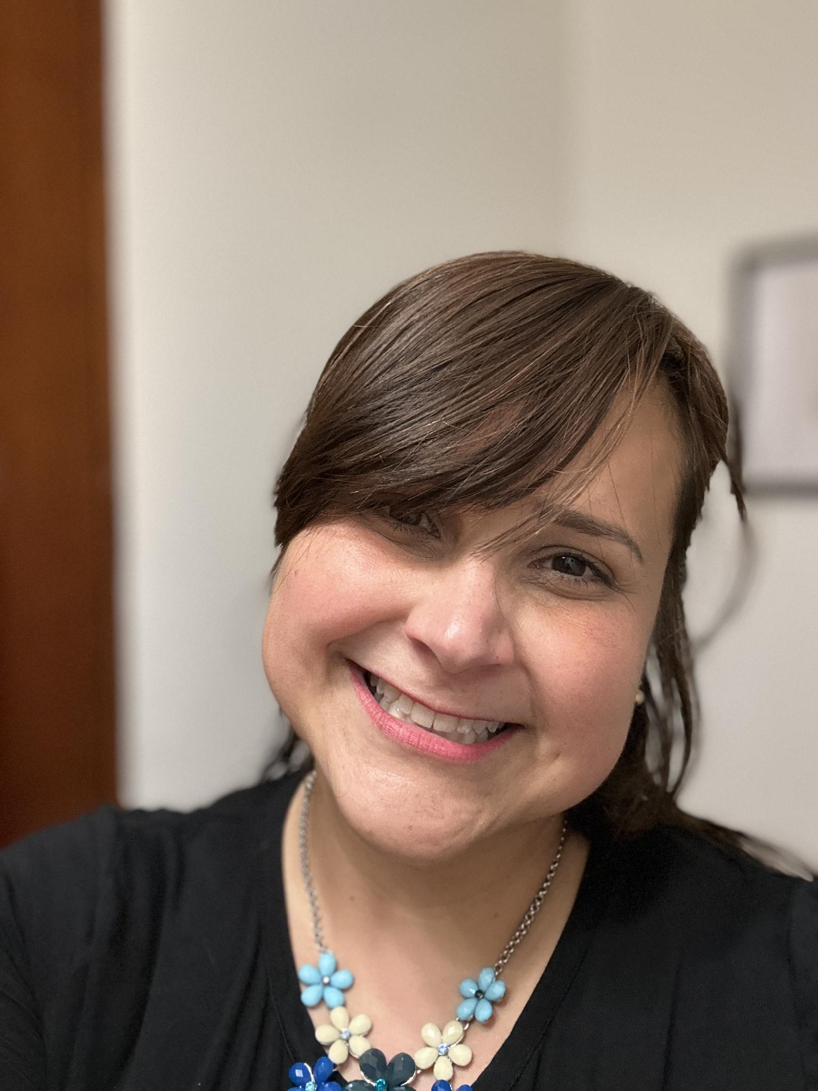
Our team
Asya
Electrical
Engineering
Physics
Turkey
Igor
Computer Science
Russia
Syed
Team Lead
Computer Science
Bangladesh
Ava
Computer Science
Iran
Nandini
IT
India
Nasser
Business&Finance
Qatar
Niyazi
Business&Finance
Turkey
Sadaf
Biology
Afghanistan
Karla
Biology
Venezuela

Slide 3
Hours of Video Review
Sadaf
Biology
Afghanistan
Karla
Biology
Venezuela
Short behavioral events
Late-night lab visits
Manual observation
Research workload
Human error

Slide 4
Can AI Solve These Problems?
Sadaf
Karla
CS People Can help us:
Igor
Computer Science
Russia
Syed
Team Lead
Computer Science
Bangladesh
Ava
Computer Science
Iran

Slide 5
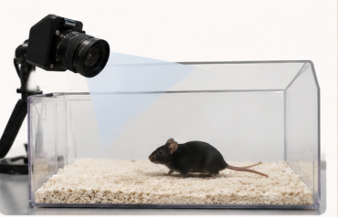
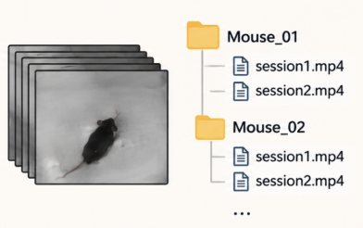
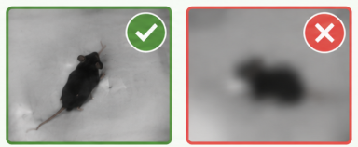
Every AI System Starts With Data
Igor
Computer Science
1.collect
2.prepare
3.Validate

Slide 6
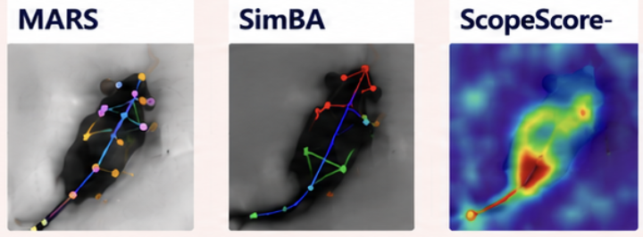
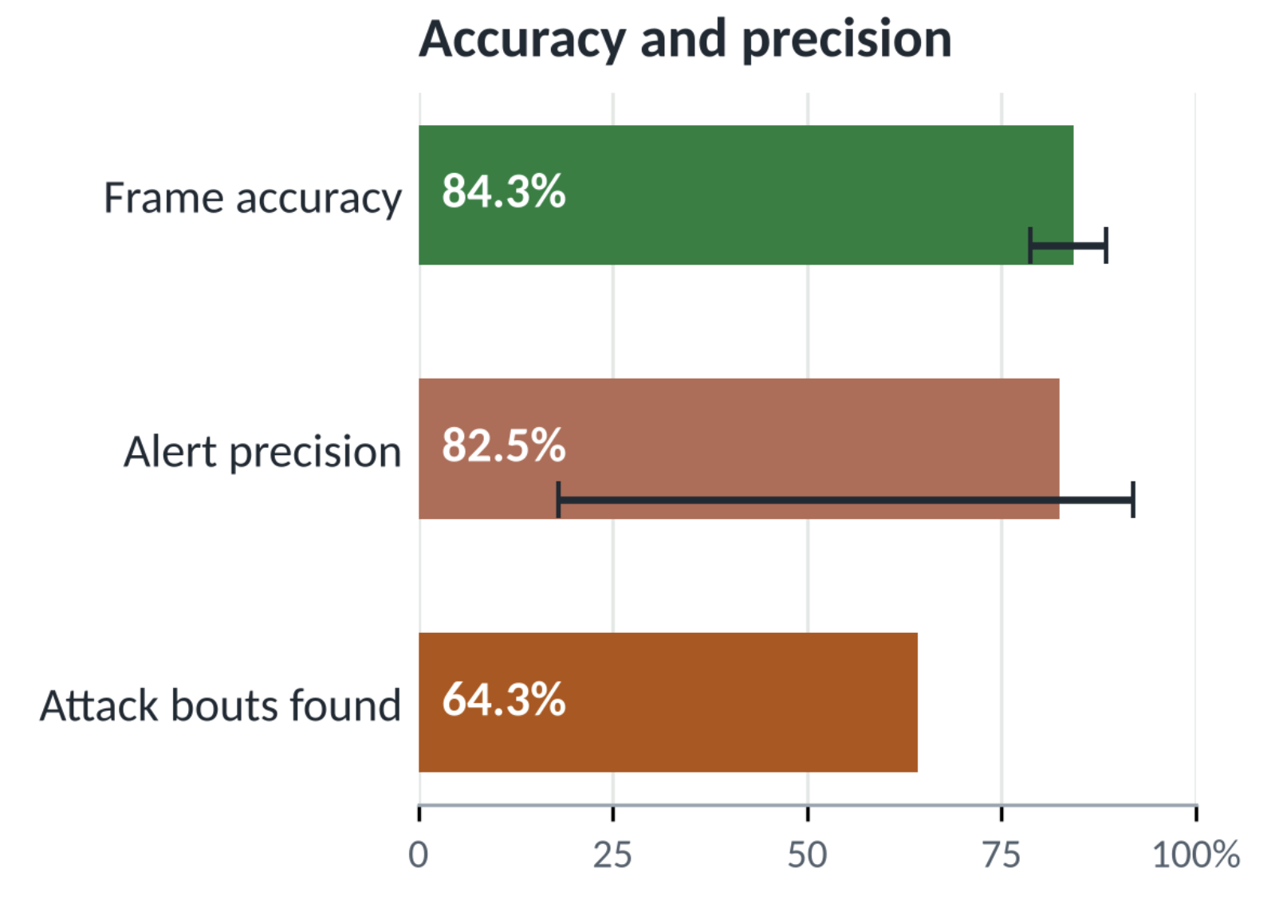
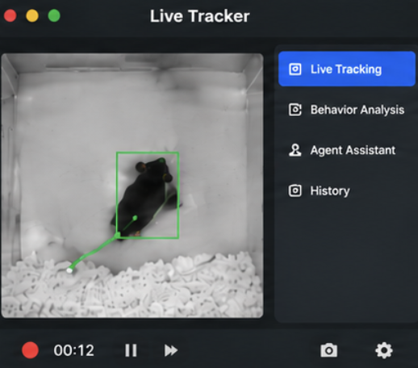
AI Research & Model Development
Ava
Computer Science
1. RESEARCH Independent AI Research
2.DEVELOP Specialized AI Models
YOLO26: Mouse detection and pose tracking Model B: Behavior classification ScopeScore-inspired: Tracking quality and smoothing
3.Validate Model Performance
Compared accuracy and speed Model B performed best across 14 validation sessions Tested real-time processing

Slide 7
Watch. Detect. Investigate.
Syed
Computer Science
1.DETECT
Identify Important Events Receive behavior alerts from AI models
2.INVESTIGATE
Agentic AI Use tools to examine events Compare evidence across time
3.EXPLAIN
Research Assistant Summarize findings Show supporting evidence

Slide 8
Meet the Business Team
Asya
EE
Nandini
IT
Niyazi
Business&Finance
Nasser
Business&Finance
RESEARCH COLLABORATIONS
Real Research Opportunities Interest from graduate students in 2 biology labs Potential app testing and data sharing Opportunity for future scientific publications

Slide 9
Who is your target market?
Behavioral Neuroscience researchers​
Animal behavior laboratories​
Preclinical drug-testing teams​
Undergraduate and graduate students that analyze the videos for their research

Slide 10
This Is Just the Beginning
Smarter features: add the nose-to-nose and facing-angle features we already built
Video evidence: attach a short clip to every alert
Test in a lab: the model will be evaluated by scientist currently working with mice to determine accuracy and precision
More behaviors and species: extend beyond mice to other model organisms starting with fruit flies (Drosophila melanogaster)
  Already trained, missing only implementation

Slide 11
Questions or Suggestions are welcome
As part of their research a scientist records mice behavior
Without our model
With our model
Records with camera
Records with camera and video can be analyzed live or after recording using our model
Reviews hours of recording
The scientist reviews the AI analysis and starts making inferences for their research
Analyzes data and makes inferences for their research

Slide 12
Appendix and References
References
• Sun, J. J., et al. (2021). The Multi-Agent Behavior Dataset: Mouse Dyadic Social
Interactions. NeurIPS Datasets and Benchmarks Track. arXiv:2104.02710. Data:
data.caltech.edu/records/s0vdx-0k302 (CC BY 4.0)
• Segalin, C., et al. (2021). The Mouse Action Recognition System (MARS) software pipeline
for automated analysis of social behaviors in mice. eLife, 10, e63720
• Nilsson, S. R. O., et al. Simple Behavioral Analysis (SimBA): an open source toolkit for
computer classification of complex social behaviors in experimental animals. bioRxiv
2020.04.19.049452
• Noldus. Everything you need to know about EthoVision XT. noldus.com
Stack
Python, NumPy, pandas, SciPy, scikit-learn, Streamlit, PyArrow, pytest, GitHub Actions (tests
on Ubuntu + Windows), Anthropic Claude API, OpenRouter, ntfy
How to run it
Python 3.10 or newer, from the repo root:
python3 -m venv .venv
.venv/bin/python -m pip install -e . -r
requirements.txt
.venv/bin/python -m pytest -q
.venv/bin/python -m streamlit run app.py
opens at localhost:8501. offline features need no API
key. fresh classification needs the CalMS21 data + the
local Model B binaries; saved runs and investigations
can be browsed without them. Windows commands,
model rebuild steps and the demo checklist are in the
README and docs/

