Slide 1
MEDITOOL
Best health care consultant application

Slide 2
TEAM NAME: bro_coders
Amaan Afif (RA1911003010787)
Leader, Machine-Learning
Prashant Shukla(RA1911003010788)
Front-end, Backend
Avad Agarwal(RA1911003010247)
Back-end, Front-end, Database-Development, Machine-Learning
Ashwini Sharma(RA1911003010090)
Front-end, Machine-Learning
THEME SELECTED : HEALTHCARE

Slide 3
Problem Statement
Now-a-days people face many health issues .During this period of pandemic it is hard and dangerous for people to go outside especially in hospitals. So to insure people's safety we believe online appointments with doctor and treatment should be priority in today's time. Basically we will create a platform where patient will report his/her health problems.

Slide 4
Solution
Basically we will create a platform where patient will report his/her health problems. After reporting the health issues the patient will be asked some questions and accordingly the application will suggest medicines for the disease. If the application is unable to detect the disease ,then the application will suggest the doctors in near area and all the medical stores in near area will also be shown.

Slide 5
Solution(contd..)
We can extract the advice, medicines and best doctor regarding patient symptoms using machine learning from the previous data which we'll be having in our database and the database will be updated regularly to give most accurate results among the present platform available
App interface will be designed using python and user data will be stored in a local server using Django.
ML algorithms will be used to predict the disease of the patient when they write their symptoms. According to the predicted disease, the patient will be prescribed medicine or will be referred to the nearest doctor in his location.

Slide 6
Methodology
This project explores the use of machine learning algorithms to predict diseases from symptoms and then give medicines according to the disease and if not then advice a suitable doctor for the treatment.
Algorithms Explored
The following algorithms have been explored in code:
clf_gini = DecisionTreeClassifier(criterion='gini', max_depth=54, random_state=0)

Slide 7





Modules Used
Numpy
Streamlit
Pandas
Sklearn
Seaborn

Slide 8
Dataset
Dataset obtained from:
https://impact.dbmi.columbia.edu/~friedma/Projects/DiseaseSymptomKB/index.html

Slide 9
Working Prototype
Video Link:
https://drive.google.com/file/d/1_u3qDWnl9VNq5_e815TBD4iWXABkGrhV/view?usp=sharing

Slide 10
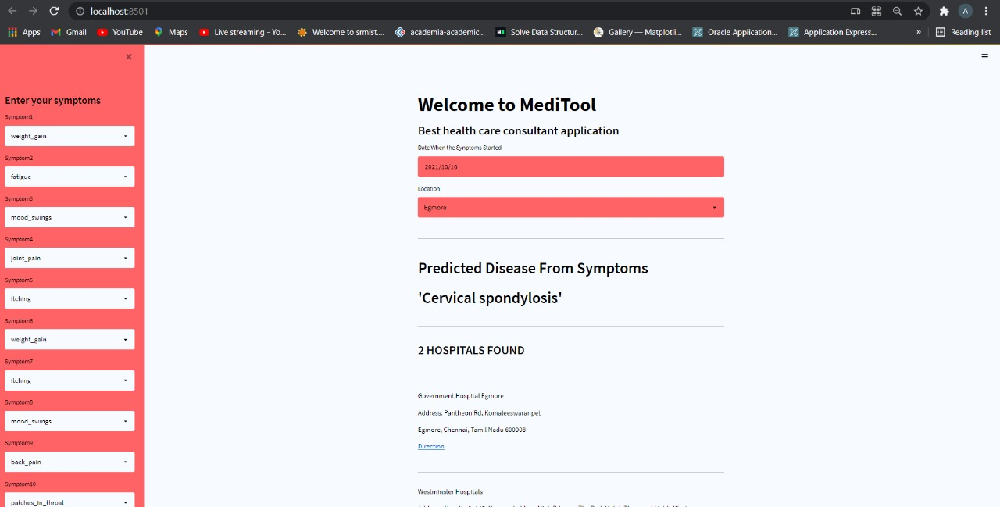
Attachments

