Slide 1
Fast Forwarding CCTV insights
with LLM & CV
Avadh Ladani
24MCD009 - M.Tech CSE(Data Science)
Guided By: Dr. Gaurang Raval

Slide 2
Problem Definition
Surveillance cameras produce massive video streams
Manual review is slow, labour-intensive, and prone to oversight.
Existing systems focus on low-level detection/tracking and rely on human interpretation, lacking deeper situational understanding and actionable insights.

Slide 3
Objectives
Develop intelligent human language query mechanism for CCTV post analysis using LLM and modern Computer Vision models.
Implement seamless integration between CV models and Large Language Models to enable reasoning, summarization, and natural language querying.
Improve the efficiency and accuracy of surveillance analysis for both real-time and historical data.
Enable comprehensive, time-stamped analysis of historical surveillance events through LLM-based querying.

Slide 4
Progress (Review 1 and 2)
Concept finalized
Literature survey completed
System architecture designed
Feasibility validated for CV event detection
Implemented 4 CV event detectors:
Person entry/exit
Vehicle entry/exit
Crowd formation/density
Abandoned object detection
Built real-time JSON log generator

Slide 5
Progress (Review 3)
Buit an entire code pipeline which simulates a tech event’s CCTV log data
Implemented the LLM integration for RAG with 2 different approaches 1. Text-to-SQL architecture 2. RAG (dense + sparse) over event narratives and episode summaries
Implemented the summarization module.

Slide 6
Literature Review
Sr. | Title | Dataset | Model / Core Tech | Take Away | Ref.
1 | YOLOv7 Real-time Object Detection | MS COCO | YOLOv7 | High-accuracy, real-time detector suitable for CCTV feeds; validates real-time event detection feasibility | [2]
2 | YOLOv8 Feature Analysis | MS COCO | YOLOv8 | Strong detection performance; anchor-free design reduces computation for CCTV tasks | [3]
3 | FLAME: Fire Detection via DNN + Motion | Fire datasets, LFDN | YOLOv8 + Background Modeling | Hybrid models reduce false positives; demonstrates domain-specific event detection reliability | [4]
4 | Abnormal Event Detection in CCTV | UCSD, Avenue | CNN–LSTM Autoencoder | Detects anomalies via reconstruction error; supports temporal event modeling | [5]
5 | Surveillance Event Detection Review | TRECVID SED, ActEV | 3D CNNs + Multi-stage Detectors | Reinforces complexity of surveillance events; validates modular CV–LLM pipeline | [10]

Slide 7
Literature Review
Sr. | Title | Dataset | Model / Core Tech | Take Away | Ref.
6 | Large Language Models for Video Surveillance Applications | MSR-VTT, CCTV | Gemini Pro Vision (VLM) | Shows VLMs can generate reliable CCTV summaries; heavy for edge deployment but useful for high-level reasoning | [1]
7 | ChatLR: Structured DB Retrieval via LLMs | FinChina SQL DB | ChatGLM (LLM) | LLMs can map natural-language queries to structured operations, enabling forensic querying on event logs | [6]
8 | HyST Hybrid Retrieval | Amazon STaRK Dataset | LLM + Hybrid Search | Shows LLMs can handle semi-structured tables similar to CCTV logs | [7]
9 | StructuredRAG JSON Formatting | JSON Benchmarks | GPT, LLaMA | Evaluates LLM structured-output reliability; informs structured insight generation design | [8]
10 | LLM-based Log Analysis Survey | Various Log Corpora | LLMs (RAG, Fine-Tuning) | LLMs reduce manual log-review effort and surface hidden patterns | [9]

Slide 8
Literature Review
1. CV for CCTV Event Detection
Selected papers include state-of-the-art detectors (YOLOv7/YOLOv8) and domain-specific CCTV event studies (abandoned object, fire, anomaly detection). These works confirm that reliable, real-time CV pipelines can generate accurate structured logs required for downstream analysis.
2. LLM Reasoning on Structured Data (SQL/JSON)
Surveyed research shows that modern LLMs can convert natural language into database queries, interpret semi-structured tables/logs, and generate meaningful summaries and insights. These capabilities form the core of our system’s forensic intelligence.

Slide 9
Literature Review
Summary
Combined, these papers validate our architecture:
CV extracts events,
LLM performs reasoning and insight generation, which is the main focus of the project.

Slide 10
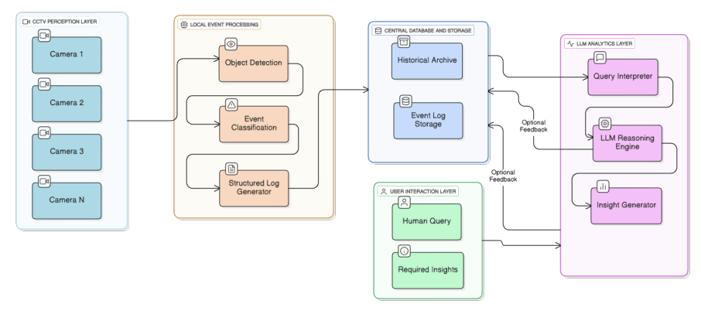
System Flow Diagram
System Flow Diagram

Slide 11
System Flow Overview
1. CCTV Perception Layer
Multiple CCTV cameras capture continuous video streams.
Lightweight CV models (YOLO + tracking) run locally on each stream to detect persons, vehicles, objects, and basic events.
2. Local Event Processing
Detected objects are passed to an event classification module (entry/exit, crowd changes, abandoned objects, etc.).
A structured JSON log generator converts detections into clean event records (timestamp, camera ID, event type, confidence, object ID, location).

Slide 12
System Flow Overview
3. Central Database & Storage
All logs are aggregated and indexed for fast retrieval.
Historical archive maintains long-term event data for forensic analysis.
Database acts as the knowledge base for LLM querying.
4. LLM Analytics Layer
The Query Interpreter converts user natural-language queries into SQL/filters.
The LLM Reasoning Engine performs temporal, spatial, and semantic reasoning.
Insight Generator produces summaries, trends, correlations, and answers.

Slide 13
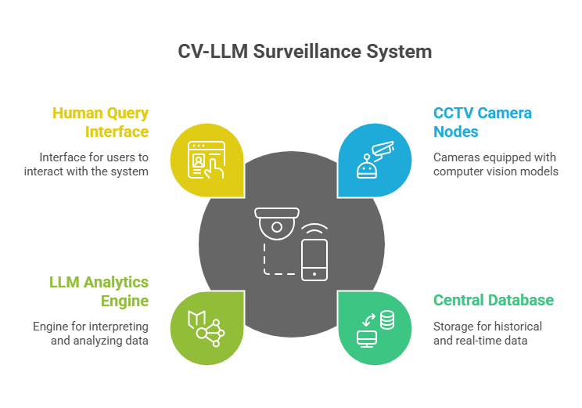
System Flow Overview
5. User Interaction Layer
Users ask questions in plain language.
System returns concise insights, reports, or event analytics.
Overall Flow: CV → Structured Logs → Central Database → LLM Reasoning → Insights
Project Github Link: https://github.com/Avadh-Ladani-0/vForensIQ/tree/main-debug

Slide 14
CV Event Detection and Data Pipepline
Per-camera lightweight CV inference: object detection (persons, vehicles, bags), event classification (entry/exit, loitering, abandoned object), tracking (DeepSORT/ByteTrack), metadata extraction (timestamp, camera ID, confidence)
Only structured JSON logs sent to central storage (not raw video) to optimize performance and privacy
Central database: aggregates and indexes logs by event type, time, camera, location; maintains historical archives; schema fields include timestamp, camera_id, event_type, object_id, confidence, location
Validated detectors like YOLOv7/YOLOv8 are suitable for CCTV feeds and real-time event detection

Slide 15
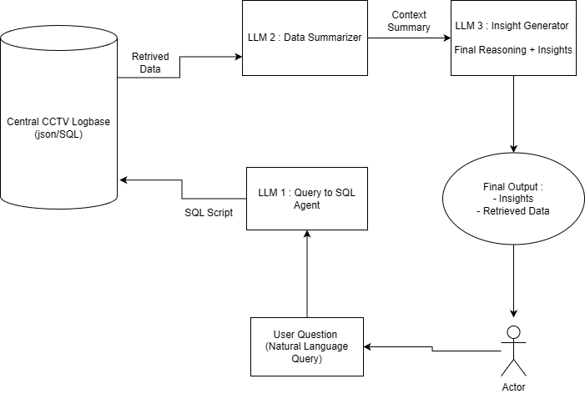
LLM Reasoning Approach – 1 (NL - SQL)

Slide 16
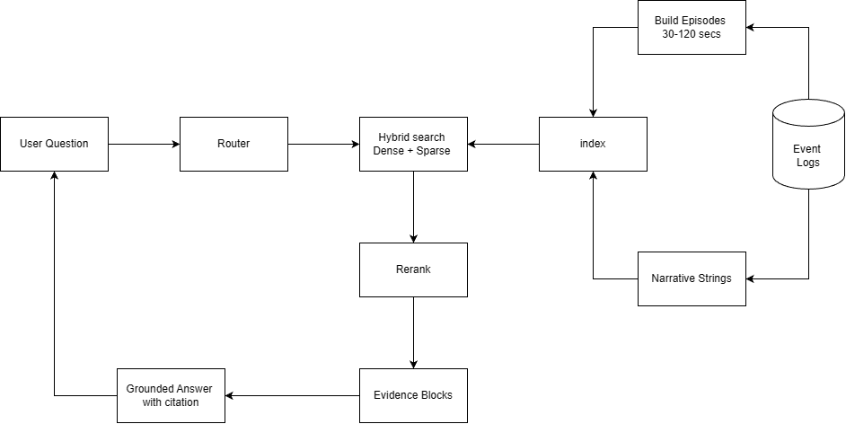
LLM Reasoning Approach – 2 (RAG)

Slide 17
Data Description
3-day synthetic tech-event CCTV dataset (Feb 13-15, 2025, 10:00-17:00 IST).
30-camera setup: vehicle gates, human entrances, and stall coverage.
Captured events: person_entry, person_exit, vehicle_entry, vehicle_exit, unattended_object, person_count.
Per-second crowd counts for stall cameras, event-driven logs for entry/exit/incidents.
Realistic behavior modeling: crowd waves, dwell times, gate preferences, highlight peaks.

Slide 18
Data Sample
cam_id :
captured_event : person_entry, person_exit, vehicle_entry, vehicle_exit, unattended_object, person_count
Timestamp : 1739421000
location_tag : ISRO stall
object_id : pc25_1739421000
person_count : 11
embedding_path : path of the detected object’s embedding

Slide 19
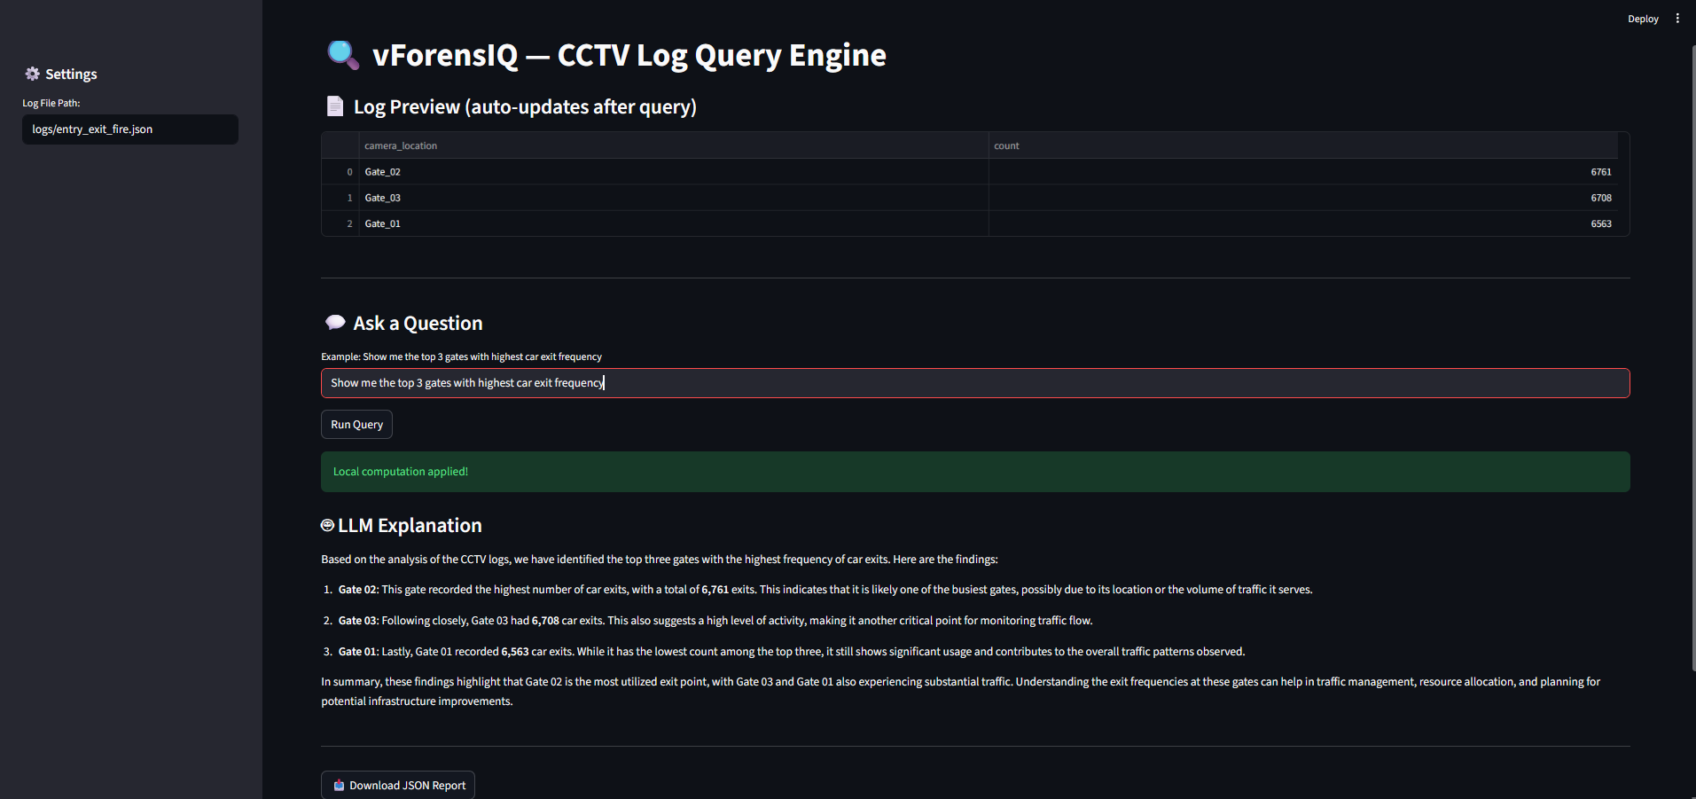
Demo

Slide 20
Query Examples
Show me the top 3 gates with highest car exit frequency Identifies high-traffic exit points to optimize traffic flow and security deployment.
Which locations have the highest person entry count Highlights high-footfall areas for crowd management and resource allocation.
Give me an hour-wise distribution of person entries for Platform 2 Reveals peak and off-peak hours to support efficient scheduling and congestion control.
Show me locations where crowd size exceeded 15 people. Detects potential overcrowding zones for safety monitoring and risk prevention.

Slide 21
Future Scopes
Fine-tuned LLMs for Surveillance Reasoning
Advanced Query Translation and SQL Generation
Multi-LLM Collaboration or Agentic Pipelines
Complex CV event detection with high accuracy VLMs
Enhanced Log Semantics and Event Ontologies
Human-in-the-Loop Feedback for Continual Learning
Contextual Multi-Modal Reasoning

Slide 22
Progress
Next Review Plan
Create Novel Structured Log Dataset from University CCTV footages LLM evaluation
Make a proper evaluation and comparison strategy for Research
Thesis completion

Slide 23
References
[1] U. De Silva, L. Fernando, B. Lau Pik Lik, Z. Koh, S. C. Joyce, B. Yuen, andC. Yuen, “Large language models for video surveillance applications,” arXiv preprintarXiv:2501.02850, 2025.
[2] C.-Y. Wang, A. Bochkovskiy, and H.-Y. M. Liao, “Yolov7: Trainable bag-of-freebies sets new state-of-the-art for real-time object detectors,” arXiv preprintarXiv:2207.02696, 2022.
[3] M. Yaseen, “What is yolov8: An in-depth exploration of the internal features of thenext-generation object detector,” arXiv preprint arXiv:2408.15857, 2024.
[4] D. Gragnaniello, A. Greco, C. Sansone, and B. Vento, “FLAME: fire detection invideos combining a deep neural network with a model-based motion analysis,” NeuralComputing and Applications, vol. 37, pp. 6181–6197, 2025.
[5] A. Joemon, A. C. Joy, A. V. Prakash, B. Thomas, and D. R, “Abnormal event detec-tion using cctv camera,” International Journal of Innovative Science and ResearchTechnology (IJISRT), vol. 6, no. 6, pp. 608–612, 2021.
[6] M. Wang, Y. Zhang, Q. Zhao, J. Yang, and H. Zhang, “Redefining informa-tion retrieval of structured database via large language models,” arXiv preprintarXiv:2405.05508, 2024.
[7] J. Myung, J. Park, S. Park, K. Lee, H. Kim, and S. Lee, “Hyst: Llm-poweredhybrid retrieval over semi-structured tabular data,” in Proceedings of the 2nd EARLWorkshop on Evaluating and Applying Recommender Systems with LLMs, 2025.16

Slide 24
[8] C. Shorten, C. Pierse, T. B. Smith, E. Cardenas, A. Sharma, J. Trengrove, and B. vanLuijt, “Structuredrag: Json response formatting with large language models,” arXivpreprint arXiv:2408.11061, 2024.
[9] S. Akhtar, S. Khan, and S. Parkinson, “Llm-based event log analysis techniques: Asurvey,” arXiv preprint arXiv:2502.00677, 2025.
[10] A. Karbalaie, F. Abtahi, and M. Sj¨ostrom, “Event detection in surveillance videos:a review,” Multimedia Tools and Applications, vol. 81, pp. 35463–35501, 2022.

Slide 25
Questions / Discussions

Slide 26
Thanks

