Slide 1
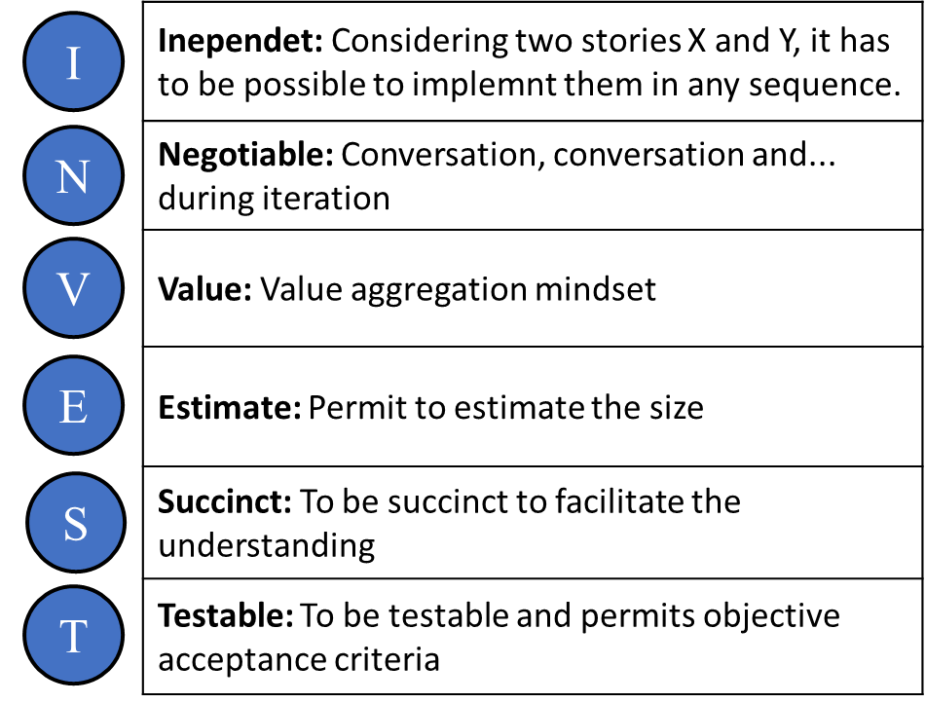
 | Inependet: Considering two stories X and Y, it has to be possible to implemnt them in any sequence.
 | Negotiable: Conversation, conversation and... during iteration
 | Value: Value aggregation mindset
 | Estimate: Permit to estimate the size
 | Succinct: To be succinct to facilitate the understanding
 | Testable: To be testable and permits objective acceptance criteria
I
N
V
E
S
T

Slide 2
 | Inependet: Considering two stories X and Y, it has to be possible to implemnt them in any sequence.
 | Negotiable: Conversation, conversation and... during iteration
 | Value: Value aggregation mindset
 | Estimate: Permit to estimate the size
 | Succinct: To be succinct to facilitate the understanding
 | Testable: To be testable and permits objective acceptance criteria
I
N
V
E
S
T

Slide 3

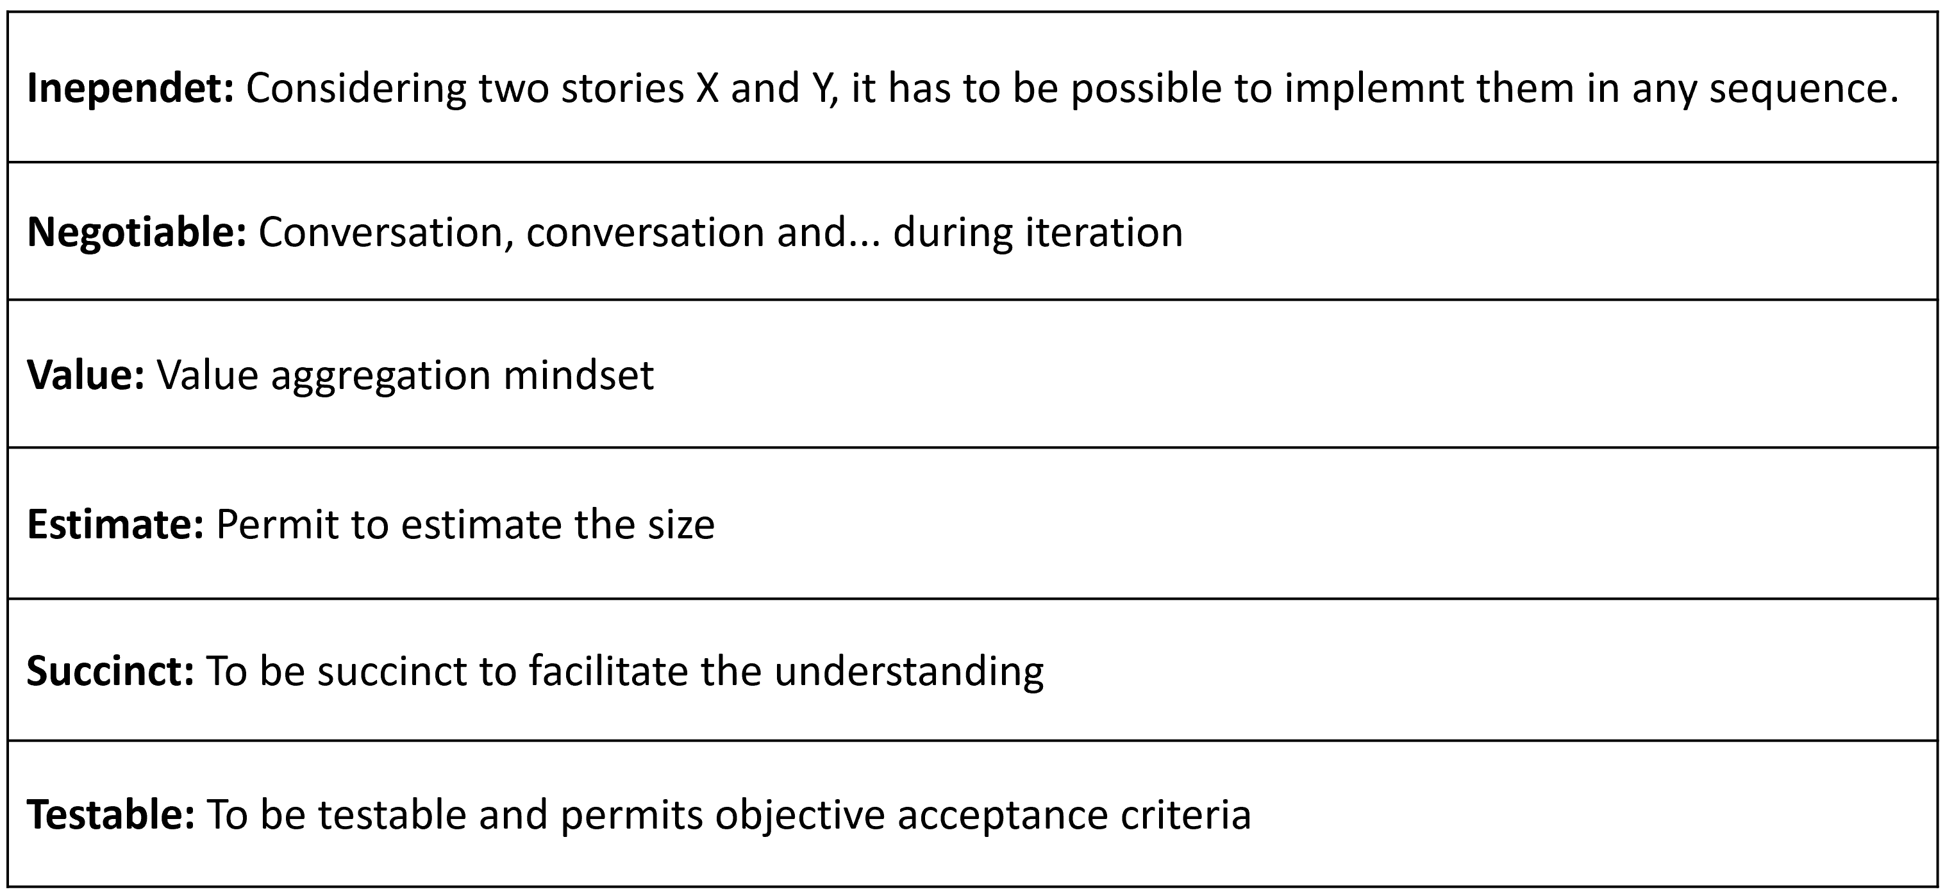

Slide 4

Funcional Requirement
Story
Setup
Project Mgmt
Acceptance
Tasks (Comments)
PROJECT
MILESTONE

Slide 5
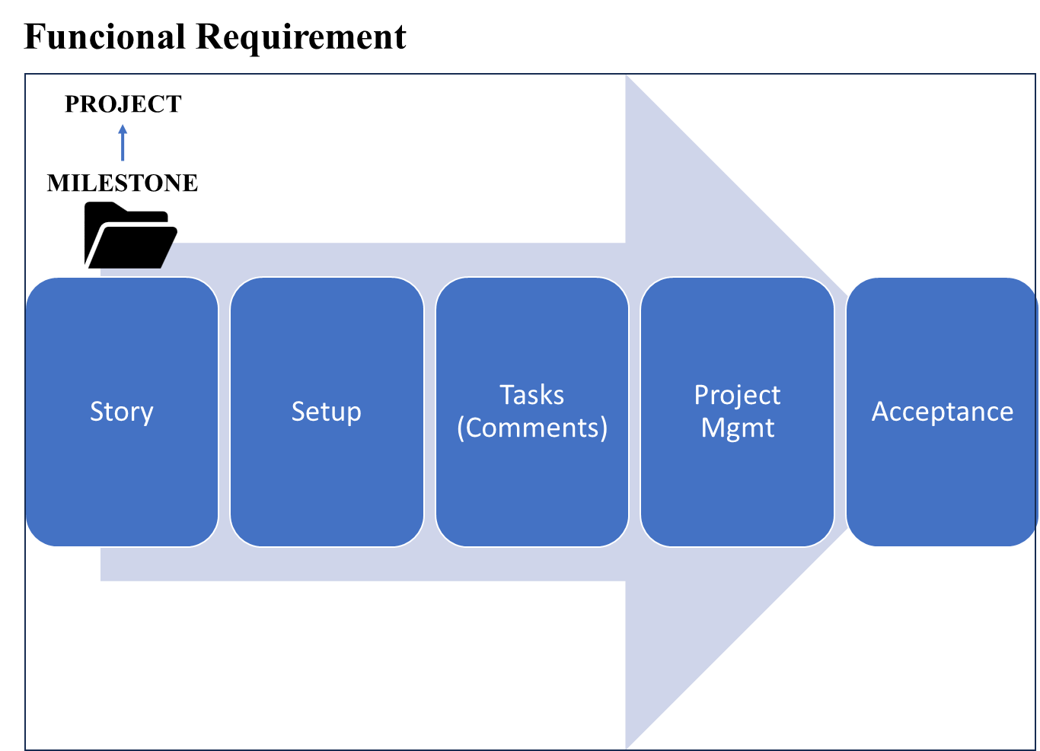

Slide 6









