Slide 1

CSCI E-96 Data Mining, Discovery and Exploration Big Data Analytic Algorithms
Steve Elston

Slide 2
Large Scale Analytic Computing
Scalable computing for analytics
Dataset size and complexity is growing rapidly with time
Scalable computing required for scalable analytics
What are the limitations for scaling analytics
Computing speed
Main memory size
File system size
Network bandwidth

Slide 3
Large Scale Analytics Computing
Computing speed
Historically, computing speed was a significant limitation
Computing capacity has increased massively
Parallel computing well established by 1980s
Cost of computing has dropped exponentially
1980 – about $100,000 per MFLOP
2020 – about $0.10 per MFLOP
Introduction of cluster and cloud computing in 2000’s
Massive on-demand capacity now available economically
For commonly used analytics algorithms computing speed is rarely a limitation

Slide 4
Large Scale Analytic Computing
Main memory size
Working (main) memory limits are still a limitation on analytics algorithms
Memory costs and speeds have changed dramatically with time
1980 - $1000 per MB, 10 MHz bus speed
2020 - $0.01 per MB, 3 GHz bus speed
But, data set sizes have grown faster!

Slide 5
Large Scale Analytic Computing
File system size
File systems have grown to accommodate massive dataset size
Disk cost has changed dramatically, but seek time has not kept pace
1980 - $100 per MB, average 20 ms seek time
2020 - $0.0001 per MB, average 2 ms seek time
Disks in the file system are the mostly likely to component to fail in a cluster
Disk transfer rate is about 200 MB/sec
Slow compared to bus speed

Slide 6
Large Scale Analytic Computing
Network bandwidth
Clusters of servers connected by networks
Network interconnected by switches
Network bandwidth is limited and has increased slowly
1980 – 10 Mbits/sec
2020 – 1,000 Mbits/sec
Network bandwidth is shared across cluster

Slide 7
Large Scale Analytic Computing
What limits scalability of clusters?
Communications bandwidth between servers in cluster is greatest limitation
Disk access is next greatest limitation
Component | Speed | Comment
CPU | High | Multiple cores per servers
Main memory | Fast, but limited size | Shared with multiple cores
File system | Massive capacity, but slow | High failure rate
Network | Low bandwidth | Shared across cluster

Slide 8
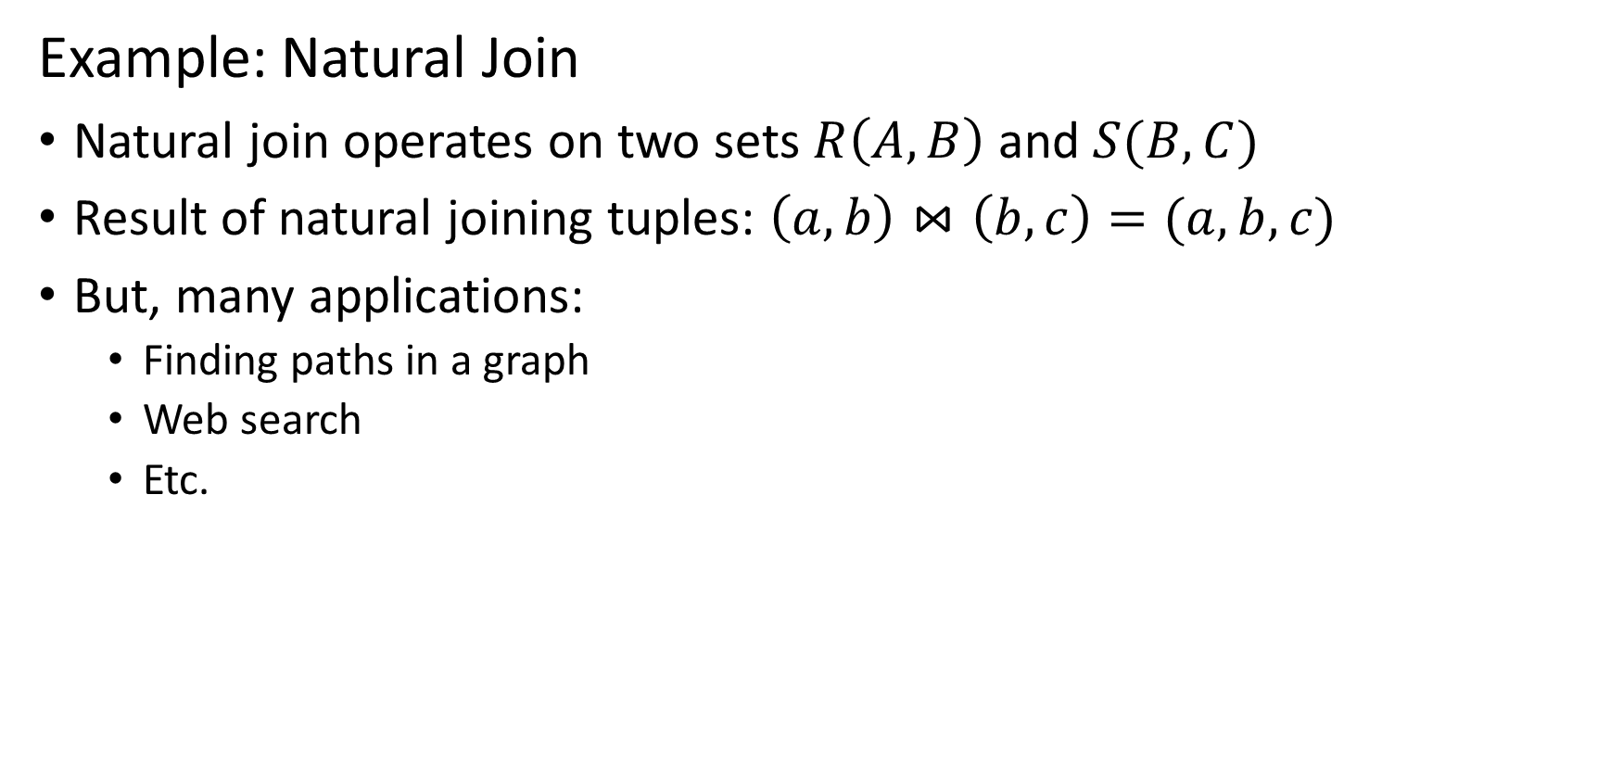
Map Reduce Algorithm
Example: Natural Join
Natural join operates on two sets $R\left(A,B\right)$ and $S(B,C)$
Result of natural joining tuples: $\left(a,b\right)⋈\left(b,c\right)=(a,b,c)$
But, many applications:
Finding paths in a graph
Web search
Etc.

Slide 9
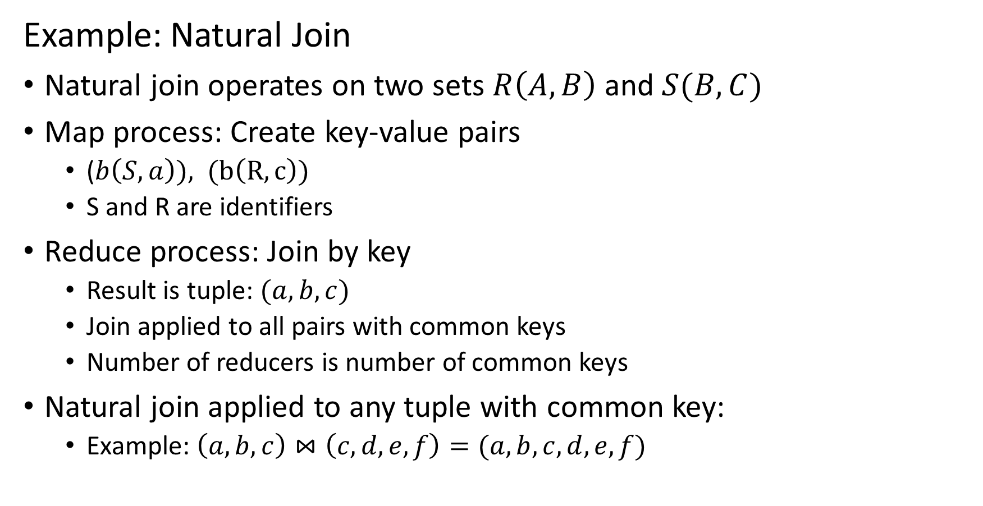
Map Reduce Algorithm
Example: Natural Join
Natural join operates on two sets $R\left(A,B\right)$ and $S(B,C)$
Map process: Create key-value pairs
($b\left(S,a\right)), (b\left(R,c\right))$
S and R are identifiers
Reduce process: Join by key
Result is tuple: $(a,b,c)$
Join applied to all pairs with common keys
Number of reducers is number of common keys
Natural join applied to any tuple with common key:
Example: $\left(a,b,c\right)⋈\left(c, d, e, f\right)=(a,b,c, d, e,f)$

Slide 10
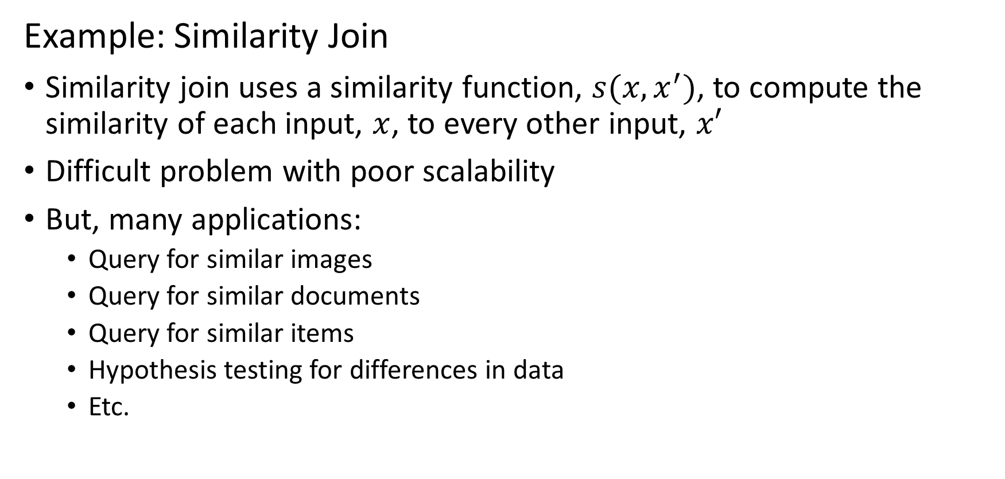
Map Reduce Algorithm
Example: Similarity Join
Similarity join uses a similarity function, $s(x,x^{′})$, to compute the similarity of each input, $x$, to every other input, $x′$
Difficult problem with poor scalability
But, many applications:
Query for similar images
Query for similar documents
Query for similar items
Hypothesis testing for differences in data
Etc.

Slide 11




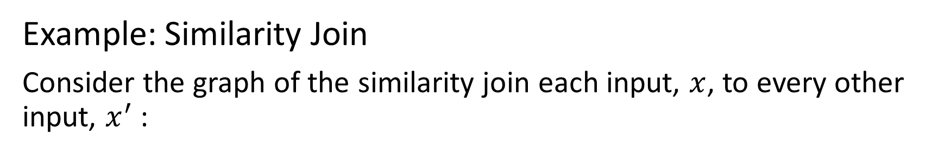






Map Reduce Algorithm
Example: Similarity Join
Consider the graph of the similarity join each input, $x$, to every other input, $x^{′}$:
${s(x}_{1},x_{2})$
$x_{1}$
${s(x}_{1},x_{3})$
Start with 4 inputs
Join inputs pairwise and compute similarity
All pairwise similarities are measured
$x_{2}$
${s(x}_{1},x_{4})$
$x_{3}$
${s(x}_{2},x_{3})$
${s(x}_{2},x_{4})$
$x_{4}$
${s(x}_{3},x_{4})$

Slide 12
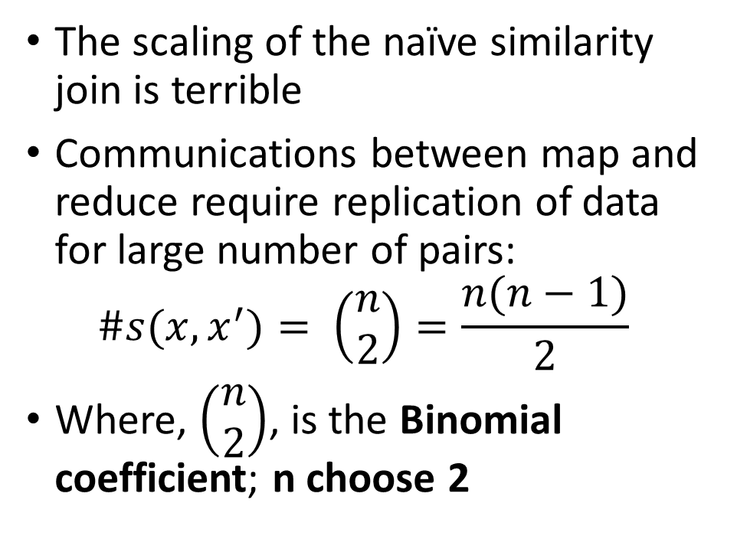
Map Reduce Algorithm
Example: Similarity Join
Consider the graph of the similarity join each input, $x$, to every other input, $x^{′}$:
The scaling of the naïve similarity join is terrible
Communications between map and reduce require replication of data for large number of pairs:
$$\#s(x,x^{′})= \left(\begin{matrix}n \\ 2\end{matrix}\right)=\frac{n(n−1)}{2}$$
Where, $\left(\begin{matrix}n \\ 2\end{matrix}\right)$, is the Binomial coefficient; n choose 2
${s(x}_{1},x_{2})$
$x_{1}$
${s(x}_{1},x_{3})$
$x_{2}$
${s(x}_{1},x_{4})$
$x_{3}$
${s(x}_{2},x_{3})$
${s(x}_{2},x_{4})$
$x_{4}$
${s(x}_{3},x_{4})$

Slide 13
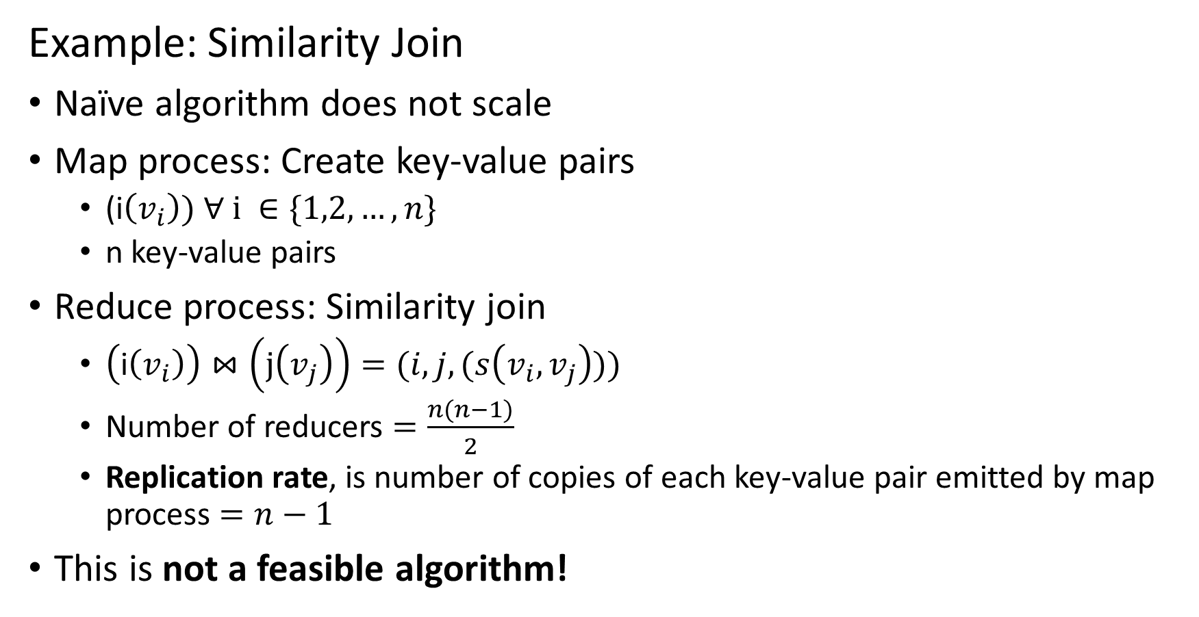
Map Reduce Algorithm
Example: Similarity Join
Naïve algorithm does not scale
Map process: Create key-value pairs
(i$\left(v_{i}\right)) ∀ i ∈\{1,2,…,n\}$
n key-value pairs
Reduce process: Similarity join
$\left(\text{i}\left(v_{i}\right)\right)⋈\left(\text{j}\left(v_{j}\right)\right)=(i, j,(s\left(v_{i},v_{j}\right)))$
Number of reducers $=\frac{n(n−1)}{2}$
Replication rate, is number of copies of each key-value pair emitted by map process $=n−1$
This is not a feasible algorithm!

Slide 14
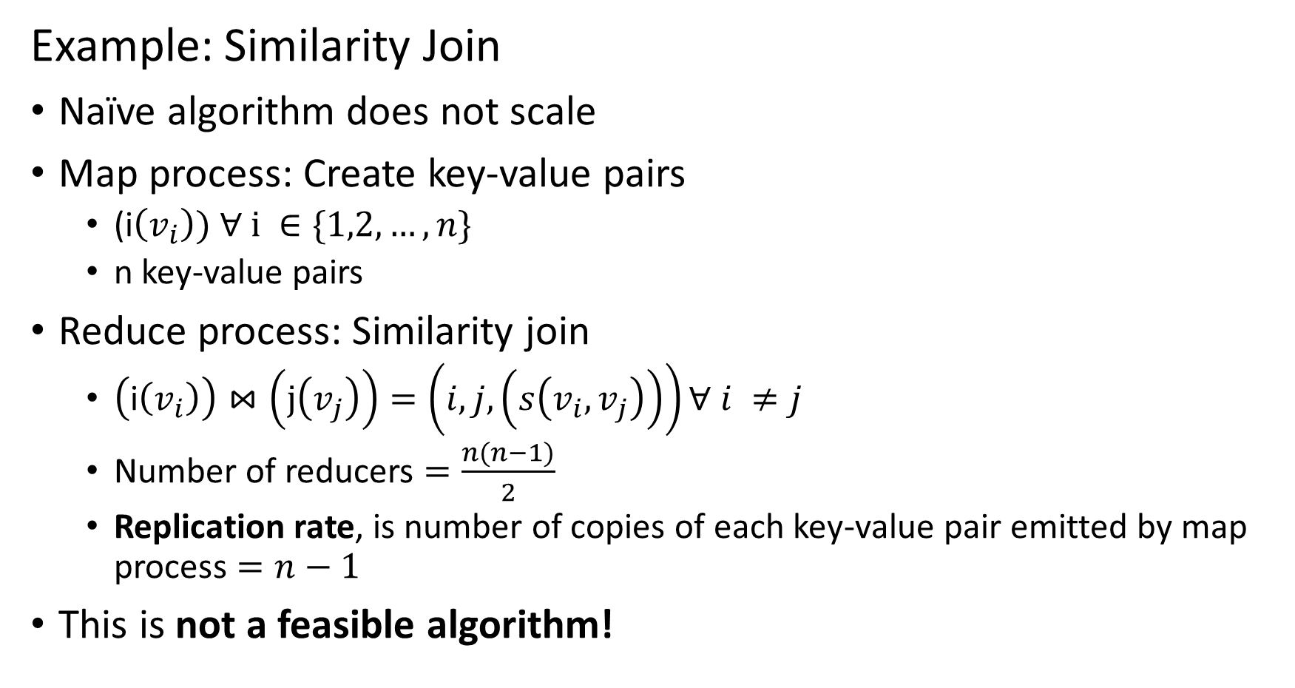
Map Reduce Algorithm
Example: Similarity Join
Naïve algorithm does not scale
Map process: Create key-value pairs
(i$\left(v_{i}\right)) ∀ i ∈\{1,2,…,n\}$
n key-value pairs
Reduce process: Similarity join
$\left(\text{i}\left(v_{i}\right)\right)⋈\left(\text{j}\left(v_{j}\right)\right)=\left(i, j,\left(s\left(v_{i},v_{j}\right)\right)\right)∀ i ≠j$
Number of reducers $=\frac{n(n−1)}{2}$
Replication rate, is number of copies of each key-value pair emitted by map process $=n−1$
This is not a feasible algorithm!

Slide 15
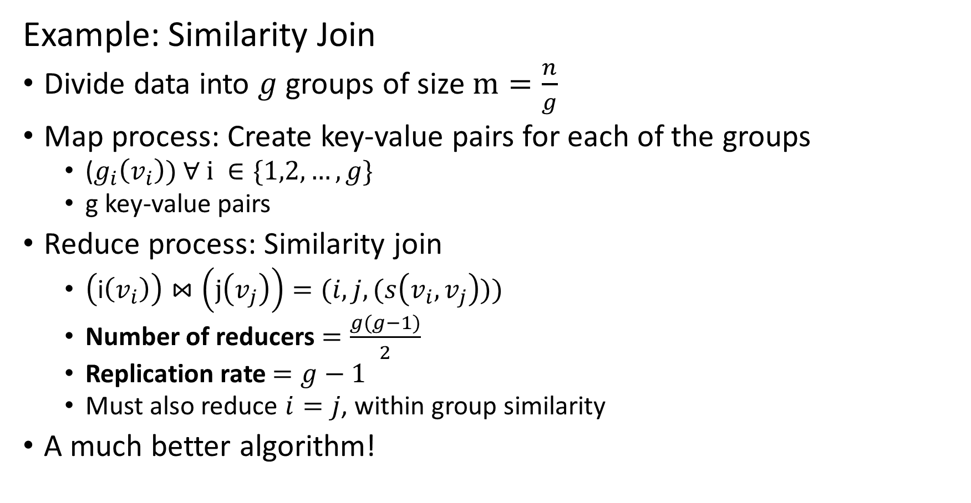
Map Reduce Algorithm
Example: Similarity Join
Divide data into $g$ groups of size $m=\frac{n}{g}$
Map process: Create key-value pairs for each of the groups
($g_{i}\left(v_{i}\right)) ∀ i ∈\{1,2,…,g\}$
g key-value pairs
Reduce process: Similarity join
$\left(\text{i}\left(v_{i}\right)\right)⋈\left(\text{j}\left(v_{j}\right)\right)=(i, j,(s\left(v_{i},v_{j}\right)))$
Number of reducers $=\frac{g(g−1)}{2}$
Replication rate $=g−1$
Must also reduce $i=j$, within group similarity
A much better algorithm!

Slide 16
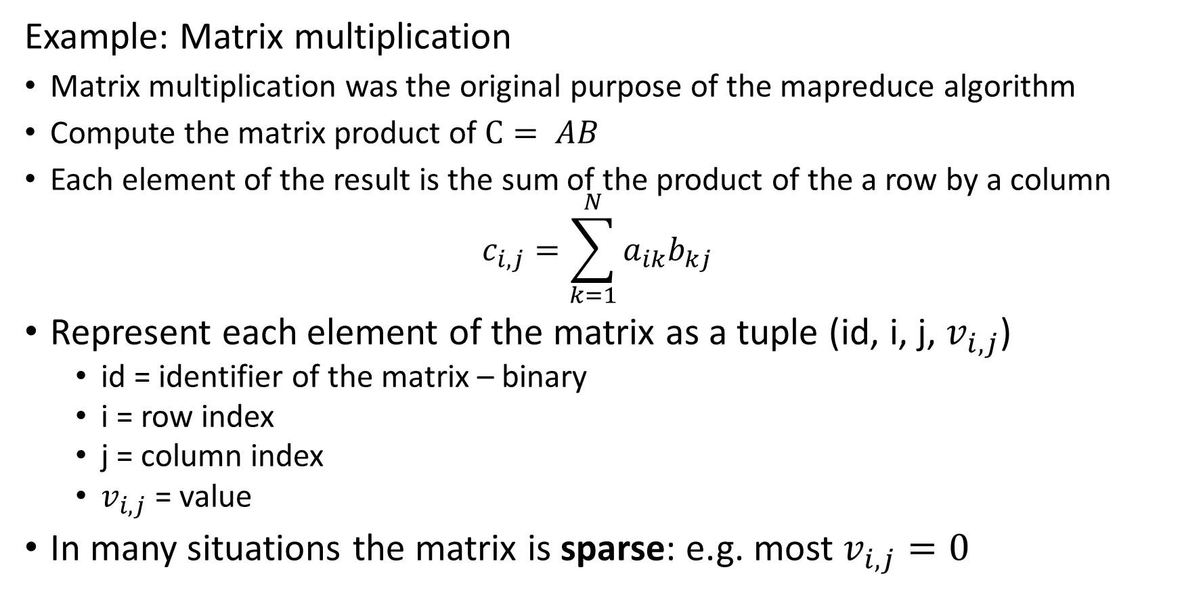
Map Reduce Algorithm
Example: Matrix multiplication
Matrix multiplication was the original purpose of the mapreduce algorithm
Compute the matrix product of $C= AB$
Each element of the result is the sum of the product of the a row by a column
$$c_{i,j}=\sum_{k=1}^{N}{a_{ik}b_{kj}}$$
Represent each element of the matrix as a tuple (id, i, j, $v_{i,j}$)
id = identifier of the matrix – binary
i = row index
j = column index
$v_{i,j}$= value
In many situations the matrix is sparse: e.g. most $v_{i,j}=0$

Slide 17
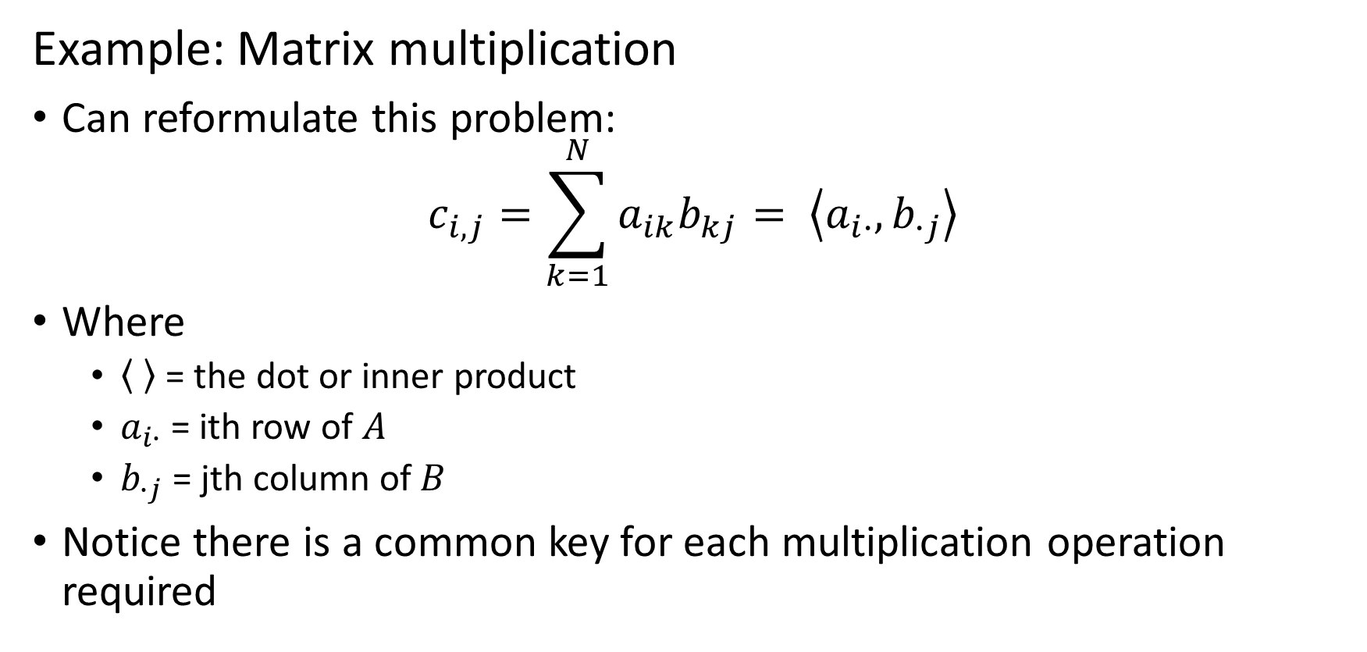
Map Reduce Algorithm
Example: Matrix multiplication
Can reformulate this problem:
$$c_{i,j}=\sum_{k=1}^{N}{a_{ik}b_{kj}= \left\langle a_{i∙},b_{∙j}\right\rangle }$$
Where
= the dot or inner product
$a_{i∙}$ = ith row of $A$
$b_{∙j}$ = jth column of $B$
Notice there is a common key for each multiplication operation required

Slide 18
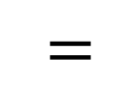
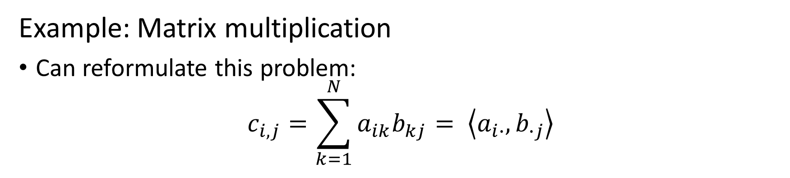



Map Reduce Algorithm
Example: Matrix multiplication
Can reformulate this problem:
$$c_{i,j}=\sum_{k=1}^{N}{a_{ik}b_{kj}= \left\langle a_{i∙},b_{∙j}\right\rangle }$$
$$a_{i∙}$$
$$b_{∙j}$$
$$=$$
$$c_{i,j}$$

Slide 19
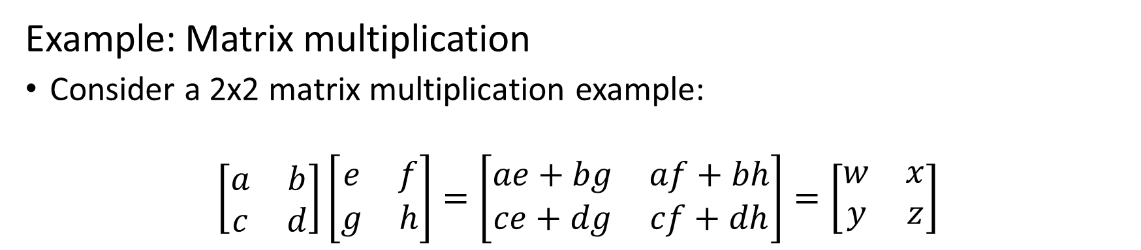
Map Reduce Algorithm
Example: Matrix multiplication
Consider a 2x2 matrix multiplication example:
$$\left[\begin{matrix}a & b \\ c & d\end{matrix}\right]\left[\begin{matrix}e & f \\ g & h\end{matrix}\right]=\left[\begin{matrix}ae+bg & af+bh \\ ce+dg & cf+dh\end{matrix}\right]=\left[\begin{matrix}w & x \\ y & z\end{matrix}\right]$$
a
b
c
d
e
f
g
h
Represent this algorithm by a graph
Start with the inputs and outputs
Each input contributes to two outputs
The complete graph shows the mapping from inputs to outputs
w
x
y
z

Slide 20
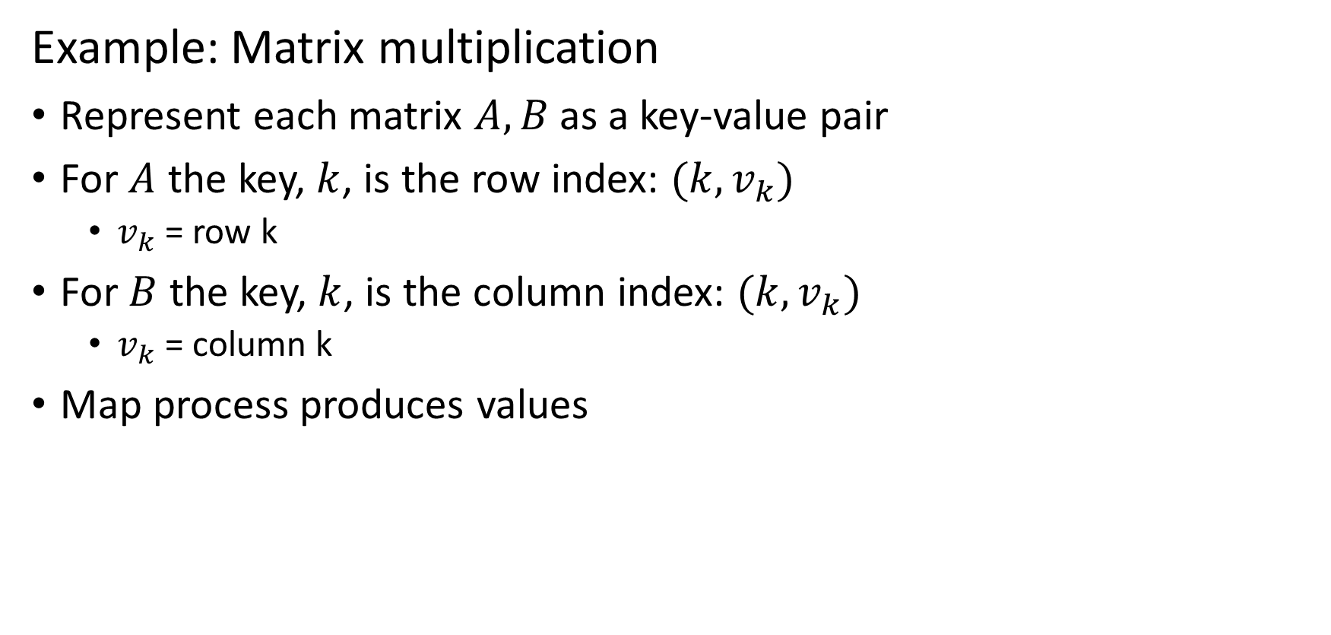
Map Reduce Algorithm
Example: Matrix multiplication
Represent each matrix $A, B$ as a key-value pair
For $A$ the key, $k$, is the row index: $(k,v_{k})$
$v_{k}$= row k
For $B$ the key, $k$, is the column index: $(k,v_{k})$
$v_{k}$= column k
Map process produces values

Slide 21

Map Reduce Algorithm
Example: Matrix multiplication
Each map task receives values for key, $k$
For each key, $k$,

