Slide 1

CSCI E-96 Data Mining, Discovery and Exploration
Steve Elston

Slide 2
What is data mining?
Data mining is the science knowledge discovery using data
Known as knowledge discovery and data mining (KDD)
Data mining is a process of exploration
Exploration is difficult
Many steps
Only some attempts work
Try lots of ideas, fail fast, keep the ones that work!

Slide 3
What is data mining?
Data mining (KDD) is generally performed at large scale
Dataset size has grown nearly exponentially
More importantly, dataset and problem complexity has grown
Data mining is at the intersection of several subjects
Statistics: What of significance can we learn from the data?
Algorithms: How do we efficiently find important relationships in large datasets?
Technology: How do we manage and process massive datasets?

Slide 4
About your Instructor: Steve Elston
Instructor for Harvard since 2017
Data science consultant with several decades of experience
Lead team that commercialized Bell Labs S, now open source R
Company co-founder and held executive positions in several industries
Creator of multiple edX courses, author of books and articles
Holder of several patents
BS, physics and math (minor), University of New Mexico
MS and PhD, geophysics, Princeton University – John von Neuman Supercomputing Fellow

Slide 5
Pace of this course
Harvard Summer School session is only 7 weeks!
Expect an intense pace!
Course moves at twice the rate of a course in a regular semester
Assignment deadlines are important
One or two assignments due every week!
Do not fall behind
There will be no time to ‘catch up’

Slide 6
What is the focus of this course?
Data mining requires a combination of data engineering and data analytics
Our focus is on analytic KDD methods and algorithms
Analytic methods have long staying power
Analytic methods at core of exploration
Good algorithms are the essential to scaling
Good algorithm can scale analysis by orders of magnitude
Better algorithm beats throwing hardware at the problem
Deliberately minimize data engineering required for course
Varied and constantly changing landscape of Big Data technologies
Many platforms support similar methods
Limited time in Harvard Summer School to deal with installation issues on varied platforms

Slide 7
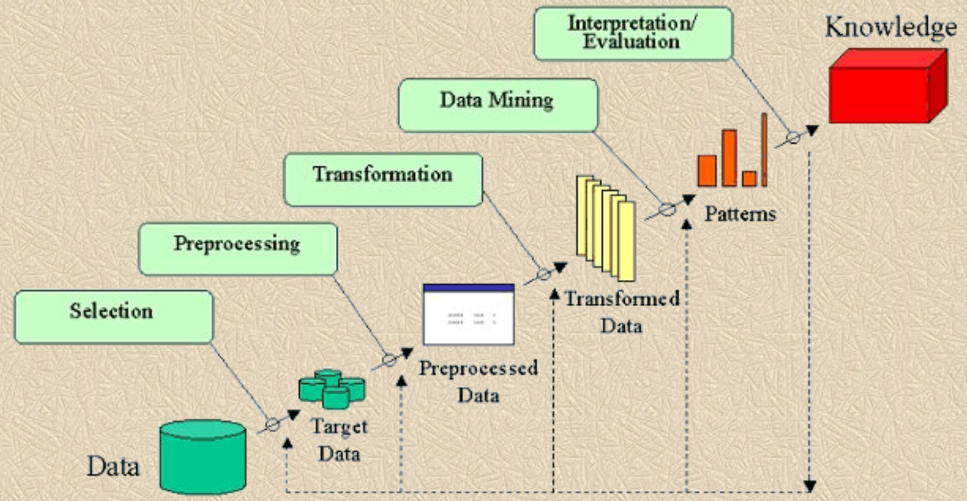
KDD process
What is the KDD process?
Is this old diagram representative? - e.g. Fayyad et.al. 1996

Slide 8
KDD process
What is the KDD process?
Is this diagram representative?
No!
KDD is an iterative process
Steps shown are reasonable
The results of on step informs updates to previous steps
Process is a series of overlapping cycles

Slide 9
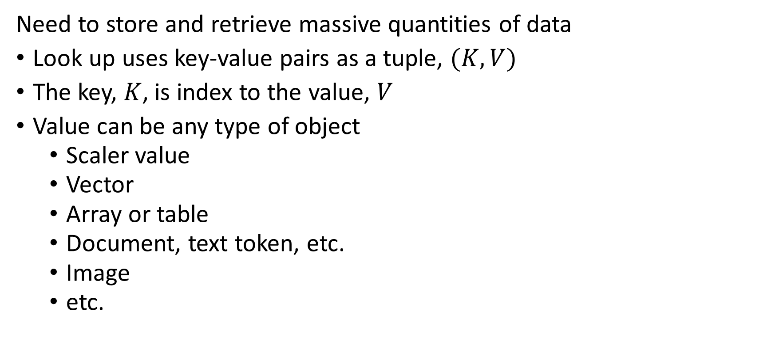
Introduction to key-value indexing
Need to store and retrieve massive quantities of data
Look up uses key-value pairs as a tuple, $(K,V)$
The key, $K$, is index to the value, $V$
Value can be any type of object
Scaler value
Vector
Array or table
Document, text token, etc.
Image
etc.

Slide 10
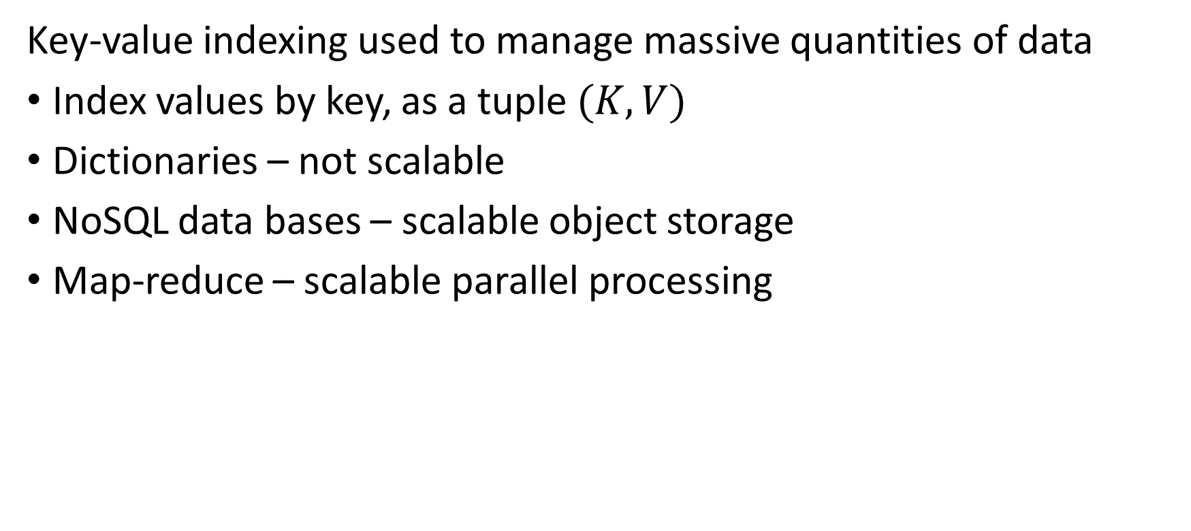
Introduction to key-value indexing
Key-value indexing used to manage massive quantities of data
Index values by key, as a tuple $(K,V)$
Dictionaries – not scalable
NoSQL data bases – scalable object storage
Map-reduce – scalable parallel processing

Slide 11
Introduction to key-value indexing
Key-value indexing used to manage massive quantities of data
With massive data sets are a very large numbers of keys
Linear search on this large number of keys is slow

Slide 12

Introduction to Hashing
Hashing is a core technique for scaling data mining algorithms
Look up uses key-value pairs as a tuple, $(K,V)$
How do we make lookups with

Slide 13
Why Probabilistic AI?
Intelligent agent interacts with uncertain environment
Information from the environment is incomplete and prone to errors
Agent must take optimal actions given uncertain information
?? Sensor Data ??
Environment
Agent
Actions

Slide 14
The Intelligent Agent
Fundamental functions of a probabilistic intelligent agent
Representation: A good representation is often the key to good machine intelligence. A good representation is a mapping of the model and the environment. Good representation is key to effective AI!
Representations are often approximate given high complexity of real world
Representation

Slide 15
The Intelligent Agent
Fundamental functions of a probabilistic intelligent agent
Inference or Reasoning: The process of computing actions or decisions from queries of the model given the evidence. In the simplest form a query returns a mathematical result, such as the marginal probability distribution or the maximum a posteriori value.
Reasoning computes a specific action which is applied to the environment.
Observations/Evidence
Representation
Inference
Actions/Decisions

Slide 16
The Intelligent Agent
Fundamental functions of a probabilistic intelligent agent
Learning: The agent performs learning using data or evidence to update the model. The evidence is observed by sensors which provide information to the model on the state of the environment
Observations/Evidence
Representation
Inference
Actions/Decisions
Learning

Slide 17
Uncertainty in the Environment
Agent must navigate to destination
Plans optimal route
How much does the traffic volume change?
Does the plan account for road repair?
Does an accident block a route?
In other words, which decisions are required to minimize travel time?
Poor response to unexpected information is known a brittleness in a model

Slide 18
Uncertainty in the Environment
Integrate sensors for collision avoidance in self-driving car
Sensors have different range and accuracy
How are sensors affected by fog, rain or darkness?
How accurate is traffic sign recognition?
What is the response of each sensor to snow and ice covered roads?
In other words, what is the posterior probability that a change in speed or direction is required?

Slide 19
Uncertainty in the Environment
Unobservable information adds to uncertainty
The intentions of other drivers
The cards held by other players in a game of poker
The spot price of wheat in the future
Net result is incomplete information

Slide 20
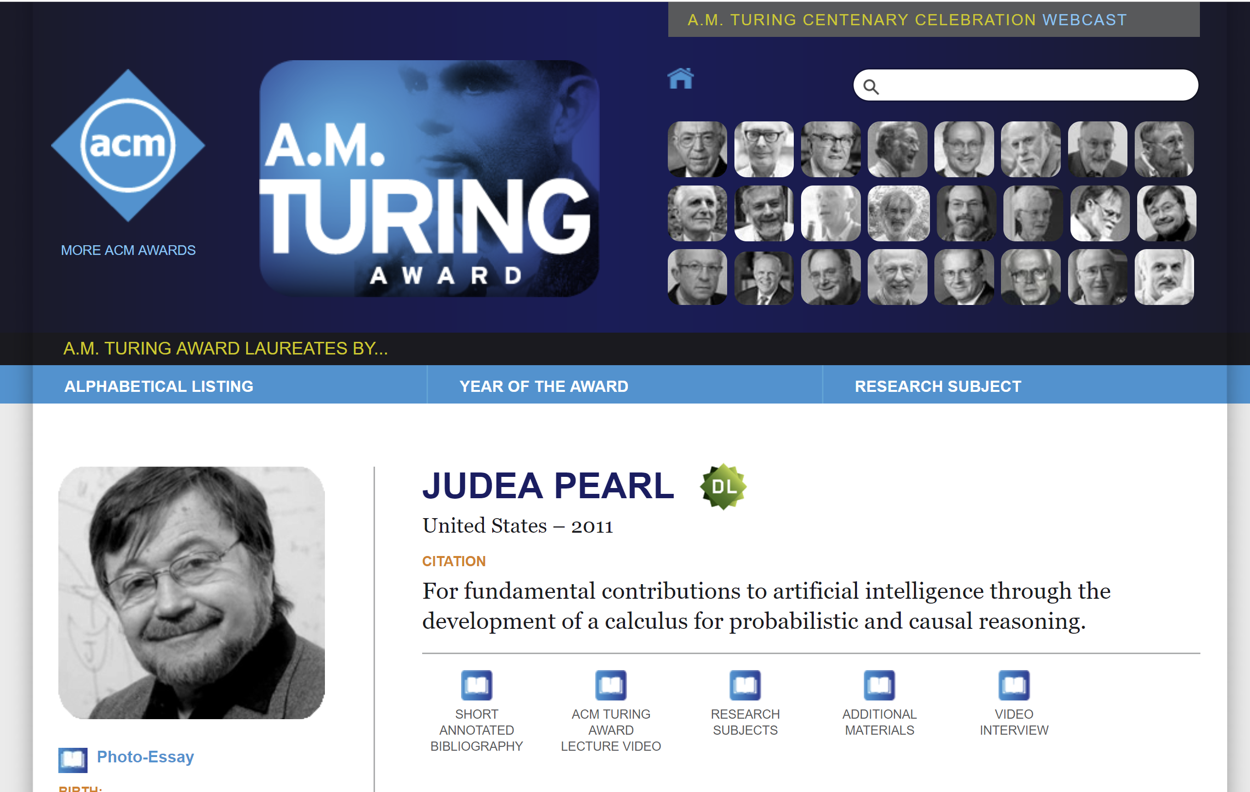
Probabilistic Reasoning Recognized as Fundamental Method
Check out videos: https://amturing.acm.org/award_winners/pearl_2658896.cfm

Slide 21
About Your Instructor
Principle Consultant at Quantia Analytics
Instructor, Harvard Extension School, University of Washington
MS and PhD in Geophysics from Princeton University
Work in machine learning starting in 1980s
Co-founded analytics businesses
Worked in a number of areas:
Capital markets risk
Image analysis
Fraud detection
Forecasting
Failure prediction

Slide 22
About Your Teaching Fellow
Sarah Asano – asano.sar@gmail.com
Electro-Optical Engineer, Lockheed Martin, Sunnyvale, California
MS Robotics, Carnegie Mellon University
BS Mechanical Engineering, California Institute of Technology
Experience in:
App development
Game development
Internet of things
Embedded systems
Robots

Slide 23
About This Course
Focus on two different classes of probabilistic algorithms
Graphical models
Efficient method to compute posterior probabilities distributions
Sequential decision models
Explainable models
Reinforcement learning algorithms
Agent learns by experience
Model free
Learn policy for complex and stochastic environment
Models related through Markov Decision Processes (MDP)

Slide 24
About This Course
Grading is based on hands on work and class participation
Homework assignments – 70%
Assignment most weeks
Focus on hands-on coding
Read directions carefully and answer all questions; don’t miss points!
On campus weekend – 30%
9am – 5 pm Dec 7-8. You must attend the entire session for course credit!
Meet at one Braddle Square, Cambridge
Team challenges
Book rooms, etc. early

Slide 25
About This Course
Course participation
Your participation important to get maximum value from this course!
Students who attend lection and precepts tend to do better.
On-line lecture – Wednesdays 5:50 – 7:50 pm US Eastern Time
Lecture focused on theory
Lectures will be recorded
Please remind your instructor to record!!
Precipt – TBD
Precipt focused on code, questions and homework
Perhaps, some background supplement for theory

Slide 26
About This Course
Text Books
Readings are from two text books
Both available at the Coop: https://tinyurl.com/300-F19-CSCI-E-82A-1
Or free pdf downloads
Bayesian Reasoning and Machine Learning, Barber, 2012, Cambridge University Press: http://web4.cs.ucl.ac.uk/staff/D.Barber/textbook/091117.pdf
Reinforcement Learning, an introduction, Second edition, Sutton and Barto, 2018, MIT Press: https://mitpress.ublish.com/book/reinforcement-learning-an-introduction-2

Slide 27
About This Course
Other reference sources I draw material from:
Artificial Intelligence, A Modern Approach, Stuart Russell and Peter Norvig, Prentice Hall, Third edition, 2010
Probabilistic Graphical Models, Principles and Techniques, Daphne Koller and Nir Freedman, MIT Press, 2009
Decision Theory Under Uncertainty: Theory and Applications, Kochenderfer, et. al., MIT Press, 2015.
Machine Learning: A Probabilistic Perspective, Murphy, MIT Press, 2012.
Deep Learning, Ian Goodfellow, Yushua Bengio, and Arron Courville, MIT Press, 2016

Slide 28
About This Course
Getting help with this course – essential component of class participation
Plan to attend the precept
Bring your questions for class discussion
Use Piazza – https://piazza.com/class#fall2019/cscie82a
Access code: cscie82a
Ask questions
Answer questions
Email Steve – stephen.elston@quantia.com
Please only ask questions of a private nature; e.g. grading questions
Please direct general questions on course material and homework to the aforementioned venues – if you have a question, others likely will too!
Grading questions: email Sarah – asano.sar@gmail.com

Slide 29
Course Materials
Obtain course materials from course Github repository
https://github.com/StephenElston/CSCI_E_82A_Probabalistic_Programming
Jupyter notebooks with review of theory and code
Slides
Course material will be updated regularly – plan on doing a pull regularly
Homework assignments will be at: https://github.com/StephenElston/CSCI_E_82A_Probabalistic_Programming/Homework
Submit completed homework and receive grades in Canvas

Slide 30
First Assignments
Lesson 0– Self-paced
Review of probability concepts – In Github repository
Not graded
Decide if this class is for you!
Homework 1 – Directed graphical models
Due September 18 at 24:00 (midnight) US Eastern Time

Slide 31
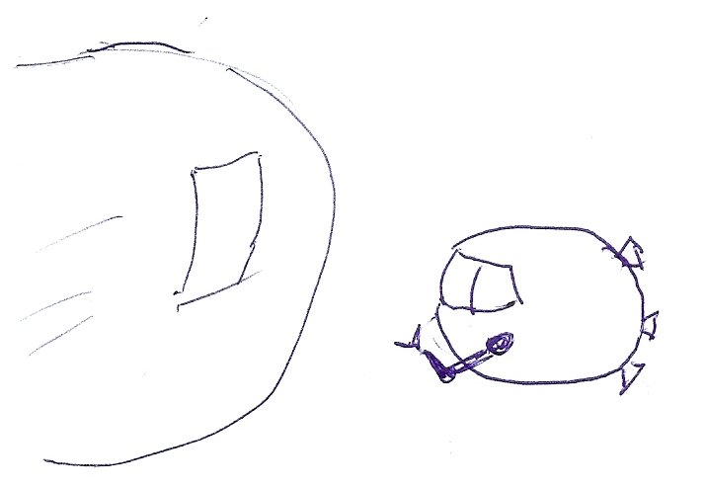
AI Is Still A Work In Progress!!
Views of 21st century AI
HAL, open the pod bay door!
Closer to reality?
As envisioned by Stanley Kubrick
c.a. 1967
I’m sorry, but I can’t do that Dave
Did you want the list of pod doors for
sale on Ebay Dave?
Copyright 2017 Stephen F Elston

