Slide 1
IOT-based Dog Daycare Robotic System
VIDYA JYOTHI INSTITUTE OF TECHNOLOGY
AN AUTONOMOUS INSTITUTION
DEPARTMENT OF ARTIFICIAL INTELLIGENCE
Under the guidance: Mr. A. Vijay Kumar
Assistant Professor
Department of Artificial Intelligence
By:
Avancha Sanjana [20911A3564]
Shiva Naina[20911A3534]
Preksha Gupta[20911A3550]
Karthikeshwar [20911A3522]

Slide 2
Abstract
Today automation technology is a trend that is easy to access, user friendly and easy to observe. Having pets can be a joy in our lives. Feeding pets is a major task and the purpose of this article is to automatically feed the pet when the owner is away from home. Over the past few years, many researchers have developed an automatic feeding machine, but their functionality is limited to the home. This advanced machine can provide real time food to the animal and monitor the animal's behavior. The IoT Based Automatic pet food feeder uses ESP-32 CAM camara module, Ultrasonic sensor, Motor control module, and consists of an interface with DC servo motor, and other hardware equipment. A software code is dumped into the micro controller to perform operations of rotating motors. The web base application developed by the PHP and HTML programming language and the real time data link with firebase database. The whole feeder system is controlled using a mobile phone. The user sends signals to the micro controller using mobile application through cloud. When the DC servo motor runs, the motor rotates the propeller which is in the feeding device. Using of ultrasonic sensor to get pet foods scale on real time.ESP32- cam to get video input to web application and could watch the behavior of the pet.

Slide 3
Abstract
Keywords:
IOT, Dog daycare robot, Pet monitoring, Automated feeding, Remote care, Animal well-being, Timely pet care, Surveillance technology, Pet-friendly robotics, Comprehensive pet support.

Slide 4
Introduction
In the area of wireless telecommunications, a new technology known as the Internet of Things (IoT) has received a huge interest in academia and industry over the last decades. These technologies have started to transform our lives in every way. The invention of the smartphone was the catalyst for the most significant transformation. Since then, we may have seen an increase in smart devices such as apps, games and tools with various functions.
Those are acting by communicating with smartphones, which are carried by the majority of individuals nowadays . As a result, we might refer to IoT as a new Internet concept in the twenty-first century . New services that can be easily implemented around our real life can use the above concepts and technologies.
In the modern generation, almost everybody wants a pet because they believe that having a pet in the house reduces daily stress, boredom, and loneliness. However, in a developing country, citizen activity is at an all- time high, reducing the ability to provide necessary food and water for pets regularly.
They are busy with various activities and have little time to keep an eye on their pets at home. In the current scenario, it is critical to provide food to pets in a variable quantity at a designated time. The pet food feeders’ market is also related to intelligent technologies with the Internet of Things (IoT) and smartphones, which can provide convenient services with various aspects for pet owners.

Slide 5
Literature Survey
There are many various types of pet food feeders on the market nowadays attempting to solve the problem of making sure that each animal has access to a healthy scale of food throughout the day, regardless of the owner's schedule.
"Smart Pet Feeder" has shown a prototype is offered to address the issue of supplying food and water for all types of pets when the owner is away from home, such as during a lockdown situation.
The owner can provide food and water to their pet on their schedule by using this prototype.
A servomotor has been added to the bowl to control the discharge of food through a PVC conduit. In the system the owner can assign the timing and quantity of food through a keyboard to supply food depending on the instantaneous weight of the food in the bowl.
"Smart Pet Monitoring and Feeding Based on Feedback Control System" was designed to produce the impact of continuous work in automation.
The IoT can also be used to record and monitor the system. The machine's basis of operation is that the food is stored in a silo with a screw conveyor inside that feeds the dog food.
Every meal is weighted and scheduled for each mash and ensures that the dog gets the proper food at each meal. Second, the action is controlled by an IoT system operated by a mobile phone, and the system can be monitored at any time.

Slide 6
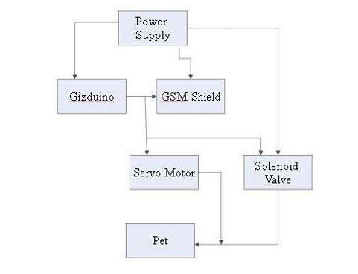
Existing system
In the existing system pet feeding is manual or timer based but dog taking feed cant be known by user as there is no camera interface
Disadvantages of Existing System
Maintenance and technical issues: Robots can encounter technical problems, malfunctions, or require regular maintenance. This can result in downtime, leaving dogs without proper care until the issues are resolved.
No camera interface: The existing IoT dog daycare robot lacks a camera interface, limiting the ability to visually monitor and assess the well-being of the dogs remotely. This absence of real-time visual feedback could hinder effective oversight and responsiveness to potential issues.

Slide 7
Proposed System (Innovation)
In the proposed system WIFI control robot will be used for feeding the pet.
One web application will be prepared for having control of feeding the pet.
Video feed will be available in the web application.
Robot is remotely control.
Robot having ultrasonic sensor for alert purpose.
In the proposed system one robot is prepared, it is connected with WIFI camera.
Dog can be monitored remotely using mobile phone
Live images will be updated on web server
Feed control can be done using web application by watching dog in the camera
Feeder robot will have two trays for feeding one for dry feed and other for water

Slide 8
Proposed System (Innovation)
Advantages of Proposed System
Real-time Monitoring:
Allows owners to monitor their pets in real-time through a mobile app.
Provides peace of mind by offering a live video feed of the dog's activities.
Interactive Features:
Engages dogs with interactive toys and activities controlled remotely.
Enables owners to virtually play with their pets, promoting mental stimulation.
Automated Feeding:
Dispenses scheduled meals, ensuring dogs are fed on time.
Customizable feeding options based on dietary needs and preferences.

Slide 9
Proposed System (Innovation)
Advantages of Proposed System
Security Features:
Equipped with surveillance cameras.
Customizable Settings:
Owners can personalize settings based on their dog's preferences and needs.
Allows for flexibility in scheduling activities, feeding times, and play sessions.

Slide 10
Proposed System (Innovation)
Advantages of Proposed System
Remote Communication:
Enables owners to communicate with daycare staff and other dog owners.
Facilitates collaboration and information sharing among the pet community.
Reduced Staff Workload:
Automates routine tasks, allowing staff to focus on personalized care.
Enhances efficiency in managing multiple dogs simultaneously.

Slide 11
Objective
The primary objective is to design and develop a pet care unit from which food and water can be given to a pet instantly and also have live video feed of the pet using camera.
The main objective of the IoT-based dog daycare robot is to enhance the overall well-being of our canine companions by providing a technologically advanced and interactive environment. This system aims to offer pet owners real-time monitoring capabilities through a user-friendly mobile app, ensuring they can observe and engage with their dogs remotely. The robot focuses on automating essential tasks such as feeding and maintaining a comfortable climate, allowing for a more efficient and stress-free experience for both pets and staff.
By fostering socialization, personalization, and security, the IoT dog daycare robot strives to create a safe and enjoyable space for dogs, promoting their mental and physical well-being while offering owners peace of mind during their absence.

Slide 12
Methodology
The methodology for IOT-based Dog Daycare Robot involves seven steps:
The ESP32-CAM is a low-cost microcontroller that integrates a camera module and Wi-Fi capabilities.
In this project, we use the ESP32-CAM to control the movement of the robot and capture video and images that can be viewed remotely.
The robot is equipped with a set of motors that enable it to move in different directions.
The methodology for developing a surveillance robot using ESP32-CAM can be divided into two steps:
hardware
software

Slide 13
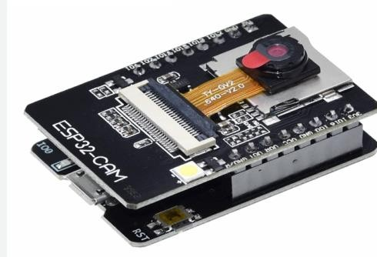
Methodology
HARDWARE REQUIREMENT
ESP32 CAM
The ESP32-CAM is a small size module based on the ESP32 microcontroller. Its low-power camera module and deep sleep current are as low as 6mA. It comes with an OV2640 camera and provides an onboard TF card slot. The ESP32-CAM can be widely used in intelligent IoT applications such as wireless video monitoring, WIFI image upload, and QR identifications. The module can support WIFI video monitoring and WIFI image upload. The onboard ESP32-S module supports WIFI and Bluetooth. The WIFI protocol is IEEE 802.11. there have several Peripheral interfaces. Such as UART, SPI, I2C and PWM. Figure 3. Shows the ESP32 CAM module.

Slide 14
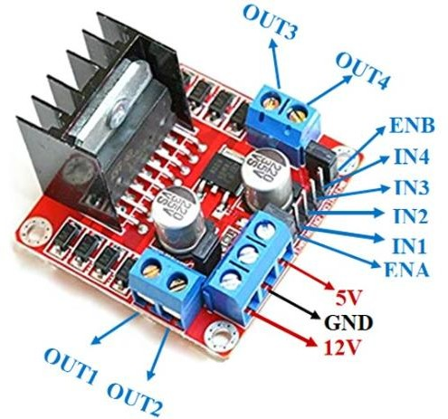
Hardware Requirement
Motor drive module
The motor drivers use for an interface between the control circuits and the motors. The controller circuit operates on low current signals, whereas the motor requires a high amount of current. Motor drivers' purpose is to convert low-current control signals into higher-current signals that can drive a motor. The motor drive module used for the L298N Motor Driver Module is a high- power motor driver module for driving Stepper and DC Motors. This module consists of a 78M05 5V regulator and L298 motor driver IC. L298N Module can control up to 4 DC motors or 2 DC motors with speed and directional control. The L298N drive can up the 46V motor supply voltage and 2A maximum motor supply current. Their drive voltage and drive current respect 5-35V and 2A. The PCB has a heatsink for better performance.

Slide 15
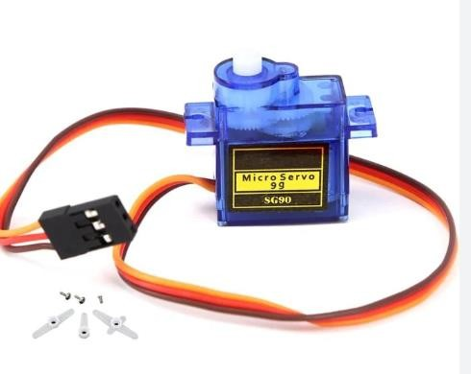
Hardware Requirement
Servo motor
According to cost analysis, we use the MG995 metal gear servo motor. MG995 Metal Gear Servo Motor is a standard high-speed servo that can rotate approximately 180 degrees (60 in each direction). Also, it provides 10kg/cm at 4.8V and 12kgcm at a voltage of 6V. The motor is a digital servo motor which receives and processes PWM signals better and faster. Its highly developed internal circuitry offers higher torque, holding power, and faster updates in response to outside forces. They are well sealed in a solid plastic container, making them water and dust-resistant, a quality that is highly beneficial for pet food feeder machines. The motor Operating Speed at no load (4.8V) is 20sec/ 60 deg. Operation Voltage is 4.8 to 7.2V. All gears are metal, which helps excellent holding power and accurate positioning.

Slide 16
Software Requirement
Arduino IDE:
Download and install the latest version of Arduino IDE, available from the official Arduino website (https://www.arduino.cc/en/software).
Ensure that the Arduino IDE supports the specific Arduino board models and components used in the dog daycare robot project.
Proteus:
Obtain and install Proteus Professional software, which allows for simulation of the hardware components used in the project.
Ensure compatibility with the Arduino boards and modules selected for the IoT dog daycare robot.
Proteus software provides an interactive platform for testing and verifying the functionality of the electronic circuits before physical implementation.

Slide 17
Software Requirement
C Language Compiler:
Set up a C language compiler for writing and compiling the software code for the Arduino microcontrollers.
Arduino IDE usually comes with a built-in C/C++ compiler, but for advanced coding and debugging, developers may use external compilers such as AVR-GCC.
Ensure that the compiler is configured correctly to generate the appropriate hex file for uploading to the Arduino boards.

Slide 18
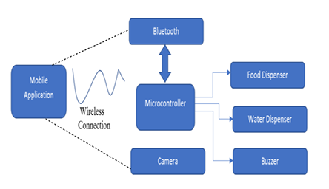
Block Diagram

Slide 19
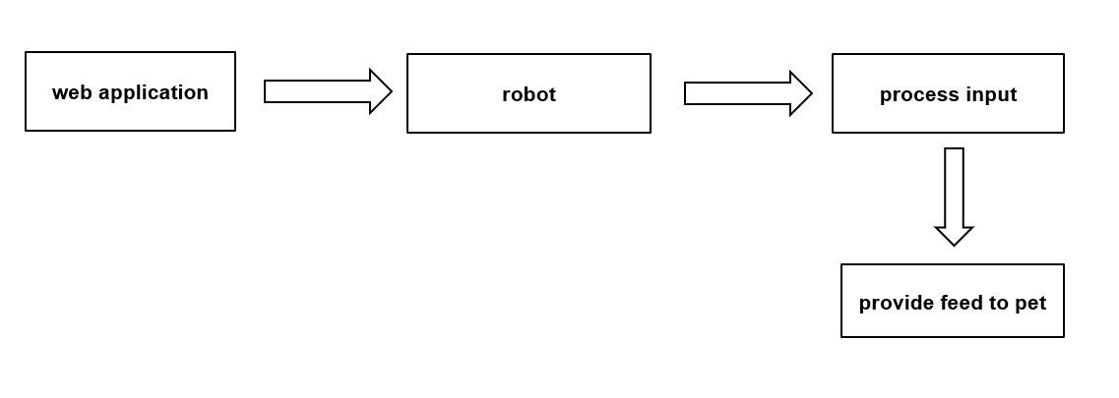
System Architecture

Slide 20
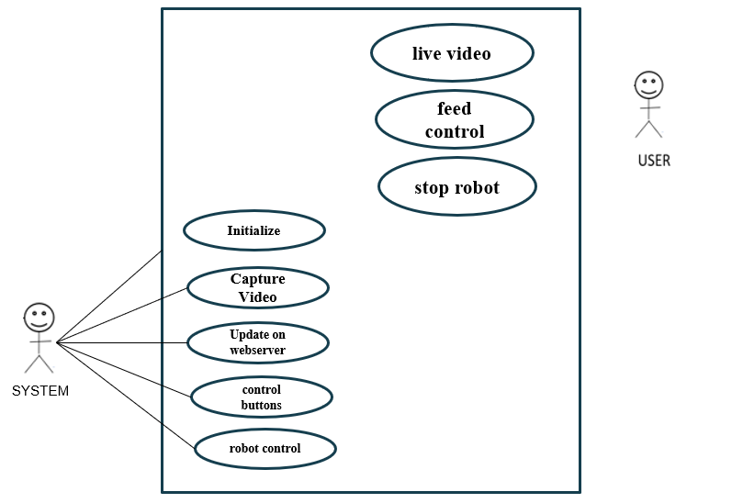
System Design:UML Diagram
Use Case Diagram

Slide 21
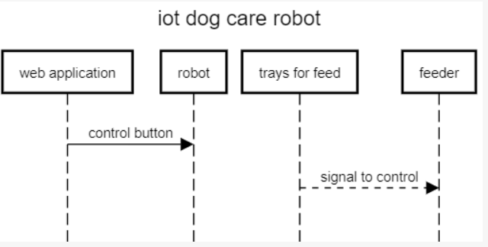
Sequence Diagram
Sequence Diagram

Slide 22
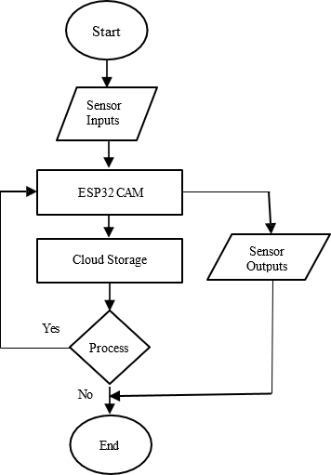
Activity Diagram
Activity Diagram

Slide 23
Algorithm
Step-1: Initialization:
Power on the robot and establish a secure connection to the IoT network.
Step-2 : User Authentication:
Authenticate the user (dog owner) through the mobile app using secure credentials.
Step-3: Dog Identification:
Use RFID or image recognition to identify and authenticate dogs entering the daycare.
Step-4: Real-time Monitoring:
Activate surveillance cameras for live video feed accessible through the mobile app.
Step-5: Interactive Play:
Allow remote control of interactive toys through the app for engaging the dogs.
Step-6: Feeding Schedule:
Implement a predefined feeding schedule and dispense meals automatically.

Slide 24
Algorithm
Step-7: Climate Control:
Monitor environmental conditions and adjust temperature/humidity as needed.
Step-8 : Health Monitoring:
Utilize sensors to track vital signs, activity levels, and detect anomalies.
Step-9: Emergency Alerts:
Send immediate alerts to the owner and designated contacts in case of health emergencies.
Step-10: Security Measures:
Enable surveillance and motion sensors to detect unauthorized access or intruders.
Step-11:Socialization Assistance:
Facilitate controlled introductions between dogs to encourage positive social interactions.
Step-12:Customization Options:
Allow owners to customize preferences for activities, feeding, and environmental settings.

Slide 25
Algorithm
Step-13: Communication Hub:
Establish a communication channel between owners, daycare staff, and other users.
Step-14 : Data Analytics:
Collect and analyze data on dog behavior, preferences, and health trends.
Step-15: Automated Cleaning:
Implement a scheduled cleaning routine for maintaining a hygienic environment.
Step-16: Energy Management:
Optimize energy usage through smart sensors and power-saving algorithms.
Step-17:Remote Diagnostics:
Enable remote diagnostic capabilities for troubleshooting and maintenance.
Step-18:User Feedback Loop:
Gather user feedback through the app to continuously improve the system.

Slide 26
Algorithm
Step-19: Shutdown Procedure:
Execute a secure shutdown process when the daycare hours end or on user request.
Step-20 :Logs and Reports:
Generate logs and reports for monitoring system performance, dog activities, and health metrics.

Slide 27
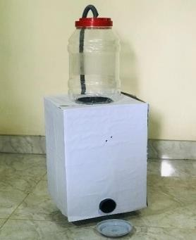
Testing and Results
Field testing of the finished product was a success, and we got the learning opportunity. The final design of the pet food feeder is shown in Fig. 6. The mechanism used in the pet feeder is rotational to linear motion. The wheels and gear motor assembly are installed between the component's base part. The robot pet food feeder works efficiently and fulfils the objective of feeding pets without its master. The servomotor rotates the propeller, and food gets delivered to the plate according to master mobile control. The whole system is connected to the mobile phone via the internet. The entire real-time data is transmitted to data base and mobile web application.
Also, we develop the client-side web base application for controlling the robot. We used HTML and CSS to create front end of web application. The camara video and robot control keys on the front of web application. Below is Fig. 7. of this demo application

Slide 28
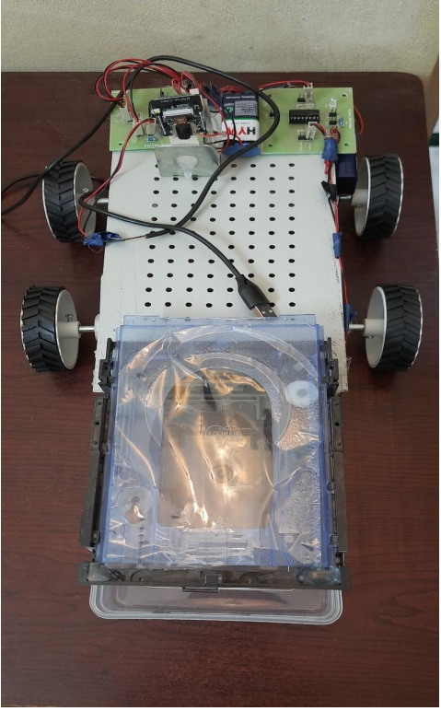
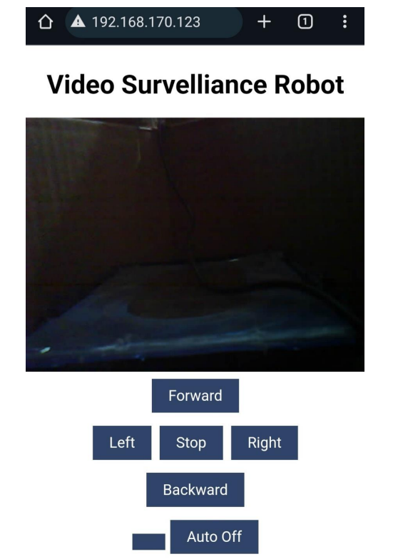
Testing and Results

Slide 29
Conclusion
This paper introduces the design and implementation of pet food feeder robot based on IoT technology. Modern world people have their busy life, and they enjoy with pets. Nowadays, we can see many new devices invented with the aid of IoT. We believe IoT can also change the pattern of the existing structure of pet food feeder robots. In this paper, we describe and implement a new pet food feeder robot that can feed the pets while the owners are absent from their homes and monitor their movement and provide their foods through the owner’s smartphones or devices. The implemented system is distinctive from others in that the proposed method is based on IoT, which uses many sensors and wireless communications.
The IoT-based pet food feeder is a helping hand as it works efficiently in the absence of its own. It helps to develop creativity in Crating projects and modify existing projects to be more energy efficient with new fabrication methods through this system.
This pet food feeder Innovation makes it easy for consumers to feed their pets and will not leave their pets hungry again.
This automatic pet feeder we developed helps give pets smaller, more frequent meals, which is helpful for weight loss and managing medical disorders such as diabetes.
Adequate food Intake benefits weight loss and drives medical conditions such as Diabetes.
When exposed to outside animals, animals or pests cannot damage the remaining food. The future can develop a mobile app for monitoring data and controlling the robot.

Slide 30
References
[1]TAdetokunbo A. Adenowo, Jonathan C. Anyl, James A. Akobada, “Internet of Things based Pet Feeder automation Using Raspberry Pi” International Journal of Scientific & Research. Volume 11, Issue 8,August 2020.
[2] M. Ibrahim, h. Zakaria, and E.W. Xian, “Pet food autofeeder by using Arduino,” In IOP Conference series:Materials science and engineering, Volume 670, No.1, November 2019, p. 012069, IOP Publishing.
[3] Hifengfang, Lidaxu, Yunqiangzhu, Jiaerhengahati, Huanpei, Jianwuyan, Andzhihuiliu (2014), ‘An Integrated System for Regional Environmental Monitoring and Management Based On IoT ' IEEETransactions On Industrial Informatics, vol. 10, no.2, pp. 1596-1605.
[4] David Naranjo-Hern´andez, Laura M. Roa, Fellow, Javier Reina-Tosina, Senior Member IEEE, and Miguel´ Angel Estudillo - Valderrama (2012), ‘So M: A Smart Sensor for Human Activity Monitoring and Assisted Healthy Ageing' IEEE Transactions on Biomedical Engineering, vol. 59, no. 11, pp. 3177-3184.
[5] Seung-Chul Son, Nak-Woo Kim, Byung-Tak Lee Chae Ho Cho, and Jo Woon Chong (2016) , ' A TimeSynchronization Technique for CoAP - based Home Automation Systems ' IEEE Transactions on Consumer Electronics, vol. 62, no. 1,pp. 10-16.
[6] Jaeseok Yun, Il - Yeop Ahn, Nak -Myung Kim (2015),' A Device Software Platform for Consumer

Slide 31
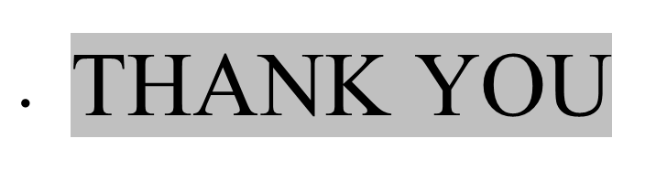
VIDYA JYOTHI INSTITUTE OF TECHNOLOGY Aziz Nagar, Hyderabad - 500075

