Slide 1
Business Case Approval In-App Advertising
FOR DECISION

Slide 2
Agenda
Sections
Executive Summary
Value Proposition
Impact Analysis
Financials
Planning and Next Steps
Back-Up

Slide 3
In-App Advertising Executive summary
Executive Summary
Status
Mobile platform and apps with good traffic growth, allowing for new monetization possibilities
potential behind mobile presents opportunity for stand alone products to foster endogenous revenue growth – meaning debundled from other products
Next steps
Complete development in mdot and mobile apps to enable display advertising
Complete IT developments to enable keying, management and invoicing of product
Customer care & Ops training
Sales training

Slide 4
Agenda
Sections
Executive Summary
Value Proposition
Impact Analysis
Financials
Planning and Next Steps
Back-Up

Slide 5

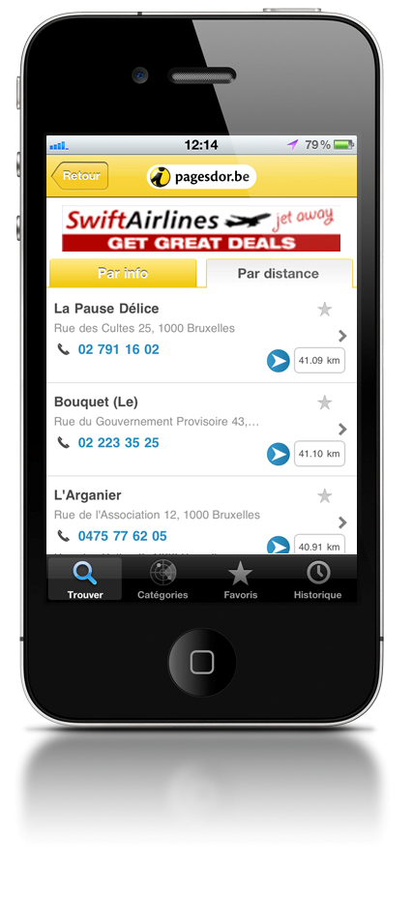
Display Advertising in Mobile
In App Advertising

Slide 6
In-App Advertising Value Proposition
In-App Advertising
Detailed description of concept
Benefits for advertisers
Offering (key features)
Key discriminators:
Brand awareness
Possibility to target campaigns with higher efficiency
Supporting features:
Display ads served contextually
Key product USP:
Display advertising in an growing platform such as mobile, with targeting possibilities to address specific consumer segments
Target customers:
Existing and new customers
Product availability:
Launch as a stand alone item in mobile
Product specifications:
Banner served in mobile (both mdot and iphone, ipad and android aps)
Banner placements (168 x 28) in Home Page and search results page
Banner will link to: customer’s mobile website, my site, detail page or click to call
Sold in a pay per inclusion model, with targeting by context (Home Page or heading) and geography
There is a limit of three ads per combination of contextual + geography targeting – each ad will get 33% of impressions, in case the full inventory is taken
Benefits for end-user
Key discriminators:
Relevant banner campaigns, served contextually
Inspirational / guiding
Supporting features:
Display ads served contextually
Suggested commercial launch
September 2011
Benefits for Truvo
Bucket
Strategic drivers
Platform(s)
Markets
Key discriminators:
Additional revenue stream
Portfolio diversification
Step into emerging market with high potential
Print
Drives short term revenues
Print
Belgium
Online (directory)
Grows usage
Web
Ireland
Online (non- directory)
Exciting, fun and innovative
TV
Mobile
Portugal
Mobile
Enabling platform
GPS

Slide 7
Product – what it is (Yellow)
Placement | Targeting | Format | Link to
Home Page | Home Page | 168 x 28 | Landing Page (Yellow) My Site Customer’s mobile website Click to call
Results Page | Heading Heading + Geography | 168 x 28
Banners are a stand-alone item (not bundled), sold on a pay per inclusion logic:
There are three available slots for each targeting option
Home Page
# Headings
# Headings + # Geographies
Banners will rotate to take same proportion of visibility/ views
1 banner → 100% views
2 banners → each banner will take 50% views
3 banners → each banner will take 33% views
Business model is based on a pay per inclusion as a starting point
As mobile traffic goes up, inventory monetization might develop towards a CPM logic
Timing
The period of campaign is flexible
Prices per inclusion are monthly to enable:
Monthly campaigns
Campaigns covering multiple months (3 month or 1 year)
Scope
The campaigns will be displayed in all Ymobile platforms ‘Mdot / Iphone / Ipad / Android

Slide 8
Product – what it is (White)
Placement | Targeting | Format | Link to
Home Page | Home Page | 168 x 28 | Landing Page (Yellow) My Site Customer’s mobile website Click to call
Results Page | Geography Zone (BE), District(PT) or County (IE) | 168 x 28
Banners are a stand-alone item (not bundled), sold on a pay per inclusion logic:
There are three available slots for each targeting option
Home Page
Result Page
Banners will rotate to take same proportion of visibility/ views
1 banner → 100% views
2 banners → each banner will take 50% views
3 banners → each banner will take 33% views
Timing
The period of campaign is flexible
Prices per inclusion are monthly to enable:
Monthly campaigns
Campaigns covering multiple months
Scope
The campaigns will be displayed in all Wmobile platforms
Mdot
Iphone
Ipad
Android
Business model is based on a pay per inclusion as a starting point
As mobile traffic goes up, inventory monetization might develop towards a CPM logic

Slide 9
Placement
Home Page
Results Page

Slide 10

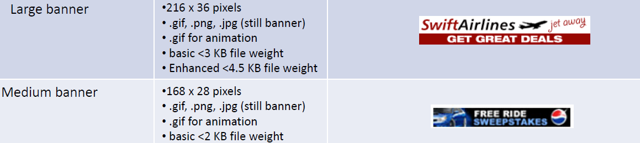
Product – Format (Product specs)
Sizes of banners
Portrait oriented banners are business standard

Slide 11
Product – Destination (Product specs)
Yellow Landing Page
When clicked upon, the user is transferred to the advertiser’s mobile Detail Page, enabling the user to use all available functionalities (map, find contact data, click to call, ...)
Mobile MySite
Designated destination for mobile bannering
User remains within Truvo products
Customer’s mobile website
Customer must have a website that is optimized for mobile
Click to Call
Direct Link to Click 2 Call feature

Slide 12
Product – Targeting (Product specs)
Contextual targeting
Home Page (fixed placement)
Heading (displayed in the results page)
The advertiser will be able to target individual categories, as per the set of headings in BE/ IE and PT
Customers signing in Heading targeting, have no exclusivity. They are guaranteed a min. # 33% share of impressions for the heading that was purchased. If no other advertisers are found, the (single) advertiser signing in, gets 100%
Contextual Targeting (heading / segment) - how it works:

Slide 13
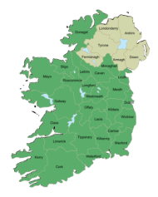
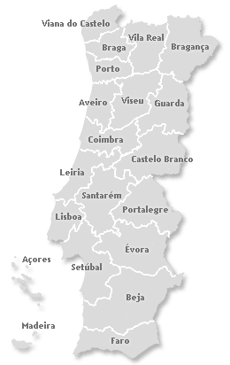
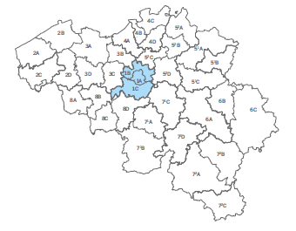
Product – Targeting (Product specs)
Banner Targeting Parameters - details
Geo
Zone (BE) / County (IE) / District (PT)
BE: Takes into consideration the 36 areas that have been defined for WPP
IE: Takes into consideration the 32 Counties
PT: Takes into consideration the 20 Portuguese Districts (including islands)
National level

Slide 14

Product – Targeting (Product specs)
Geo targeting BE
Local Area level
36 areas, defined for WPP rescope
3 area tiers, defined by share of subscribers vs. national # subscr
These 3 area tiers are not to be considered as a differentiator for 2012 price setting. They are to be considered as an additional geotargeting parameter in a second phase of the project.

Slide 15
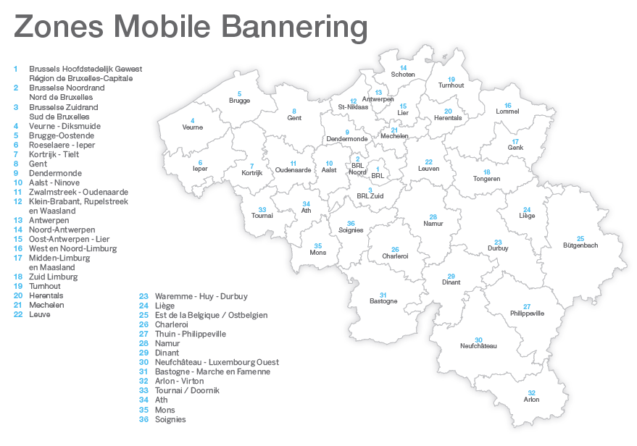


Slide 16

Product – what it is (Product specs)
Geo targeting IE
County level

Slide 17
Product – what it is (Product specs)
Geo targeting
District level :
Açores
Aveiro
Beja
Braga
Bragança
Castelo Branco
Coimbra
Évora
Faro
Guarda
Leiria
Lisboa
Madeira
Portalegre
Porto
Santarém
Setúbal
Viana do Castelo
Vila Real
Viseu

Slide 18
Product – what it is (Product specs)
Geo targeting – “where is display shown? “
Scenarios:

Slide 19

Product – what it is (Product specs)
Time based targeting
Yearly
Season
Monthly
Campaign runs
throughout the
whole year
Campaign runs
throughout 1
specific season, defined as a 3-month period
Campaign runs
throughout 1 specific
month
Time targeting and time flexibility can be defined through a start date and end date for each campaign

Slide 20
Traffic & Business models
 | 2011 (F) | 2012 (P) | 2013 (P)
BE | 2.328.000 | 3.794.640 | 6.109.370
IE | 1.920.000 | 3.129.600 | 4.819.584
PT | 732.000 | 1.127.280 | 1.882.558
Mobile – volume of impressions year
Data: Webtrends
Despite the consistent growth of about 60% a year from 2011 to 2013, the amount of impressions that is expected makes it difficult to enable a CPM based model, especially when trying to enabling granular targeting options like segment or heading – the resulting inventory would be extremely small and hard to manage
Main conclusion follows: pay per inclusion is the best model to monetize mobile - at this stage

Slide 21
Pricing – Yellow
Contextual targeting | Geo Targeting | Monthly | Seasonal (3-month) | Yearly
Home Page |  | 600,00 € | 1.710,00 € | 6.480,00 €
Heading | Zone | 20,00 € | 57,00 € | 216,00 €
 | National | 30,00 € | 85,50 € | 324,00 €
Discount is applied to favour stability and longer-term campaigns
5% Discount
10% Discount
 | Home Page Impressions (month) | Results Page Impressions (month) | Total
Iphone Yellow | 50.000 | 49.000 | 99.000
Mobile Yellow | 35.000 | 60.000 | 95.000
Total | 85.000 | 109.000 | 194.000
Home Page
CPM between €7 (exclusivity) and €21 (3 placements taken)
Heading + National: CPM between €180 (exclusivity) and €550 (3 placements taken)
Heading + Zone: CPM between €275 (exclusivity) and €825 (3 placements taken)

Slide 22
Pricing - White
Contextual targeting | Geo Targeting | Monthly | Seasonal (3-month) | Yearly
Home Page |  | 400,00 € | 1.140,00 € | 4.320,00 €
Results Page | Zone | 20,00 € | 57,00 € | 216,00 €
Discount is applied to favour stability and longer-term campaigns
5% Discount
10% Discount
 | Home Page Impressions (month) | Results Page Impressions (month) | Total
Iphone Yellow | 50.000 | 49.000 | 99.000
Mobile Yellow | 35.000 | 60.000 | 95.000
Total | 85.000 | 109.000 | 194.000
Home Page
CPM between €7 (exclusivity) and €22 (3 placements taken)
Heading + Zone: CPM between €28 (exclusivity) and €75 (3 placements taken)

Slide 23
Pricing – Yellow
Contextual targeting | Geo Targeting | Monthly | Seasonal (3-month) | Yearly
Home Page |  | 400,00 € | 1.140,00 € | 4.320,00 €
Heading | Zone | 20,00 € | 57,00 € | 216,00 €
 | National | 30,00 € | 85,50 € | 324,00 €
Discount is applied to favour stability and longer-term campaigns
5% Discount
10% Discount
 | Home Page Impressions (month) | Results Page Impressions (month) | Total
Iphone Yellow | 11.000 | 10.000 | 21.000
Mobile Yellow | 15.000 | 25.000 | 40.000
Total | 26.000 | 35.000 | 61.000
Home Page
CPM between €12 (exclusivity) and €36 (3 placements taken)
Heading + National: CPM between €850 (exclusivity) and €2500 (3 placements taken)
Heading + Zone: CPM between €571 (exclusivity) and €1700 (3 placements taken)

Slide 24
Pricing - White
Contextual targeting | Geo Targeting | Monthly | Seasonal (3-month) | Yearly
Home Page |  | 100,00 € | 285,00 € | 1.080,00 €
Results Page | Zone | 20,00 € | 57,00 € | 216,00 €
Discount is applied to favour stability and longer-term campaigns
5% Discount
10% Discount
 | Home Page Impressions (month) | Results Page Impressions (month) | Total
Iphone White | 2.000 | 1.500 | 3.500
Mobile White | 3.000 | 3.500 | 6.500
Total | 5.000 | 5.000 | 10.000
Home Page
CPM between €20 (exclusivity) and €60 (3 placements taken)
Heading + Zone: CPM extremely high

Slide 25

Pricing – Yellow
Contextual targeting | Geo Targeting | Monthly | Seasonal (3-month) | Yearly
Home Page |  | 600,00 € | 1.710,00 € | 6.480,00 €
Heading | Zone | 20,00 € | 57,00 € | 216,00 €
 | National | 30,00 € | 85,50 € | 324,00 €
Discount is applied to favour stability and longer-term campaigns
5% Discount
10% Discount
 | Home Page Impressions (month) | Results Page Impressions (month) | Total
Iphone Yellow | 50.000 | 55.000 | 105.000
Mobile Yellow | 15.000 | 40.000 | 55.000
Total | 65.000 | 95.000 | 160.000
Home Page
CPM between €7 (exclusivity) and €23 (3 placements taken)
Heading + National: CPM between €315 (exclusivity) and €950 (3 placements taken)
Heading + Zone: CPM between €210 (exclusivity) and €630 (3 placements taken)

Slide 26
In-App advertising Monetization potential and market sizing
In-App Advertising
Monetization potential
Target segments and market sizing
Short term
Advertiser segments
Monetization options
Item will be sold as a stand alone item to explore increasing appeal behind mobile
Model is pay per inclusion, since traffic, although going up significantly, is still low to enable a CPM based model
Price level includes:
Perceived value behind mobile (Alignment with market CPM done when possible)
Reporting
Key segments:
Existing mobile customers in each unit are expected to convert easily to in-app advertising solution
As mobile penetration grows (including through pure acquisition), so does the size of the addressable market
Long term
End-user segments
Monetization options
Transition model to CPM, to enable better monetization of growing inventory
Suggested price structure and price levels
TBD
Key end-user segments:
All mobile users performing local search including product/brands – this means both:
Direct mobile users
SEO traffic (users coming from search engines)
Notes:
31 March 2011
26

Slide 27
In-App Advertising Go-To-Market for End-Users
In-App Advertising
Description of end-user offering
Key aspects of launch strategy
KPI’s
Serve banners in a contextual manner that is relevant for consumers looking for products and services
Banners will link to a destination addressing consumer needs (information or contact):
My site
Detail page
Customer’s mobile site
Click to call
Create awareness:
Update apps with enhancement
Quantitative:
Impressions
Click through rate
Key initiatives to build end-user loyalty
Enhance search experience and relevancy of banners that are served

Slide 28
In-App Advertising Go-To-Market for Advertisers
In-App Advertising
Description of advertiser offering
Key aspects of sales strategy
KPI’s
Banners displayed in the Home Page and results page of all Truvo mobile platforms (mdot, iphone, ipad and android)
Targeting options (contextual – Home Page or Heading – plus geography) will allow advertisers to address consumer segments with high granularity and conversion
Being pay per inclusion there will be 3 available slots for each targeting combination
Campaign periods are flexible (1 month, 3 month, 1 year) to enable time-specific campaigns
Product availability and specifications:
Product sold as a stand alone item, based on a pay per inclusion model, as traffic grows
Targeting options: contextual – Home Page or Heading – and geography – 3 slots available in each targeting option
Sales effort:
Introduce product in sales automation tools to drive adoption and penetration
Develop clear targets and incentives
Sales Pitch:
Increase advertiser reach by advertising in a platform with increasing popularity and usage
Quantitative:
Penetration
Revenue
ARPA
Key initiatives to increase advertiser spending
Target existing mobile customers
Target existing display advertising customers
Train and focus sales force on importance and relevance of mobile offering

Slide 29
Agenda
Sections
Executive Summary
Value Proposition
Impact Analysis
Financials
Planning and Next Steps
Back-Up

Slide 30
Impact Analysis - Product Definition In-App Advertising
Impact Analysis
Summary
Develop
Maintain
Product Definition
Display Advertising in Truvo’s mobile platforms
..
Business Requirement(s)
Assumptions, impact, risks and mitigation
Resources needed for development / maintenance
Product features and functionality
Develop mdot and apps to serve banners according to business (targeting rules)
Develop items in IT systems to enable keying, management , invoicing and reporting
Develop inventory management tool to control existing inventory (in the short term: fixed placements; in the medium term: impressions)
Pricing and discounts
Fixed price depending on targeting options
Campaign period is flexible, with increasing discounts as period of campaign increases
Bundling
Stand alone item
Business Rules
Sold according to targeting options and constraints in terms of available fixed inventory per targeting option (max 3)
Relationship with existing products
Integration with mobile platforms
No relationship with other commercial products, since banners will be sold as stand alone items.
Assumptions
Model is pay per inclusion
Inventory management tool is in place
Ad server is fully operational
Impact
AS400/ BIRDS
mdot
iphone, ipad and android apps
Truvo Tech db for Reporting
Risks and mitigation
Plan with New Media
AREA | Design | Build | Test | Maintain
AS 400
Birds
Mdot
Iphone app
Android app
Truvo Tech
30
Notes:
31 March 2011
30

Slide 31
Impact Analysis - Sales In-App Advertising
Impact Analysis
Summary
Develop
Maintain
Sales
In-App advertising is a new product in mobile. Training on product and sales pitch is required
..
Business Requirement(s)
Assumptions, impact, risks and mitigation
Resources needed for development / maintenance
Training materials
Sales Collateral
training program
Training
Training of sales staff on virtual paper as part of sales cycle launch 2011 training
Sales materials
Sales Collateral
Sales automation tools adjusted to enable product
Price setting
Fixed price depending on targeting options
Campaign period is flexible, with increasing discounts as period of campaign increases
Assumptions
In-App advertising to be launched as part of the September canvass
Adjustment of sales automation tools to enable product offering
Impact
Development of specific training materials on in-app advertising and training of sales personnel to be aligned with Sales and included in national training calendars
Risk and mitigation
Plan with Sales
AREA | Design | Build | Test | Maintain
Sales automation tools
..
31
Notes:
31 March 2011
31

Slide 32
Impact Analysis - Fulfilment In-App Advertising
Impact Analysis
Summary
Develop
Maintain
Fulfilment
Fulfillment requires developments in the host systems, acquisition of ad serving capabilities, creation of ads, and inventory management tools
Business Requirement(s)
Assumptions, impact, risks and mitigation
Resources needed for development / maintenance
Contract loading
No specific requirements - contract loading to be done ‘as usual’ through existing tools
developments in AS400 and Birds required
Contract confirmation
No specific requirements, contract confirmation to be done ‘as usual’
Fulfilment / Delivery
Loading of contract in host system
Creation of ads
Loading of ads in ad server with campaign details
Billing and collections
Product is billed separately
Collections to be done ‘as usual’
Canvass Management
Considering that item could be sold for periods shorter than 1 year, CO to be renewed needs to be handled differently
Campaign management
An ad server is required to manage the campaigns and gather additional information about usage
An inventory management tool is required to keep track of existing inventory (in the short term there are 3 fixed slots; in the medium term, inventory is constrained by volume of impressions)
Assumptions
In-app advertising will go live in september
Ad server will be in place to serve banners
Impact
Creation of ads done in Ops
Loading of ads in ad server
Control of available inventory though automated system
Risks and mitigation
Planning with Ops
AREA | Design | Build | Test | Maintain
Selligent
Backoffice Fulfilment
32
Notes:
31 March 2011
32

Slide 33
Impact Analysis - Support In-App Advertising
Impact Analysis
Summary
Develop
Maintain
Support
Initial training support (integrated in cycle launch) and support to Ops and Customer Care
..
Business Requirement(s)
Assumptions, impact, risks and mitigation
Resources needed for development / maintenance
Training materials
Sales Collateral
Training
Training of sales staff as part of Truvo Cycle launch 2011
Training of Ops and Customer Care
Complaint handling
Business as Usual, no additional requirements
Database management
Business as Usual, no additional requirements
Assumptions
Training to customer care and Ops provided by Sales Training
Impact
Development of training materials and training of support personnel to be aligned with Operations and included in national training calendars
Logging of complaints (by advertisers should be enabled in Selligent
Risk and mitigation
None
AREA | Design | Build | Test | Maintain
Back Office 2nd line support
33
Notes:
31 March 2011
33

Slide 34
Impact Analysis - Reporting In-App Advertising
Impact Analysis
Summary
Develop
Maintain
Reporting
Both sales as usage statistics need to be tracked into the reporting systems and included in advertisers’ analytics
..
Business Requirement(s)
Assumptions, impact, risks and mitigation
Resources needed for development / maintenance
Internal reporting
Included in Marketing Datawarehouse for product performance tracking
Extended usage statistics via Webtrends tagging
Extra Reporting available through ad server
External reporting
Analytics to be available in Truvo Lounge
Assumptions
All relevant metrics (impressions and clicks) are tagged and measured..
Impact
Webtrends Tagging
Info storage in Datawarehouse
Truvo Lounge
Risks and mitigation
Planning with New Media
AREA | Design | Build | Test | Maintain
Webtrends
DWH
34
Notes:
31 March 2011
34

Slide 35
Impact Analysis – Summary and recommendations Virtual Paper
Impact Analysis
Summary
Develop
Maintain
Summary
..
Resources needed for development / maintenance
Conclusions and recommendations
TOTAL | Design | Build | Test | Maintain
AS400
Birds
MySites
Yellow
Truvo Tech
Propricing
Selligent
Backoffice
Support
Webtrends
DWH
Conclusion
..
Recommendations
..
Earliest possible launch date
..
Major risks and dependencies
..
35
Notes:
31 March 2011
35

Slide 36
Agenda
Sections
Executive Summary
Value Proposition
Impact Analysis
Financials
Planning and Next Steps
Back-Up

Slide 37
In-App Advertising
In-App Advertising Detailed forecast, Belgium
Virtual Paper
BELGIUM | 2011 | 2012 | 2013
Addressable market
Mobile Customers | 26.339 | 55.800 | 60.450
Home Page
Expected penetration on addressable market | 0,01% | 0,01% | 0,00%
Expected ARPA (€ per year) | 6.480 | 7.128 | 7.484
Total Order Input | 19.440 | 21.384 | 20.726
Heading + National
Expected penetration on addressable market | 0,35% | 0,53% | 0,53%
Expected ARPA (€ per year) | 164 | 214 | 246
Total Order Input | 14.969 | 62.552 | 71.935
Heading + Zone
Expected penetration on addressable market | 0,64% | 0,98% | 0,98%
Expected ARPA (€ per year) | 110 | 142 | 164
Total Order Input | 18.533 | 77.446 | 89.062
TOTAL ORDER INPUT | 52.942 | 161.382 | 181.723
Penetration Assumptions
Total:
Home Page: 3 available slots taken
Results page (heading national or heading zone): penetration limited by inventory of targeting combinations
Product repartition:
Home Page: inventory limited to 3 slots
In results page, heading zone will be favoured over heading national (65/ 35)
Time split – 1 month/ 3 month/ 1 year campaigns: 30/ 30/ 40
ARPA Assumptions:
ARPA reflects ratecard applied to assumptions above
Price increase of 10% in 2012 and 5% in 2013
Launch Assumptions:
September 1
Notes:
31 March 2011
37

Slide 38
In-App Advertising
In-App Advertising Detailed forecast, Ireland
Virtual Paper
IRELAND | 2011 | 2012 | 2013
Addressable market
Mobile Customers | 5.500 | 8.320 | 8.320
0
Home Page
Expected penetration on addressable market | 0,05% | 0,04% | 0,04%
Expected ARPA (€ per year) | 1.425 | 5.940 | 6.237
Total Order Input | 4.275 | 17.820 | 18.711
Heading + National
Expected penetration on addressable market | 0,33% | 0,53% | 0,53%
Expected ARPA (€ per year) | 164 | 214 | 246
Total Order Input | 2.989 | 9.327 | 10.726
Heading + Zone
Expected penetration on addressable market | 0,61% | 0,98% | 0,98%
Expected ARPA (€ per year) | 110 | 142 | 164
Total Order Input | 3.701 | 11.547 | 13.280
TOTAL ORDER INPUT | 10.965 | 38.694 | 42.716
Penetration Assumptions
Total:
Home Page: 3 available slots taken
Results page (heading national or heading zone): penetration limited by inventory of targeting combinations
Product repartition:
Home Page: inventory limited to 3 slots
In results page, heading zone will be favoured over heading national (65/ 35)
Time split – 1 month/ 3 month/ 1 year campaigns: 30/ 30/ 40
ARPA Assumptions:
ARPA reflects ratecard applied to assumptions above
Price increase of 10% in 2012 and 5% in 2013
Launch Assumptions:
September 1
Notes:
31 March 2011
38

Slide 39
In-App Advertising
In-App Advertising Detailed forecast, Portugal
Virtual Paper
PORTUGAL | 2011 | 2012 | 2013
Addressable market
Mobile Customers | 18.567 | 37.800 | 37.170
0
Home Page
Expected penetration on addressable market | 0,02% | 0,01% | 0,01%
Expected ARPA (€ per year) | 3.240 | 3.564 | 3.742
Total Order Input | 9.720 | 10.692 | 11.417
Heading + National
Expected penetration on addressable market | 0,34% | 0,53% | 0,53%
Expected ARPA (€ per year) | 223 | 290 | 333
Total Order Input | 14.261 | 57.544 | 66.175
Heading + Zone
Expected penetration on addressable market | 0,64% | 0,98% | 0,98%
Expected ARPA (€ per year) | 110 | 142 | 164
Total Order Input | 13.002 | 52.463 | 60.333
TOTAL ORDER INPUT | 36.982 | 120.699 | 137.925
Penetration Assumptions
Total:
Home Page: 3 available slots taken
Results page (heading national or heading zone): penetration limited by inventory of targeting combinations
Product repartition:
Home Page: inventory limited to 3 slots
In results page, heading zone will be favoured over heading national (65/ 35)
Time split – 1 month/ 3 month/ 1 year campaigns: 10/ 30/ 60
ARPA Assumptions:
ARPA reflects ratecard applied to assumptions above
Price increase of 10% in 2012 and 5% in 2013
Launch Assumptions:
September 1
Notes:
31 March 2011
39

Slide 40
In-App Advertising Detailed forecast, all markets
In-App Advertising
ALL MARKETS | 2010 | 2011 | 2012
Addressable market
Mobile Customers | 50.406 | 101.920 | 105.940
0
Home Page
Expected penetration on addressable market | 0,02% | 0,01% | 0,01%
Expected ARPA (€ per year) | 3.715 | 5.544 | 5.650
Total Order Input | 33.435 | 49.896 | 50.854
Heading + National
Expected penetration on addressable market | 0,34% | 0,53% | 0,53%
Expected ARPA (€ per year) | 186 | 242 | 268
Total Order Input | 32.219 | 129.422 | 148.836
Heading + Zone
Expected penetration on addressable market | 0,64% | 0,98% | 0,98%
Expected ARPA (€ per year) | 110 | 142 | 157
Total Order Input | 35.236 | 141.456 | 162.674
TOTAL ORDER INPUT | 100.890 | 320.775 | 362.364
Assumptions & Comments
Total penetration is limited by available inventory dictated by targeting combinations from pay per inclusion model
Volume is expected to increase though, through increased penetration in Year 2 and enhanced mobile adoption generally speaking
Growth is also enabled through price increases in Year 2 and 3, following expected traffic growth, and corresponding impact on volume of impressions
Launch Assumptions:
September 1
Notes:
31 March 2011
40

Slide 41
In-App Advertising Revenue forecast
In-App Advertising
Incremental revenues, total group
Incremental margins (excl. Investments/CSC), total group

Slide 42
In-App Advertising Margin and Free Cash Flow forecast
In-App Advertising
Incremental margin, total group*
Key assumptions
Product related investment
Key assumptions
Ad server set-up: € 20K
Inventory management tool: € 20k
Cost of Goods Sold (COGS)
Key assumptions
Cost of impressions sold: €0,10 CPM house banners
Creativity: costs negligible
Cost of Sales / Service (COS)
Key assumptions
Incremental sales commission 8% on OI
* Excluding cumulated CSC of 131K€

Slide 43
Agenda
Sections
Executive Summary
Value Proposition
Impact Analysis
Financials
Planning and Next Steps
Back-Up

Slide 44
In-App Advertising High level project plan
In-App Advertising
 |  | 2009 |  |  | 2010
Product / Enabler | Owner | Nov | Dec | Jan | Feb | Mar | Apr | May | Jun | Jul | Aug | Sep | Oct | Nov | Dec | Jan
Idea Generation
[Name PM]
Idea
Concept Development
[Name PM]
Concept
1
Business Case
[Name PM]
BC
2
Implementation
[Name PM]
Implementation
3
Commercial Launch
[Name PM]
L BE
L
[other activities]
[name owner]
[other activities]
[name owner]
[other activities]
[name owner]
[other activities]
[name owner]
[other activities]
[name owner]
Legend
[other activities]
[name owner]
GC: Approval to start concept development
[other activities]
[name owner]
1
TLT: TG1, approval to start Business Case
2
TLT: TG2, approval to start implementation
[other activities]
[name owner]
3
TLT: TG3, approval for commercial launch
today
L
Commercial launch

Slide 45
Virtual Paper Resources needed for implementation
In-App Advertising
Role | Name | Available | Comments
Product Manager | Gert Van Steen |  | 50%
Project Manager / TPM |  | 
Operations | name] |  | See impact analysis
IT / AS400 | [name] |  | See impact analysis
IT / Selligent, SCM | [name] |  | See impact analysis
IT / Truvo Lounge, reporting | [name] |  | See impact analysis
New Media / Yellow | [name] |  | See impact analysis
New Media / MySite | [name] |  | See impact analysis
Legend

Available

Not available
Check not performed yet


Slide 46
Virtual Paper Resources needed for Go-To-Market
In-App Advertising
Role | Name | Available | Comments
Product Manager | Gert Van Steen |  | 30%
Sales representative Belgium | Katrijn Steenbeke |  | X%, from a/a/a to b/b/b
Sales representative Ireland | TBC |  | X%, from a/a/a to b/b/b
Sales representative Portugal | TBC |  | X%, from a/a/a to b/b/b
Legend

Available

Not available
Check not performed yet


Slide 47
Agenda
Sections
Executive Summary
Value Proposition
Impact Analysis
Financials
Planning and Next Steps
Back-Up

