Slide 1
Retrieval-Augmented Generation (RAG) Overview

Slide 2
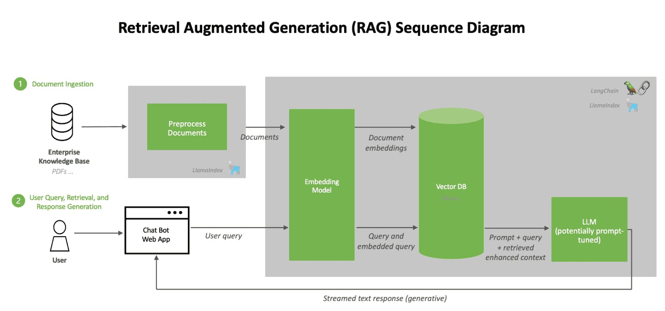
1.What is RAG?
RAG combines Information Retrieval + Large Language Models.
Retrieves external knowledge before answering.
Produces factual and grounded responses.
Reduces hallucinations.

Slide 3
2. Why RAG is Needed
LLMs have limited or outdated internal knowledge.
RAG accesses private or live data.
Ensures accuracy and context awareness.
Reduces hallucinations.

Slide 4
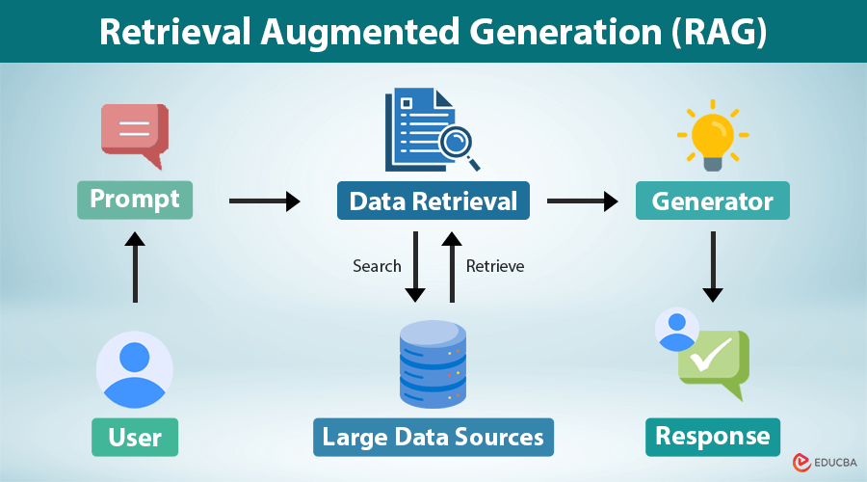
3. RAG Architecture
Two main components:
1) Retrieval Module – fetches relevant text chunks.
2) Generation Module – LLM uses retrieved context.
Flow: Query → Retrieval → Context → LLM → Answer.

Slide 5
4. Chunking (Text Splitting)
Splits large documents into smaller pieces.
Using Recursive Character Chunking.
Chunk size: 500 chars, overlap: 80.
Preserves meaning for better retrieval.

Slide 6
5. Embeddings
Converts text into numerical vectors.
Similar meanings create similar embeddings.
Enables semantic (meaning-based) search.
Foundation of retrieval in RAG.

Slide 7
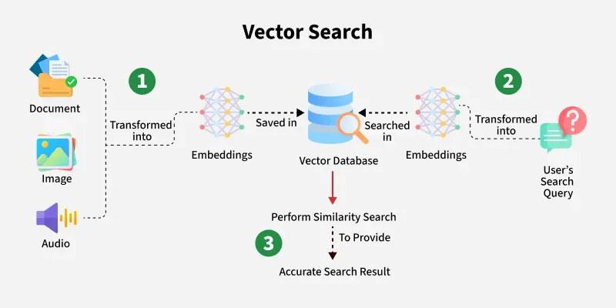
6. FAISS & Semantic Search
FAISS:
High-performance vector store from Meta.
Stores embeddings for fast search.
Semantic Search:
Finds meaning-based matches.
Query → embedding → nearest document vectors.

Slide 8
7. Generation using LLM
Retrieved context is passed into the prompt.
Gemini 2.5 Flash generates grounded answers.
Ensures answers are factual and context-aware.

Slide 9
8. Limitations of RAG
Retrieval errors lead to wrong answers
Chunking must be tuned
Vector search may bring irrelevant chunks
Hallucinations can still occur
Embedding model quality matters

Slide 10
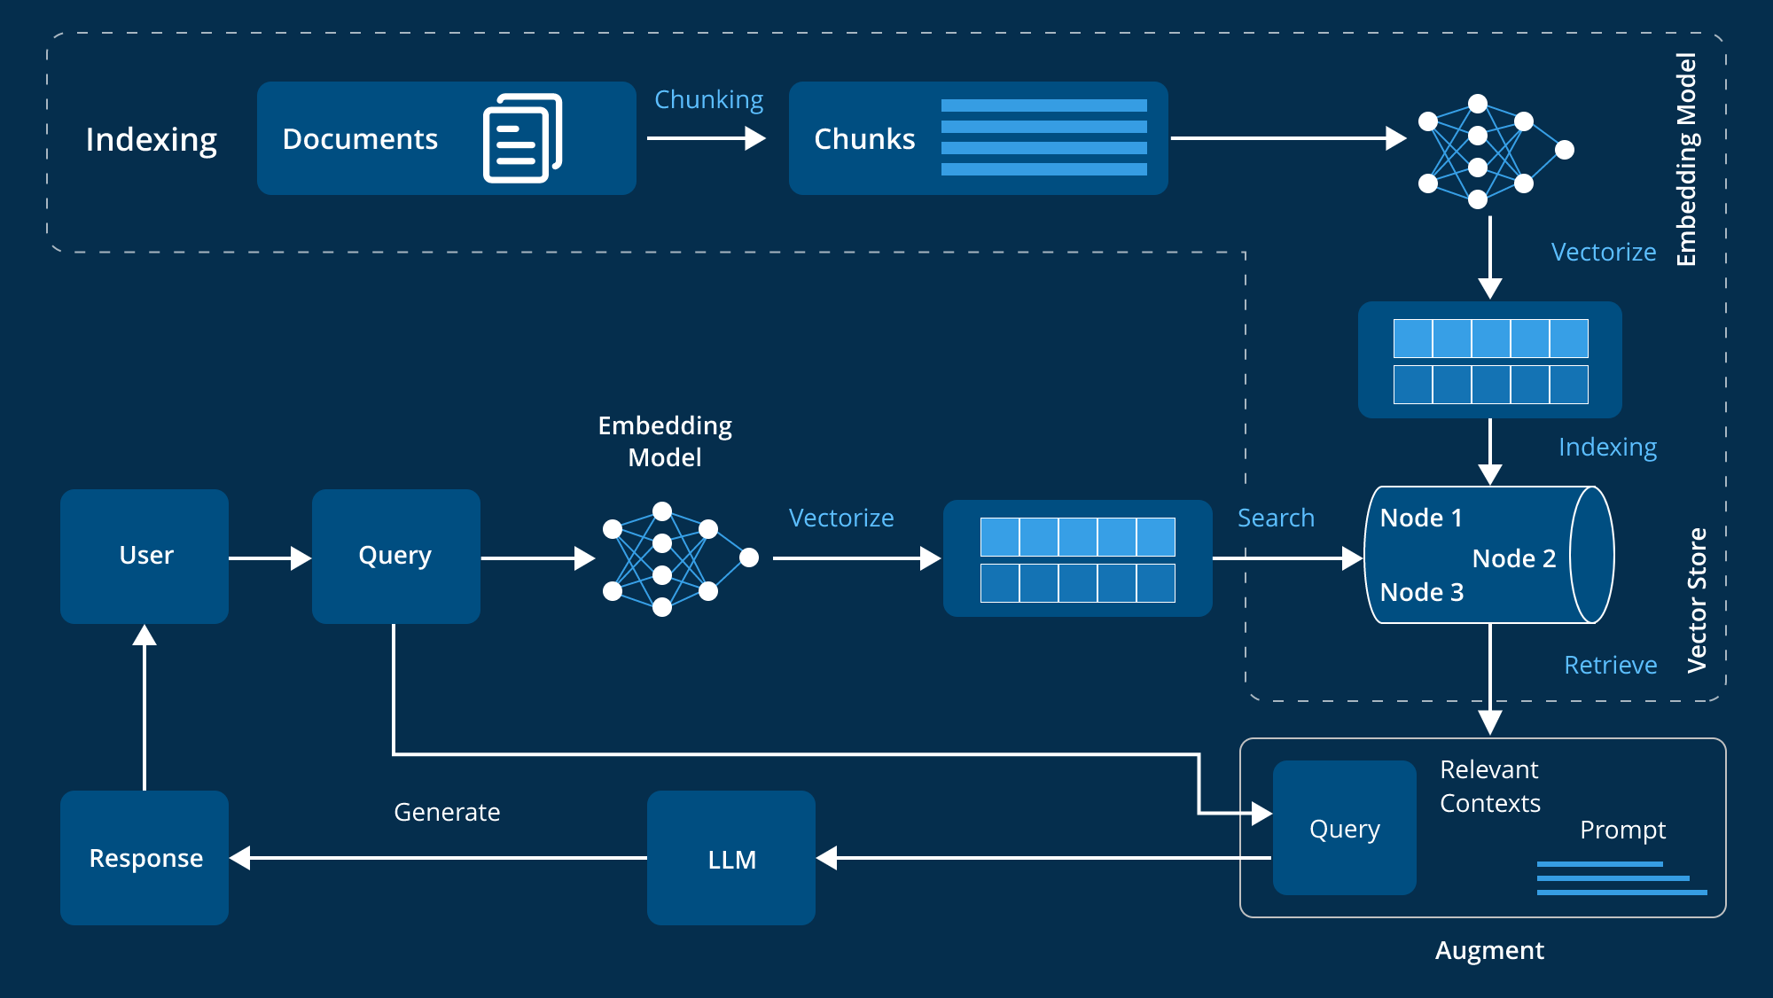
9. Summary
RAG = Retrieval + Generation.
Key elements: Chunking, Embeddings, FAISS, Semantic Search.
More reliable than standalone LLMs.
Useful for enterprise Q&A and search systems.

