Slide 1
Legal-Serve On-Boarding Platform
CSE7101- Capstone Project
Batch Number: CSE_46
Under the Supervision of,
Ms. Sushmitha S S
School of Computer Science and Engineering
Presidency University
Roll Number | Student Name
20221CSE0498 | AVANI M
20221CSE0533 | LIKITHA N
20221CSE0543 | POOJA Y
Name of the Program: Computer Science And Engineering
Name of the HoD: Dr. Asif Mohammed
Name of the Program Project Coordinator: Dr. Jayavadivel Ravi
Name of the School Project Coordinators: Dr. Sampath A K , Dr. Geetha A

Slide 2
Problem Statement Number: PSCS_3
Organization: Ministry of Law and Justice
Category (Hardware / Software / Both) : Software
Problem Description:
Incentives based Design for onboarding Legal Service Providers such as Advocates, Arbitrators, Mediators, Notaries, Document Writers, etc. on e-Market Place for extending Legal Services to Citizens in India.

Slide 3
PROBLEM STATEMENT AND OBJECTIVES
“ Incentives-Based Design for Onboarding Legal Service Providers
such as Advocates, Arbitrators, Mediators, Notaries, Document
Writers, etc., on e-Marketplace for Extending Legal Services to
Citizens in India. ”
A web-based e-Marketplace.
Incentive-driven system
Accessibility and affordability of legal services
Trust, transparency, and quality in the delivery of legal services

Slide 4
Background and Related Work
India faces significant gaps in access to affordable and timely legal services.
In India, the integration of advocates, notaries, mediators, and document writers into a centralized, citizen-centric online platform remains underdeveloped.
Incentive-based models—commonly used in marketplaces like ride-sharing (Uber/Ola), freelancing (Upwork), and e-commerce—can be adapted to legal service delivery.

Slide 5
Analysis of Problem Statement
Access to affordable and reliable legal services in India remains limited, especially for citizens in rural and semi-urban areas.
Many legal service providers—such as advocates, arbitrators, mediators, notaries, and document writers—struggle to reach potential clients due to a lack of digital presence or awareness among citizens.
An e-marketplace for legal services can bridge this gap, but its success depends on onboarding a critical mass of qualified service providers.

Slide 6
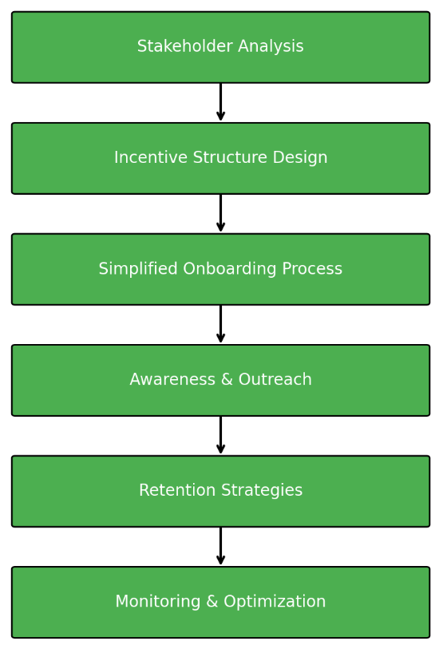
Proposed Methodology
Fig : 01

Slide 7
Proposed Methodology
Stakeholder Analysis:
Identify target legal service providers and understand their needs, challenges, and motivations.
2.Incentive Structure Design
  Financial Incentives: Reduced commission for early adopters, referral bonuses, milestone rewards.
  Non-Financial Incentives: Verified professional badges, priority listing, marketing support.
  Performance Rewards: Increased visibility for high-rated and active providers.
3.Simplified Onboarding Process:
Minimal documentation, multilingual support, and guided registration.
4.Awareness & Outreach
Collaborations with bar associations, legal forums, and digital campaigns.
5.Retention Strategies
Exclusive benefits for active members, regular training, and platform updates.
6.Monitoring & Optimization
Track engagement metrics and adjust incentives based on performance data.

Slide 8
Overview Of The Project
Problem:
Limited Access to Justice
Accessibility: Limited reach for citizens.
Delays: Slow service delivery.
Affordability: High cost of legal advice
A key challenge is onboarding and retaining legal service providers to extend quality services to rural and semi-urban areas.

Slide 9
Critique of Current Approaches
Limitations of Existing Approaches
Existing legal aid portals and e-governance apps lack sufficient incentives to retain providers, leading to low participation and unequal service distribution.
[1] Low Provider Participation: Many systems are transaction-based only.
Unequal Distribution: Services concentrated in urban areas, neglecting rural regions.
[2] Poor Quality Monitoring: Lack of robust mechanisms to track service quality.

Slide 10
Insights of Research Paper
Insights from Literature
Our approach is informed by comprehensive research into e-governance, incentive systems, crowdsourcing, and digital inclusion.
[3] Crowdsourcing: Monetary and non-monetary rewards boost participation.
Digital Governance: Incentives increase user adoption of government services.
[4] Legal-Tech: Transparency, accessibility, and affordability bridge justice gaps.
Hybrid Models: Financial and recognition incentives sustain long-term engagement.

Slide 11
Our Innovation
Multi-Dimensional Incentive Model
Our proposed solution rewards providers based on monetary, recognition, and social incentives, integrated into existing e-governance apps.
Monetary: Payment for services rendered.
Recognition: Badges, certifications, rankings.
Social: Contribution recognition in government reports.

Slide 12
Our Solution
Incentivizing Legal Professionals
Our objective is to design an incentive-based framework that motivates legal professionals and organizations to join a digital platform, making legal services more accessible and reliable.
Digital Platform: A centralized hub for legal services.
Incentive Model: Rewarding participation and quality.
Accessible Services: Reaching more citizens.

Slide 13
Key Goals
Measurable Objectives
Increase Onboarding(30%): More legal professionals in the first year.
Improve Accessibility(70%): Citizens in pilot regions reach digital legal services.
Enhance Quality(80%): User satisfaction with service ratings.
Sustain Engagement(60%): Active participation of providers over time.

Slide 14
System Architecture and Modules
Incentive Engine: Monitors participation, allocates rewards.
A motivational system designed to encourage active participation from both citizens and service providers.
Data Management: Citizen records and case history.
A secure and centralized repository that handles all citizen records, case histories, and provider information.
Analytics & Feedback: Quality checks and reporting.
Provides insights into system performance, user satisfaction, and overall effectiveness of legal service delivery.

Slide 15
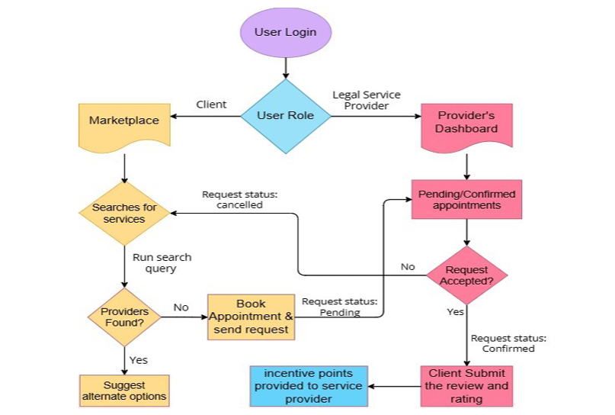
System Architecture and Modules (Block diagram)

Slide 16
Requirements
Software Requirements:
Operating System: Windows 10 or above
Frontend: HTML5, CSS3, JavaScript (React)
Backend: Node.js
Database: MySQL
Server: Apache or AWS Cloud Hosting
Tools: VS Code, Git

Slide 17
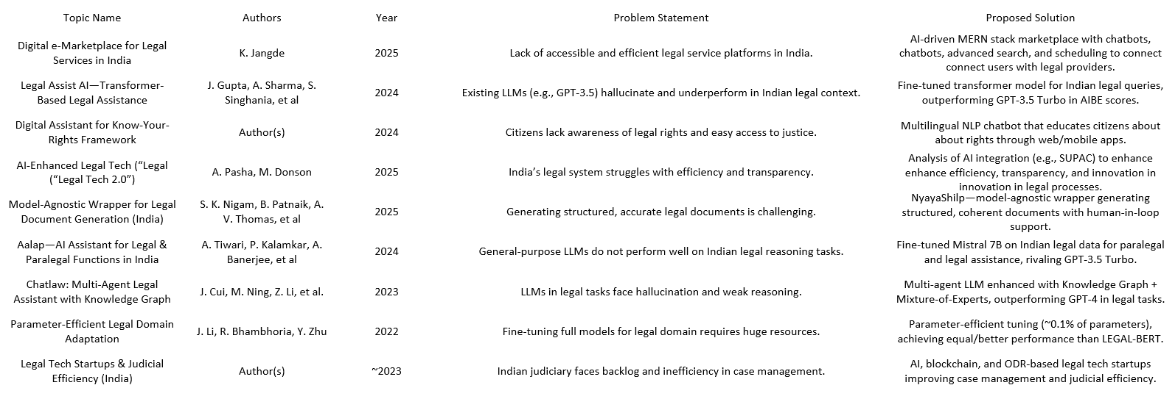
Literature Review

Slide 18
Future Scope:
Integrate AI-driven legal document assistance.
Expand platform to cover pan-India multilingual support.
Incorporate blockchain-based contract and case tracking for enhanced security.

Slide 19


