Slide 1
Legal-Serve On-Boarding Platform
CSE7101- Capstone Project
Review-1
Batch Number: CSE_46
Under the Supervision of,
Ms. Sushmitha S S
School of Computer Science and Engineering
Presidency University
Roll Number | Student Name
20221CSE0498 | AVANI M
20221CSE0533 | LIKITHA N
20221CSE0543 | POOJA Y
Name of the Program: Computer Science And Engineering
Name of the HoD: Dr. Asif Mohammed
Name of the Program Project Coordinator: Dr. Jayavadivel Ravi
Name of the School Project Coordinators: Dr. Sampath A K , Dr. Geetha A

Slide 2
Problem Statement Number: PSCS_3
Organization: Ministry of Law and Justice
Category (Hardware / Software / Both) : Software
Problem Description: Incentives based Design for onboarding Legal Service
Providers such as Advocates, Arbitrators, Mediators, Notaries, Document
Writers, etc on eMarket Place for extending Legal Services to Citizens in India

Slide 3
Content
Problem Statement
Objectives
Background and Related work for title Selection
Analysis of Problem Statement
Innovation or Novel Contributions
Git-hub Link
Timeline of the Project
References

Slide 4
PROBLEM STATEMENT AND OBJECTIVES
“ Incentives-Based Design for Onboarding Legal Service Providers
such as Advocates, Arbitrators, Mediators, Notaries, Document
Writers, etc., on e-Marketplace for Extending Legal Services to
Citizens in India. ”
A web-based e-Marketplace.
Incentive-driven system
Accessibility and affordability of legal services
Trust, transparency, and quality in the delivery of legal services

Slide 5
Background and Related Work
India faces significant gaps in access to affordable and timely legal services.
In India, the integration of advocates, notaries, mediators, and document writers into a centralized, citizen-centric online platform remains underdeveloped.
Incentive-based models—commonly used in marketplaces like ride-sharing (Uber/Ola), freelancing (Upwork), and e-commerce—can be adapted to legal service delivery.

Slide 6
Analysis of Problem Statement (contd...)
Access to affordable and reliable legal services in India remains limited, especially for citizens in rural and semi-urban areas.
Many legal service providers—such as advocates, arbitrators, mediators, notaries, and document writers—struggle to reach potential clients due to a lack of digital presence or awareness among citizens.
An e-marketplace for legal services can bridge this gap, but its success depends on onboarding a critical mass of qualified service providers.

Slide 7
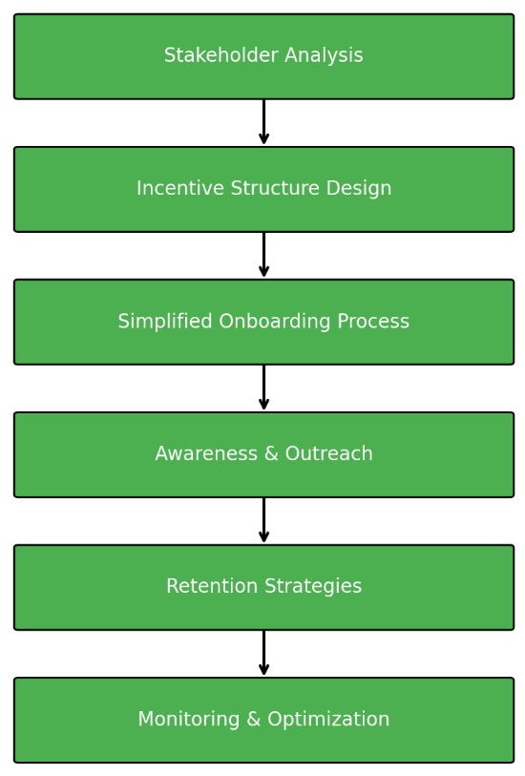
Proposed Methodology
Fig : 01

Slide 8
Proposed Methodology
Stakeholder Analysis:
Identify target legal service providers and understand their needs, challenges, and motivations.
2.Incentive Structure Design
Financial Incentives: Reduced commission for early adopters, referral bonuses, milestone rewards.
Non-Financial Incentives: Verified professional badges, priority listing, marketing support.
Performance Rewards: Increased visibility for high-rated and active providers.
3.Simplified Onboarding Process:
Minimal documentation, multilingual support, and guided registration.
4.Awareness & Outreach
Collaborations with bar associations, legal forums, and digital campaigns.
5.Retention Strategies
Exclusive benefits for active members, regular training, and platform updates.
6.Monitoring & Optimization
Track engagement metrics and adjust incentives based on performance data.

Slide 9
Requirements
Software Requirements:
Operating System: Windows 10 or above
Frontend: HTML5, CSS3, JavaScript (React)
Backend: Node.js
Database: MySQL
Server: Apache or AWS Cloud Hosting
Tools: VS Code, Git

Slide 10
Future Scope:
Integrate AI-driven legal document assistance.
Expand platform to cover pan-India multilingual support.
Incorporate blockchain-based contract and case tracking for enhanced security.

Slide 11
References (IEEE Paper format)
P. R. Karnale, S. R. Chavan, A. B. Chougale, and A. A. Patil , “Incentives based Design for onboarding Legal Service Providers for Extending Legal Services to Citizens in India” , *International Journal of Scientific Research in Engineering and Management (IJSREM)*, vol. no. 7 (10, Oct. 2023).

Slide 12
Github Link
Github Link
https://github.com/Avani-04/Legal-Serve-On-Board-Platform
https://github.com/Pooja-9192/Dev-doodles.git
https://github.com/Likitha-2122/shiny-goggles

Slide 13
Timeline of the Project (Gantt Chart)
Timeline as follow’s
Phase 1
Planning & Research
Phase 2
Development Setup
Phase 3
Implementation & Finalization
Requirement gathering
Literature review & problem statement finalization
System design and architecture planning
Backend development and database setup
Integration of core marketplace features
Incentive mechanism & gamification integration
Testing & debugging
Deployment and documentation submission
Frontend UI/UX design initiation

Slide 14


