Slide 1
Legal-Serve On-Boarding Platform
CSE7101- Capstone Project
Review-2
Batch Number: CSE_46
Under the Supervision of,
Ms. Sushmitha S S
School of Computer Science and Engineering
Presidency University
Roll Number | Student Name
20221CSE0498 | AVANI M
20221CSE0533 | LIKITHA N
20221CSE0543 | POOJA Y
Name of the Program: Computer Science And Engineering
Name of the HoD: Dr. Asif Mohammed
Name of the Program Project Coordinator: Dr. Jayavadivel Ravi
Name of the School Project Coordinators: Dr. Sampath A K , Dr. Geetha A

Slide 2
Problem Statement Number: PSCS_3
Organization: Ministry of Law and Justice
Category (Hardware / Software / Both) : Software
Problem Description: Incentives based Design for onboarding Legal Service
Providers such as Advocates, Arbitrators, Mediators, Notaries, Document
Writers, etc. on e-Market Place for extending Legal Services to Citizens in India

Slide 3
Content
Overview Of The Project
Review Of Research Paper
Goals Of The Project
Summary and critique of current approaches
Innovation or Novel Contributions
System Architecture and modules
Technologies used
Timeline of the Project
References

Slide 4
Overview Of The Project
Problem:
Limited Access to Justice
Accessibility: Limited reach for citizens.
Delays: Slow service delivery.
Affordability: High cost of legal advice
A key challenge is onboarding and retaining legal service providers to extend quality services to rural and semi-urban areas.

Slide 5
Our Solution
Incentivizing Legal Professionals
Our objective is to design an incentive-based framework that motivates legal professionals and organizations to join a digital platform, making legal services more accessible and reliable.
Digital Platform: A centralized hub for legal services.
Incentive Model: Rewarding participation and quality.
Accessible Services: Reaching more citizens.

Slide 6
Literature Review
Topic Name | Authors | Year | Problem Statement | Proposed Solution
Digital e-Marketplace for Legal Services in India | K. Jangde | 2025 | Lack of accessible and efficient legal service platforms in India. | AI-driven MERN stack marketplace with chatbots, advanced search, and scheduling to connect users with legal providers.
Legal Assist AI—Transformer-Based Legal Assistance | J. Gupta, A. Sharma, S. Singhania, et al. | 2024 | Existing LLMs (e.g., GPT-3.5) hallucinate and underperform in Indian legal context. | Fine-tuned transformer model for Indian legal queries, outperforming GPT-3.5 Turbo in AIBE scores.
Digital Assistant for Know-Your-Rights Framework | Author(s) | 2024 | Citizens lack awareness of legal rights and easy access to justice. | Multilingual NLP chatbot that educates citizens about rights through web/mobile apps.

Slide 7
Literature Review
Topic Name | Authors | Year | Problem Statement | Proposed Solution
AI-Enhanced Legal Tech ("Legal Tech 2.0") | A. Pasha, M. Donson | 2025 | India’s legal system struggles with efficiency and transparency. | Analysis of AI integration (e.g., SUPACE) to enhance efficiency, transparency, and innovation in legal processes.
Model-Agnostic Wrapper for Legal Document Generation (India) | S. K. Nigam, B. D. Patnaik, A. V. Thomas, et al. | 2025 | Generating structured, accurate legal documents is challenging. | NyayaShilp—model-agnostic wrapper generating structured, coherent documents with human-in-loop support.
Aalap—AI Assistant for Legal & Paralegal Functions in India | A. Tiwari, P. Kalamkar, A. Banerjee, et al. | 2024 | General-purpose LLMs do not perform well on Indian legal reasoning tasks. | Fine-tuned Mistral 7B on Indian legal data for paralegal and legal assistance, rivaling GPT-3.5 Turbo.

Slide 8
Literature Review
Topic Name | Authors | Year | Problem Statement | Proposed Solution
Chatlaw: Multi-Agent Legal Assistant with Knowledge Graph | J. Cui, M. Ning, Z. Li, et al. | 2023 | LLMs in legal tasks face hallucination and weak reasoning. | Multi-agent LLM enhanced with Knowledge Graph + Mixture-of-Experts, outperforming GPT-4 in legal tasks.
Parameter-Efficient Legal Domain Adaptation | J. Li, R. Bhambhoria, X. Zhu | 2022 | Fine-tuning full models for legal domain requires huge resources. | Parameter-efficient tuning (~0.1% of parameters), achieving equal/better performance than LEGAL-BERT.
Legal Tech Startups & Judicial Efficiency (India) | Author(s) | ~2023 | Indian judiciary faces backlog and inefficiency in case management. | AI, blockchain, and ODR-based legal tech startups improving case management and judicial efficiency.

Slide 9
Summary and Critique of Current Approaches
Limitations of Existing Approaches
Existing legal aid portals and e-governance apps lack sufficient incentives to retain providers, leading to low participation and unequal service distribution.
[1] Low Provider Participation: Many systems are transaction-based only.
Unequal Distribution: Services concentrated in urban areas, neglecting rural regions.
[2] Poor Quality Monitoring: Lack of robust mechanisms to track service quality.

Slide 10
Insights of Research Paper
Insights from Literature
Our approach is informed by comprehensive research into e-governance, incentive systems, crowdsourcing, and digital inclusion.
[3] Crowdsourcing: Monetary and non-monetary rewards boost participation.
Digital Governance: Incentives increase user adoption of government services.
[4] Legal-Tech: Transparency, accessibility, and affordability bridge justice gaps.
Hybrid Models: Financial and recognition incentives sustain long-term engagement.

Slide 11
Our Innovation
Multi-Dimensional Incentive Model
Our proposed solution rewards providers based on monetary, recognition, and social incentives, integrated into existing e-governance apps.
Monetary: Payment for services rendered.
Recognition: Badges, certifications, rankings.
Social: Contribution recognition in government reports.

Slide 12
Key Goals
Measurable Objectives
Increase Onboarding(30%): More legal professionals in the first year.
Improve Accessibility(70%): Citizens in pilot regions reach digital legal services.
Enhance Quality(80%): User satisfaction with service ratings.
Sustain Engagement(60%): Active participation of providers over time.

Slide 13
System Architecture and Modules
Architecture & Modules
The system features a user interface, service request module, incentive engine, data management, and analytics. Key modules include registration, incentive management, service delivery, feedback, and monitoring.
User Interface: For citizens and legal providers.
The UI acts as the entry point for both citizens (service seekers) and legal providers (lawyers, mediators, notaries, etc.).
Service Request: Case submission and query portal.
A central component where citizens can submit legal queries, register new cases, or request specific services.

Slide 14
System Architecture and Modules
Incentive Engine: Monitors participation, allocates rewards.
A motivational system designed to encourage active participation from both citizens and service providers.
Data Management: Citizen records and case history.
A secure and centralized repository that handles all citizen records, case histories, and provider information.
Analytics & Feedback: Quality checks and reporting.
Provides insights into system performance, user satisfaction, and overall effectiveness of legal service delivery.

Slide 15
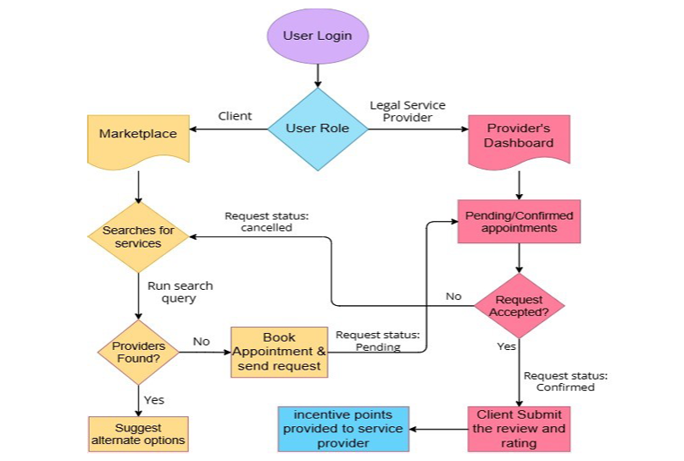
System Architecture and Modules (Block diagram)

Slide 16
Technologies Used
Software Requirements:
Operating System: Windows 10 or above
Frontend: HTML5, CSS3, JavaScript (React)
Backend: Node.js
Database: MySQL
Server: Apache or AWS Cloud Hosting
Tools: VS Code, Git

Slide 17
References (IEEE Paper format)
[1] P. R. Karnale, S. R. Chavan, A. B. Chougale, and A. A. Patil , “Incentives based Design for onboarding Legal Service Providers for Extending Legal Services to Citizens in India” , *International Journal of Scientific Research in Engineering and Management (IJSREM)*, vol. no. 7 (10, Oct. 2023).
[2] K. Jangde, Digital e-Marketplace for Legal Services in India,“Bridging the Legal Gap through AI-Driven Digital e-Marketplace for Legal Services in India,” International Journal of 2025.

Slide 18
References (IEEE Paper format)
[3] J. Gupta, A. Sharma, S. Singhania, et al., “Legal Assist AI: Leveraging Transformer-Based Model for Effective Legal Assistance,” [Preprint], Oct. 2024.
[4] A. Pasha and M. Donson, “LEGAL TECH 2.0: Exploring the Next Wave of Innovation in Legal Technology,” [Publication], Mar. 2025.

Slide 19
Github Link
Github Link
https://github.com/Avani-04/Legal-Serve-On-Board-Platform
https://github.com/Pooja-9192/Dev-doodles.git
https://github.com/Likitha-2122/shiny-goggles

Slide 20
Timeline of the Project (Gantt Chart)
Timeline as follow’s
Phase 1
Planning & Research
Phase 2
Development Setup
Phase 3
Implementation & Finalization
Requirement gathering
Literature review & problem statement finalization
System design and architecture planning
Backend development and database setup
Integration of core marketplace features
Incentive mechanism & gamification integration
Testing & debugging
Deployment and documentation submission
Frontend UI/UX design initiation

Slide 21


