Slide 1
Storage and DB

Slide 2
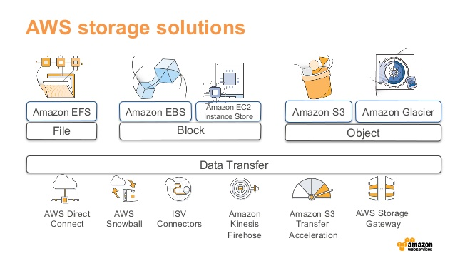
Aws storage options

Slide 3
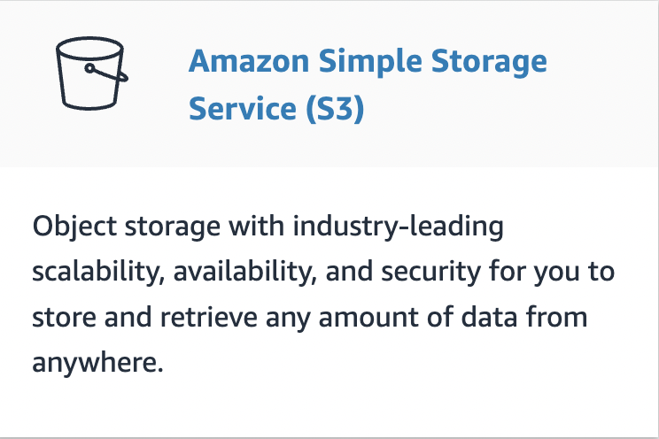
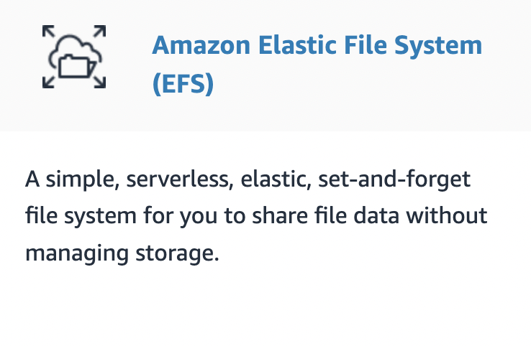

Slide 4
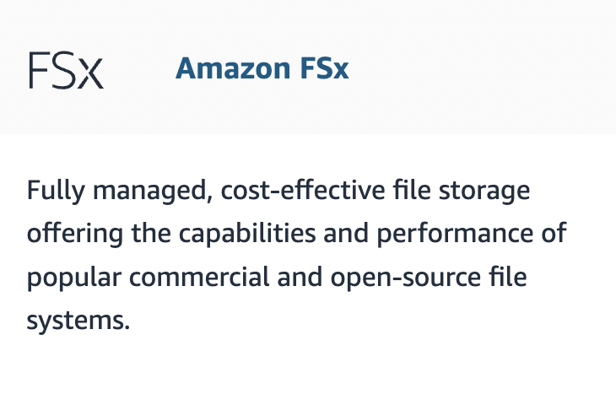
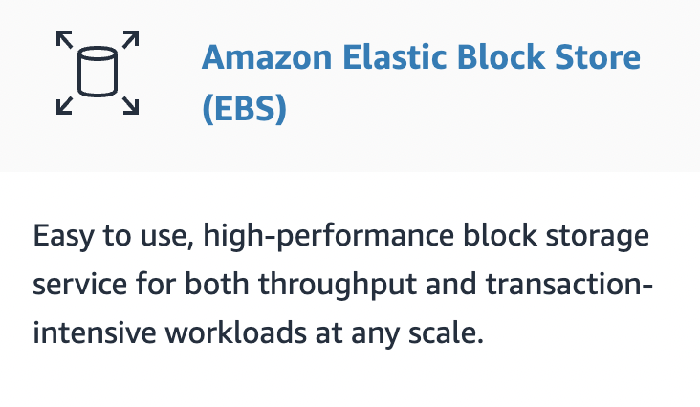

Slide 5
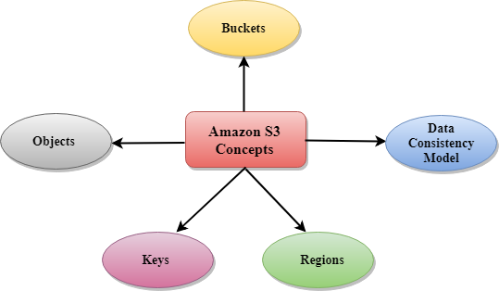
AMAZON s3 key concepts

Slide 6
Buckets- A bucket is a container used for storing the objects.
Objects- Objects are the entities which are stored in an S3 bucket.
Key- A key is a unique identifier for an object.
Regions- You can choose a geographical region in which you want to store the buckets that you have created.
Data Consistency Model- Amazon S3 replicates the data to multiple servers to achieve high availability. Two types of models: 1. Read-after-write consistency for PUTS of new objects.
2. Eventual consistency for overwrite PUTS and DELETES

Slide 7
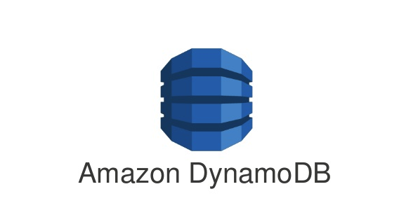
Amazon DynamoDb
Amazon DynamoDB is a fully managed NoSQL database service that provides fast and predictable performance with seamless scalability.
DynamoDB lets you offload the administrative burdens of operating and scaling a distributed database so that you don't have to worry about hardware provisioning, setup and configuration, replication, software patching, or cluster scaling.
DynamoDB also offers encryption at rest, which eliminates the operational burden and complexity involved in protecting sensitive data.

