Slide 1
Saas for queuing, notifying & caching

Slide 2
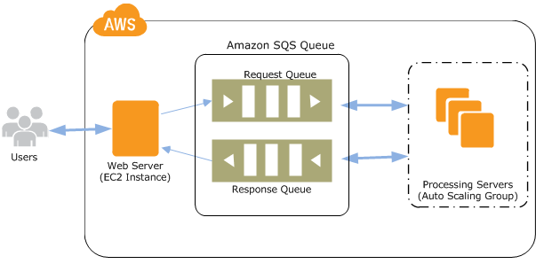
Amazon simple queue service

Slide 3
Amazon Simple Queue Service (Amazon SQS) offers a secure, durable, and available hosted queue that lets you integrate and decouple distributed software systems and components.
Amazon SQS offers common constructs such as dead-letter queues and cost allocation tags. It provides a generic web services API that you can access using any programming language that the AWS SDK supports.
Amazon SQS supports both standard and FIFO queues.

Slide 4
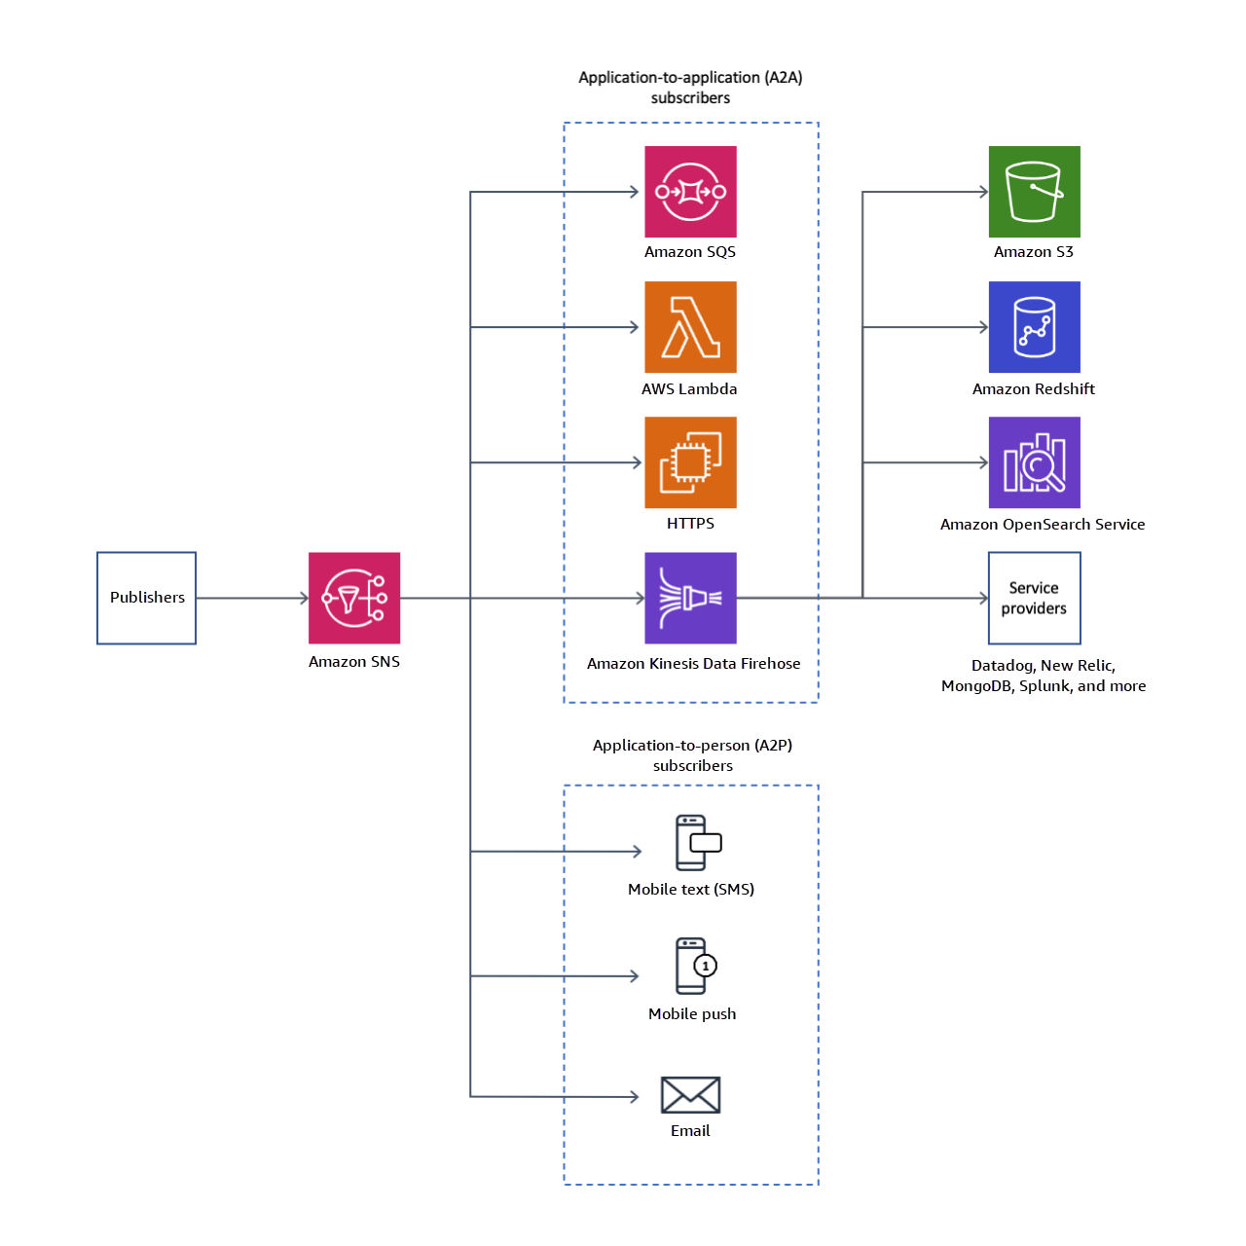
Amazon simple notification service

Slide 5
Amazon Simple Notification Service (Amazon SNS) is a managed service that provides message delivery from publishers to subscribers (also known as producers and consumers).
Publishers communicate asynchronously with subscribers by sending messages to a topic, which is a logical access point and communication channel. Clients can subscribe to the SNS topic and receive published messages using a supported endpoint type, such as Amazon Kinesis Data Firehose, Amazon SQS, AWS Lambda, HTTP, email, mobile push notifications, and mobile text messages (SMS).

Slide 6
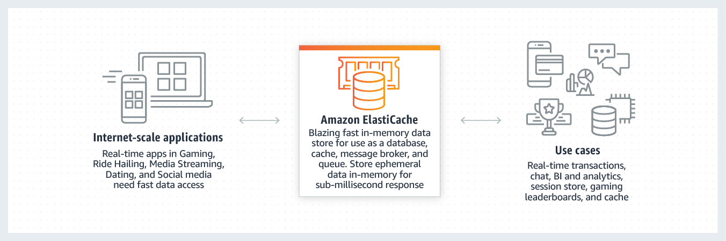
Amazon elasticache

Slide 7
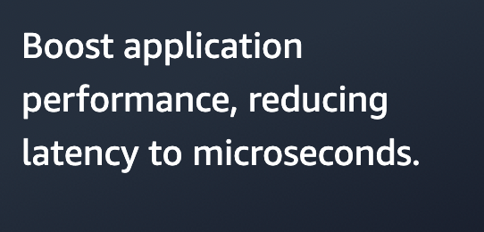
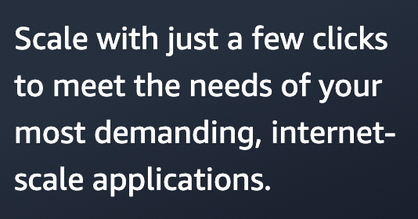
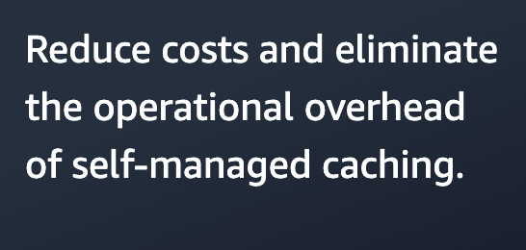
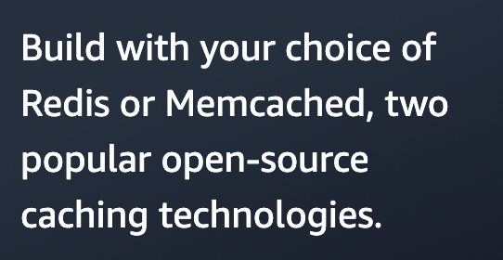
Amazon ElastiCache is a fully managed, in-memory caching service supporting flexible, real-time use cases. You can use ElastiCache for caching, which accelerates application and database performance, or as a primary data store for use cases that don't require durability like session stores, gaming leaderboards, streaming, and analytics. ElastiCache is compatible with Redis and Memcached.

Slide 8
Caching Strategies
Lazy loading- As the name implies, lazy loading is a caching strategy that loads data into the cache only when necessary.
Write-through- The write-through strategy adds data or updates data in the cache whenever data is written to the database.
Adding TTL- Time to live (TTL) is an integer value that specifies the number of seconds until the key expires. Memcached specifies this value in seconds. When an application attempts to read an expired key, it is treated as though the key is not found. The database is queried for the key and the cache is updated. This approach doesn't guarantee that a value isn't stale. However, it keeps data from getting too stale and requires that values in the cache are occasionally refreshed from the database.

Slide 9
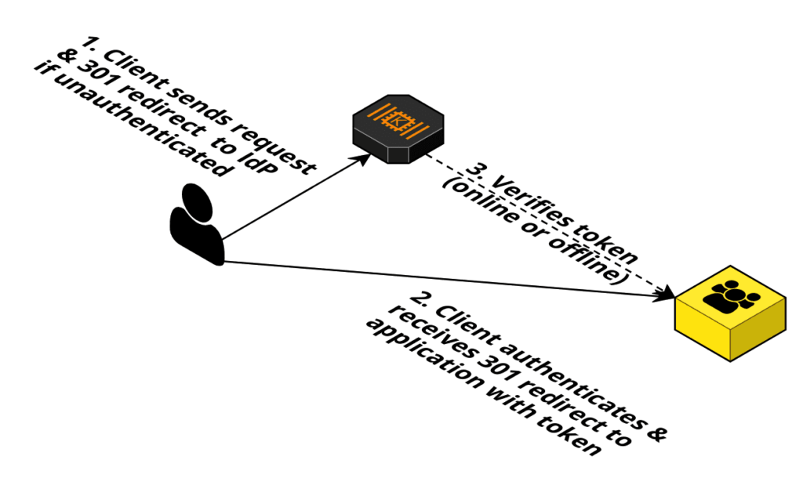
Authenticating your applications to aws

Slide 10
we will see how we can use AWS Cognito for Authentication & Authorization for a Web App in a completely serverless way. We will walk through the steps for enabling Signup, Sign in and Authorization to access to an AWS Resource.
Configure a Cognito User Pool for a User Authentication process.
Configure a Cognito Identity Pool (Federated Identities) for Authorizing the users to AWS resources.
Configure IAM Policy for what AWS Resources users can access.
Configure the specific AWS resource, in our case, it will be AWS S3.
Start using the AWS Cognito Authentication/Authorization in your Web App.

Slide 11
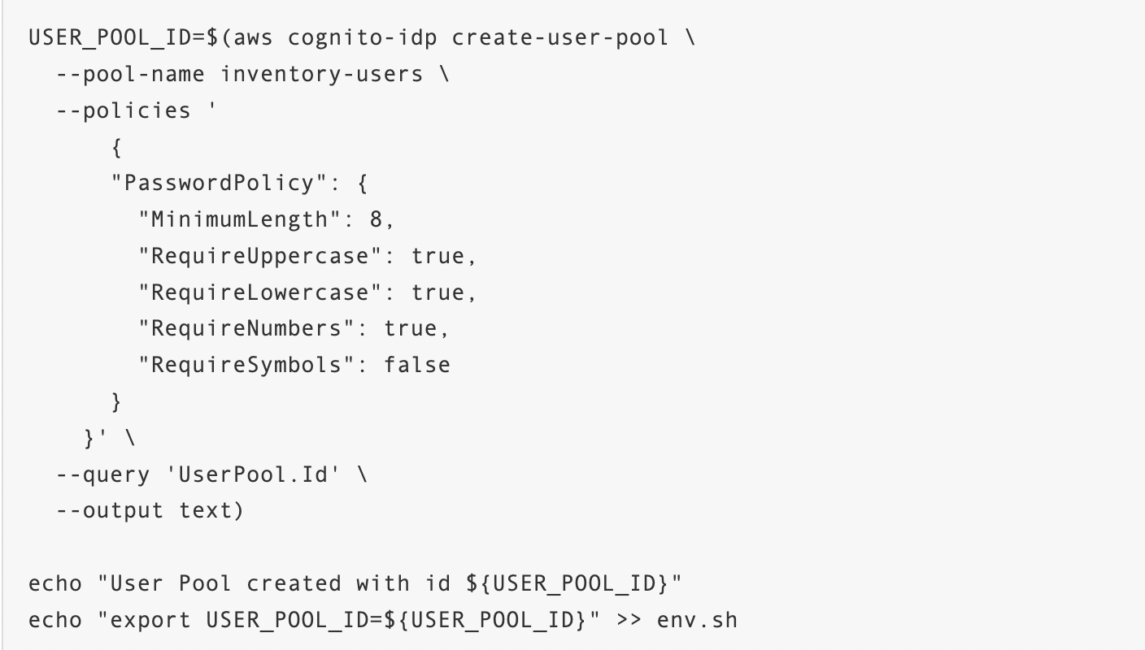
Building an end-to-end app with authentication
Configure Amazon Cognito for use as the authentication provider in your application. Amazon Cognito is a fully managed authentication provider that allows for user sign-up, verification, login, and more.
We create an Amazon Cognito user pool. Then you create a client to access the user pool.
Step 1. Create an Amazon Cognito user pool

Slide 12
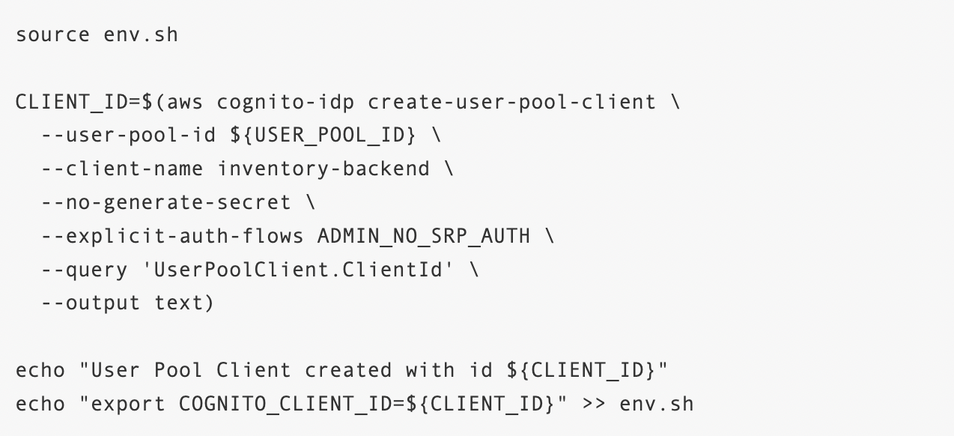
This script uses the AWS Command Line Interface (AWS CLI) to create a user pool. You give your user pool a name -- inventory-users -- and specify your password policies.
create your user pool by executing the script with the following command:
$ bash scripts/create-user-pool.sh
You should see the following output:
User Pool created with id <user-pool-id>
Step 2. Create a user pool client
There is a file in the scripts/ directory called create-user-pool-client.sh for creating a user pool client. The contents of the file are as follows:

Slide 13
Run the script to create the user pool client with the following command:
$ bash scripts/create-user-pool-client.sh
You should see the following output:
User Pool Client created with id <client-id>
Step 3. Review authentication code
you have created a user pool and a client to access the pool, let’s see how you use Amazon Cognito in your application.
The first function is createCognitoUser and is used when registering a new user in Amazon Cognito. The function looks as follows:

Slide 14
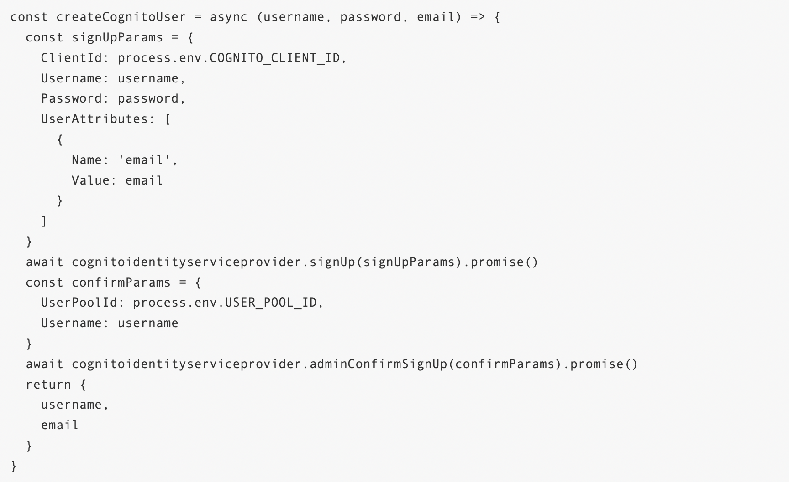
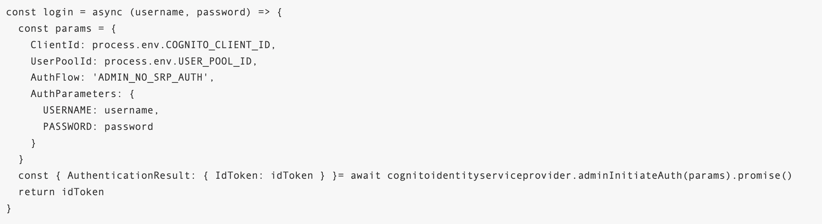
The second core method is the login function that is used when registered users are authenticating. The code is as shown below

Slide 15
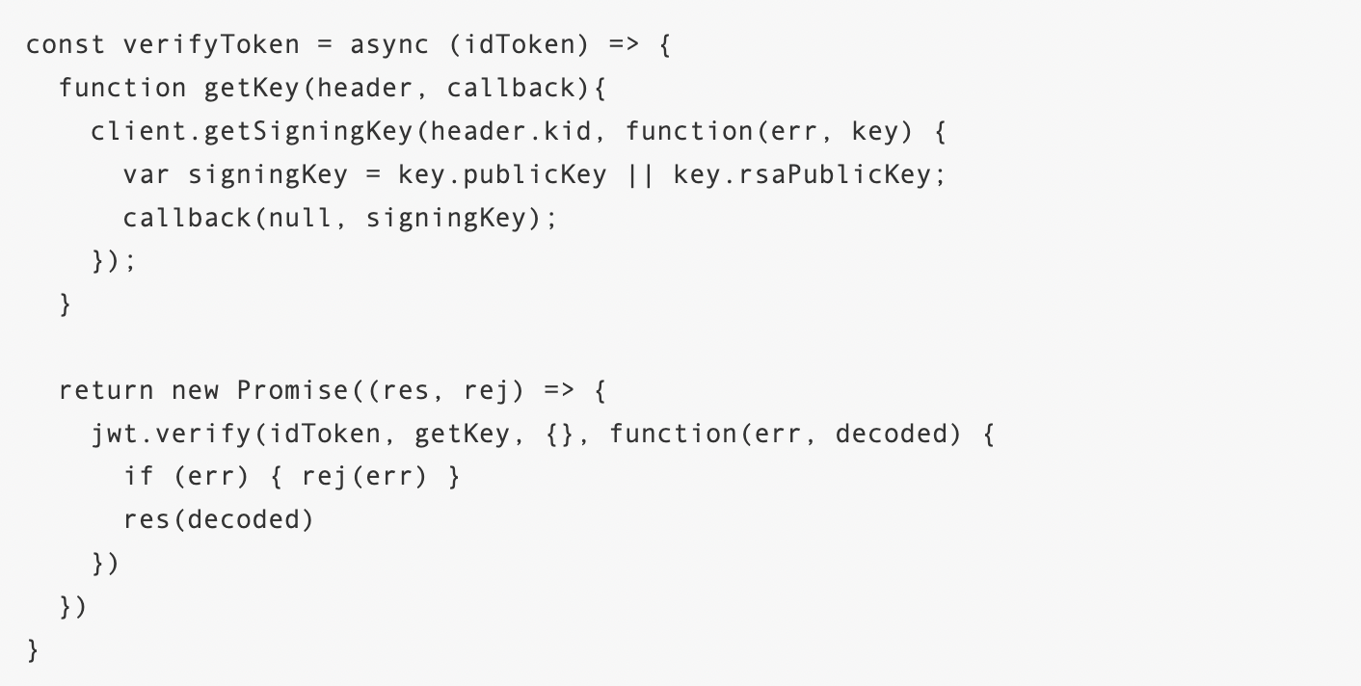
Finally, there is a verify token function. The contents of this function are as follows:
This function verifies an ID token that has been passed up with a request. The ID token given by Amazon Cognito is a JSON Web Token, and the verify token function confirms that the token was signed by your trusted source and identifies the user. This function is used in endpoints that require authentication to ensure that the requesting user has access.

