Slide 1
DevOPS

Slide 2
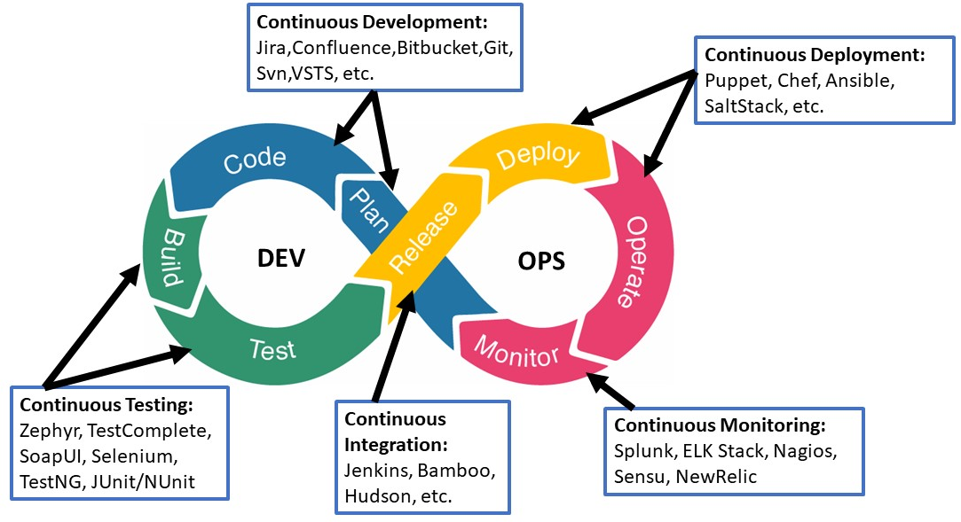
Introduction to devops

Slide 3
•DevOps is the acronym given for the combination of Development and Operations. It refers to a collaborative approach to making the Application Development team and the IT Operations team of an organization to seamlessly work with better communication.
•DevOps is visualized as an infinite loop comprising the steps: plan, code, build, test, release, deploy, operate, monitor, then back to plan, and so on.

Slide 4
Deployment and testing strategies
1. End to end tests- It is very important to test the functional areas and therefore we need to write end-to-end tests. End to end tests cover the real-time scenarios of each module and not just depend upon the unit tests.
2. Test automation and testing types- In DevOps, the constant integration of code is kept to a central repository, which means the application is always ready for continuous testing. Testing the application at several stages can help in delivering better products.
3. Kanban boards make it simple- The Kanban boards are part of agile methodology which has a major focus on the smooth project delivery. With the key features such as a clear picture of the project status, issues and updates help the team to communicate and collaborate better.

Slide 5
4. Testing tools
Testing tools make the tester’s work easier if the tester has adequate expertise and skills to analyze and use the tool. The budget factor also plays a role when talking about the testing tools in automation. Some of the DevOps testing tools are designated as:
Monitoring Tools
Version Control Tools
Security Testing Tools
Performance Testing Tools
Continuous Delivery Tools

Slide 6
DevOps Testing Tools
Some of the familiar tools include:
Docker: It is an open-source DevOps technology suite that works on the concept of containerization enabling development teams to code, deploy and test applications regardless of the project environment.
Jenkins: An open-source tool that helps create, test & deploy the software. It also permits developers to find and fix bugs in their codebase.
GitHub: Another widely used tool holding up effortless collaboration. Version restoration is a key feature of GitHub in case of any error found in the latest version.
Selenium: It is one of the browser automation tools plotted to carry through Web UI testing largely used in DevOps pipelines.
JMeter: It is a highly adaptable open-source load testing tool used to test and assess the performance of the website.

Slide 7
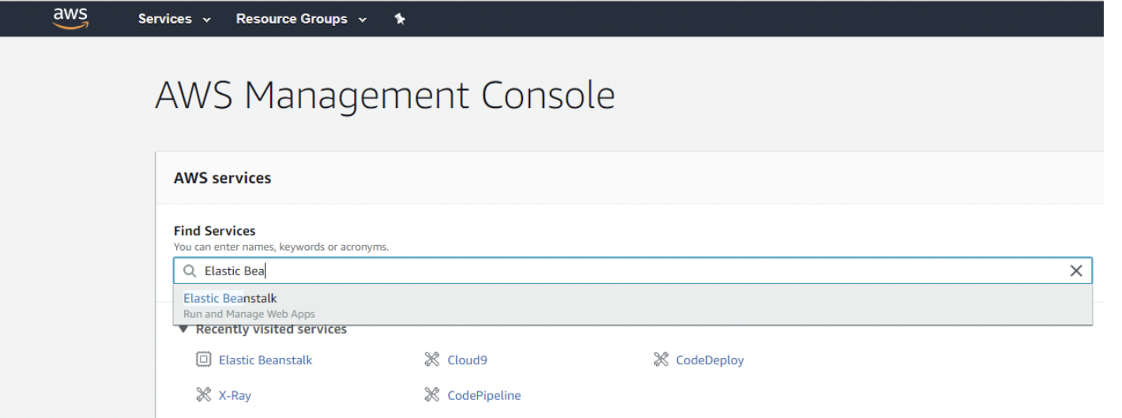
Deploying applications with AWS elastic Beanstalk
1. First, we need an application to deploy.
2. Adding Configuration to Elastic Beanstalk

Slide 8
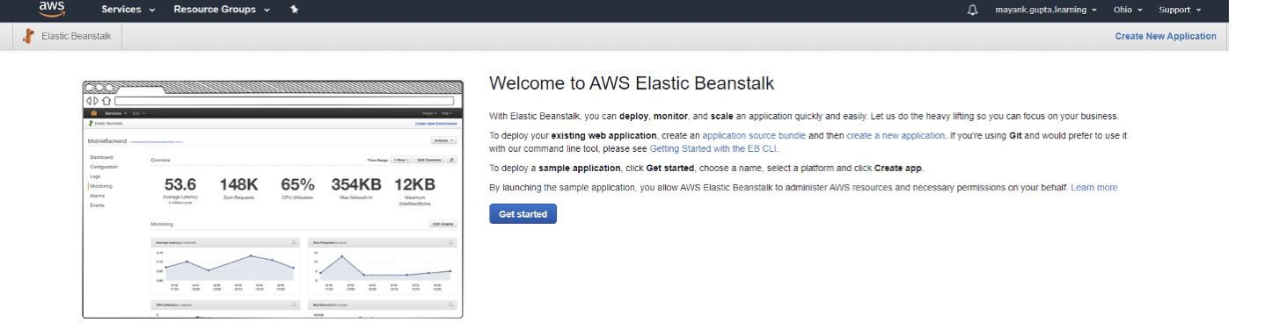
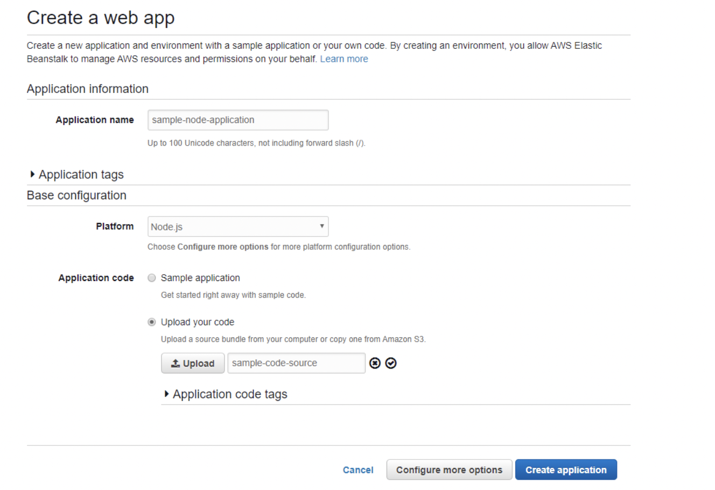
3. Go to the Elastic Beanstalk console
4. Create a new web application

Slide 9
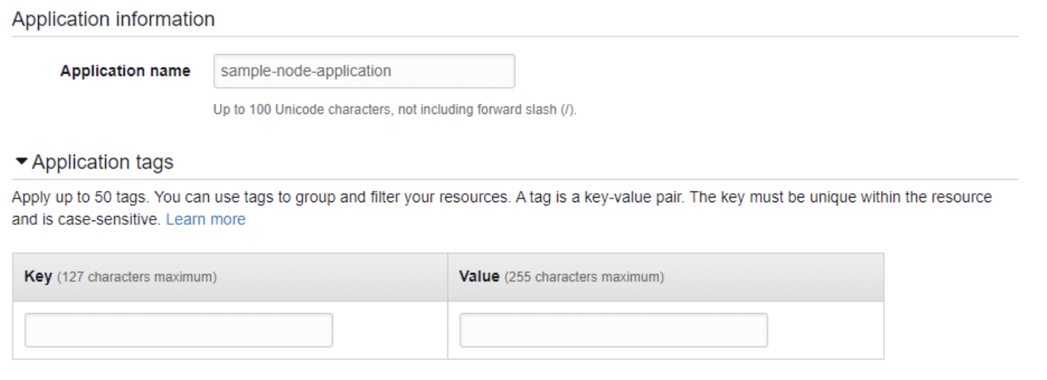
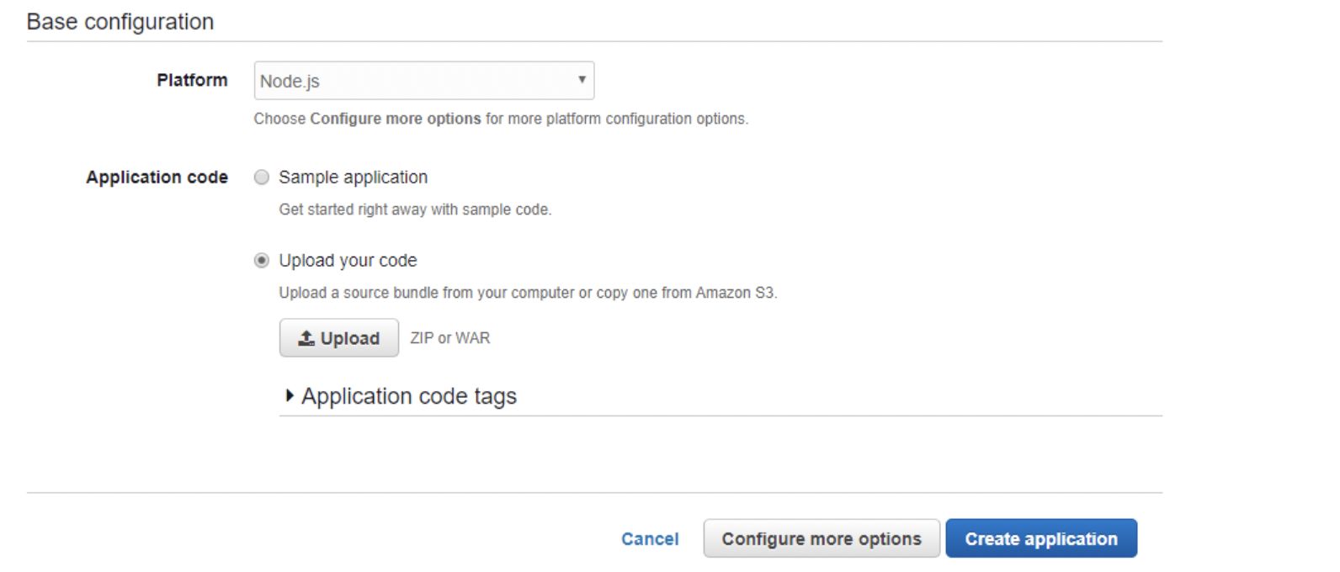
5. Configuring application information
6. Configuring base configuration

Slide 10
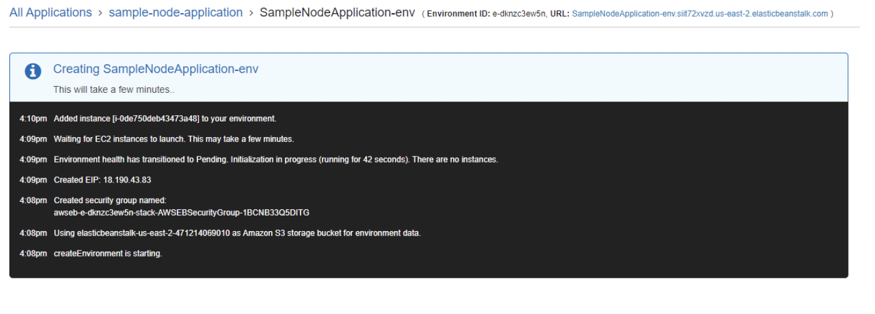
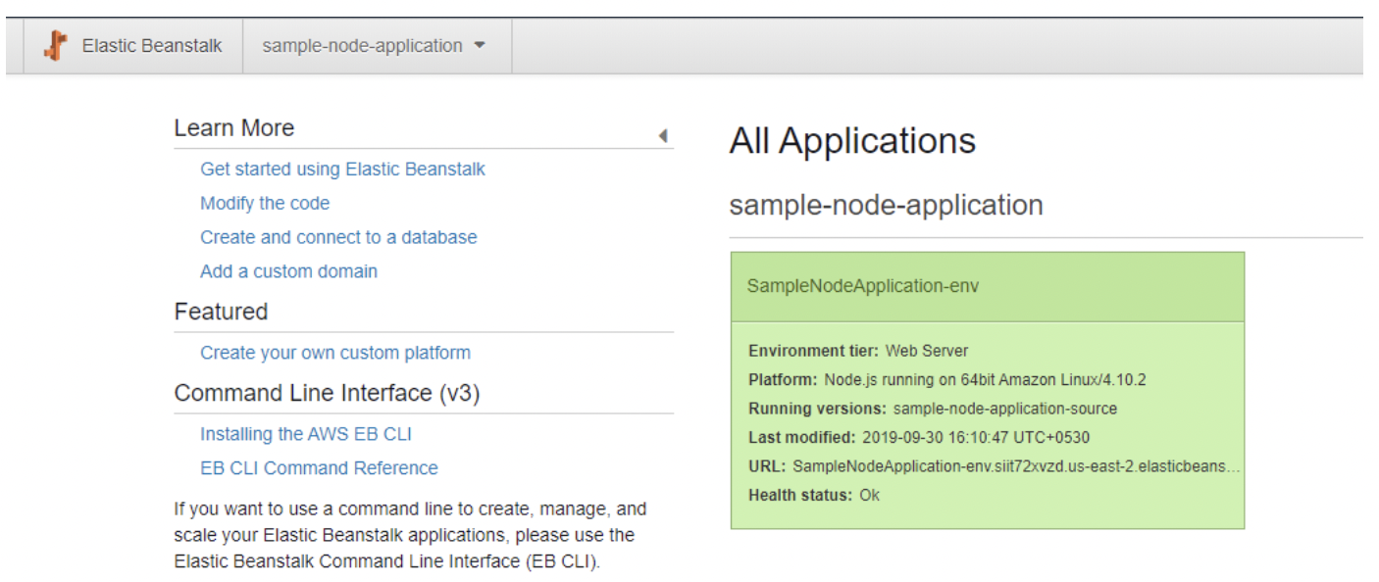
7. Upload the ZIP file to the base configuration.
8. Create an application once configured
9. After a while, the application will be deployed and made available.

Slide 11
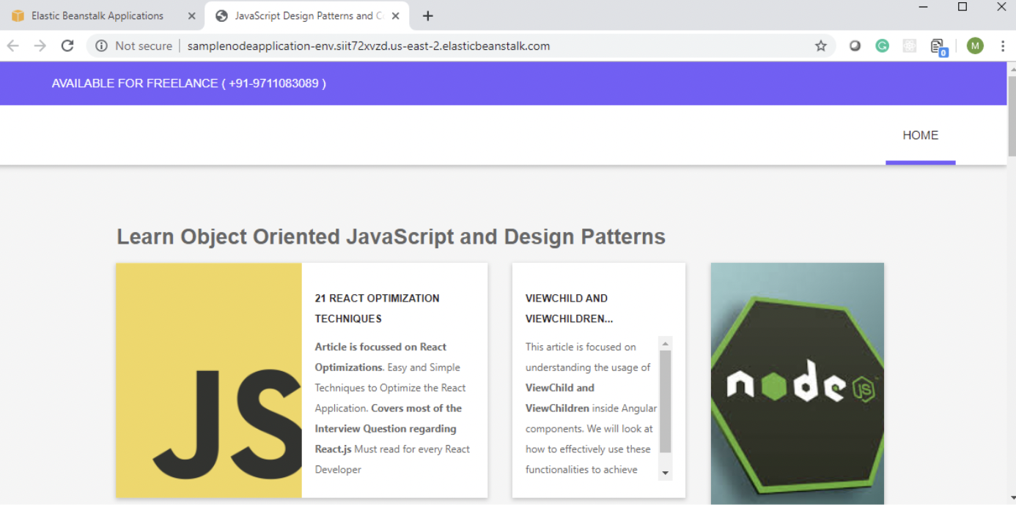
And, finally, the application is up and running on the URL specified:

