Slide 1
Business models behind Iaas, Saas, PaaS

Slide 2
Introduction to serverless/event-driven computing
Serverless Computing allows you to build and run applications and services without thinking about servers.
With serverless computing, your application still runs on servers, but all the server management is done by AWS.
Using AWS and its Serverless Platform, you can build and deploy applications on cost-effective services that provide built-in application availability and flexible scaling capabilities.
This lets you focus on your application code instead of worrying about provisioning, configuring, and managing servers.

Slide 3
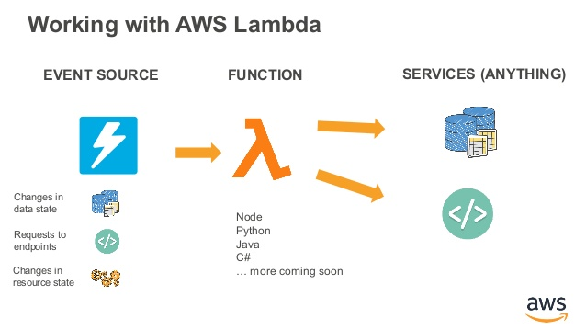
AWS lambada

Slide 4
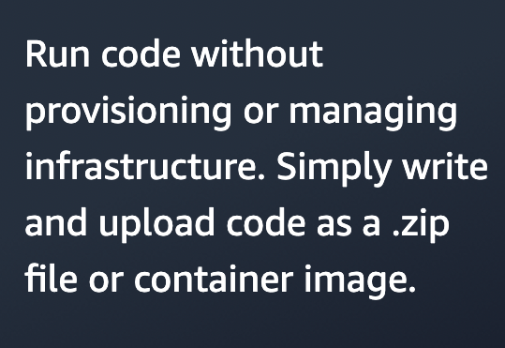
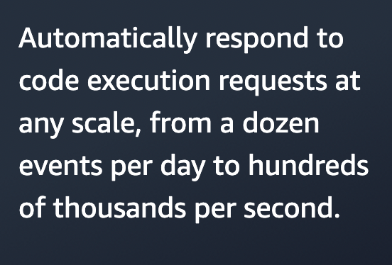
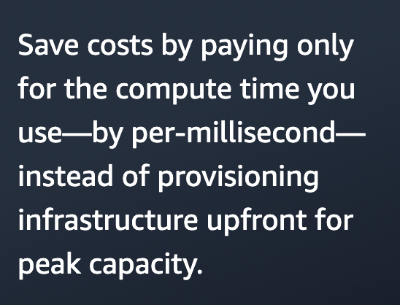
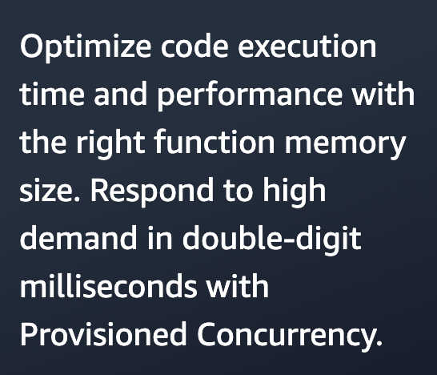

Slide 5
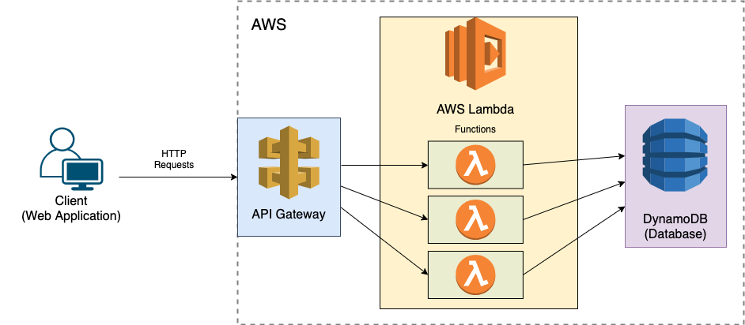
Build an end-to-end app

Slide 6
When a client makes a HTTP request to a public API endpoint provided by API Gateway, a Lambda function will be invoked.
The Lambda function manipulates the database provided by DynamoDB and then sends the response back to the client.

Slide 7
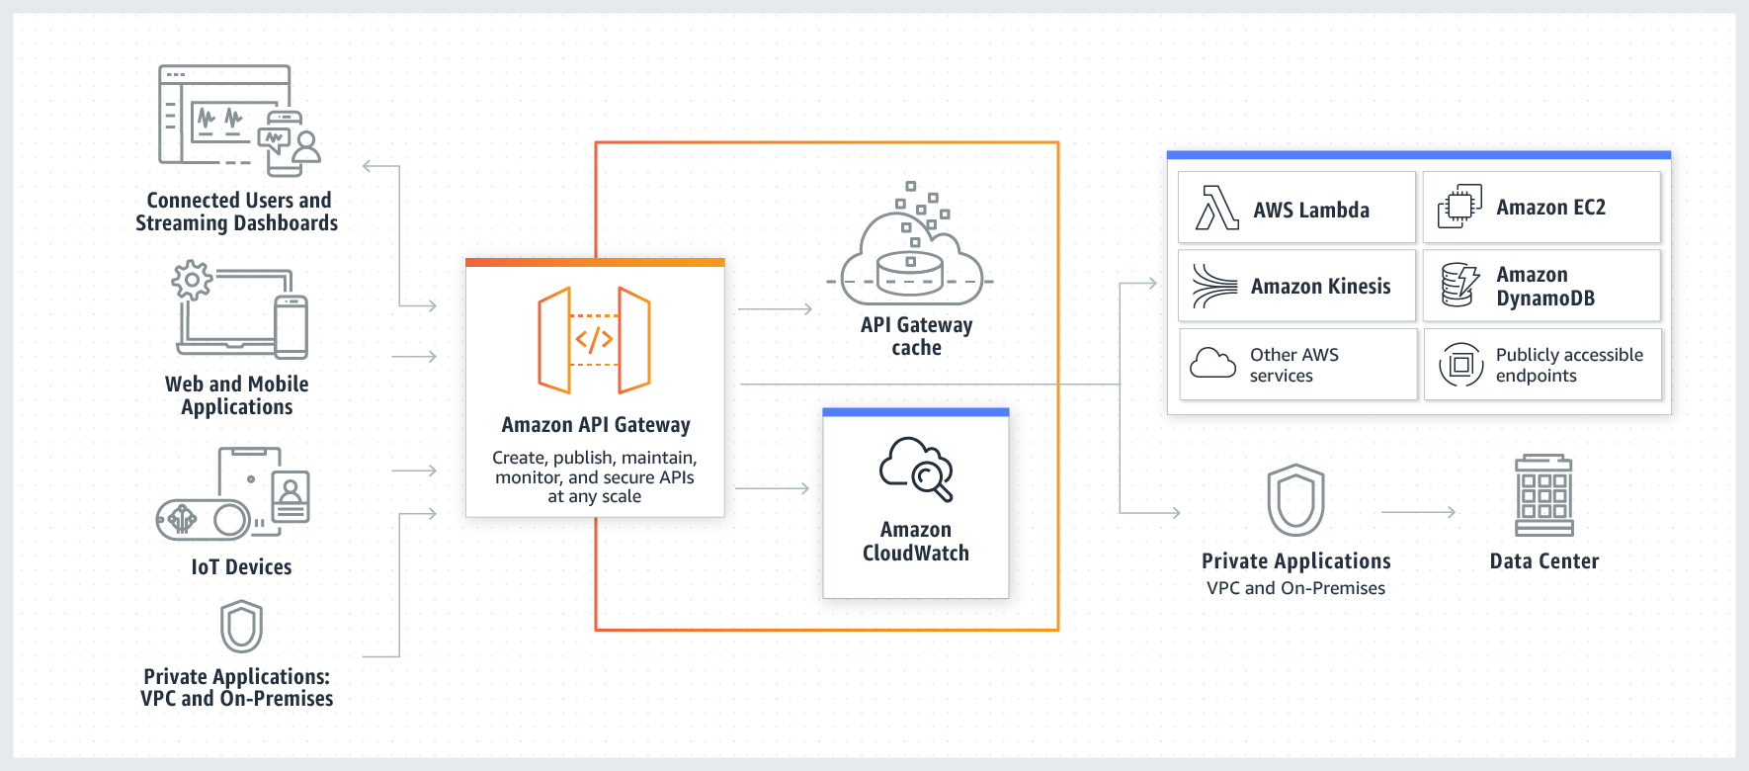
Api gateway

Slide 8
•Amazon API Gateway is an AWS service for creating, publishing, maintaining, monitoring, and securing REST, HTTP, and WebSocket APIs at any scale. API developers can create APIs that access AWS or other web services, as well as data stored in the AWS Cloud.
•As an API Gateway API developer, you can create APIs for use in your own client applications. Or you can make your APIs available to third-party app developers.
•API Gateway creates RESTful APIs that:
•Are HTTP-based.
•Enable stateless client-server communication.
•Implement standard HTTP methods such as GET, POST, PUT, PATCH, and DELETE.

Slide 9
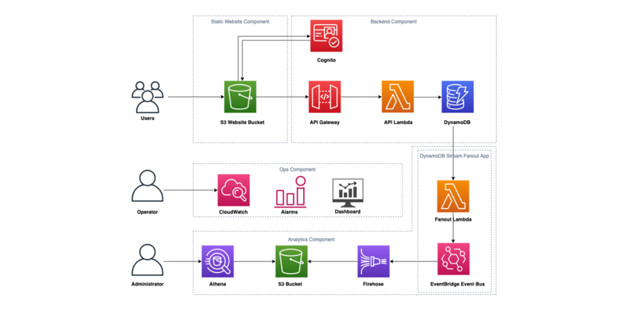
Aws serverless application model

Slide 10
The AWS Serverless Application Model (AWS SAM) is an open-source framework that you can use to build serverless applications on AWS.
A serverless application is a combination of Lambda functions, event sources, and other resources that work together to perform tasks. Note that a serverless application is more than just a Lambda function—it can include additional resources such as APIs, databases, and event source mappings.

Slide 11
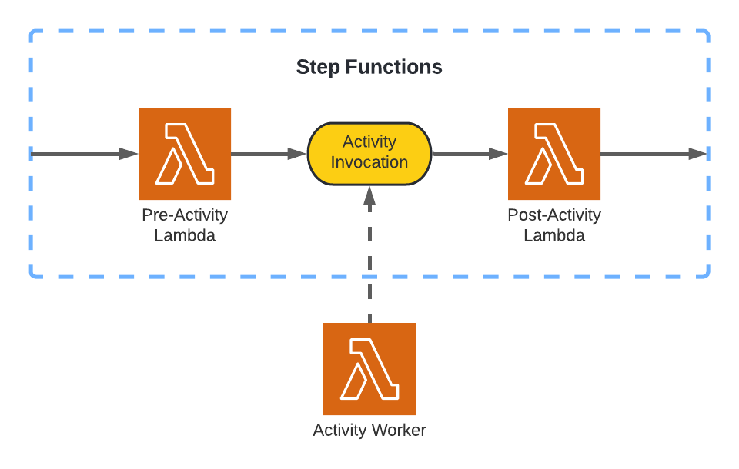
Aws step functions

Slide 12
Step Functions is a serverless orchestration service that lets you combine AWS Lambda functions and other AWS services to build business-critical applications. Through Step Functions' graphical console, you see your application’s workflow as a series of event-driven steps.
Step Functions are based on state machines and tasks. A state machine is a workflow. A task is a state in a workflow that represents a single unit of work that another AWS service performs. Each step in a workflow is a state.
With Step Functions' built-in controls, you examine the state of each step in your workflow to make sure that your application runs in order and as expected.

