Slide 1
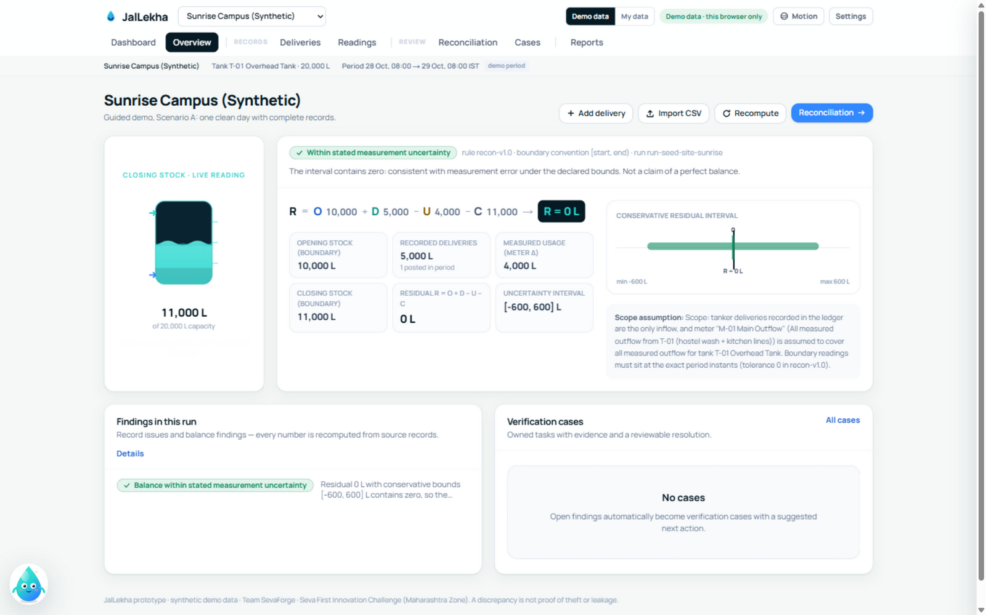
SEVA INNOVATION CHALLENGE 2026 > JALLEKHA - TEAM SEVAFORGE
JalLekha
Working prototype - live demo
Deterministic engine - AI never decides.
55 unit + 33 e2e checks, all green.
Browser demo · synthetic data.
A water-balance engine that reconciles tanker receipts, tank readings and meter logs - what came in, what was measured, what needs checking.
Sector: Sustainability - Energy, Climate and Others
Sub-theme: pollution mitigation, water conservation, waste management
Track A - Product / Technology Solution · Open Level
jallekha.vercel.app/demo
Notes:
Title slide. Fill every field exactly as entered in the online application form so reviewers can match the deck to the application.

Slide 2
2
The Problem
What real challenge in society, government service or industry are you solving?
What is the problem?
Who is affected, and where?
Tanker receipts, tank dipstick readings and cumulative meter logs live in three separate registers. When water doesn't add up, staff trace entries by hand - and the register cannot say why.
Campus facilities teams and housing-society maintenance staff; students and residents feel it in billing disputes and unreliable supply. Target: urban Maharashtra.
3
separate registers - one water balance that must agree
Evidence
Current gaps
Why it matters
Honest by design: no field pilot yet. The engine is validated on synthetic ledgers - 55 unit tests and 33 browser checks assert the four signature scenarios to the litre (docs/VALIDATION.md).
Registers total numbers but flag nothing: duplicates go unnoticed, missing readings read as losses, and corrections overwrite the audit trail - disputes cannot be evidenced.
Unmeasured losses stay invisible; supplier disputes stay unresolvable.
Seva Innovation Challenge 2026 | Slide 2 of 6
Notes:
Reviewers look for a clearly defined, real and significant problem backed by evidence. One strong statistic is better than many weak ones. Cite the source for every number.

Slide 3
3
Our Solution & Innovation
What have you built or designed, how does it work, and what is new about it?
Our solution in brief
What makes it new?
Facilities teams record tanker receipts, tank readings and meter values; a deterministic engine reconciles them into one water balance with a visible uncertainty interval - and findings become owned, evidence-backed cases.
 | Existing approach | Our approach
Cost | ₹ 0 software + hours of tracing | ₹ 0 licence - any browser
Speed / time | Days of hand-tracing per dispute | Seconds to a documented verdict
Reach / access | One register-holder's memory | Any operator; CSV in, review out
Ease of use | Spreadsheet discipline required | Guided demo; plain-language verdicts
How it works
1
2
3
Input
›
Process
›
Output
Receipts, dipstick readings, meter logs - typed or CSV
Engine computes R = O + D - U - C with summed bounds
Verdict, findings, owned cases, audit trail
Key USP
Uncertainty you can see and verdicts that never accuse - same inputs, same verdict, and every correction keeps its before-and-after history.
Seva Innovation Challenge 2026 | Slide 3 of 6
Notes:
Show clearly how the solution addresses the problem on Slide 2. Compare against what exists today — reviewers score originality and relevance here.

Slide 4
4
Feasibility & Implementation
How ready is the solution, and what will it take to implement it on the ground?
Current stage (mark ✔ where you are today)
Idea
Proof of Concept
Working Prototype
Field Pilot
Ready to Deploy
Technology
Estimated cost
Timeline
Partners
Next.js 16 + TypeScript web app; pure-TypeScript rule engine recon-v1.0; CSV import; browser-local storage; optional provider-neutral AI, off by default.
₹ 0 licence - runs in a browser on one existing device. Pilot needs operator time only: no sensors, no hardware.
Now: 4-6 week single-device pilot. Next: shared authenticated workspaces (adapter designed). Then: multi-site rollup.
Seeking one permissioned campus or society; measurement-quality mentorship; a route toward a government-department pilot.
Seva Innovation Challenge 2026 | Slide 4 of 6
Notes:
Be realistic. A clear, costed plan with an identified adopting department scores better than an ambitious but vague one. Mention any validation already done (tests, user feedback, certifications).

Slide 5
5
Impact & Scalability
What change will your solution create, and how can it grow beyond the first location?
1
4
3
Beneficiaries reached
Saving in cost / time
Jobs or livelihoods
pilot campus or society in year one
impact metrics instrumented - baselines set on field data
sustainability domains evidenced: water, haulage, trust
Social impact
Sustainability
Scale-up plan
Evidence-backed records end billing disputes and repeat reconciliation work; residents see a documented balance instead of a disputed bill.
Zero-licence software on existing devices. The pilot publishes baselines first - no litres-saved claims before field data exists.
NOW: single-device pilot > NEXT: shared authenticated workspaces (adapter designed) > THEN: multi-site rollup for a campus chain or ward.
Seva Innovation Challenge 2026 | Slide 5 of 6
Notes:
Quantify impact wherever possible and state your assumptions. Where relevant, link the solution to an existing Government scheme, mission or the Sustainable Development Goals.

Slide 6
6
Team/Individual & Support Required
Who is behind the idea, and what help do you need from the Challenge?
AJ
Arya Jannawar
SP
Siddhant Pardeshi
Support we are seeking
Team Lead
Quality & user workflow
Product & the reconciliation equation
55-test gate, 33 browser journeys
One permissioned pilot campus or society
Mentorship: study design & measurement quality
Lab access for reviewer-time measurement
AV
Avani Jannawar
VS
Vijay Sahu
Engineering lead
Research & validation
A route to shared, authenticated deployment
Engine, CSV pipeline, adapters
Measurement uncertainty & evidence
Introduction to a department for a broader pilot
A 4-6 week pilot on one device publishes the first honest baselines - turning the prototype into evidence.
Mentor: to be assigned - seeking measurement-quality and study-design guidance.
Thank you | Team SevaForge · github.com/Avani376/jallekha · jallekha.vercel.app
Seva Innovation Challenge 2026 | Slide 6 of 6
Notes:
List only active team members. Be specific about the support requested — it helps the organisers match you with the right mentor, department or incubator.

