Slide 1
What is ReactJS?
ReactJS is an open-source front-end JavaScript library for building user interfaces. ReactJS is maintained by Facebook and a community of individual developers and companies. It is widely used as a base in building single-page websites and mobile applications. It is very easy to use, and it allows users to create reusable UI components.
Features of ReactJS
JSX : JSX is an extension to javascript. Though it is not mandatory to use JSX in react, it is one of the good features and easy to use.
Components: Components are like pure javascript functions that help make the code easy by splitting the logic into reusable independent code. We can use components as functions and components as classes. Components also have a state, props which makes life easy. Inside a class, the state of each of the props is maintained.
Virtual DOM: React creates a virtual dom, i.e., in-memory data -structure cache. Only the final changes of DOM has later updated in the browsers DOM.
Javascript Expressions: JS expressions can be used in the jsx files using curly brackets, for example {}.

Slide 2
Advantages of ReactJS
ReactJS uses virtual dom that makes use of in-memory data-structure cache, and only the final changes are updated in browsers dom. This makes the app faster.
You can create components of your choice by using the react component feature. The components can be reused and also helpful in code maintenance.
Reactjs is an open-source javascript library, so it is easy to start with.
ReactJS has become very popular in a short span and maintained by Facebook and Instagram. It is used by many famous companies like Apple, Netflix, etc.
Facebook maintains ReactJS, the library, so it is well maintained and kept updated.
ReactJS can be used to develop rich UI for both desktop and mobile apps.
Easy to debug and test as most of the coding is done in Javascript rather than on Html.

Slide 3
Architecture of the React Application
React library is just UI library and it does not enforce any particular pattern to write a complex application. Developers are free to choose the design pattern of their choice.
React community advocates certain design pattern.
One of the patterns is Flux pattern.
React library also provides lot of concepts like Higher Order component, Context, Render props, Refs etc., to write better code.
React Hooks is evolving concept to do state management in big projects. Let us try to understand the high level architecture of a React application.

Slide 4
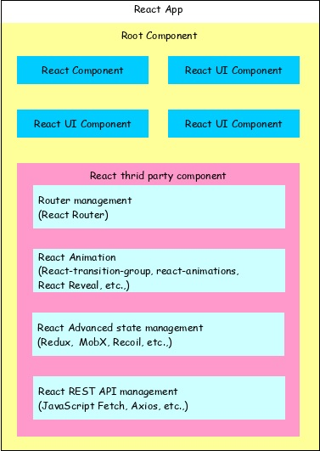

Slide 5
React app starts with a single root component.
Root component is build using one or more component.
Each component can be nested with other component to any level.
Composition is one of the core concepts of React library. So, each component is build by composing smaller components instead of inheriting one component from another component.
Most of the components are user interface components.
React app can include third party component for specific purpose such as routing, animation, state management, etc.

Slide 6
Pre-requisite for ReactJS
NodeJS and NPM
React and React DOM
Need for ReactJS
Node.js is a run-time environment which includes everything you need to execute a program written in JavaScript. It’s used for running scripts on the server to render content before it is delivered to a web browser.
NPM stands for Node Package Manager, which is an application and repository for developing and sharing JavaScript code.
Install ReactJS
There are two ways to set up an environment for successful ReactJS application. They are given below.
Using the npm command
Using the create-react-app command

Slide 7
Install Nodejs
https://nodejs.org/en/download/
Check Node version
node –v
npm -v
npx create-react-app my-app
cd my-app
npm start

Slide 8
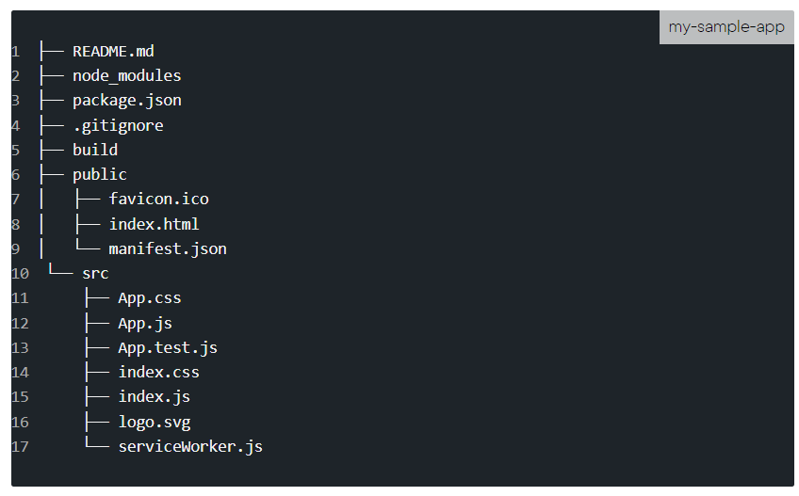
Project Layout
Below is how the project will be structured:

Slide 9
1)build
build represents the path to our final production build. This folder would actually be created after we run the npm build.
2) node_modules
We can see all the "dependencies" and "devDependencies" required by our React app in node_modules. These are as specified or seen in our package.json file. If we just run the ls -l command, we'll see almost 800 sub-directories. This directory gets added to .gitignore so it does not really get uploaded/published as such. Also, once we minimize or compress our code for production, our sample app should be less than 100 KB in size.
3)Public
Our static files are located in the public directory. Files in this directory will retain the same name when deployed to production. Thus, they can be cached at the client-side and improve the overall download times.
4)Src
All of the dynamic components will be located in the src. To ensure that, at the client side, only the most recent version is downloaded and not the cached copy, Webpack will generally have the updated files a unique file name in the final build.

Slide 10
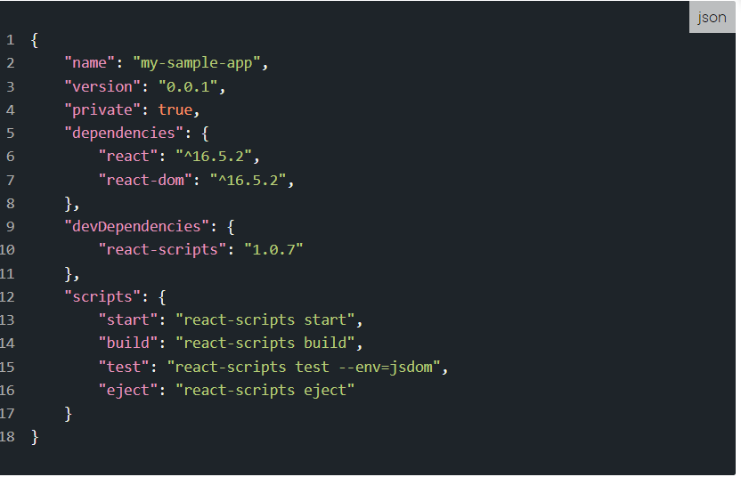
5) package.json
The overall configuration for the React project is outlined in the package.json. Below is what that looks like:

