Slide 1
AGENT OS
CASE STUDY
OPERATING SYSTEMS · UNIT 4 & 5

Slide 2
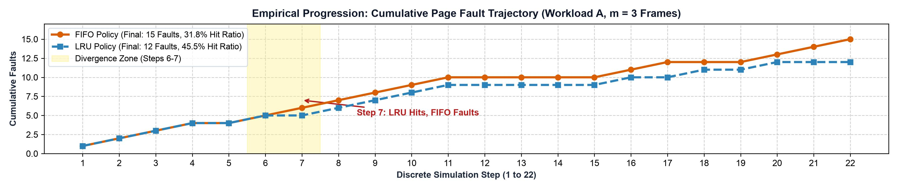
AGENT OS
Memory & File Management Case Study

Slide 3
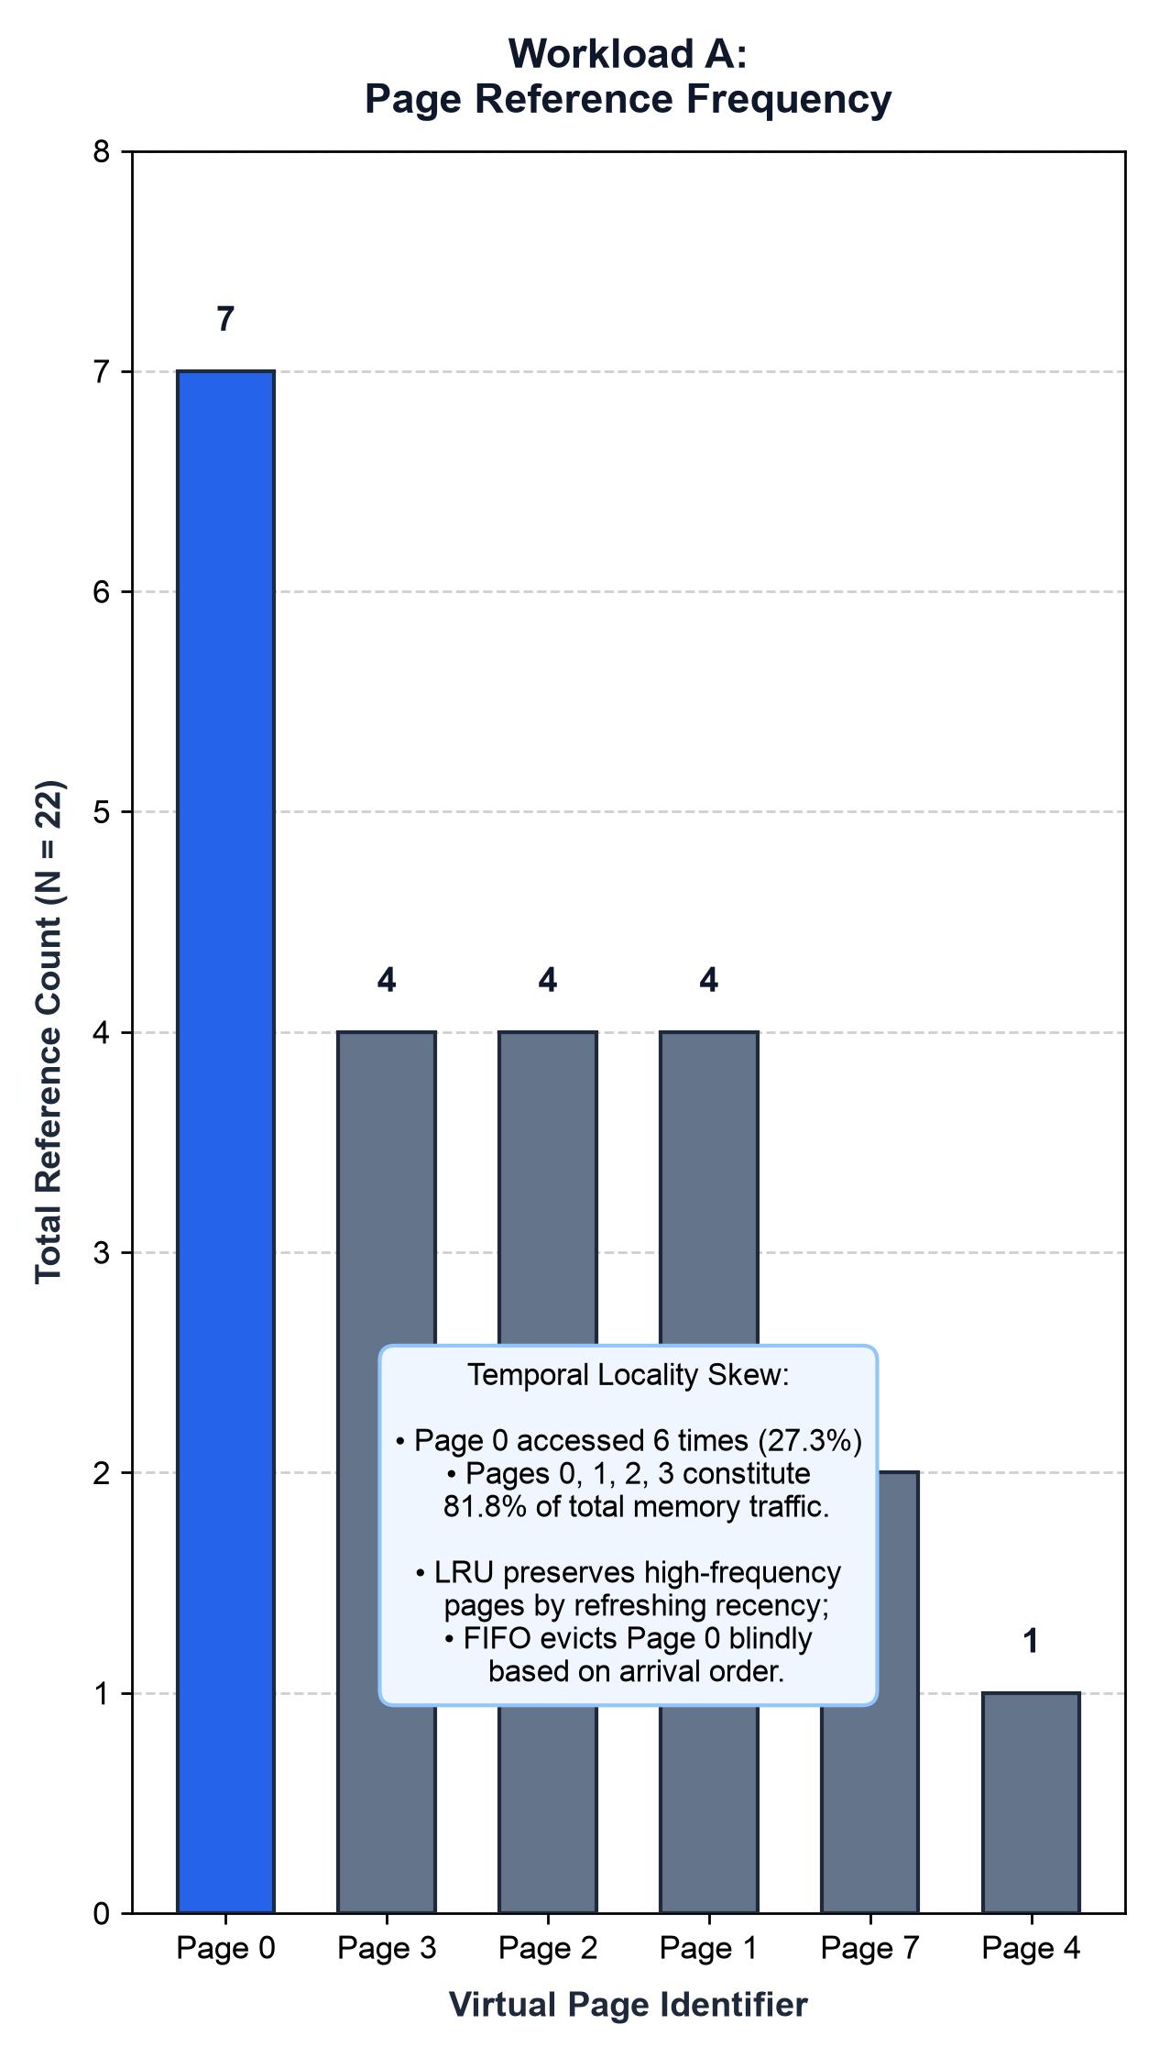
PROBLEM & MOTIVATION
OPERATING SYSTEMS · UNIT 4 & 5
Classical operating systems manage shared hardware resources under strict physical constraints. In modern agent-oriented workspaces, tasks like Research, Coding, and Report agents generate bursty memory demands and concurrent file accesses.
AgentOS investigates two fundamental OS questions:
1. Unit 4: How demand-paged memory replacement (FIFO vs. LRU) behaves under fixed frame limits.
2. Unit 5: How hierarchical file structures enforce access control with zero information leakage.

Slide 4
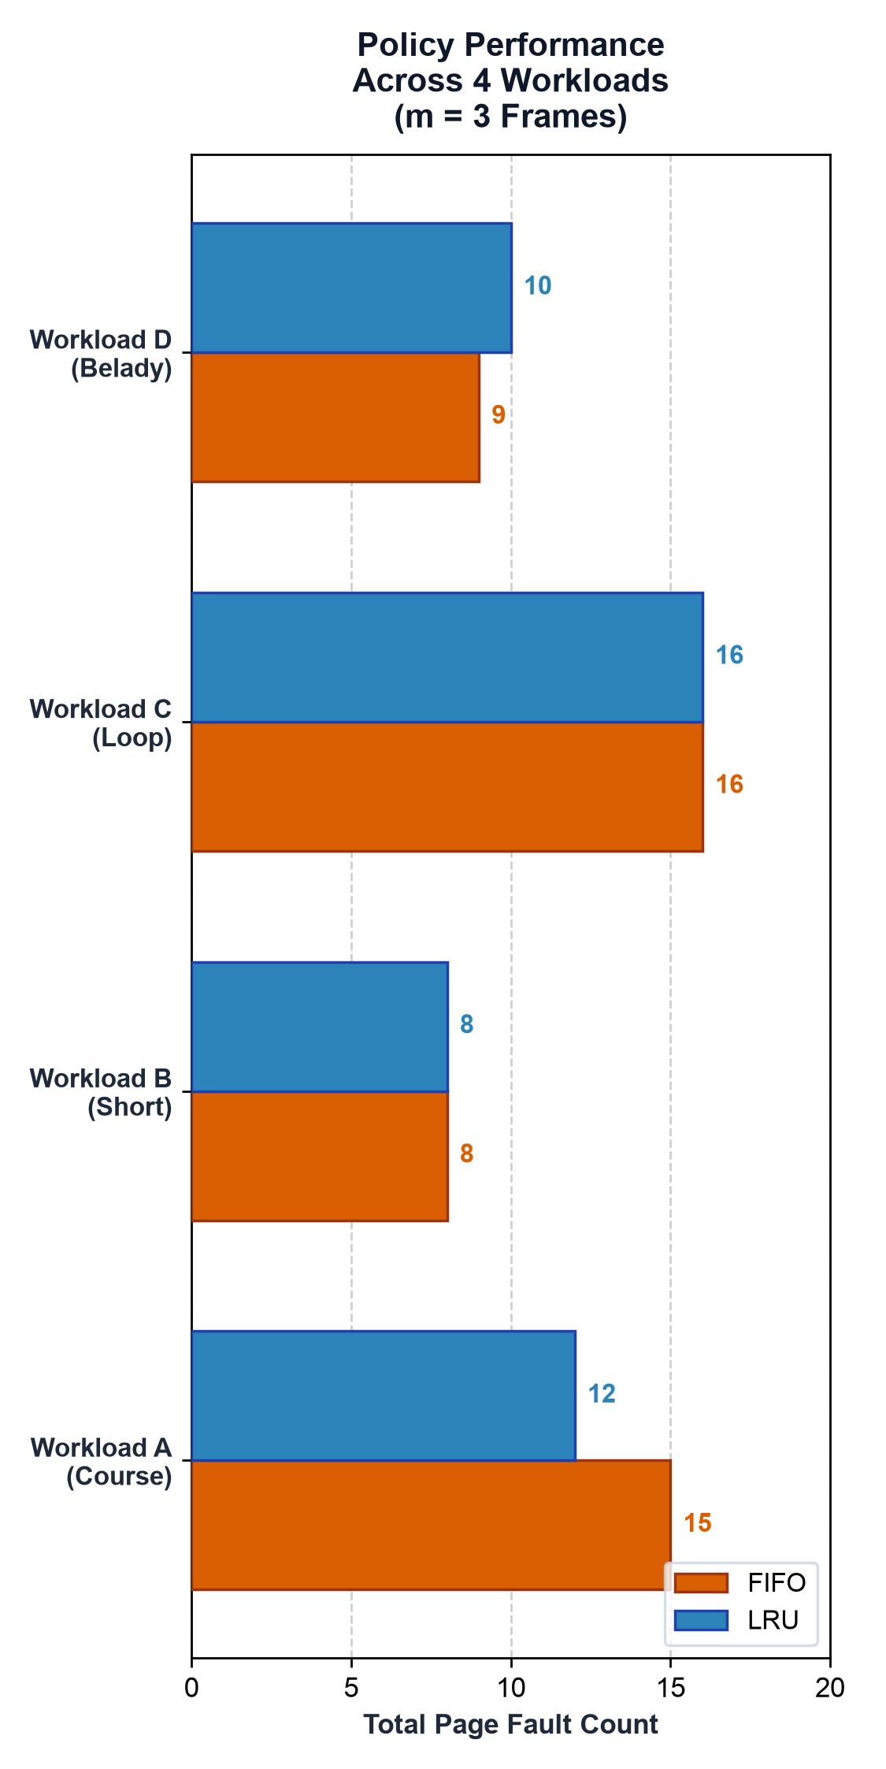
UNIT 4 · MEMORY MANAGEMENT
DEMAND PAGING CONTENTION
Autonomous tasks repeatedly reference shared context pages under a constrained memory capacity (m = 3 physical frames):
• Page Hits & Faults: Resident pages hit immediately; absent pages trigger fault traps and victim evictions.
• FIFO Replacement: Evicts the page loaded earliest, preserving strict arrival order regardless of access frequency.
• LRU Replacement: Evicts the least recently referenced page, capturing temporal locality.
• Core Focus: Which policy satisfies the stack inclusion property and minimizes fault rates.

Slide 5
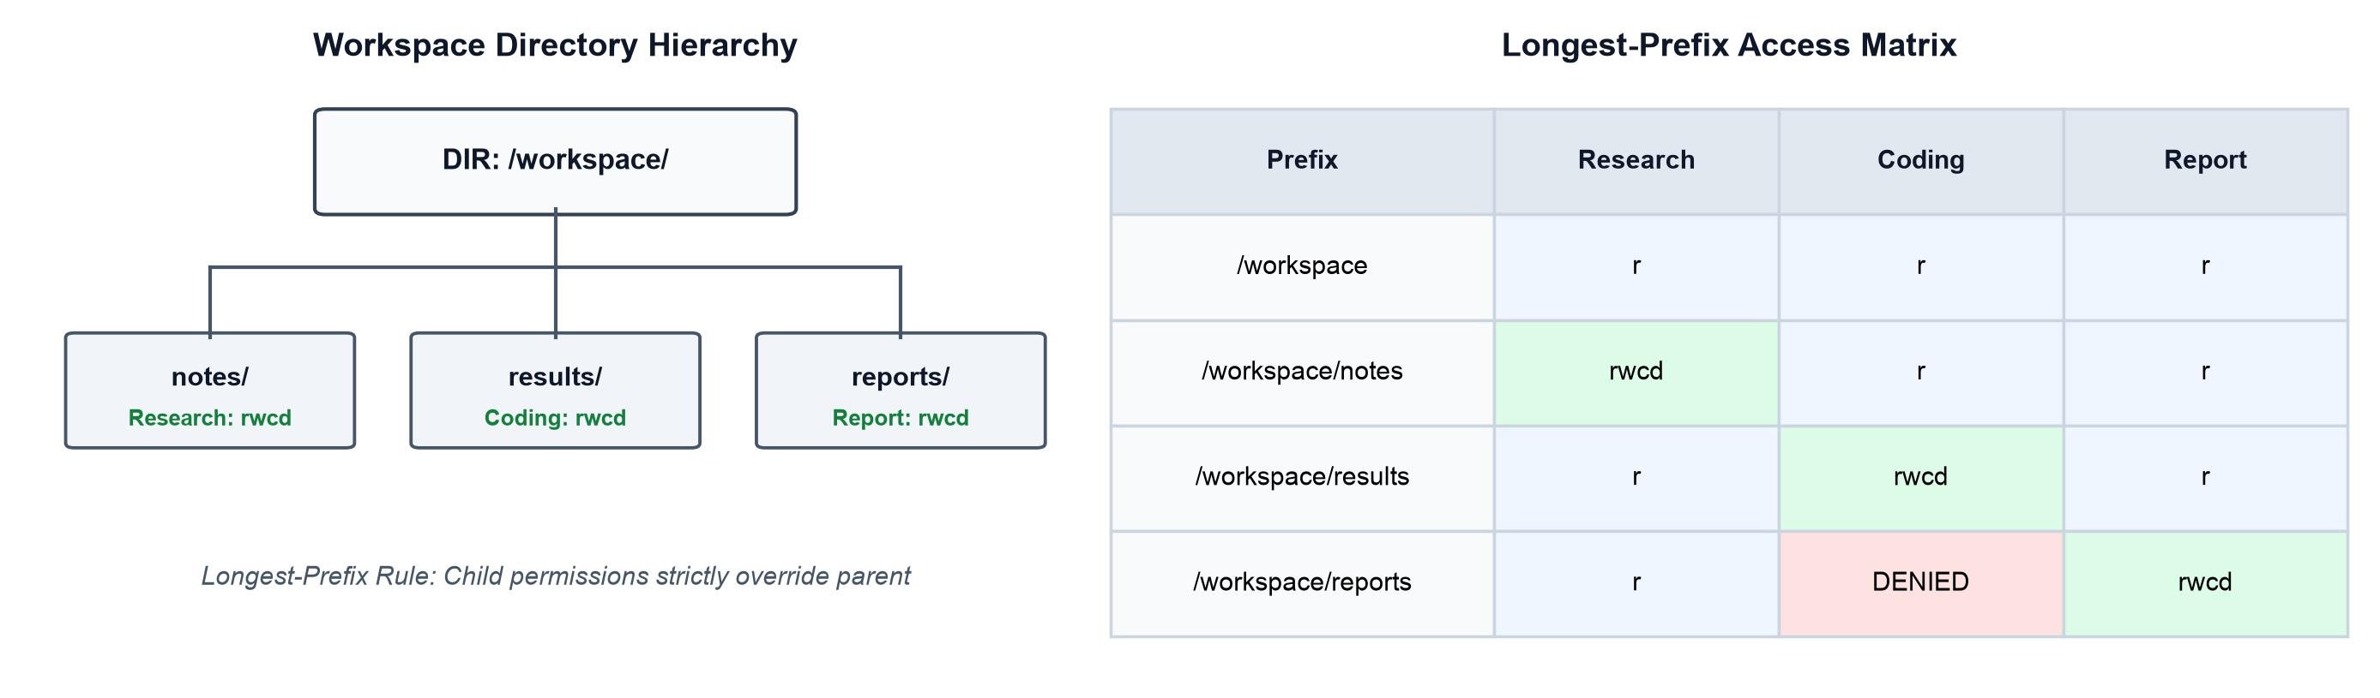
HIERARCHICAL ACCESS CONTROL
UNIT 5 · FILE SYSTEMS
Multi-agent collaboration requires structured directory protection across shared paths (/notes, /results, /reports):
• Longest-Prefix Matching: Effective permissions are resolved from the most specific path rule before disk resolution.
• Zero Information Leakage: Unauthorized operations are rejected without revealing target file existence.
• Optimistic Concurrency: Atomic version comparisons reject stale writes, preventing lost updates in shared workspaces.

Slide 6
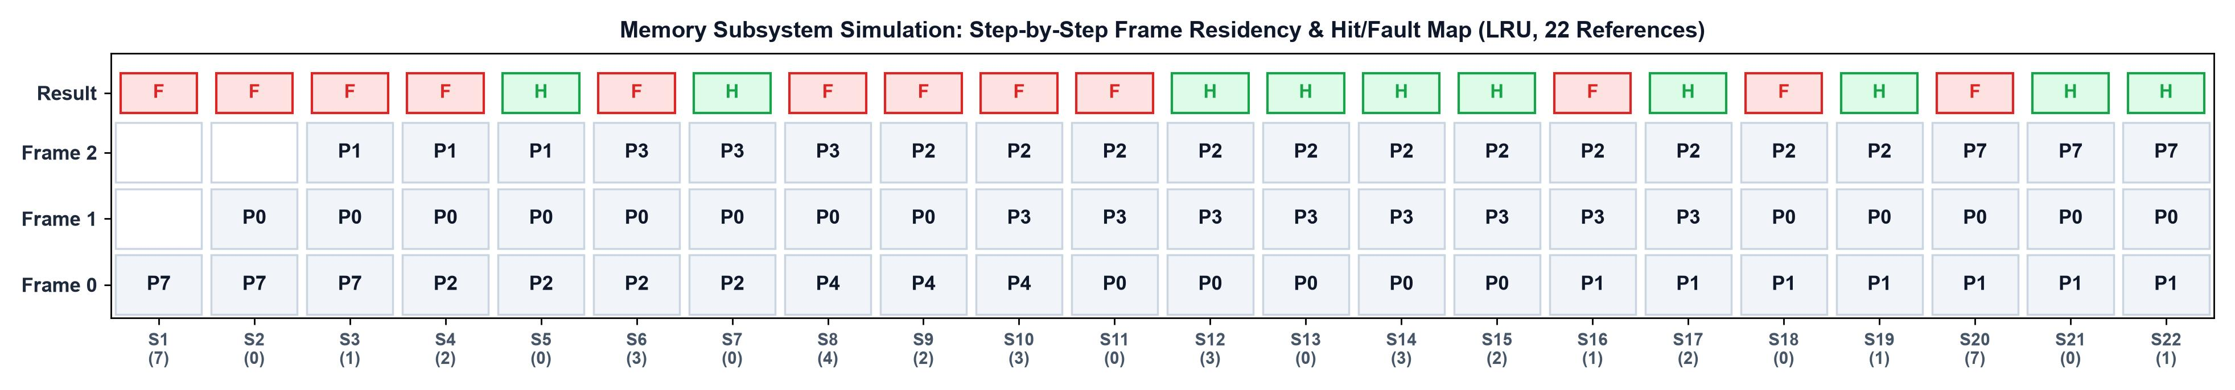
SYSTEM ARCHITECTURE
ONE PYTHON SIMULATOR, TWO MODULES
AgentOS is implemented as a deterministic, reproducible Python simulation using only standard library modules:
• Module A (Memory Subsystem): Simulates page traces, frame allocation, hit/fault metrics, and FIFO/LRU policies.
• Module B (File System): In-memory directory tree with longest-prefix ACLs, logical timestamps, and audit logging.
• 42/42 automated tests pass with 100% determinism and zero platform dependencies.

Slide 7
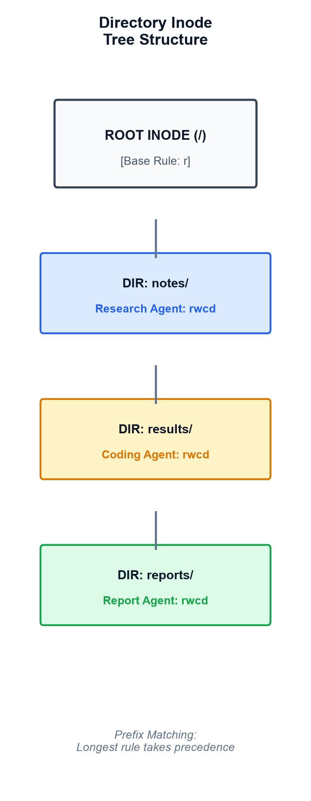
CORE DATA STRUCTURES
DIRECTORY TREE & PAGING QUEUES
Dedicated OS Data Structures:
• Directory Inode Tree: Hierarchical directory tree rooted at /workspace with nested subfolders, file metadata, and version tags.
• FIFO Arrival Queue: Linear queue where page load order is preserved; hits do not reorder frames.
• LRU Recency Map: Timestamp table tracking last reference times; victim selection finds the minimum logical timestamp.

Slide 8
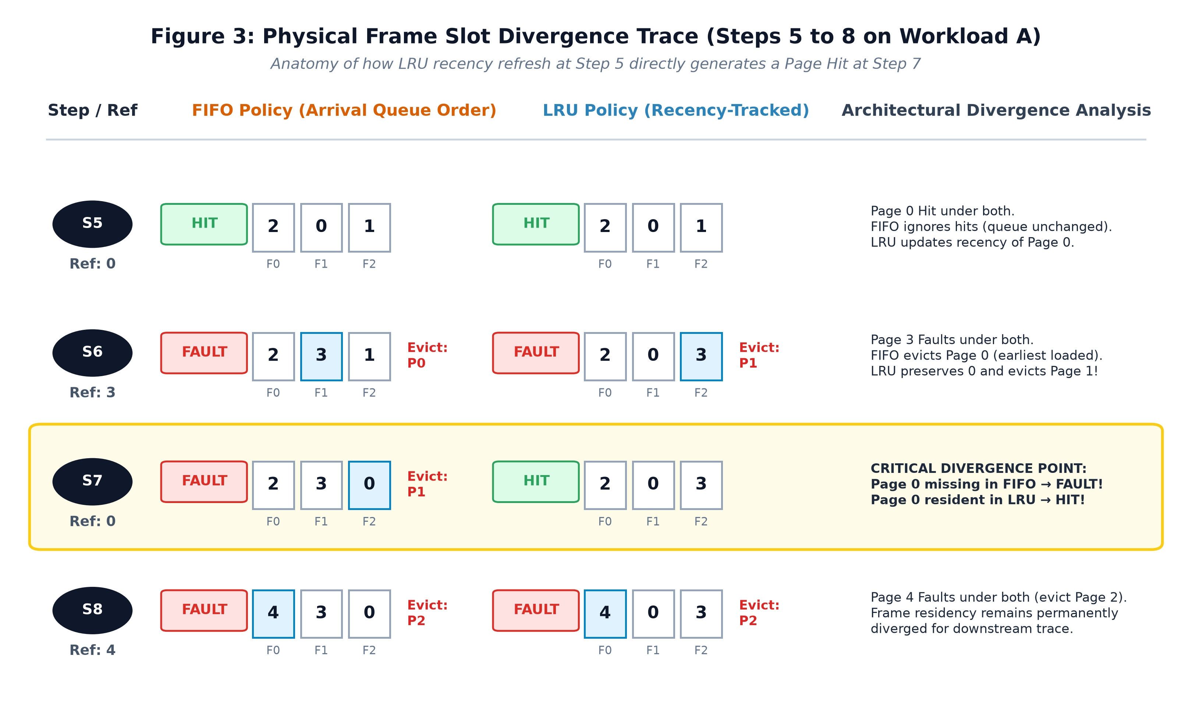
FIFO VS LRU TRACE DIVERGENCE
UNIT 4 · MEMORY WALKTHROUGH
Divergence & Final Outcomes:
• Step 7 (Page 0 Reference):
Page 0 is referenced again! FIFO suffers a costly Page Fault. LRU scores a direct Page HIT!
Benchmark Results:
• FIFO: 7 Hits, 15 Faults (31.82% Hit Ratio)
• LRU: 10 Hits, 12 Faults (45.45% Hit Ratio)
LRU delivers +13.63% higher hit ratio on temporal workloads.
Workload A Trace (3 Frames):
• Step 5 (Page 0 Hit):
Both policies hold frames [2, 0, 1]. FIFO queue remains unchanged. LRU updates Page 0 timestamp to t=5.
• Step 6 (Page 3 Fault):
FIFO evicts Page 0 (oldest arrival).
LRU evicts Page 1 (least recently used), retaining Page 0 in memory.

Slide 9
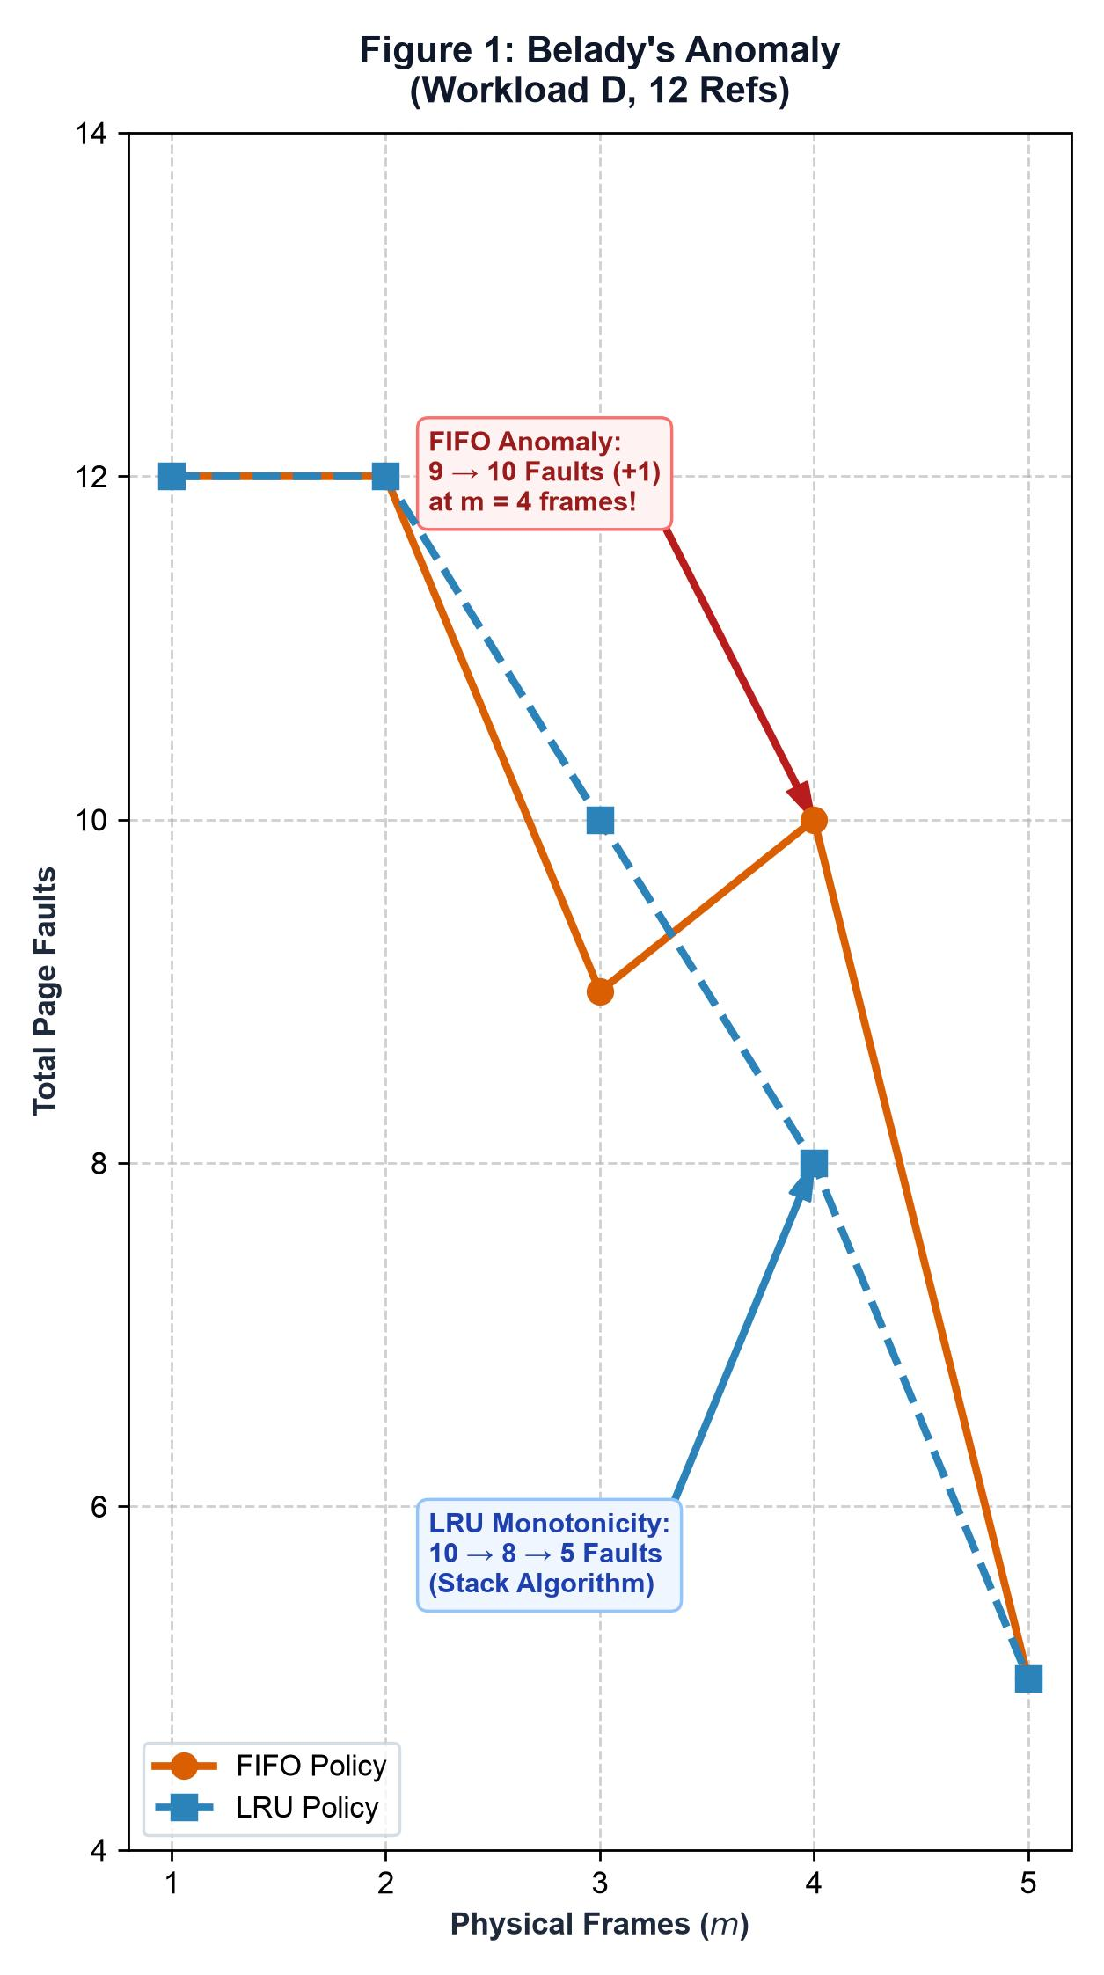
THEORETICAL PROOF · UNIT 4
Workload D Benchmark: [1, 2, 3, 4, 1, 2, 5, 1, 2, 3, 4, 5] evaluated across 1 to 5 frames.
Stack Inclusion Theorem: M(m, t) ⊆ M(m+1, t)
• FIFO Anomaly: Increasing frame capacity from 3 to 4 frames causes faults to increase from 9 to 10 (+1 fault). Proves FIFO violates the stack inclusion property.
• LRU Monotonicity: Faults strictly decrease (10 → 8 → 5 faults). Proves LRU is a true stack algorithm that guarantees better performance with additional memory.
BELADY'S ANOMALY PROOF
github.com/Avanipihu/AGENTOS

Slide 10
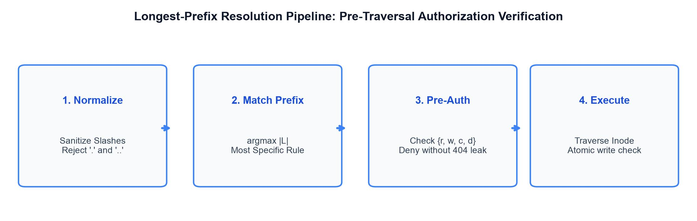
SECURITY ALGORITHM · UNIT 5
Mathematical Formulation:
A(S, P) = Rule(S, argmax_{L ⊑ P} |L|)
Four-Stage Security Pipeline:
1. Path Normalization: Standardize delimiters and reject relative paths / traversal.
2. Longest-Prefix Resolution: Identify the most specific directory rule matching the agent role.
3. Pre-Resolution Authorization: Deny unauthorized operations prior to filesystem inspection, preventing timing attacks and path enumeration.
4. Atomic Execution: Traverse inode tree and execute version-checked operations.
LONGEST-PREFIX MATCHING
github.com/Avanipihu/AGENTOS

Slide 11
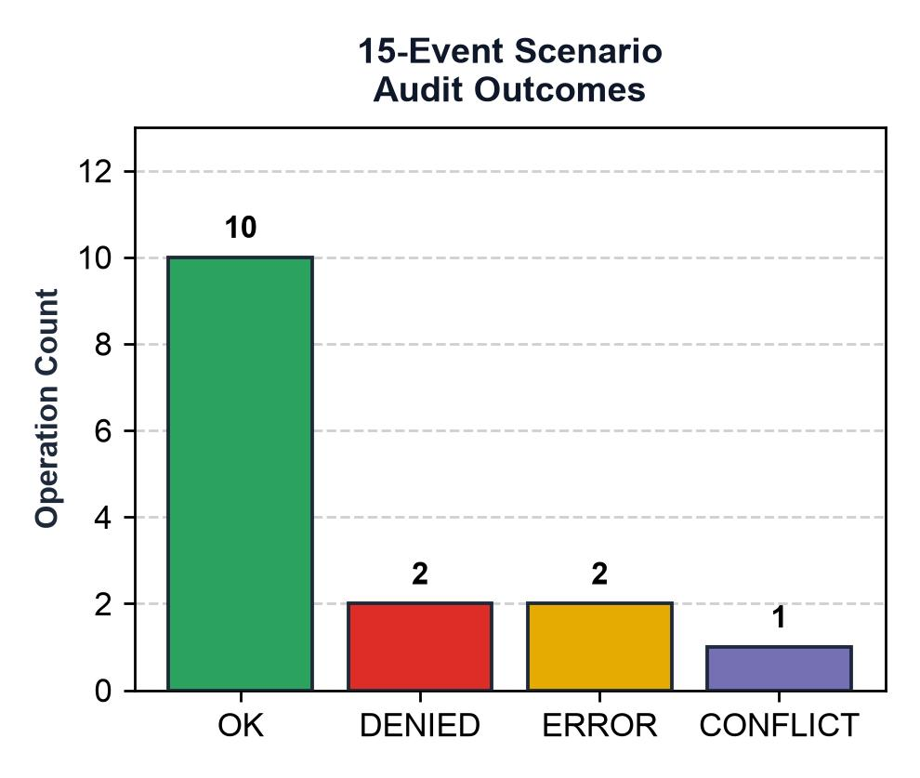
CONCURRENCY & INTEGRITY
OPTIMISTIC CONCURRENCY CONTROL
Protecting Shared Workspace State:
• Version-Checked Writes: write(path, expected_version=v). If concurrent agent operations modified the file, the write is aborted with CONFLICT status.
• Audit Logging: Standardized 15-operation scenario generates a tamper-evident audit trace (10 OK, 2 DENIED, 2 ERROR, 1 CONFLICT) with logical timestamp tracking.

Slide 12
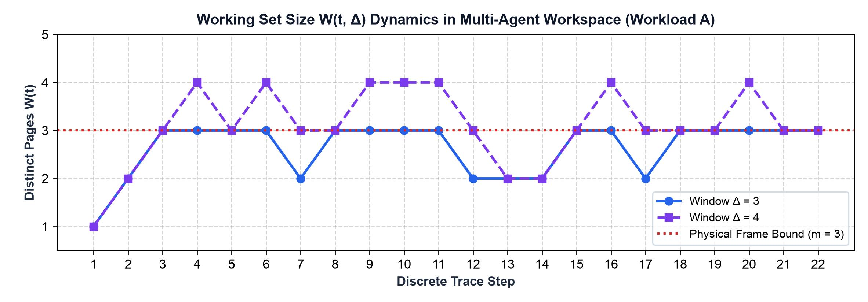
EXPLICIT CLAIM BOUNDARIES
Contemporary Systems Context:
• Omarchy: Arch Linux desktop distribution using Hyprland and agent launchers. Provides real-world workspace setting but relies on standard Linux kernel paging.
• AIOS (Mei et al.): Academic research architecture proposing LLM kernel scheduling and context switching.
RELATED SYSTEMS CONTEXT
• MemGPT: Prompt-level virtual context management for LLM context windows.
• AgentOS: Bounded educational simulation modeling classical Unit 4 demand paging and Unit 5 hierarchical access control.

Slide 13
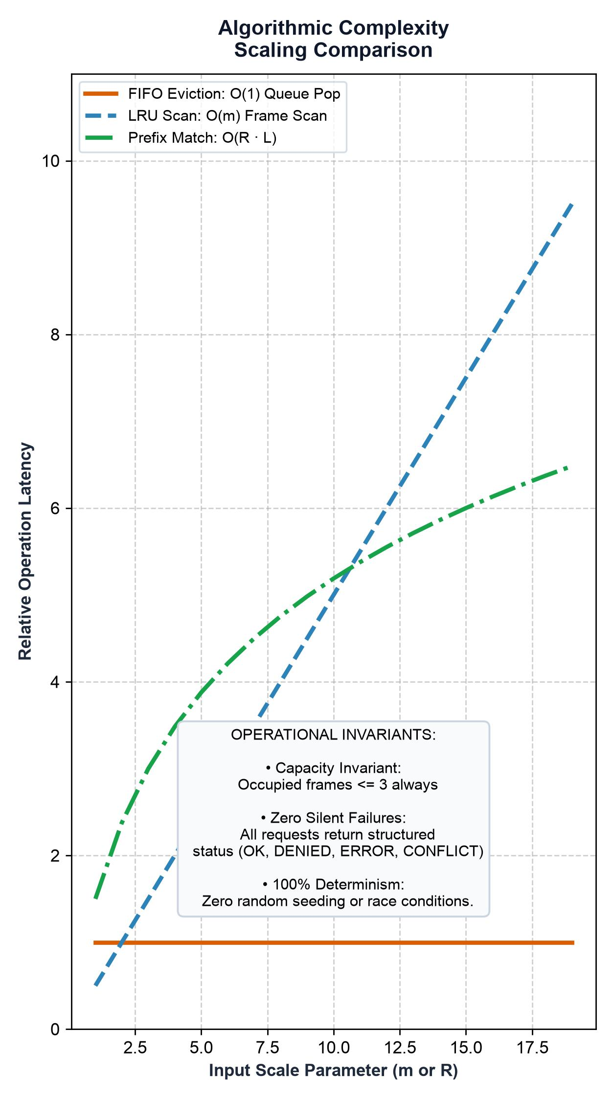
ALGORITHMIC EFFICIENCY
COMPLEXITY ANALYSIS
Time Complexity of Core Operations:
• FIFO Queue Eviction: O(1) via queue head pop and tail append.
• LRU Recency Lookup: O(m) linear scan over m = 3 physical frames.
• Longest-Prefix Matching: O(R · L) where R is rule count and L is path length.
• Version Conflict Check: O(1) integer equality comparison.
Operational Invariants Verified:
• Strict Frame Bound: Resident frames never exceed m.
• Zero Silent Failures: Every call returns structured status (OK, DENIED, ERROR, CONFLICT).
• Complete Determinism: 100% reproducible across operating systems.

Slide 14
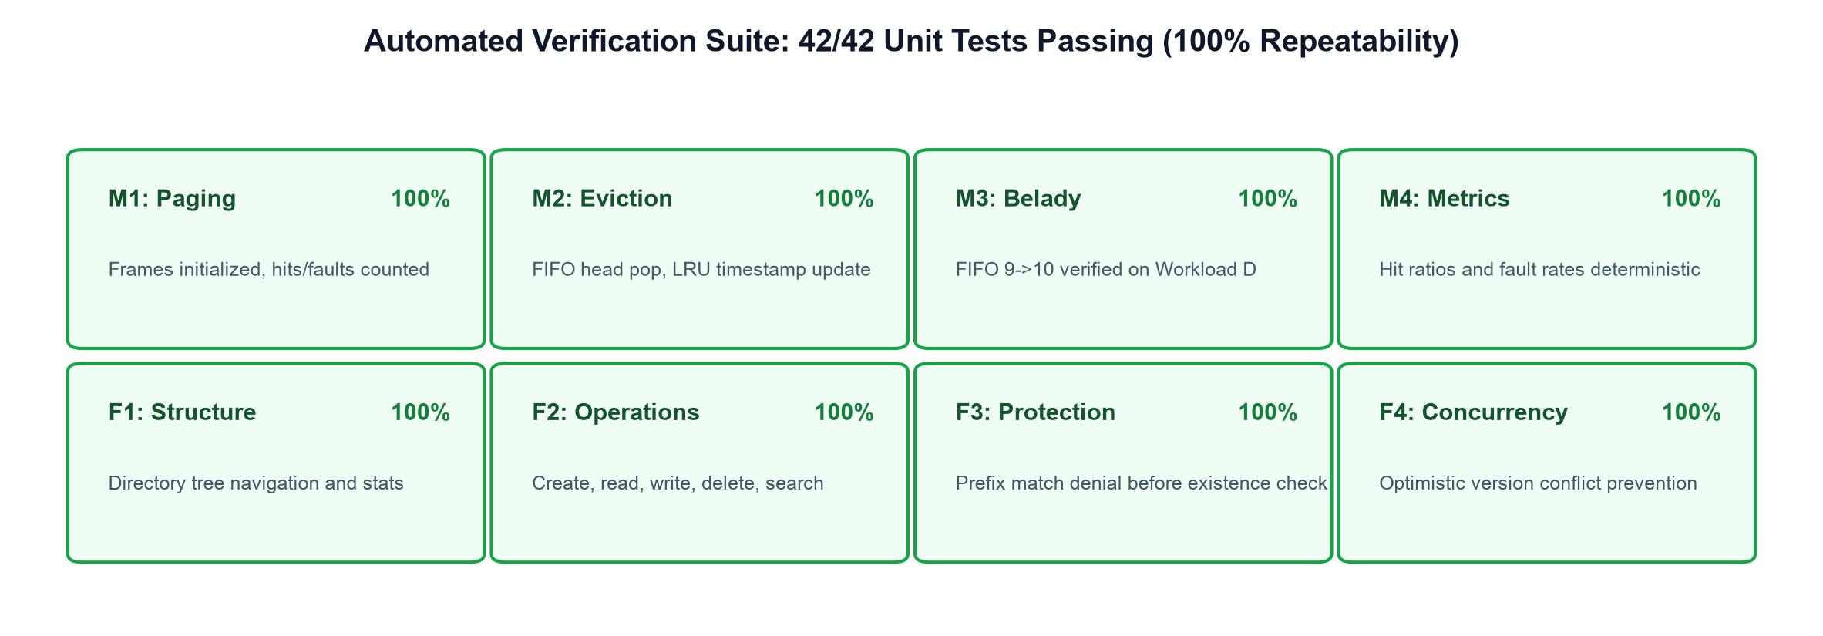
EXPERIMENTAL SUMMARY
Rigorous Verification Suite:
• 42 Automated Unit Tests covering edge cases (zero frames, empty traces, repeated references, unauthorized deletes, path collisions).
• Automated evaluation runner: python evaluate.py with --check verification flag.
Key Conclusions:
• LRU provides superior cache efficiency (+13.6% hit ratio) for agent workloads with temporal locality.
• Longest-prefix matching eliminates information leakage in shared multi-agent environments.
• Classical OS principles directly extend to autonomous agent workspaces.
EVALUATION & VERIFICATION
github.com/Avanipihu/AGENTOS

Slide 15
AGENTOS · OS CASE STUDY
THANK YOU
QUESTIONS?
github.com/Avanipihu/AGENTOS
AgentOS: An OS Case Study on Memory and File Management in Agent-Oriented Workspaces. Complete codebase, test matrix, and visual figures available on GitHub.

