Slide 1
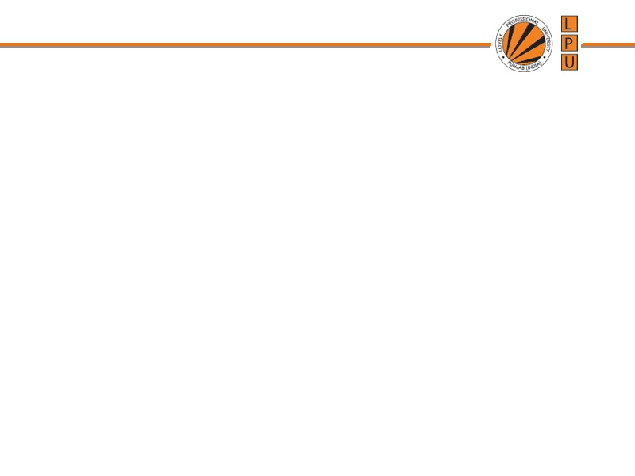
CSE408
Design and Analysis
of Algorithms
Lecture #1

Slide 2
Lecture Outline
❖ What is an Algorithm?
❖ Need for Algorithm Analysis
❖ Time Complexity
❖ Space Complexity
❖ Best, Average & Worst Case Analysis
❖ Asymptotic Notations (Big-O, Big-Ω, Big-Θ)

Slide 3
What is an Algorithm?
❖ Definition
• A finite, well-defined sequence of instructions to solve a specific problem or perform a computation.
❖ Characteristics
• Finiteness – Must terminate after finite steps
• Definiteness – Each step precisely defined
• Input – Zero or more inputs from a specified set
• Output – One or more outputs related to inputs
• Effectiveness – Steps basic enough to be carried out
❖ Example
• Euclid's algorithm for GCD, Sorting algorithms, Searching
Notes:
Example: Binary Search Linear Search SJF

Slide 4
Algorithm Life Cycle
Problem Definition
Requirement(Conditions)
Logic Design Strategy
Develop Algorithm
Validation(Prove correctness)
Analysis
Implementation
Testing & Debugging
Maintenance
Notes:
Example: Binary Search Linear Search SJF

Slide 5
Example: Finding Maximum Element
❖ Pseudocode
❖ Analysis
Algorithm FindMax(A, n)
Input: Array A of n elements
Output: Maximum element
max ← A[0]
for i ← 1 to n-1 do
if A[i] > max then
max ← A[i]
return max
• Comparisons: n − 1
• Time: O(n) – Linear
• Space: O(1) – Constant
❖ Trace Example
A = [3, 7, 2, 9, 5]
max: 3→7→7→9→9
Output: 9

Slide 6
Need for Algorithm Analysis
❖ Performance Prediction
• Estimate running time and memory before implementation
❖ Compare Alternatives
• Choose the best among multiple solutions
Ex: Linear Search O(n) vs Binary Search O(log n)
❖ Scalability
• Understand behavior as input grows: 100 → 1,000,000
Ex: O(n²) on 10⁶ items = 10¹² ops — too slow!
❖ Resource Optimization
• Minimize cost – crucial in embedded, real-time, cloud
Ex: Choosing Merge Sort over Bubble Sort for large data

Slide 7
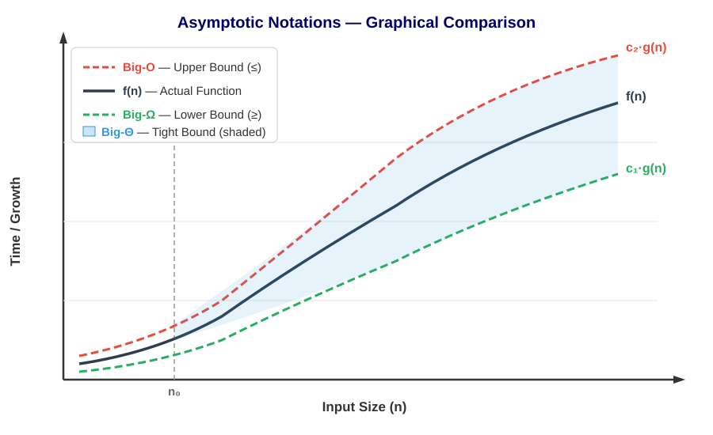
Asymptotic Notations
❖ What are they?
• Mathematical tools or function to describe
growth rate as n → ∞
❖ Three Notations
• Big-O → Upper Bound (≤)
• Big-Ω → Lower Bound (≥)
• Big-Θ → Tight Bound (=)
❖ Key Idea
• Ignore constants & lower-order
• Focus on dominant term
Ex: 3n² + 5n + 2 → O(n²)
After n₀, f(n) is bounded between c₁·g(n) and c₂·g(n)
→ This defines the Θ (Tight Bound) region

Slide 8
Asymptotic Notation
❖ Big-O Notation (Upper Bound)
Describes the worst-case / maximum growth rate of an algorithm
Ex: Linear Search takes at most n comparisons → O(n)
❖ Big-Ω (Omega) Notation (Lower Bound)
Describes the best-case / minimum time an algorithm will take
Ex: Linear Search finds element at first position → Ω(1)
❖ Big-Θ (Theta) Notation (Tight Bound)
When upper and lower bounds match — exact growth rate
Ex: Merge Sort is Θ(n log n) in all cases
❖ Why Asymptotic?
Focuses on large input behavior, ignoring constants and lower-order terms
Ex: 3n² + 5n + 2 simplifies to O(n²)

Slide 9
Big-O Notation (Upper Bound)
❖ Formal Definition
• f(n) = O(g(n)) if ∃ constants c > 0, n₀ > 0 such that:
f(n) ≤ c · g(n) for all n ≥ n₀
❖ Meaning
• f(n) grows at most as fast as g(n) for large n
• Describes the worst-case upper bound on growth
• Most commonly used in practice
❖ Examples
• 3n + 5 = O(n) [c=4, n₀=5]
• 2n² + 3n + 1 = O(n²) [c=3, n₀=4]
• 5n³ + 2n² = O(n³)
• log n + 7 = O(log n)

Slide 10
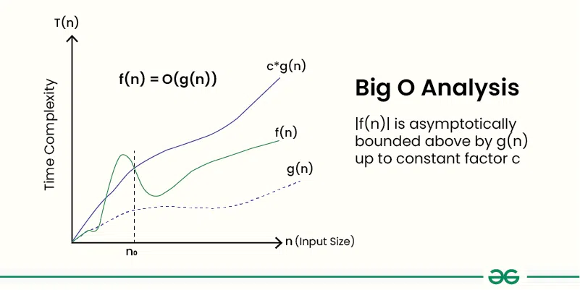
Big-O Notation (Upper Bound)

Slide 11
Big-O Notation (Upper Bound)
Example 1: f(n) = 3n² + 2n + 1000Logn + 5000
After ignoring lower order terms, we get the highest order term as 3n²
After ignoring the constant 3, we get n²
Therefore the Big O value of this expression is O(n²)
Example 2 : f(n) = 3n³ + 2n² + 5n + 1
Dominant Term: 3n³
Order of Growth: Cubic (n³)
Big O Notation: O(n³)

Slide 12
Big-O Notation (Upper Bound)
Example 1: Prove f(n) = 3n + 5 is O(n)
We need to show: 3n + 5 ≤ c · n
Choose c = 4, n₀ = 5
For n ≥ 5:
3n + 5 ≤ 4n
5 ≤ 4n - 3n
5 ≤ n → true for all n ≥ 5
Condition satisfied → f(n) = O(n)

Slide 13
Big-O Notation (Upper Bound)
Example 2: Prove f(n) = 5n² + 2n + 1 is O(n²)
We need to show: 5n² + 2n + 1 ≤ c · n²
Choose c = 8, n₀ = 1
For n ≥ 1:
5n² + 2n + 1 ≤ 8n²
2n + 1 ≤ 3n²
For n = 1 → 3 ≤ 3 → true
For n ≥ 1 → 3n² grows faster than 2n + 1 → always true
Condition satisfied → f(n) = O(n²)

Slide 14
Big-Ω Notation (Lower Bound)
❖ Formal Definition
• f(n) = Ω(g(n)) if ∃ constants c > 0, n₀ > 0 such that:
f(n) ≥ c · g(n) for all n ≥ n₀
❖ Meaning
• f(n) grows at least as fast as g(n)
• Algorithm takes at least this much time
• Proves a problem cannot be solved faster
❖ Examples
• n² + n = Ω(n²) [c=1, n₀=1]
• 5n + 3 = Ω(n) [c=5, n₀=1]
• n³ + 2n = Ω(n²) [also Ω(n)]
❖ Use Case
• Comparison-based sorting needs Ω(n log n) at minimum

Slide 15
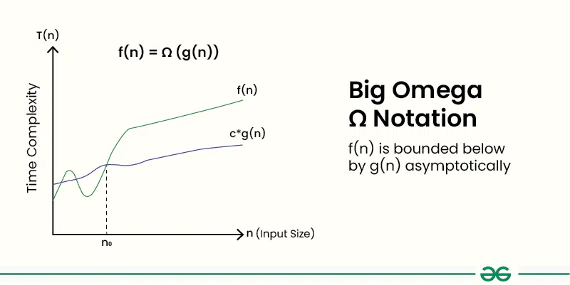
Big-Ω Notation (Lower Bound)

Slide 16
Big-Ω Notation (Lower Bound)
Example 1: Prove f(n) = 3n + 5 is Ω(n)
Definition: f(n) = Ω(g(n)) if there exist constants c > 0 and n₀ ≥ 1 such that f(n) ≥ c · g(n) for all n ≥ n₀
We need to show: 3n + 5 ≥ c · n
Choose c = 1, n₀ = 1
For n ≥ 1:
3n + 5 ≥ 1 · n
3n + 5 ≥ n → always true since 3n itself is ≥ n
Condition satisfied → f(n) = Ω(n)

Slide 17
Big-Ω Notation (Lower Bound)
Example 2: Prove f(n) = 5n² + 2n + 1 is Ω(n²)
We need to show: 5n² + 2n + 1 ≥ c · n²
Choose c = 1, n₀ = 1
For n ≥ 1:
5n² + 2n + 1 ≥ 1 · n²
5n² + 2n + 1 ≥ n² → always true since 5n² itself is ≥ n²
Condition satisfied → f(n) = Ω(n²)

Slide 18
Big-Θ Notation (Tight Bound)
❖ Formal Definition
• f(n) = Θ(g(n)) if ∃ constants c₁, c₂ > 0, n₀ > 0:
c₁·g(n) ≤ f(n) ≤ c₂·g(n) for all n ≥ n₀
❖ Meaning
• f(n) grows at exactly the rate of g(n)
• Both upper and lower bounds simultaneously
• f(n) = Θ(g(n)) ⟺ f(n) = O(g(n)) AND f(n) = Ω(g(n))
❖ Examples
• 2n² + 3n = Θ(n²) [c₁=2, c₂=3, n₀=3]
• n + log n = Θ(n)
• 6n³ = Θ(n³)
❖ Use Case
• Merge Sort is Θ(n log n) in all cases

Slide 19
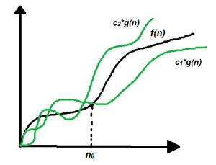
Big-Θ Notation (Tight Bound)

Slide 20
Big-Θ Notation (Tight Bound)
Example 1: Prove f(n) = 3n + 5 is Θ(n)
We need to show: c₁ · n ≤ 3n + 5 ≤ c₂ · n
Choose c₁ = 1, c₂ = 4, n₀ = 5
For n ≥ 5:
Lower bound:
1 · n ≤ 3n + 5
n ≤ 3n + 5 → always true
Upper bound:
3n + 5 ≤ 4n
5 ≤ n → true for n ≥ 5
Both satisfied → f(n) = Θ(n)

Slide 21
Big-Θ Notation (Tight Bound)
Example 2: Prove f(n) = 5n² + 2n + 1 is Θ(n²)
We need to show: c₁ · n² ≤ 5n² + 2n + 1 ≤ c₂ · n²
Choose c₁ = 1, c₂ = 8, n₀ = 1
For n ≥ 1:
Lower bound:
1 · n² ≤ 5n² + 2n + 1
n² ≤ 5n² + 2n + 1 → always true
Upper bound:
5n² + 2n + 1 ≤ 8n²
2n + 1 ≤ 3n²
For n = 1 → 3 ≤ 3 → true
Both satisfied → f(n) = Θ(n²)

Slide 22
Best, Average & Worst Case
❖ Best Case (Ω – Omega)
• Minimum time over all inputs of size n
Ex: Linear Search: element at first position → O(1)
❖ Average Case (Θ – Theta)
• Expected time averaged over all possible inputs
Ex: Linear Search: element at middle → O(n/2) = O(n)
❖ Worst Case (O – Big-O)
• Maximum time over all inputs of size n
Ex: Linear Search: element at last or absent → O(n)
❖ Why Worst Case Matters
• Provides upper bound guarantee for all inputs
• Most commonly used in algorithm analysis

Slide 23
Practice Problems
Q1: f(n) = 7n + 3
a) Prove f(n) = O(n)
b) Prove f(n) = Ω(n)
c) Prove f(n) = Θ(n)
Q2: f(n) = 4n² + 10
a) Prove f(n) = O(n²)
b) Prove f(n) = Ω(n²)
c) Prove f(n) = Θ(n²)
Q3: f(n) = 2n³ + 4n² + 6n + 8
a) Prove f(n) = O(n³)
b) Prove f(n) = Ω(n³)
c) Prove f(n) = Θ(n³)
Q4: f(n) = n² + 100n
a) Prove f(n) = O(n²)
b) Prove f(n) = Ω(n²)
c) Is f(n) = O(n)? Why?

Slide 24
Comparison of Asymptotic Notations
Notation | Bound | Math Definition | Analogy | Example
Big-O | Upper | f(n) ≤ c·g(n) | ≤ (at most) | 3n+5 = O(n)
Big-Ω | Lower | f(n) ≥ c·g(n) | ≥ (at least) | n²+n = Ω(n²)
Big-Θ | Tight | c₁g(n)≤f(n)≤c₂g(n) | = (exactly) | 2n²+3n = Θ(n²)
❖ Key Takeaway
• Big-O → most used for worst-case guarantees
• Big-Θ → preferred when exact growth rate is known
• Big-Ω → used for lower bound proofs of problems
❖ Practical Rule
• Drop constants & lower-order terms:
Ex: 7n³ + 4n² + 2n + 6 → O(n³)

Slide 25
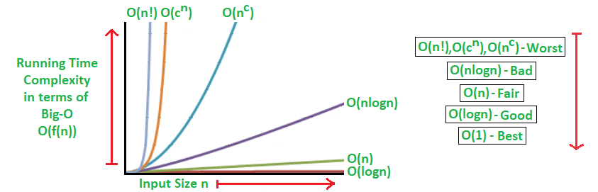
Dominant Relations
Constant < logarithmic < polynomial < exponential
Example: 100 < logn < n < nlogn < n^2 < 2^n < n! < n^n

Slide 26
Time Complexity
❖ Definition
• Number of basic operations as a function of input size n
• Independent of machine, language, or programmer
❖ Common Time Complexities with Examples
• O(1) – Constant: Array index access A[5]
• O(log n) – Logarithmic: Binary Search
• O(n) – Linear: Linear Search, Find Max
• O(n log n) – Linearithmic: Merge Sort, Quick Sort (avg)
• O(n²) – Quadratic: Bubble Sort, Selection Sort
• O(2ⁿ) – Exponential: Recursive Fibonacci, Subset Sum

Slide 27
Space Complexity
❖ Definition
• Total memory an algorithm uses relative to input size
• S(P) = C + Sₚ(instance)
❖ Fixed Part (C)
• Memory independent of input: variables, constants
Ex: int max, i; → fixed regardless of array size
❖ Variable Part (Sₚ)
• Memory dependent on input size n
Ex: Merge Sort needs O(n) extra array
Ex: Recursive calls use O(n) stack for n-depth recursion
❖ Example
• Linear Search: O(1) space (only index variable)
• Merge Sort: O(n) space (auxiliary array)

Slide 28
Insertion Sort
❖ Basic Idea
Builds the sorted array one element at a time
Picks each element and inserts it into its correct position in the sorted part
Ex: Like sorting playing cards in your hand
❖ How It Works
Start from the 2nd element (assume 1st is already sorted)
Compare current element with elements on its left
Shift larger elements to the right and insert current element in correct position
❖ Key Properties
In-place sorting (no extra array needed)
Stable sort (equal elements maintain their order)
Best for small or nearly sorted data

Slide 29
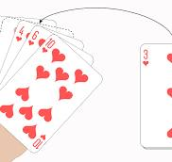
Insertion Sort

Slide 30
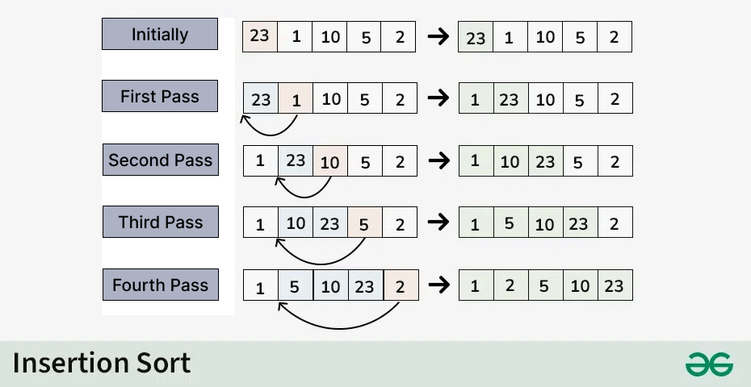
Insertion Sort

Slide 31
Insertion Sort Pesudo COde
INSERTION-SORT(A, n)
for i = 1 to n-1
key = A[i]
j = i - 1
while j >= 0 AND A[j] > key
A[j+1] = A[j]
j = j - 1
A[j+1] = key

Slide 32
Insertion Sort Time & Space Complexity
❖ Best Case: O(n)
Array is already sorted
Only outer loop runs, inner loop does 1 comparison each time
Ex: A = [1, 2, 3, 4, 5] → just n-1 comparisons
❖ Worst Case: O(n²)
Array is in reverse order
Every element shifts all the way to the beginning
Ex: A = [5, 4, 3, 2, 1] → total comparisons = n(n-1)/2
❖ Average Case: O(n²)
Elements are in random order
On average, each element moves halfway
Ex: A = [3, 1, 5, 2, 4] → roughly n²/4 comparison
Space Complexity
❖ Space Complexity: O(1)
Sorting is done in-place (inside the same array)
Only one extra variable used (key)
No extra array or data structure needed

Slide 33
Merge Sort
❖ Basic Idea
Divide the array into two halves, sort each half, then merge them back
Uses Divide and Conquer strategy
Ex: Split the problem into smaller parts, solve each, combine results
❖ How It Works
Step 1: Divide the array into two halves
Step 2: Recursively sort each half
Step 3: Merge the two sorted halves into one sorted array
❖ Key Properties
Not in-place (needs extra array for merging)
Stable sort (equal elements maintain their order)
Works well for large datasets

Slide 34
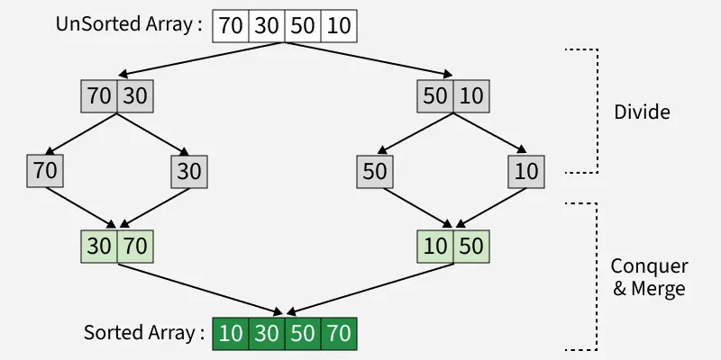
Merge Sort Dry Run

Slide 35
Merge Sort Algorithm
MERGE-SORT(A, left, right)
if left < right
mid = (left + right) / 2
MERGE-SORT(A, left, mid)
MERGE-SORT(A, mid+1, right)
MERGE(A, left, mid, right)
MERGE(A, left, mid, right)
n1 = mid - left + 1
n2 = right - mid
Create arrays L[n1] and R[n2]
Copy A[left..mid] into L
Copy A[mid+1..right] into R
i = 0, j = 0, k = left
while i < n1 AND j < n2
if L[i] <= R[j]
A[k] = L[i], i++
else
A[k] = R[j], j++
k++
Copy remaining elements of L into A
Copy remaining elements of R into A

Slide 36
Merge Sort Order of Growth
❖ Dividing Phase
Array is divided into 2 halves each time
Total levels of division = log n
Ex: 8 elements → 3 levels (8→4→2→1), log₂8 = 3
❖ Merging Phase
At each level, all n elements are compared and merged
Work done at each level = n
❖ Total Work
Total = n work × log n levels
∴ Order of growth = n log n
❖ Recurrence Relation
T(n) = 2T(n/2) + n
T(1) = 1
∴ Solving gives T(n) = n log n

Slide 37
Merge Sort Time Complexity
❖ Best Case: O(n log n)
Even if array is already sorted, it still divides and merges
No shortcut — always does full work
❖ Worst Case: O(n log n)
Reverse sorted array — still divides into log n levels
Each level does n comparisons
Ex: A = [5, 4, 3, 2, 1] → still n log n
❖ Average Case: O(n log n)
Random order — same process of divide and merge
Time remains consistent regardless of input
∴ Merge Sort always takes O(n log n) — no variation

Slide 38
Merge Sort Space Complexity
❖ Space Complexity: O(n)
Needs extra temporary arrays L and R during merging
Total extra space = size of original array = n
Also uses O(log n) space for recursion stack

Slide 39
Analysis of Iterative Algorithms
❖ What is Iterative Analysis?
Counting how many times each statement executes in loops
Helps determine Time Complexity and Space Complexity
❖ What We Count
Assignments → variable = value
Comparisons → if, while, for conditions
Arithmetic operations → +, -, *, /
❖ Key Rule
Focus on the loop — it dominates the running time
Ignore constants and lower order terms for Big-O

Slide 40
Example 1 : Sum of Array Element
int sum(int A[], int n) {
int total = 0; // 1 time
for (int i = 0; i < n; i++) // n+1 times
total = total + A[i]; // n times
return total; // 1 time
}
Time Complexity = O(n)
Space Complexity = O(1) (constant extra space)

Slide 41
Example 1 : Find Maximum Element
int findMax(int A[], int n) {
int max = A[0]; // 1 time
for (int i = 1; i < n; i++) // n times
if (A[i] > max) // n-1 times
max = A[i]; // n-1 times (worst)
return max; // 1 time
}
Time Complexity = O(n)
Space Complexity = O(1) (constant extra space)

Slide 42
Loop Analysis
for (int i = 0; i < n; i++) {
// body executes n times
}
Single loop T= O(n)
for (int i = 0; i < n; i++) { // n times
for (int j = 0; j < n; j++) { // n times each
// body
}
}
Double loop Time Complexity = O(n²)

Slide 43
Pattern 1: Both loops run n times
for (int i = 0; i < n; i++) { // n times
for (int j = 0; j < n; j++) { // n times each
// body
}
}
Total = n × n = n²
∴ Time Complexity = O(n²)

Slide 44
Pattern 2: Inner loop depends on outer
for (int i = 0; i < n; i++) { // n times
for (int j = 0; j < i; j++) { // 0,1,2,...,n-1
// body
}
}
Total = 0 + 1 + 2 + ... + (n-1) = n(n-1)/2
∴ Time Complexity = O(n²)

Slide 45
Pattern 3: Inner loop halves
for (int i = 0; i < n; i++) { // n times
for (int j = 1; j < n; j = j*2) { // log n times
// body
}
}
Total = n × log n
∴ Time Complexity = O(n log n)

Slide 46
Pattern 1: All loops run n times
for (int i = 0; i < n; i++) {
for (int j = 0; j < n; j++) {
for (int k = 0; k < n; k++) {
// body
}
}
}
Total = n × n × n = n³
∴ Time Complexity = O(n³)

Slide 47
Pattern 2: Inner loops depend on outer
for (int i = 0; i < n; i++) {
for (int j = 0; j < i; j++) {
for (int k = 0; k < j; k++) {
// body
}
}
}
Total = 0 + 0 + 1 + (1+2) + (1+2+3) + ... ≈ n³/6
∴ Time Complexity = O(n³)

Slide 48
Questions:
1. int x = A[0];
cout << x;
2. for (int i = 0; i < n; i++) {
cout << A[i];
}
3. for (int i = 1; i < n; i++) {
cout << A[i];
}
4. for (int i = 0; i < n; i = i + 2) {
cout << A[i];
}
5. for (int i = 1; i < n; i = i * 2) {
cout << i;
}
6. for (int i = n; i > 1; i = i / 2) {
cout << i;
}
7. for (int i = 0; i < n; i++) {
for (int j = 0; j < n; j++) {
cout << i + j;
}
}
8. for (int i = 0; i < n; i++) {
for (int j = 0; j < n; j = j * 2) {
cout << j;
}
}

Slide 49
Questions:
9. for (int i = 0; i < n; i++) {
cout << i;
}
for (int j = 0; j < n; j++) {
cout << j;
}
10. for (int i = 0; i < n; i++) {
for (int j = 0; j < i; j++) {
cout << "*";
}
}
11. int sum = 0;
for (int i = 0; i < n; i++) {
sum += A[i];
}
return sum;
12. int B[n];
for (int i = 0; i < n; i++) {
B[i] = A[i] * 2;
}
13. for (int i = 1; i < n; i = i * 2) {
for (int j = 0; j < n; j++) {
cout << i + j;
}
}
14. for (int i = 0; i < n; i++) {
for (int j = 1; j < n; j = j * 2) {
for (int k = 0; k < n; k++) {
cout << i + j + k;
}
}
}

Slide 50
Matrix Multiplication (Triple Loop)
void multiply(int A[][10], int B[][10], int C[][10], int n) {
for (int i = 0; i < n; i++) { // n times
for (int j = 0; j < n; j++) { // n times
C[i][j] = 0; // n² times
for (int k = 0; k < n; k++) { // n times
C[i][j] = C[i][j] + A[i][k] * B[k][j]; // n³ times
}
}
}
}
Outer (i) | n
Middle (j) | n × n = n²
Inner (k) | n × n × n = n³
Multiplication + Addition | n³
❖ Total Operations
T(n) = n³ + n² + n
Dominant term = n³
Time Complexity = O(n³)
Space Complexity = O(n²)

Slide 51
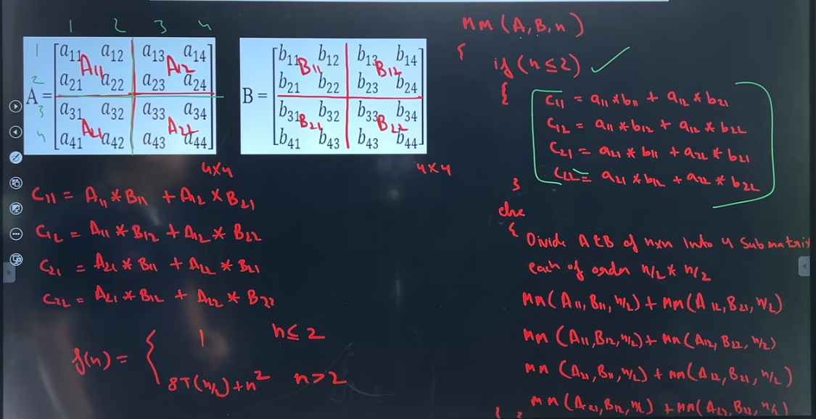
Matrix Multiplication ( Divide and conquer)

Slide 52
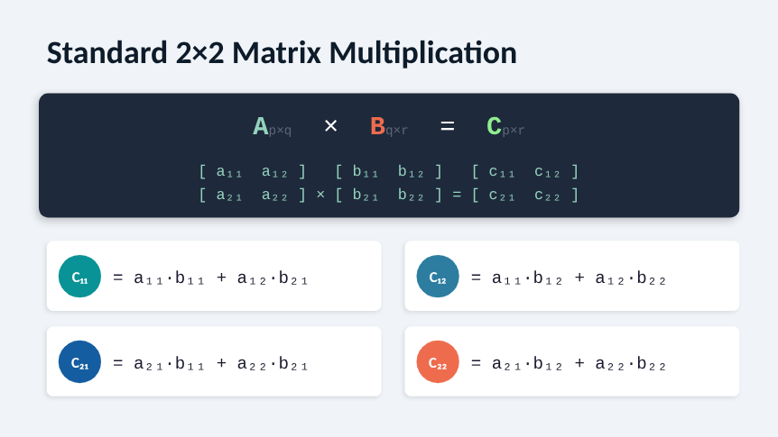
Strassen Matrix Multiplication

Slide 53
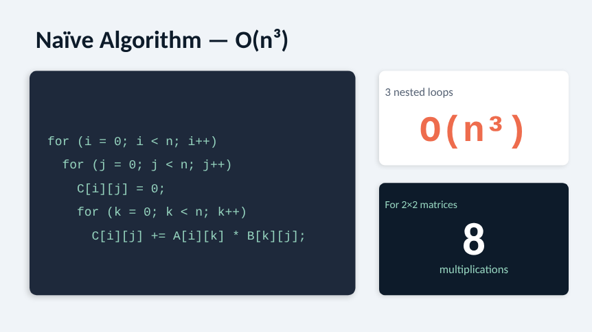
Strassen Matrix Multiplication

Slide 54
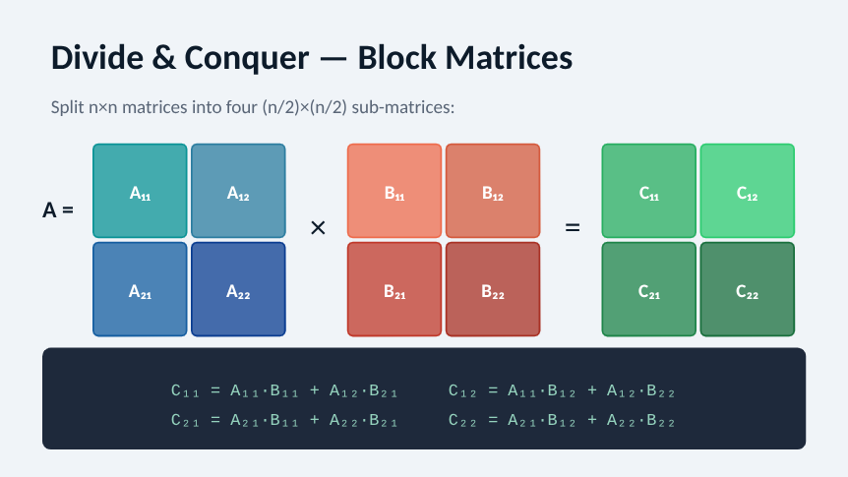
Strassen Matrix Multiplication

Slide 55
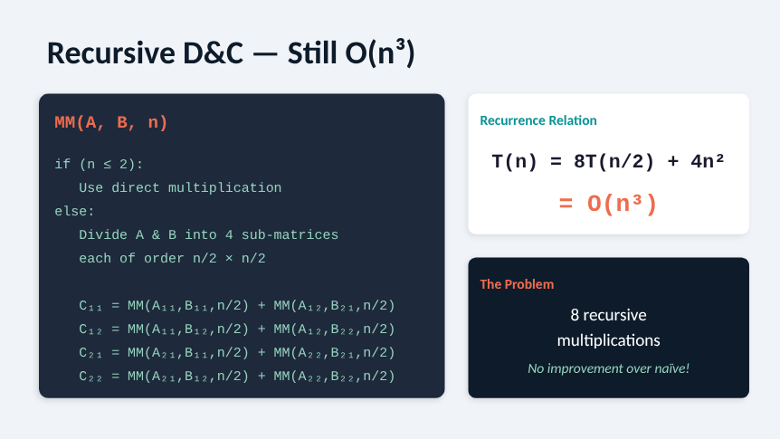
Strassen Matrix Multiplication

Slide 56
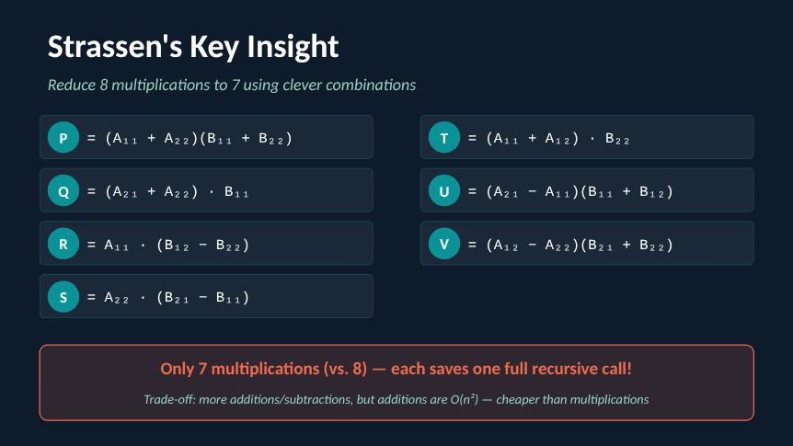
Strassen Matrix Multiplication

Slide 57
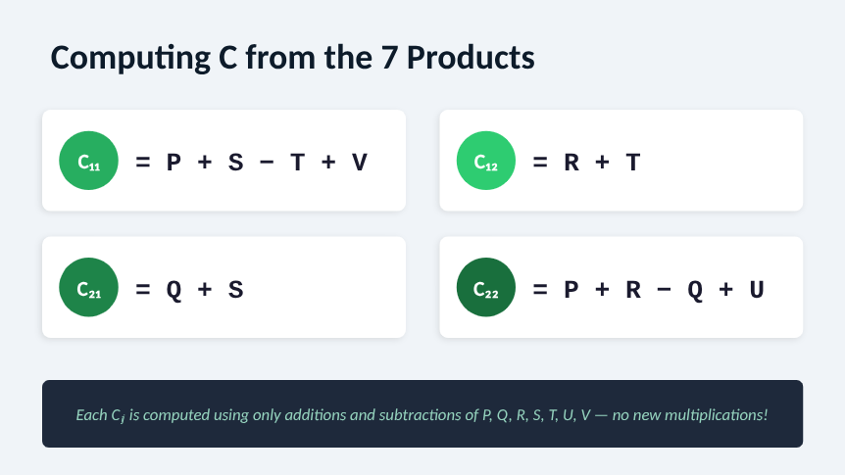
Strassen Matrix Multiplication

Slide 58
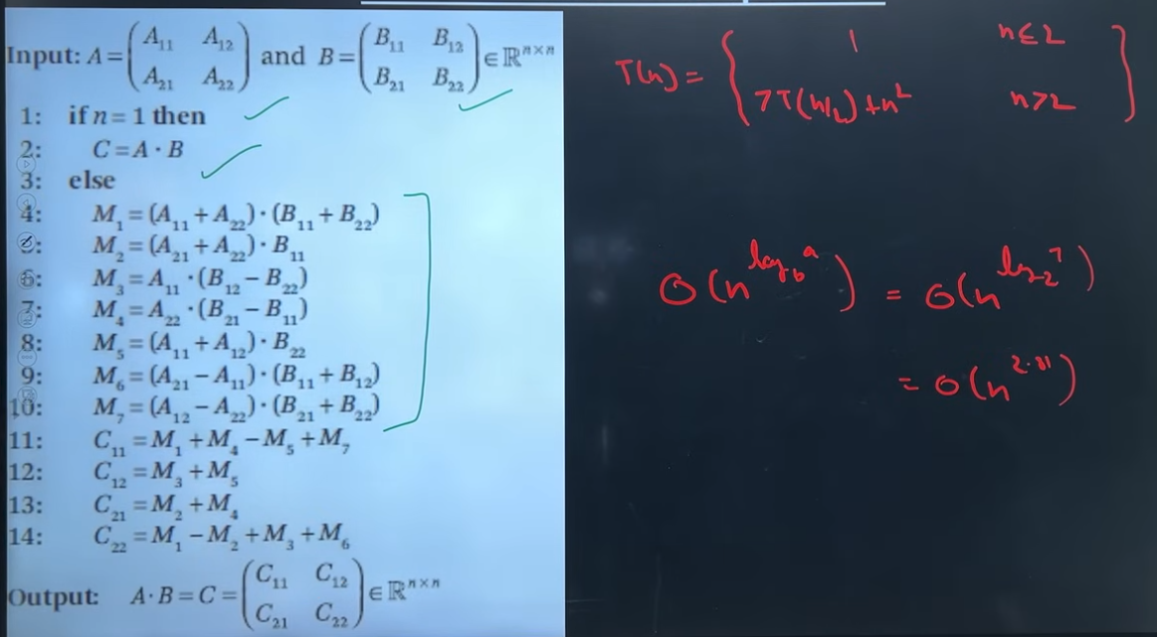
Strassen Matrix Multiplication

Slide 59
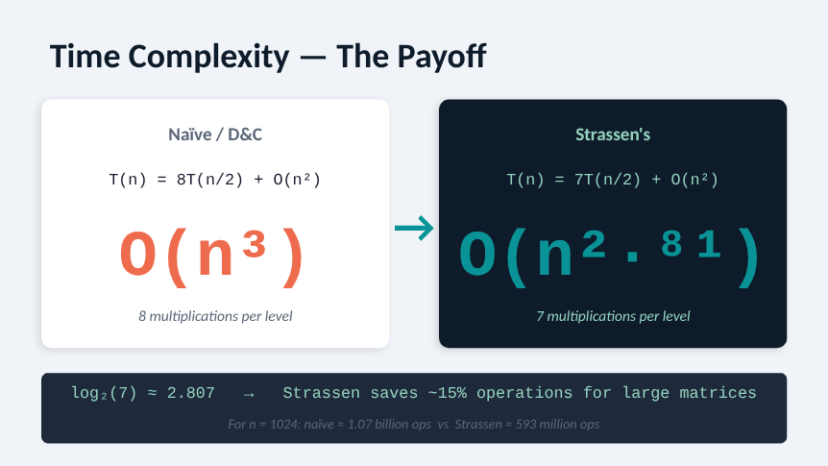
Strassen Matrix Multiplication

Slide 60
Strassen Matrix Multiplication
Example: Multiply A × B using Strassen's Method
A = [1 3] B = [5 7]
[2 4] [6 8]
Step 1: Identify sub-matrices
A11 = 1, A12 = 3, A21 = 2, A22 = 4
B11 = 5, B12 = 7, B21 = 6, B22 = 8
Step 2: Compute 7 Products
P = (A11 + A22)(B11 + B22) = (1 + 4)(5 + 8) = 5 × 13 = 65
Q = (A21 + A22)(B11) = (2 + 4)(5) = 6 × 5 = 30
R = (A11)(B12 − B22) = (1)(7 − 8) = 1 × (−1) = −1
S = (A22)(B21 − B11) = (4)(6 − 5) = 4 × 1 = 4
T = (A11 + A12)(B22) = (1 + 3)(8) = 4 × 8 = 32
U = (A21 − A11)(B11 + B12) = (2 − 1)(5 + 7) = 1 × 12 = 12
V = (A12 − A22)(B21 + B22) = (3 − 4)(6 + 8) = (−1) × 14 = −14
Step 3: Compute C using 7 Products
C11 = P + S − T + V = 65 + 4 − 32 + (−14) = 23
C12 = R + T = −1 + 32 = 31
C21 = Q + S = 30 + 4 = 34
C22 = P + R − Q + U = 65 + (−1) − 30 + 12 = 46
Result
C = [23 31]
[ 34 46]

Slide 61
Strassen Matrix Multiplication
Verification (Normal Method)
C11 = 1×5 + 3×6 = 5 + 18 = 23
C12 = 1×7 + 3×8 = 7 + 24 = 31
C21 = 2×5 + 4×6 = 10 + 24 = 34
C22 = 2×7 + 4×8 = 14 + 32 = 46

Slide 62
Recursion
What is Recursion?
❖ Basic Idea
A function that calls itself to solve a smaller version of the same problem
Keeps calling until it reaches a base case (stopping condition)
❖ Two Parts of Every Recursive Function
Base Case → when to stop (without this → infinite loop)
Recursive Case → function calls itself with smaller input
Simple Example
CCOUNTDOWN(n)
if n == 0 ← Base Case
print "Done"
else
print n
COUNTDOWN(n - 1) ← Recursive Case

Slide 63
Recursion Analysis
How to Analyze?
We cannot count loop iterations like iterative algorithms
Instead we write a Recurrence Relation
What is a Recurrence Relation?
❖ Definition
A mathematical equation that defines T(n) in terms of T(smaller value)
T(n) = time taken for input of size n
Example
T(n) = T(n-1) + 1 ← does 1 work + calls itself on n-1
T(1) = 1 ← base case takes constant time

Slide 64
Substitution Method
Example 1 — Factorial (Simplest Recursion)
FACTORIAL(n)
if n == 0
return 1
else
return n × FACTORIAL(n - 1)
Recurrence Relation:
T(n) = T(n-1) + 1 ← 1 multiplication + call on n-1
T(0) = 1 ← base case
Time Complexity = O(n)
Space Analysis
Each call sits on the call stack until base case is reached
Maximum calls on stack = n + 1
∴ Space Complexity = O(n) (recursion stack)

Slide 65
Substitution Method
Solve by Expansion (Back Substitution)
T(n) = T(n-1) + 1
T(n) = T(n-2) + 1 + 1 = T(n-2) + 2
T(n) = T(n-3) + 3
T(n) = T(n-k) + k
When k = n → T(0) + n = 1 + n
T(n) = n + 1 → Time Complexity = O(n)

Slide 66
Substitution Method
Given recurrence:
Example 2: T(n)=T(n/2)+C if n>1
1 if n=1
Step 1: Expand it
T(n)=T(n/2)+C
T(n/2)=T(n/4)+C
T(n)=T(n/4)+C+C =T(n/4)+2C
T(n/4)=T(n/8)+C
T(n)=T(n/8)+3C
Pattern:
T(n)=T(n/2k)+kC

Slide 67
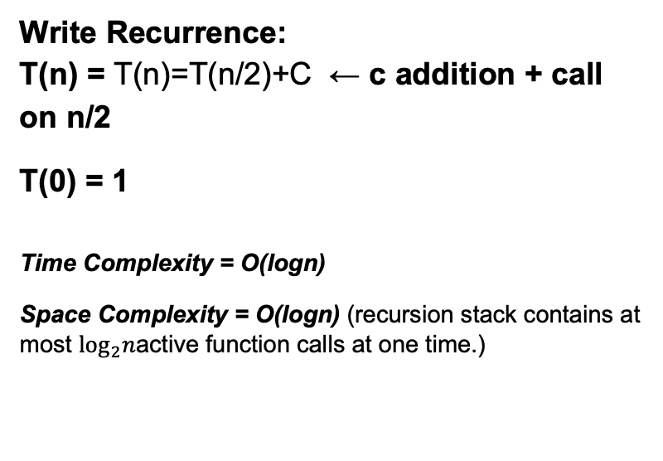
Substitution Method
Step 3: So:
n​/2k=1
n=2k
Therefore:
k=log₂​n
T(n)=T(n/2k)+kc
Since n/2k=1,
T(n)=T(1)+kc
And k=log2​n,
T(n)=T(1)+clog₂​n
T(n)=O(logn)​
Write Recurrence:
T(n) = T(n)=T(n/2)+C ← c addition + call on n/2
T(0) = 1
Time Complexity = O(logn)
Space Complexity = O(logn) (recursion stack contains at most $\log_{2}n$active function calls at one time.)

Slide 68
Substitution Method
Example 2 — Sum of Array(Recursive)
SUM(A, n)
if n == 0
return 0
else
return A[n-1] + SUM(A, n-1)
Write Recurrence:
T(n) = T(n-1) + 1 ← 1 addition + call on n-1
T(0) = 1
Time Complexity = O(n)
Space Complexity = O(n) (recursion stack depth = n)

Slide 69
Substitution Method
Given Recurrence:
T(n) = 2T(n/2) + n
T(1) = 1
Step 1: Substitute once (k = 1)
T(n) = 2T(n/2) + n
= 2[2T(n/4) + n/2] + n
= 4T(n/4) + n + n
= 2²T(n/2²) + 2n
Step 2: Substitute twice (k = 2)
T(n) = 4T(n/4) + 2n
= 4[2T(n/8) + n/4] + 2n
= 8T(n/8) + n + 2n
= 2³T(n/2³) + 3n

Slide 70
Substitution Method
Step 3: Substitute three times (k = 3)
T(n) = 8T(n/8) + 3n
= 8[2T(n/16) + n/8] + 3n
= 16T(n/16) + n + 3n
= 2⁴T(n/2⁴) + 4n
Step 4: General pattern after k substitutions
T(n) = 2ᵏ T(n/2ᵏ) + kn
Step 5: Find k using base case
Base case T(1) occurs when:
n/2ᵏ = 1
2ᵏ = n
k = log₂n

Slide 71
Substitution Method
Step 6: Substitute k = log₂n
T(n) = 2^(log₂n) · T(1) + n · log₂n
We know:
T(1) = 1
2^(log₂n) = n
Therefore:
T(n) = n · 1 + n · log₂n
T(n) = n + n log₂n
Final Answer:
T(n) = Θ(n log n)

Slide 72
Substitution Method
Given Recurrence:
T(n) = 3T(n/3) + n
T(1) = 1
Step 1: Substitute once (k = 1)
T(n) = 3T(n/3) + n
= 3[3T(n/9) + n/3] + n
= 9T(n/9) + n + n
= 3²T(n/3²) + 2n
Step 2: Substitute twice (k = 2)
T(n) = 9T(n/9) + 2n
= 9[3T(n/27) + n/9] + 2n
= 27T(n/27) + n + 2n
= 3³T(n/3³) + 3n

Slide 73
Substitution Method
Step 3: Substitute three times (k = 3)
T(n) = 27T(n/27) + 3n
= 27[3T(n/81) + n/27] + 3n
= 81T(n/81) + n + 3n
= 3⁴T(n/3⁴) + 4n
Step 4: General pattern after k substitutions
T(n) = 3ᵏ T(n/3ᵏ) + kn
Step 5: Find k using base case
Base case T(1) occurs when:
n/3ᵏ = 1
3ᵏ = n
k = log₃n

Slide 74
Substitution Method
Step 6: Substitute k = log₃n
T(n) = 3^(log₃n) · T(1) + n · log₃n
We know:
T(1) = 1
3^(log₃n) = n
Therefore:
T(n) = n · 1 + n · log₃n
T(n) = n + n log₃n
Final Answer:
T(n) = Θ(n log n)

Slide 75
Substitution Method
Solve the following using Substitution Method:
T(n) = 2T(n/2) + 1, T(1) = 1
T(n) = T(n/2) + 1, T(1) = 1
T(n) = T(n/2) + n, T(1) = 1
T(n) = 3T(n/3) + 1, T(1) = 1
T(n) = 2T(n/2) + n², T(1) = 1

Slide 76
Substitution Method Hints
Hints & Answers
Pattern: 2ᵏT(n/2ᵏ) + (2ᵏ - 1) → T(n) = Θ(n)
Pattern: T(n/2ᵏ) + k → T(n) = Θ(log n)
Pattern: T(n/2ᵏ) + n(1 + 1/2 + 1/4 + ...) → T(n) = Θ(n)
Pattern: 3ᵏT(n/3ᵏ) + (3ᵏ - 1)/2 → T(n) = Θ(n)
Pattern: 2ᵏT(n/2ᵏ) + n²(1 + 1/2 + 1/4 + ...) → T(n) = Θ(n²)

Slide 77
Masters Theorem
In the analysis of algorithms, the master theorem for divide-and-conquer recurrences provides an asymptotic analysis (using Big O notation) for recurrence relations of types that occur in the analysis of many divide and conquer algorithms.
T(n) = a T(n/b) + f(n)
For recurrence: T(n) = aT(n/b) + f(n)
Case 1
• If f(n) = O(n^(log_b a − ε)) for some constant ε > 0,
• then T(n) = Θ(n^(log_b a))
Case 2
• If f(n) = Θ(n^(log_b a)),
• then T(n) = Θ(n^(log_b a) lg n)
Case 3
• f(n) = Ω(n^(log_b a + ε)) for some constant ε > 0,
• and if a f(n/b) <= c f(n) for some constant c < 1 and all sufficiently large n,
• then T(n) = Θ(f(n))

Slide 78
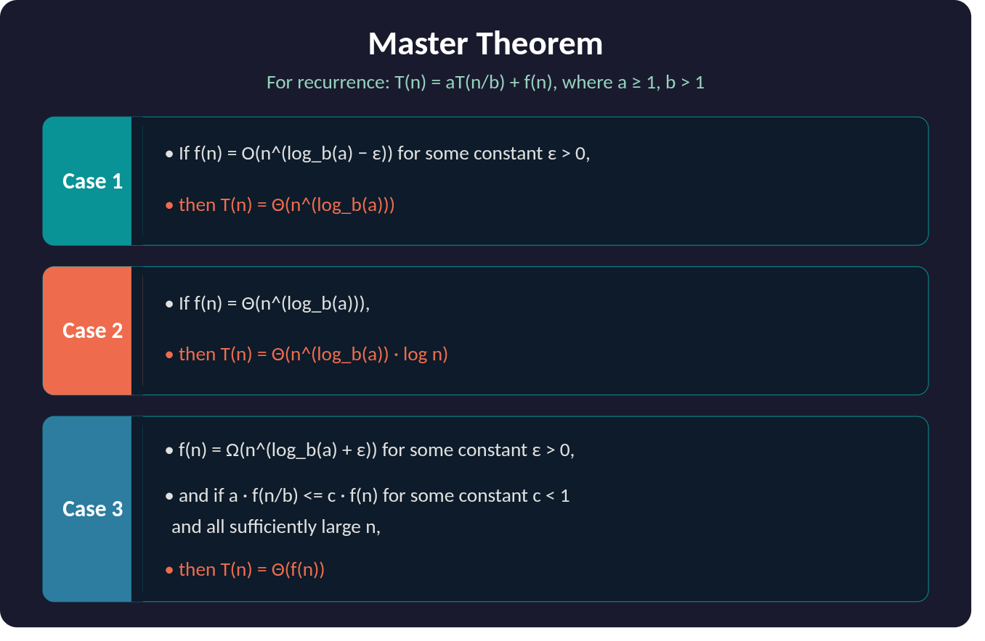
Masters Theorem

Slide 79
Masters Theorem Example
Master Method (Theorem)
T(n)=aT(n/b)+f(n) a≥1,b>1
Solution is:
T(n)=n^{log}_{b}​ª[U(n)]
U(n) depends on f(n).
Bcoz,
h(n)= f(n)​/ n^{log}_{b}​ª
If h(n):
Examples
1)
T(n)=8T(n/2)+n2
2)
T(n)=T(n/2)+C
For Example 2:
T(n)=T(n/2)+C => a=1,b=2,f(n)=C
T(n)=n^{log}_{b}^{​a}U(n) =n^{log}₂^{​1}U(n) =n⁰U(n) =U(n) => h(n)= f(n)​/ n^{log}_{b}​ª =C/n^{log}₂​¹​=(log₂​n)⁰⋅C =(log₂​n)⁰C
Then,
(log₂​n)⁰⁺¹​.C=(log₂​n)C
Therefore,
T(n)=O(log₂​n)​

Slide 80
Masters Theorem Example
h(n) | U(n)
n^{r}, r>0 | O(nr)
n^{r}, r<0 | O(1)
(logn)^{i}, i≥0 | (log₂​n)^{i+1}/i+1​

Slide 81
Masters Theorem Example
Q T(n) = 4T(n/2) + n
a a = 4, b = 2, f(n) = n
n^(log_b(a)) = n^(log₂4) = n²
Compare: f(n) = n vs n² → n is smaller
Check Case 1: Is n = O(n^(2−ε)) ?
Take ε = 1: n = O(n¹) = O(n)
Case 1 applies.
T(n) = Θ(n²)

Slide 82
Masters Theorem Example
Solve T(n) = 9T(n/3) + n²
a = 9, b = 3, f(n) = n²
n^(log_b(a)) = n^(log₃9) = n²
Compare: f(n) = n² vs n² → Both are equal
Case 2 applies.
T(n) = Θ(n² log n)

Slide 83
Masters Theorem Example
Solve T(n) = 2T(n/2) + n
a = 2, b = 2, f(n) = n
n^(log_b(a)) = n^(log₂2) = n¹ = n
Compare: f(n) = n vs n → Both are equal
Case 2 applies.
T(n) = Θ(n log n)

Slide 84
Masters Theorem Example
Q. Solve T(n) = T(n/3) + n
a = 1, b = 3, f(n) = n
n^(log_b(a)) = n^(log₃1) = n⁰ = 1
Compare: f(n) = n vs 1 → n is larger
Check Case 3: Is n = Ω(n^(0+ε)) ?
Take ε = 1: n = Ω(n¹) = Ω(n)
Regularity: a · f(n/b) = 1 · (n/3) = n/3 ≤ c · n
Take c = 1/3: n/3 ≤ n/3 ✓
Case 3 applies.
T(n) = Θ(n

Slide 85
Masters Theorem Practice Problem
Practice Problems
Solve using Master Theorem:
T(n) = 4T(n/2) + n²
T(n) = 2T(n/2) + n²
T(n) = 8T(n/2) + n²
T(n) = 3T(n/3) + n

Slide 86
Masters Theorem Practice Problem Ans
a=4, b=2, n^(log₂4)=n², f(n)=n²=n² → Case 2 → Θ(n² log n)
a=2, b=2, n^(log₂2)=n, f(n)=n²>n → Case 3 → Θ(n²)
a=8, b=2, n^(log₂8)=n³, f(n)=n²<n³ → Case 1 → Θ(n³)
a=3, b=3, n^(log₃3)=n, f(n)=n=n → Case 2 → Θ(n log n)

Slide 87
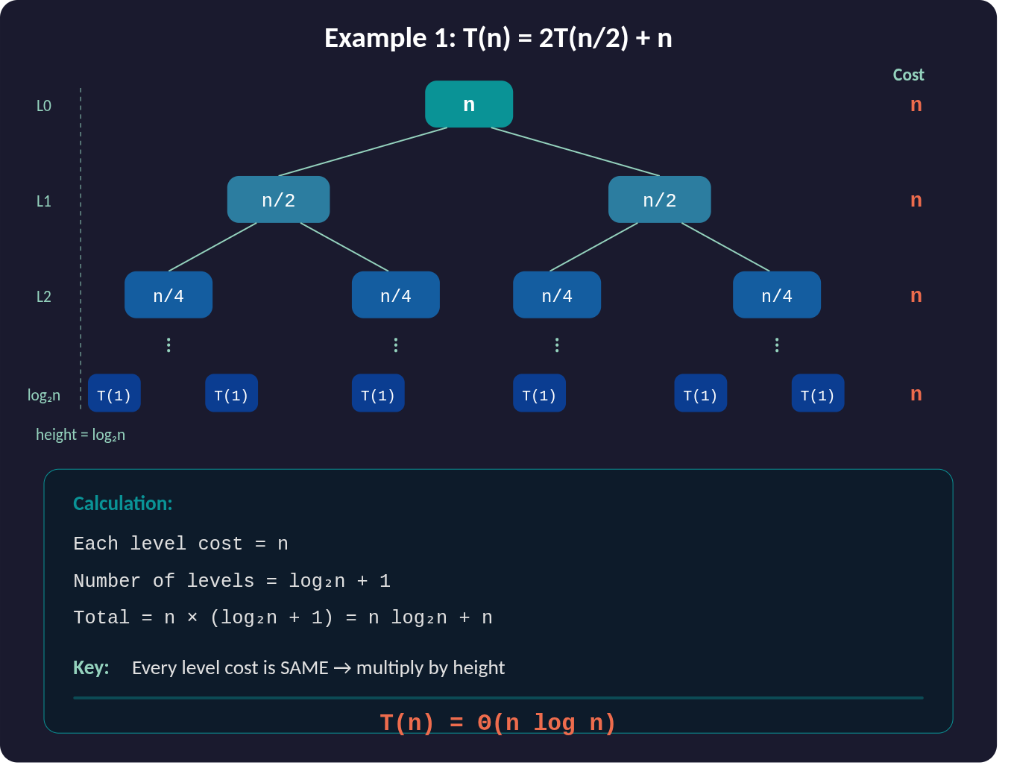
Recursive Tree

Slide 88
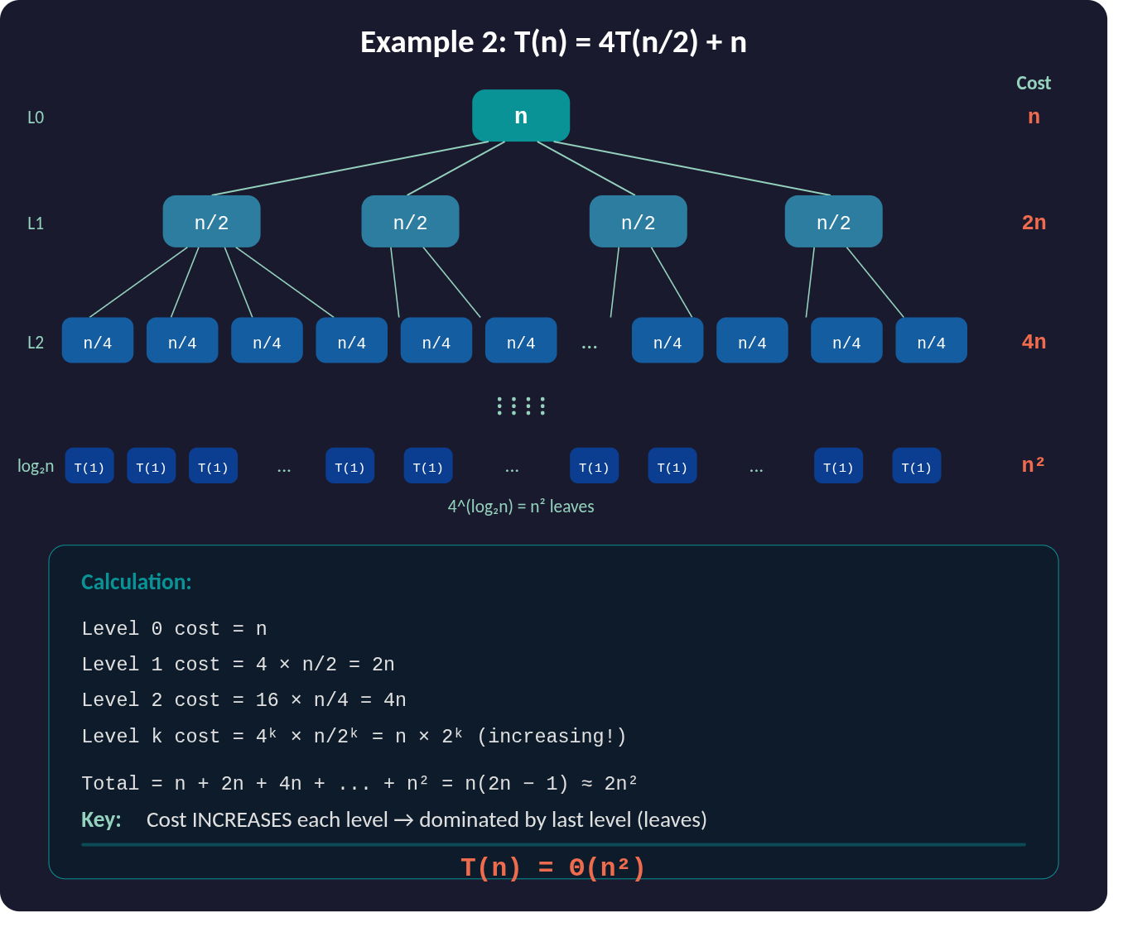
Recursive Tree

Slide 89
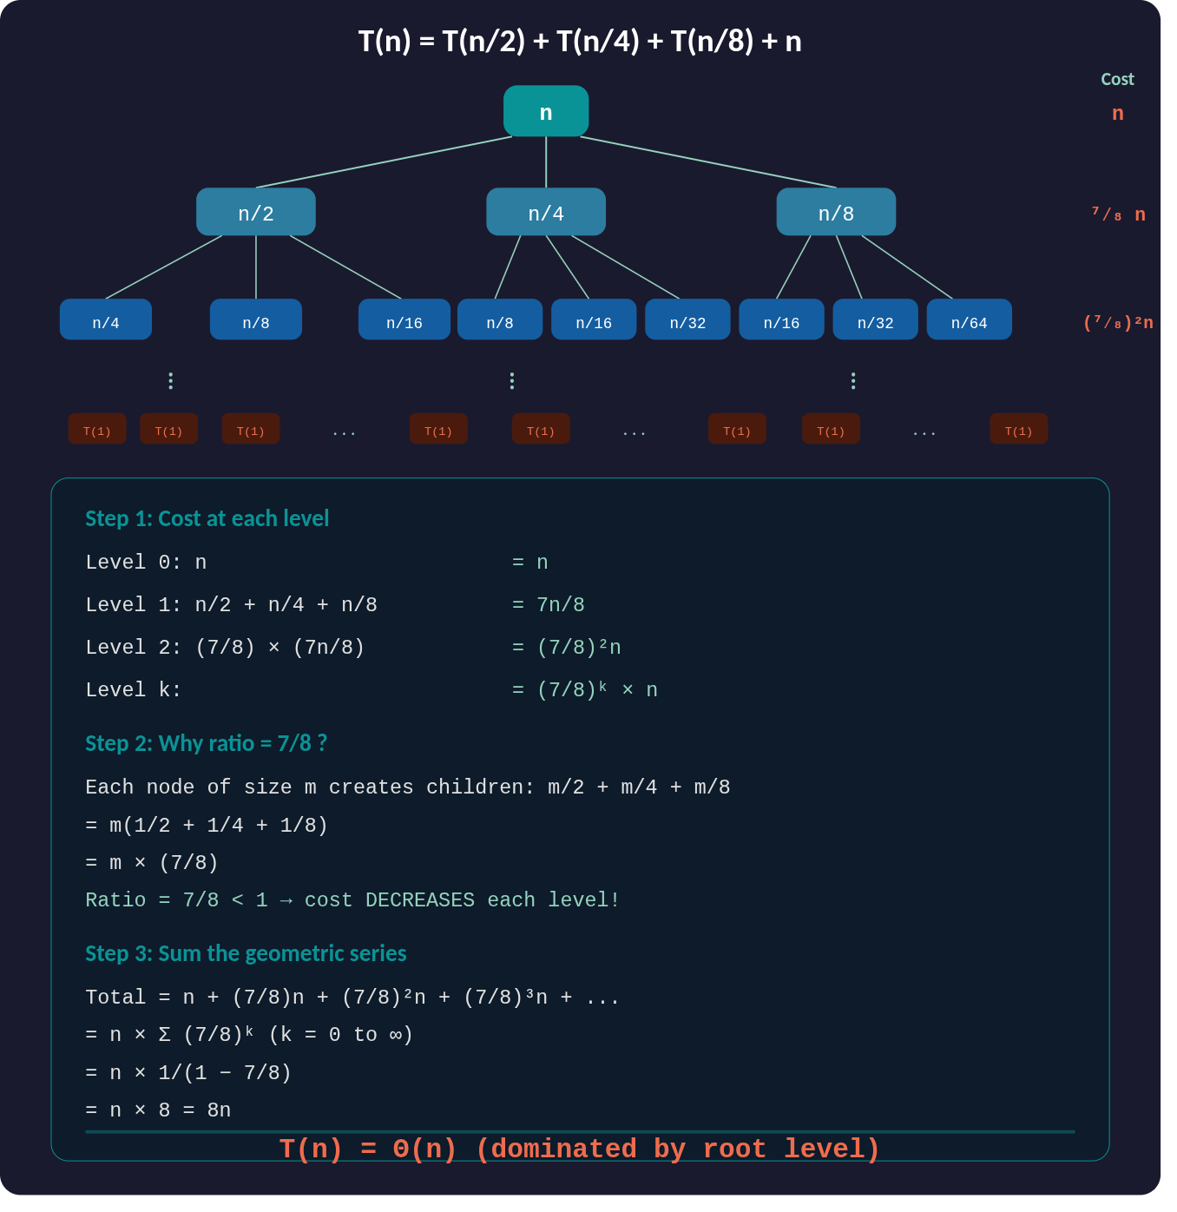
Recursive Tree

Slide 90
Recursive Tree Practice Problem
Solve T(n) = T(n−1) + T(n−2) + 1
Ans :O(2ⁿ)

Slide 91
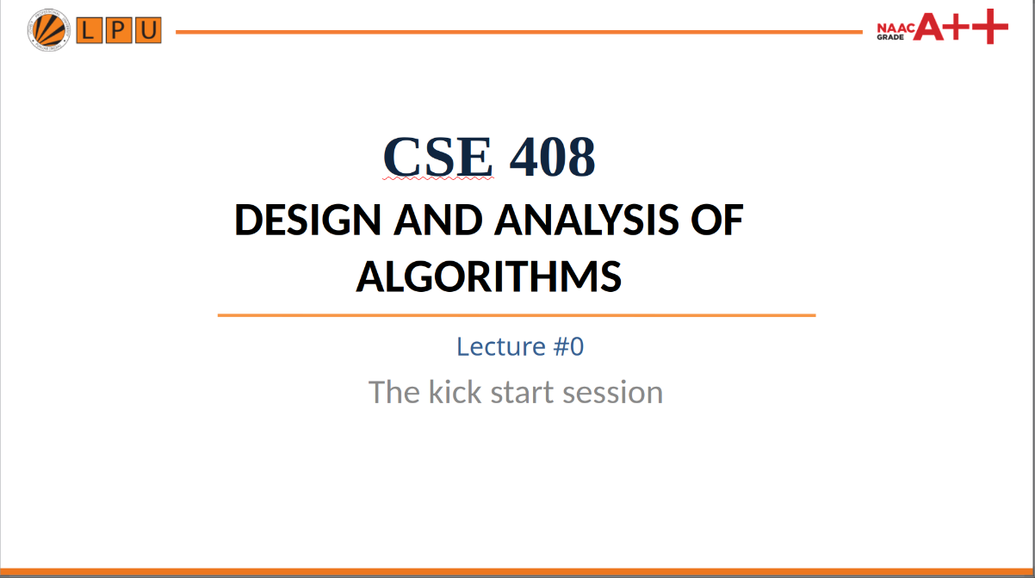
Learning Objectives
1. Understand
2. Apply Quick Select
3. Analyze Complexity
Define order statistics and identify the k-th smallest and k-th largest elements.
Use partitioning to find a required rank without sorting the complete array.
Understand expected O(n), worst-case O(n²), and extra-space requirements.
4. Implement in C++
5. Handle k-th Largest
Write readable Quick Select code and trace it using a dry run.
Convert k-th largest into a k-th smallest problem using n − k + 1.
2

Slide 92
What Is an Order Statistic?
An order statistic identifies an element by its position in the sorted order.
7
2
9
4
1
6
3
SORT
Original array
3rd smallest = 3
5th smallest = 6
2nd largest = 7
1
2
3
4
6
7
9
Sorted order
3

Slide 93
k-th Smallest and k-th Largest
k-th Smallest
k-th Largest
The element at position k in ascending order.
Example: k = 4 → 4th smallest.
The element at position k in descending order.
Ascending equivalent:
(n − k + 1)-th smallest.
Key idea: We need one rank — not the complete sorted sequence.
4

Slide 94
Why Not Sort the Entire Array?
Full Sorting
Selection Using Quick Select
Sort every element first.
Typical comparison-based sorting:
O(n log n)
Then read A[k−1].
We only care about one rank.
Quick Select:
Expected O(n)
Partition → discard one side → repeat.
Selection can avoid work that full sorting would perform.
5

Slide 95
Quick Select: Core Idea
1
2
3
4
Choose pivot
Partition
Find pivot rank
Continue only in needed side
Unlike Quick Sort, Quick Select explores only ONE partition.
k = pivot rank
k < pivot rank
k > pivot rank
Return pivot.
Search left side.
Search right side.
6

Slide 96
Partition Example
8
3
7
1
9
4
6
Choose pivot = 6
After partition: values smaller than the pivot are on the left, and larger values are on the right.
3
1
4
6
9
7
8
< 6
pivot
> 6
The pivot is now in its final position. Its rank tells us which side contains the answer.
7

Slide 97
Dry Run: Find the 4th Smallest
A = [7, 2, 9, 4, 1, 6, 3] Target: 4th smallest
Step 1
Choose pivot = 3 → [2, 1, 3, 4, 9, 6, 7]
Pivot rank = 3. Since 4 > 3, search the right partition.
Step 2
Right partition = [4, 9, 6, 7]. Choose pivot = 7.
In this subarray, k = 1. Pivot 7 has rank 4 → search left: [4, 6].
Then pivot 6 has rank 2 → search left. The answer is 4.
Final answer: 4th smallest = 4
8

Slide 98
Quick Select Pseudocode
PARTITION(A, low, high)
pivot ← A[high]
i ← low
FOR j ← low TO high – 1
IF A[j] < pivot THEN
SWAP A[i] AND A[j]
i ← i + 1
END IF
END FOR
SWAP A[i] AND A[high]
RETURN i
Important: k is relative to the current subarray.
9

Slide 99
Quick Select Pseudocode
QUICKSELECT(A, low, high, k)
if low == high
return A[low]
p = PARTITION(A, low, high)
rank = p - low + 1
if k == rank
return A[p]
else if k < rank
return QUICKSELECT(A, low, p - 1, k)
else
return QUICKSELECT(A, p + 1, high, k - rank)
Important: k is relative to the current subarray.
9

Slide 100
Finding the k-th Smallest Element
Example: A = [12, 3, 5, 7, 4, 19, 26], k = 3
12
3
5
7
4
19
26
For verification only
Quick Select
Sorted array = [3, 4, 5, 7, 12, 19, 26]
3rd smallest = 5
Partitions around pivots and keeps only the side containing rank 3.
Result = 5
Goal: find the required rank, not produce the complete sorted array.
11

Slide 101
Finding the k-th Largest Element
Convert the problem to a k-th smallest problem:
k-th largest = (n − k + 1)-th smallest
Example: n = 7, k = 2
Shortcut
Required ascending rank = 7 − 2 + 1 = 6
Run the same Quick Select algorithm with target k' = n − k + 1.
A = [12, 3, 5, 7, 4, 19, 26]
6th smallest = 19 → 2nd largest = 19
12

Slide 102
Time and Space Complexity
Best Case
Average Case
Worst Case
Pivot lands at the target rank.
Time = O(n)
Good partitions shrink the search region.
Expected Time = O(n)
Every pivot is extremely unbalanced.
Time = O(n²)
Auxiliary Space
In-place partition → O(1) auxiliary array space.
Recursive stack: O(log n) average, O(n) worst case.
Pivot selection strongly affects practical performance.
13

Slide 103
Pivot Selection Strategies
First / Last Element
Random Pivot
Median-of-Three
Simple implementation.
Risk: O(n²) on sorted or nearly sorted input.
Choose a random index.
Expected O(n) time and avoids many deterministic worst cases.
Use median of first, middle and last.
Often gives better practical partitions.
For teaching: fixed pivot is easiest. For robust implementations: randomized pivot is a good choice.
14

Slide 104
What About Duplicate Values?
Example: [4, 2, 4, 1, 4, 3, 2]
4
2
4
1
4
3
2
Standard partition
3-way partition
Equal values can consistently go to one side. Quick Select remains correct.
Separate into three regions: < pivot, = pivot, and > pivot. If k falls in the = pivot region, return the pivot.
3-way partition is especially useful when many elements are equal.
15

Slide 105
Quick Select vs Quick Sort
Aspect
Quick Sort
Quick Select
Goal
Sort all elements
Find one rank
Partitions
Both sides
Only one side
Average
O(n log n)
Expected O(n)
Worst case
O(n²)
O(n²)
Output
Sorted array
Selected element
16

Slide 106
Classroom Practice
1. Find the 4th smallest element in [10, 4, 8, 2, 7, 6, 1].
2. Find the 3rd largest element in [12, 5, 9, 3, 20, 7].
3. What is the relation between k-th largest and k-th smallest?
4. Why does Quick Select have expected O(n) time?
5. What happens if every pivot is the smallest element?
Think → Partition → Determine rank → Keep only the required side
17

Slide 107
Key Takeaways
Order Statistic
Quick Select
An element identified by its rank: k-th smallest or k-th largest.
Partition around a pivot and recursively explore only the needed side.
Complexity
k-th Largest
Expected O(n), worst-case O(n²); in-place partition uses O(1) auxiliary array space.
Convert using n − k + 1 and reuse the k-th smallest algorithm.
ORDER STATISTICS → PARTITION → RANK → SELECT
18

Slide 108
Thank You !!!

