Slide 1



Automated Water Quality Monitoring: Algae Bloom Detection using CNN

Slide 2

Learning Objectives
To understand the fundamentals of Deep Learning and Convolutional Neural Networks (CNNs).
To learn techniques for Image Pre-processing and Data Augmentation using Keras.
To identify and solve model overfitting using Optimization techniques like Dropout.
To build an end-to-end pipeline for binary image classification.
The goal of this project is to develop a rapid, low-cost, and accessible early-warning system for water quality.
We aim to automate the detection of Harmful Algal Blooms (HABs) using computer vision, replacing slow manual testing methods with instant AI analysis.
GOAL
Source :
www.freepik.com/

Slide 3
Tools and Technology used
Programming Language: Python
Development Environment: Google Colab (Cloud GPU)
Deep Learning Libraries: TensorFlow, Keras
Data Handling & Visualization: NumPy, Matplotlib
Version Control: Git & GitHub

Slide 4
Methodology
Data Collection: gathered a custom dataset of raw images for two classes: algae-bloom and healthywater.
Pre-processing: Used ImageDataGenerator for resizing (150x150px), rescaling (normalization), and data augmentation (rotation/zoom) to increase dataset diversity.
Model Building: Designed a custom CNN architecture from scratch using Conv2D, MaxPooling2D, and Dense layers.
Optimization: Implemented Dropout layers to stabilize the model and prevent overfitting.
Evaluation: Trained for 25 epochs and tested on unseen data to ensure reliability.

Slide 5
Problem Statement:
The Issue: Traditional water quality monitoring is manual, expensive, and slow.
The Risk: Harmful Algal Blooms (HABs) are toxic to wildlife and humans. Delays in lab testing mean warnings often come too late to prevent ecological damage.
The Gap: There is currently no easy way for a non-expert (like a park ranger or citizen) to instantly check a water body for potential blooms using just a photograph.

Slide 6
Solution:
Developed a Custom Convolutional Neural Network.
Input: Digital images resized to 150x150 pixels.
Architecture:
3 Convolutional Blocks (to detect features like color and texture).
MaxPooling layers (to reduce computational load).
Dropout Layers (30% & 50%) (Added during Week 3 optimization to fix overfitting).
Output: A binary probability score (Sigmoid activation).

Slide 7
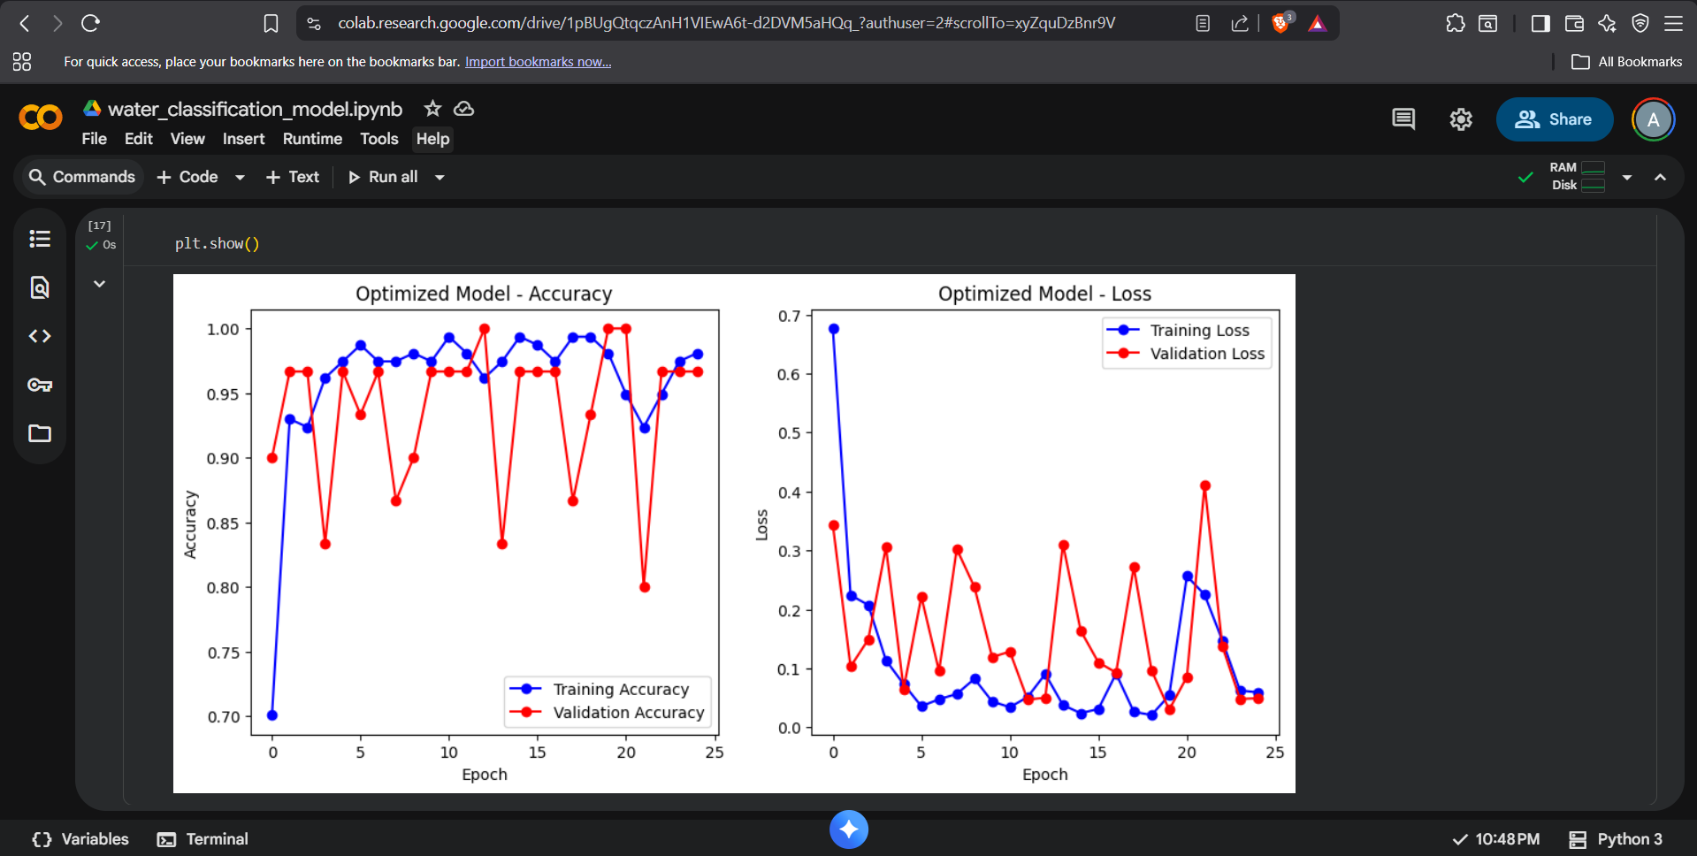
Solution:
Observation: The graphs demonstrate that the Optimized Model is stable. The Training and Validation lines are close together, indicating the model has learned to generalize well and is not just memorizing the data.

Slide 8
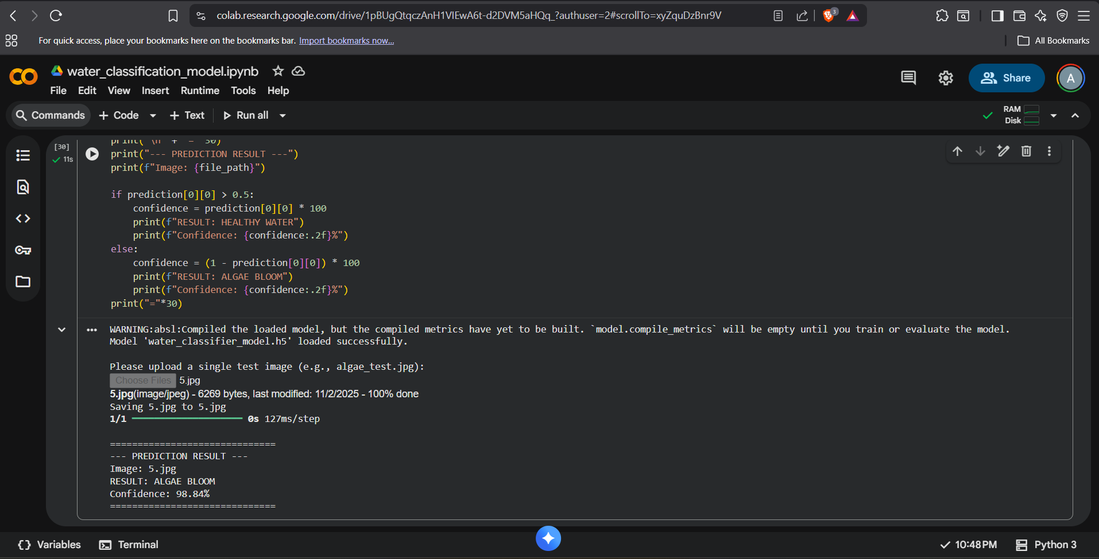
Screenshot of Output:
Description: The model successfully loaded the saved .h5 file, processed a completely new, unseen image, and correctly identified it as an Algae Bloom with high confidence.

Slide 9
Conclusion:
Achievement: Successfully built and trained a CNN that detects Algae Blooms with >93% accuracy.
Impact: This solution proves that AI can provide a viable, low-cost alternative to initial manual testing.
Future Scope: This model can be deployed to a mobile app or embedded on a drone, allowing for real-time monitoring of large lakes and reservoirs.

