Slide 1
Artificial Intelligence
Chapter 4
Knowledge Representation Issues

Slide 2
Representations and Mappings
Let us first understand about the fact and representation
Fact : truths in some relevant world. These are things we want to
represent.
Representation of facts : It is the chosen formalism. These are the
things we will actually be able to manipulate
One way to think of structuring these entities is as two levels:
The knowledge level at which facts(including each agent’s behaviour
and current goals) are described.
The Symbol level at which the representation of objects at the
knowledge level are defined in terms of symbols which can be
manipulated by programs.

Slide 3
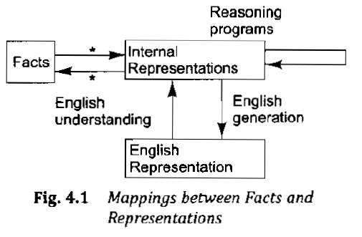

Slide 4
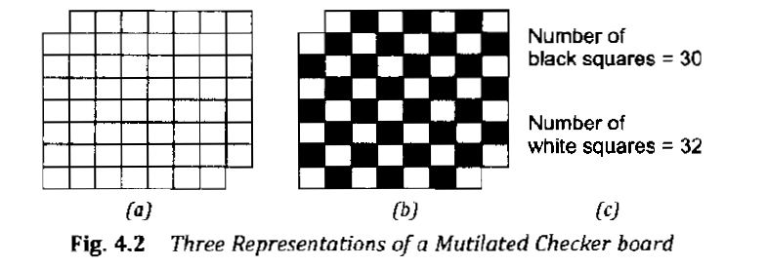

Slide 5
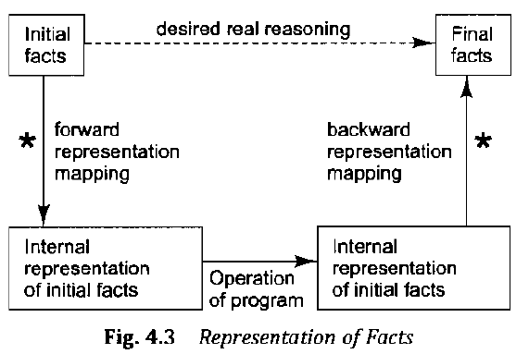

Slide 6
Approaches to Knowledge Representation
A good system for the representation of knowledge in a particular domain should possess the following four properties:
Representational Adequacy: is the ability to represent all of the kinds of knowledge that are needed in the domain
Inferential Adequacy: is the ability to manipulate the representational structures in such a way as to derive the new structures corresponding to new knowledge inferred from old.
Inferential Efficiency: is the ability to incorporate into the knowledge structures additional information that can be used to focus the attention of the inference mechanisms in the most promising direction.

Slide 7
Acquisitional Efficiency : is the ability to acquire new information very easily. The simplest case involves direct insertion, by a person of new knowledge into the database. Ideally, the program itself would be able to control knowledge acquistion.

Slide 8
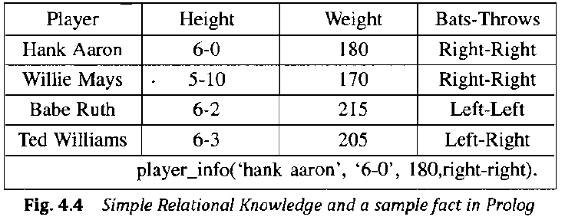
Approaches to Knowledge Representation
Simple Relational Knowledge

Slide 9
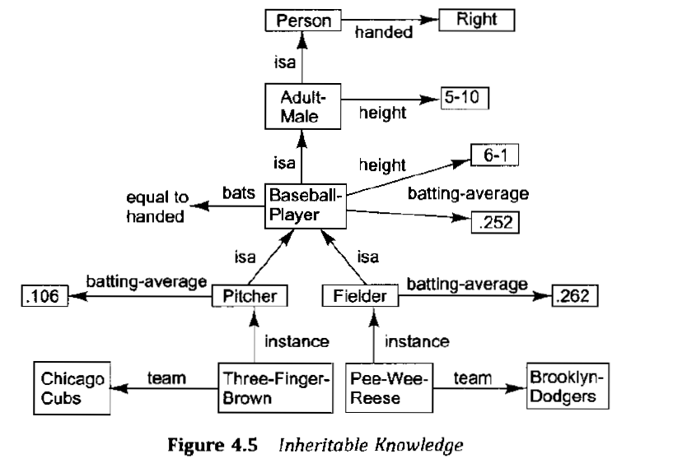
Inheritable Knowledge

Slide 10
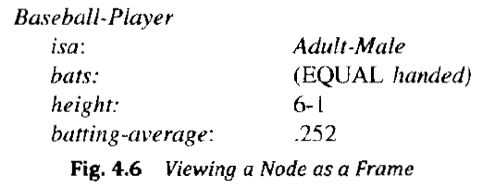

Slide 11
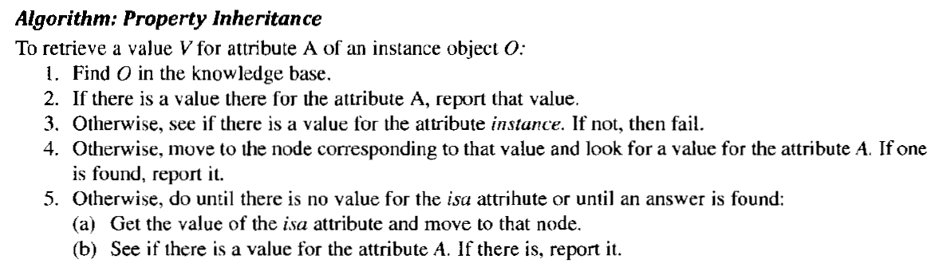

Slide 13
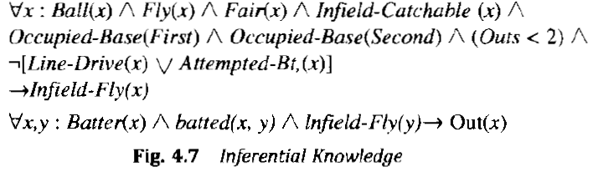
Inferential Knowledge

Slide 14
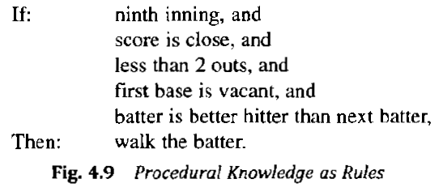
Procedural Knowledge

Slide 15
Knowledge Representation Issues
Important Attributes
Relationships among Attributes
Choosing the granularity of representation
Representing Sets of Objects
Finding the Right Structures as needed

Slide 16
Choosing the granularity of representation
John spotted sue
We could represent this as :
Spotted(agent(John),object(sue))
Such a representation would make it easy to answer the question such as:
Who spotted Sue?
But now suppose we want to know:
Did John see Sue?

Slide 17
The answer is “Yes” but given only one fact we have, we cannot discover that answer. We could add other facts such as:
spotted(x,y) saw(x,y)
We could then infer the answer to the question.
Alternative solution to this problem is to represent the fact that spotting is really a special type of seeing explicitly in the representation of the fact.
saw(agent(John), object(Sue), timespan(briefly))
In representation we have broken the idea of spotting apart into more primitive concepts of seeing and timespan.

Slide 18
The major advantage of converting all statements into a representation in terms of a small set of primitives is that rules that are used to derive the inferences from the knowledge need to be written only in terms of the primitives rather than in terms of the many ways in which the knowledge may originally have appeared.
There are several arguments against the use of low-level primitives. One is that simple high-level facts may require a lot of storage when broken down into primitives.
For ex : Suppose that actions are being represented as combination of a small set of primitive actions. Then the fact that John punched Mary might be represented as shown in the figure below

Slide 19
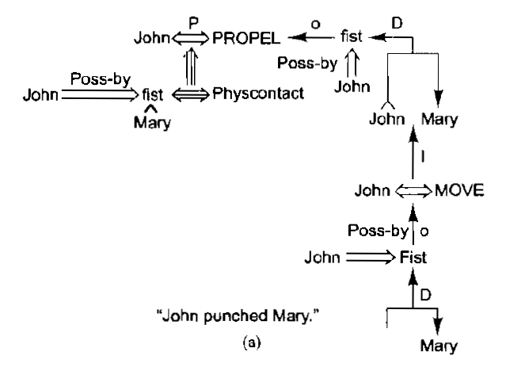

Slide 20
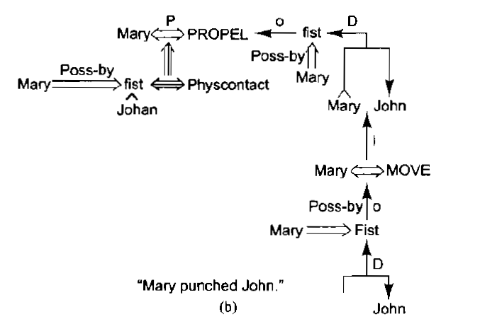
Bur suppose we are representing the fact “Mary punched John” then
We store the structure as shown in the figure below

Slide 21
A second but related problem is that if knowledge is initially
represented in a relatively high level form, such as English, then
substantial work must be done to reduce the knowledge into
primitive form.
A third problem with the use of low level primitives is that in many
domains, it is not all clear what the primitives should be. And even
in domains in which there may be an obvious set of primitives, there
may not be enough information present in each use of high-level
constructs to enable them to be converted into their primitive
components.
The classic example of this sort of situation is provided by kinship
terminology[Lindsay,1963]. There exists at least one obvious set of
primitives : mother, father, son, daughter and possibly brother and
sister

Slide 22
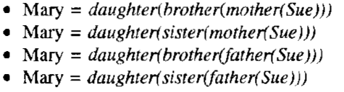
But suppose we are told that “Mary is Sue’s cousin”. An attempt to describe the relationship in terms of the primitives could produce any of the following interpretations:
If we do not already know that Mary is female, then of course there are four more possibilities as well.
The other way to solve this problem is to change our primitives. We could use the set: parent, child, sibling, male and female. Then the fact that Mary is Sue’s cousin could be represented as

Slide 23


In less well-structured domains, even more problems arise. For ex:
Given just the fact
John broke the window

Slide 24
Representation of set of objects
It is important to be able to represent sets of objects for several reasons. One is that there are some properties which are true of sets that are not true of the individual members of the set.
For ex : Consider the assertions that are being made in the
following sentences
(i) There are more sheep than people in Australia.
(ii) English speakers can be found all over the world.
There are three obvious ways in which sets may be represented.
(i) First one simplest by just mentioning the name of the set.

Slide 25
This is what we essentially did in the Baseball player example in section 4.2 when we used node named “Baseball-Player” in our semantic net and when we used predicates such as “Ball” and “Batter” in our logical representation.
There are other two ways to state a definition of a set and its element. The first is to list the members of the set. Such a specification is called extensional definition.
The second is to provide a rule that, when a particular object is evaluated, returns true or false depending on whether the object is in the set or not. Such a rule is called an intensional definition.
For ex : an extensional description of the set of our sun’s planets on which people live is {Earth}. An intensional descritption is
{x: sun-planet(x) ^ human-inhabited(x)}

Slide 26

Additional intensional definitions are:
Intensional representations have two important properties that
extensional ones lack.
The first is that they can be used to describe infinite sets and
sets not all of whose elements are not known.
The second thing we can do with intensional descriptions is to
allow them to depend on parameters that can change such as
time or spatial location.

Slide 27
Finding the Right Structures as Needed
The issue here is to locate the appropriate knowledge structures that have been stored in the memory.
For ex : Suppose we have a script (description of a class of events in terms of contexts, participants and subevents) that describes the typical sequence of events in a restaurant. This script would enable us to take a text such as :
John went to Steak and Ale last night. He ordered a large steak, paid his bill, and left.
And answer “yes” to the question
Did John eat dinner last night?

Slide 28
Notice that nowhere in the story was John’s eating anything mentioned explicitly. If we know in advance to use the restaurant
script, then we can answer the question easily.
In order to have access to the right structure for describing a particular situation , it is necessary to solve all of the following problems
How to perform an initial selection of the most appropriate structure?
How to fill in appropriate details from the current situation?
How to find a better structure if the one chosen initially turns out not to be appropriate?
What to do if none of the available structures is appropriate?
When to create and remember a new structure?

Slide 29
There is no good, general purpose method for solving all these problems. Some knowledge-representation techniques solve some of them. We will look into some solutions to two of these problems:
how to select an initial structure to consider
how to find a better structure if that one turns out not to be a
good match

Slide 30
Selecting an Initial Structure
Selecting candidate knowledge structures to match a particular problem-solving situation is a hard problem; there are several ways in which it can be done. Three important approaches are the following:
Index the structures directly by the significant English words that can be used to describe them. For ex: let each verb have associated with it a structure that describes its meaning.
This approach may not be adequate, since many words may
have several distinct meanings.
For ex : The word “fly” has a different meaning in each of the
following sentences:

Slide 31
(ii) Consider each major concept as a pointer to all of the
structures(such as script) in which it might be involved.
This may produce several sets of prospective structures.
For ex : the concept Steak might point to two scripts, one for
restaurant and one for supermarket. The concept Bill might point
to a restaurant and a shopping script. Take the intersection of
those sets to get the structure(s) preferably precisely one, that
involves all the content words. Given the pointers just described
and story about John’s trip to Steak and Ale, the restaurant script
would be evoked.
One important problem with this method is that if the problem
description contains even slightly extraneous concepts, then the

Slide 32
intersection of the associated structures will be empty. Another problem
is that it may require a great deal of computation to compute all of the
possibility sets and then to intersect them.
(iii) Locate one major clue in the problem description and use it to
select an initial structure. As other clues appear, use them to
refine the initial selection or to make a completely new one if
necessary. The major problem with this method is that in some
situations there is not an easily identifiable major clue. A second
problem is that it is necessary to anticipate which clues are going
to be important and which are not.

Slide 33
Revising the choice When necessary
Once we find a candidate knowledge structure, we must attempt
to do a detailed match of it to the problem at hand. Depending upon
representation we are using, the details of the matching process will
vary.
The process of instantiating a structure in a particular situation often
does not proceed smoothly. When the process runs into a snag,
though it is not necessary to abandon the effort and start over.
Rather, there are variety of things that can be done:
Select the fragments of the current structure that do correspond to
the situation and match them against the candidate alternatives.

Slide 34
Once we find a candidate knowledge structure, we must attempt
to do a detailed match of it to the problem at hand. Depending upon
representation we are using, the details of the matching process will
vary.
The process of instantiating a structure in a particular situation often
does not proceed smoothly. When the process runs into a snag,
though it is not necessary to abandon the effort and start over.
Rather, there are variety of things that can be done:
Select the fragments of the current structure that do correspond to
the situation and match them against the candidate alternatives.
Make an excuse for the current structure’s failure and continue to
use it.

Slide 35
Refer to specific stored links between structures to suggest the
new directions in which to explore.
If the knowledge structures are stored in an isa hierarchy, traverse upward in it until a structure is found that is sufficiently general that it does not conflict with the evidence.

Slide 36
The Frame Problem
The whole problem of representing the facts that change as well as those that do not is known as the frame problem [McCarthy and Hayes, 1969]. In some domains, the only hard part is representing all the facts. In others, though figuring out which ones change is nontrivial.
For ex : In the robot world, there might be a table with a plant on it
under the window. Suppose we move the table to the center
of the room. We must also infer that the plant is now in the
center of the room too but that the window is not.
To support this of kind of reasoning, some systems make use of an
explicit set of axioms called frame axioms which describe all the
things that do not change when a particular operator is applied

Slide 37
in the state n to produce the state (n+1). Thus in the robot domain,
we might the axioms such as
color(x,y,s1) ^ move(x,y,S2) color(x,y,S2)

