Slide 1
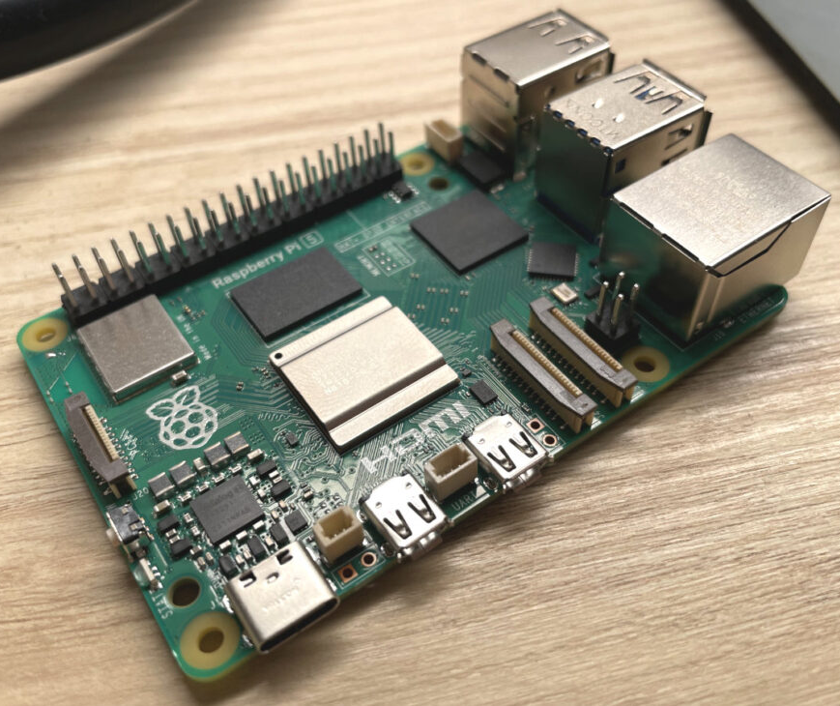
Smart License Plate Detection System
Raspberry Pi technical Training
17 June 2025
Avani B Nair
Ganga AS
Reuben Vinod

Slide 2
Objective
Detect License plates in real time
Log data locally and remotely
Provide a user-friendly interface using tkinter and flask
Support multiple protocols including TCP/ MQTT

Slide 3
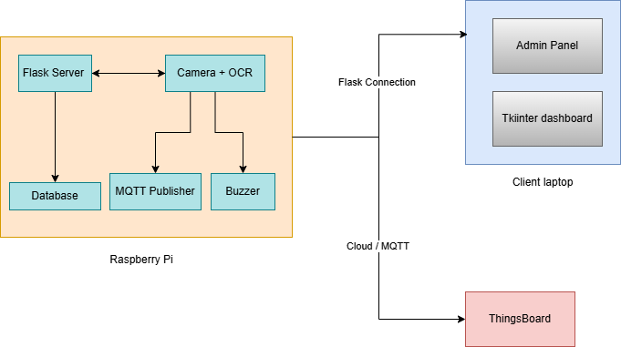
System Architecture
The main system is comprised of
Raspberry Pi that contains the flask server, camera and the OCR detection using EASYOCR
The flask server maintains an SQLLITE database that stores the recorded plates
The flask admin can be accessed on the client laptop remotely and can access and edit the database.
MQTT data is being sent over the cloud to a ThingsBoard dashboard

Slide 4
Functional Components
Detection & OCR pipeline (OpenCV + EasyOCR)
Audible Feedback on detection
Logging mechanism (SQLite + File Logs)
Tkinter dashboard (live feed + last detection)
Flask remote admin (log view + control)
MQTT for real-time streaming
ThingsBoard Cloud Dashboard

Slide 5
Pros and Cons
Advantages:
Real time Vehicle license plate monitoring.
Lightweight and portable system using raspberry Pi
Logs can be easily accessed via web dashboard.
Simple architecture and easily explainable
Offline data storage and export options
Disadvantages
EasyOCR may not produce correct detection all the time, lighting will cause errors in detection
Requires a consistent camera angle for accuracy
Compute power of raspberry pi is limited
No Automatic number plate recognition (APNR)
Local MQTT not successful due to network limitation

Slide 6
Future Enhancements
Integrate ANPR deep learning model for better accuracy.
Improved preprocessing able to detect even in low lighting or different angles.
Add vehicle image storage in cloud
Multiuser role-based access in dashboard
Enable GPS tagging and timestamp synchronization’
Improve UI/UX of dashboard using bootstrap and React.

Slide 7
Demo

Slide 8
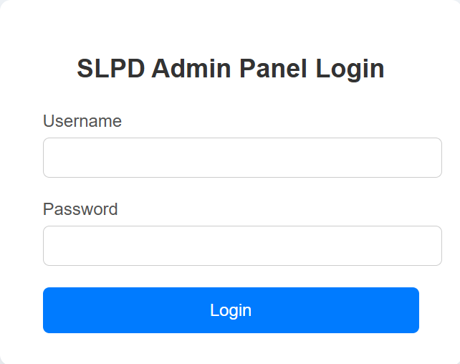
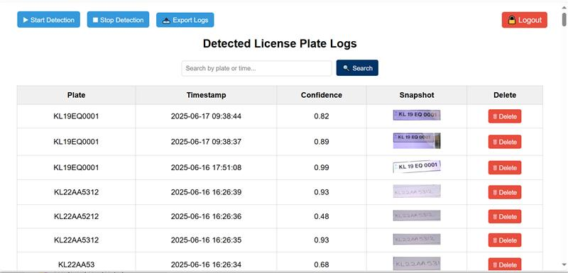
Flask admin panel

Slide 9
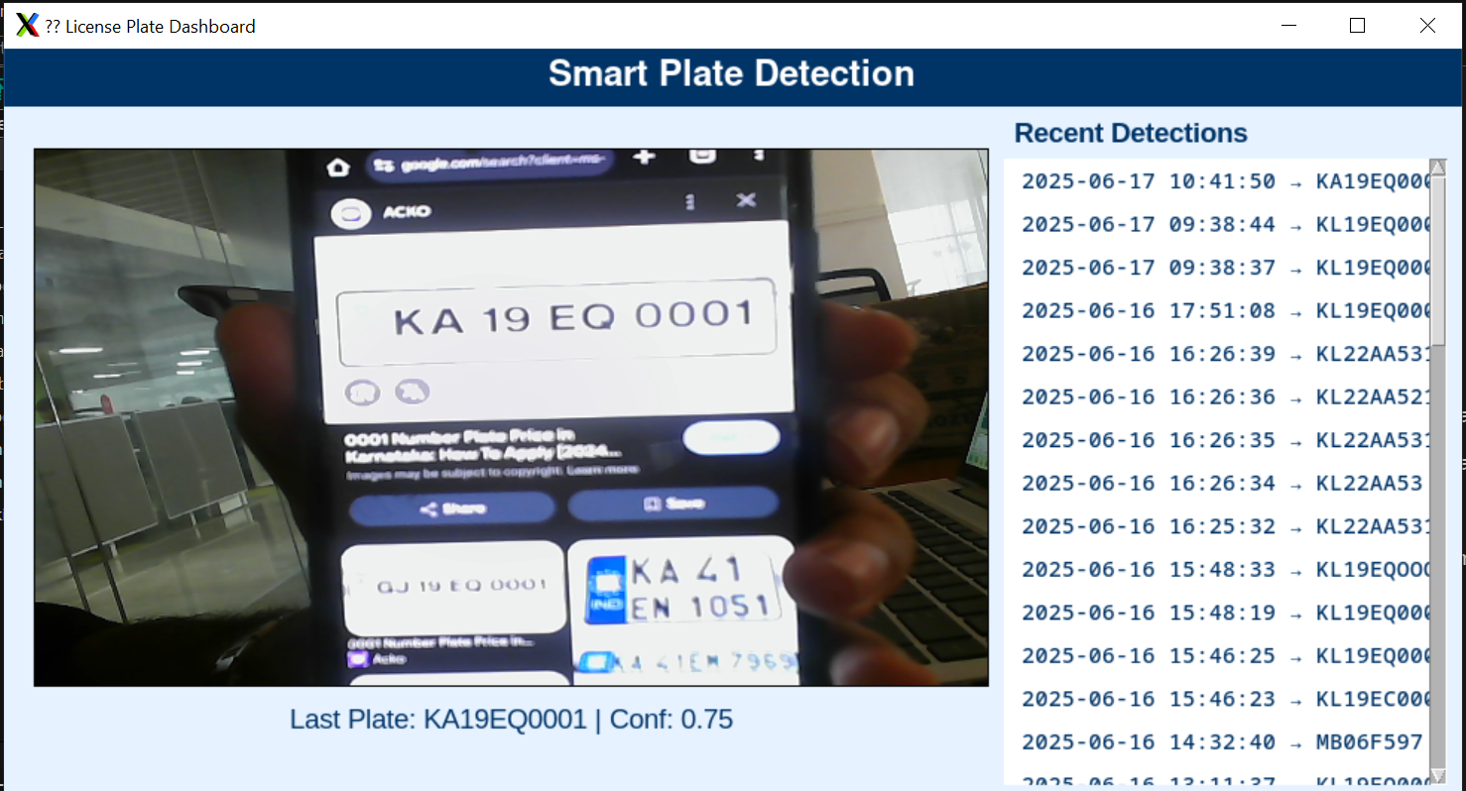
Tkinter Panel

