Slide 1
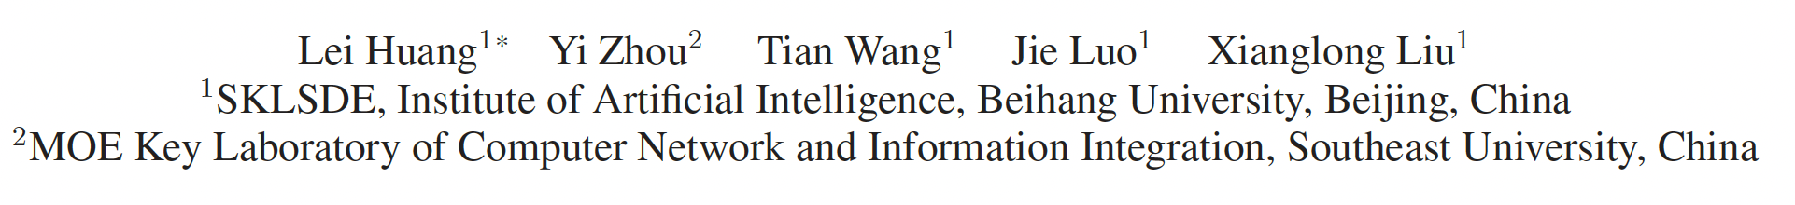
Delving into the Estimation Shift of Batch Normalization in a Network
Avanti Kopulwar
Om Waikar

Slide 2
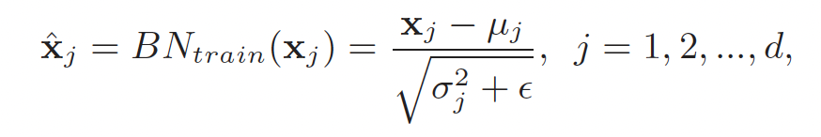
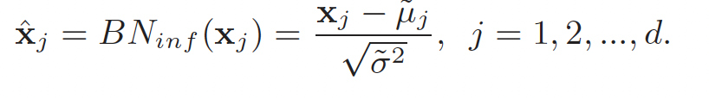
What is Batch Normalization (BN)?
A technique that normalizes the activations of intermediate layers in a deep neural network.
It standardizes the inputs to a layer by adjusting and scaling them. For a given activation x, it performs:
BN operates using two different mechanisms during its two phases.
Training Phase: Normalization is performed using the mini-batch mean and variance.
Testing Phase: Normalization switches to estimated population statistics that were calculated during training.

Slide 3

Problem Statement
Estimation Shift Magnitude is defined as the difference between the estimated population statistics and the expected statistics (the true stats of the test data)
The paper's primary observation is that this error accumulates.
An error in Layer 1 causes a shift, which makes Layer 2's error even worse, and so on.
This accumulation of error is the underlying cause of BN's two primary, well-known failures:
Small-Batch-Size Training: Mini-batch statistics become highly stochastic (random), leading to inaccurate population estimates that compound through the network .
Distribution Shift: Population statistics estimated from the training domain do not generalize to the test domain, and the resulting error is amplified layer by layer

Slide 4
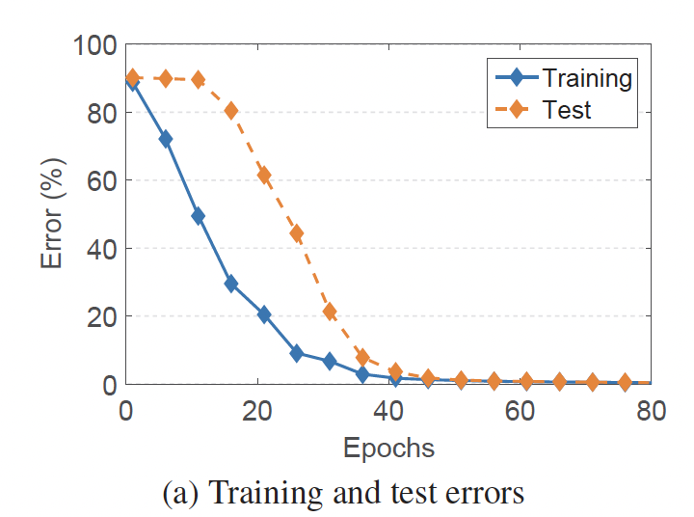
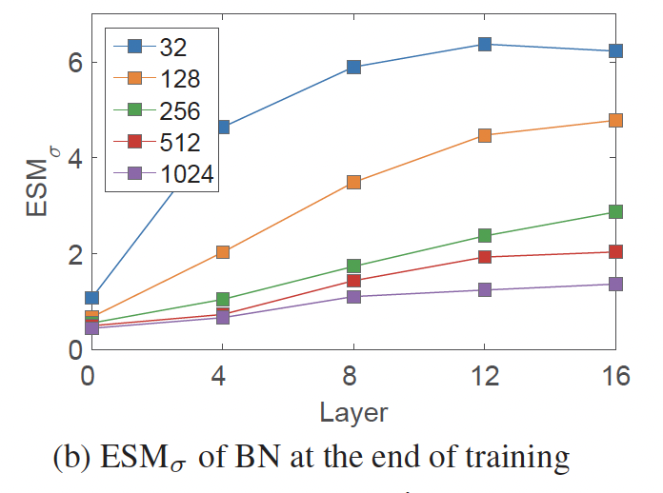
Figure (a):
Shows a clear gap between training and test error, even on the same data. This proves that BN’s population statistics are inaccurately estimated.
Figure (b):
Shows that ESM grows in deeper layers, especially with small training sets, demonstrating that BN’s estimation error accumulates as it passes through the network.

Slide 5
Literature Review
Previous works identified issues with BN's population statistics , often focusing on the small-batch-size problem by proposing Batch-Free Normalization (BFN) methods like Group Norm (GN).
Another line of research focused on correcting statistics during inference, adapting them for domain shifts or corruption robustness.
Researchers have also combined BN with other methods, such as Switchable Normalization (SN), but often to learn adaptive weights or style-invariant features.
The Unaddressed Gap: The existing literature treated the Estimation Shift as an isolated, per-layer problem. No prior work had systematically investigated its accumulation through a deep stack of BN layers.
This Paper's Contribution: This work is the first to identify and provide evidence that the Estimation Shift accumulates, reframing the problem from fixing a single layer to blocking a chain reaction of compounding error.

Slide 6
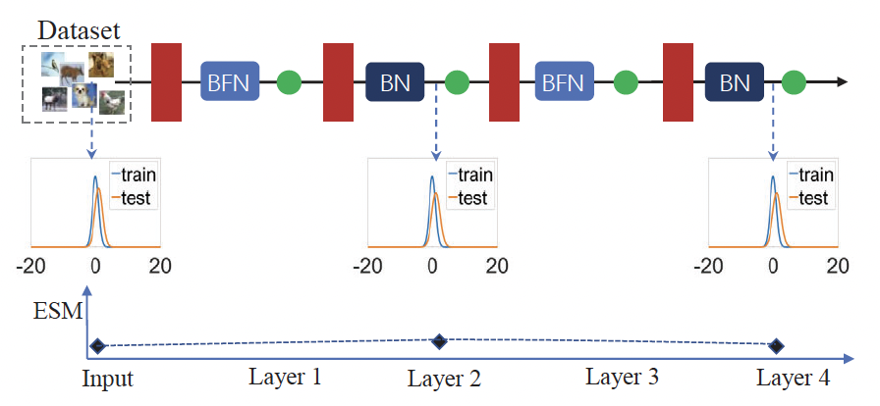
Methodology (Part 1)
To solve the accumulation problem, the authors hypothesized that a Batch-Free Normalization (BFN) layer could act as a barrier.
A BFN (like Group Norm, or GN) uses consistent operations for training and inference. It has no Estimation Shift, so it can block the chain reaction of compounding error.
The authors created a GNBN network, replacing the BN layers in odd-numbered layers with GN to interrupt the error propagation

Slide 7
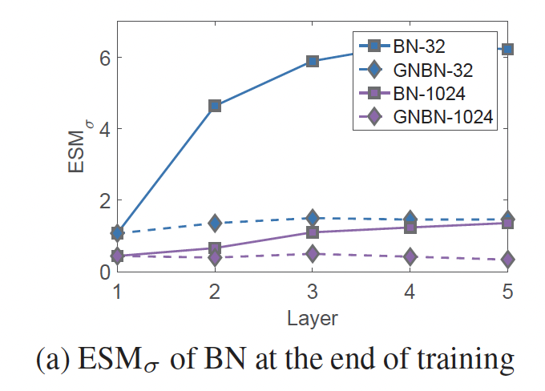
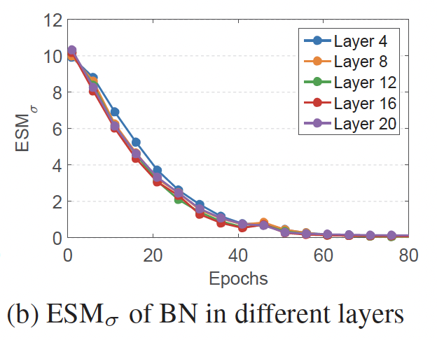
Results From Methodology 1
Figure (a): Validation of Error Blocking. The contrast between the rising ESM in the standard BN network (solid lines) and the flat ESM in the GNBN network (dashed lines) empirically proves that the blocking mechanism effectively reduces the accumulation of estimation shift.
Figure (b): Uniformity Across Depth. The overlapping ESM trajectories for widely separated layers (Layer 4 to Layer 20) demonstrate that the error is contained locally, preventing the rapid buildup of error in deeper layers .

Slide 8
Methodology (Part 2)
The Design (XBNBlock):
  Instead of replacing every BN layer, which hurts performance as derived from experiments in paper, the authors propose a hybrid approach .
  They modify the standard Residual Bottleneck Block by replacing just one BN layer with a Batch-Free Normalization (BFN) layer .
Design Choices:
  They selected Group Norm (GN) because it is flexible and stable.
  They tested replacing the 1st, 2nd, or 3rd BN layer. The 2nd position (P2) performed the best.
  Result: The final XBNBlock-P2 keeps the training speed of BN while using the GN layer in the middle to block error accumulation.

Slide 9
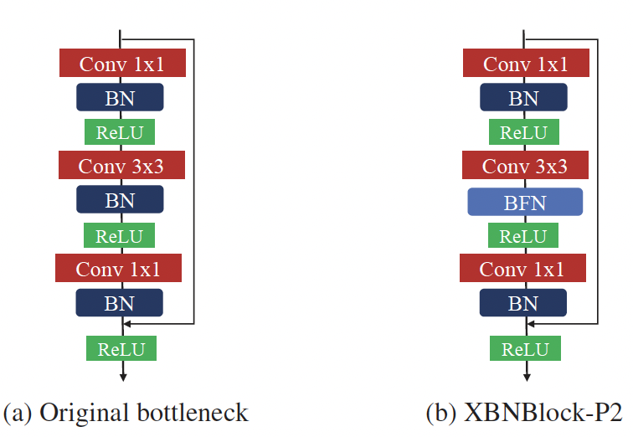
Left (6a): The original Bottleneck block with 3 BN layers (blue).
Right (6b): The proposed XBNBlock-P2. The middle BN is replaced by a BFN (blue) layer. This single layer acts as the accumulation barrier for the block.

Slide 10
Experimental Setup: Datasets & Architectures
ImageNet Classification Benchmark: Experiments were conducted on the standard ImageNet dataset (1.000 classes), utilizing 1.28 million training images and 50,000 validation images .
Classification Architectures: The XBNBlock was evaluated across widely used deep architectures, including ResNet-50, ResNet-101, ResNeXt-50, and ResNeXt-101, to demonstrate consistent scalability.
COCO Detection & Segmentation: To validate generalization beyond classification, experiments were extended to the Microsoft COCO benchmark (train2017/val2017 splits) .
Detection Frameworks: The method was integrated into standard object detection pipelines, specifically Faster R-CNN(for bounding box detection) and Mask R-CNN (for instance segmentation).
Training Protocol: All models adhered to standard training protocols (SGD, Momentum 0.9) to ensure fair comparisons against the baselines.

Slide 11
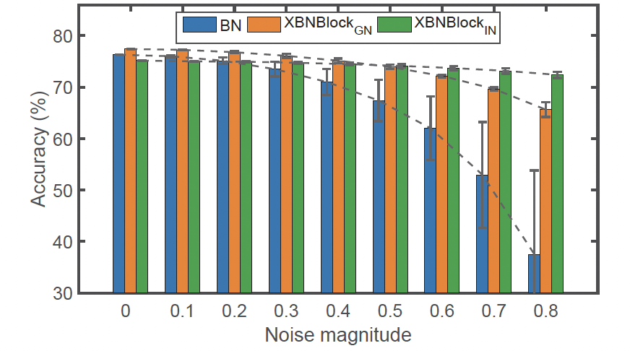
Results (Part 1)
The Stress Test Experiment:
  The authors simulated a severe Estimation Shift by manually adding random noise to the estimated mean and variance during testing .
  They compared the standard BN model against the XBNBlock model under these noisy conditions.
Key Finding:
  Standard BN: Performance crashes rapidly as noise increases.
  XBNBlock: Maintains high accuracy even with significant noise.
Conclusion: This confirms that the BFN intervention successfully mitigates the impact of inaccurate statistics.

Slide 12
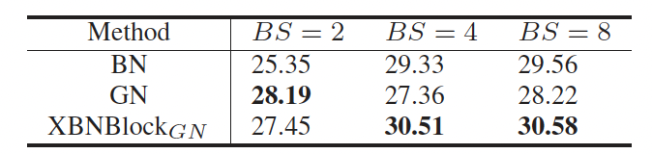
Results (Part 2)
The Real-World Challenge:
Tasks like Object Detection (finding objects in images) require heavy memory, forcing users to train with small batch sizes (e.g., 2 images per GPU).
Standard BN fails here because small batches create noisy, inaccurate statistics .
The Experiment:
They trained object detection models (Faster R-CNN) using small batch sizes (BS = 2, 4, and 8).
Key Results:
At Batch Size 2: Standard BN fails (25.35 AP). XBNBlock significantly outperforms it (27.45 AP), almost matching the performance of Group Norm (GN).
At Batch Size 4 & 8: XBNBlock is the clear winner, outperforming both standard BN and pure GN.

Slide 13
Hypothesis
Hypothesis 1: Optimizing the Blocking Mechanism Type
The paper defaults to Group Norm (GN), which necessitates tuning a hyperparameter (groups).
We hypothesize that Layer Normalization (LN) is a superior blocking mechanism. LN imposes a global constraint across all channels, potentially blocking error accumulation more effectively than GN without the complexity of group tuning.
Hypothesis 2: Optimizing the Barrier Location (Depth-Dependency)
While the paper applies XBNBlocks uniformly throughout the network (e.g., every 2nd block), experimental results show that Estimation Shift is negligible in early layers and accumulates significantly only in deeper layers .
We hypothesize that placing XBNBlocks only in the final stages of the network will be more effective than uniform placement. This positions the blocking layer exactly where the accumulated error is most severe, preserving the benefits of standard BN in the early layers where the error is low.

Slide 14
Expected Outcomes
Validating Hypothesis 1 (Type):
If XBNBlock-LN > XBNBlock-GN: We prove that a simpler, parameter-free mechanism is superior.
If GN wins: We confirm the paper's choice of grouping channels is necessary for representation.
Validating Hypothesis 2 (Location):
If Late-Stage-XBN matches/beats Uniform-XBN: We prove that the compounding error only needs to be blocked at the end. This would be a significant efficiency finding, showing we don't need to modify the whole network.
If Uniform wins: We prove that blocking the error early before it grows is critical, even if the estimation shift appears negligible in the shallow layers.

Slide 15
Thank You!

