Slide 1
Early Detection of Fake Engagement in Social Media
22MIA1096
AVANTIKA Kumarasamy

Slide 2
Problem Statement
The Issue: Social media platforms suffer from artificial engagement generated by bots and coordinated "swarms," which distorts genuine user behavior and platform metrics.
The Goal: Build a behavioral detection model to differentiate organic from artificial activity and provide an "Authenticity Score" for transparency.

Slide 3
Data & Features
Dataset Type: Synthetic behavioral data (5,000 records) generated to model specific human vs. bot patterns.
Key Behavioral Indicators:
Timing Regularity: Measure of consistency in posting intervals.
Engagement Burst Patterns: Frequency spikes over short durations.
Network Coordination: Degree of synchronized activity with other accounts.
Linguistic Entropy: Diversity of language used; bots typically have low entropy (high consistency).

Slide 4
Model Overview
Algorithm: Random Forest Classifier (chosen for high explainability and performance).
Objective: Binary classification (Organic vs. Artificial) with probability outputs.
Key Outputs: * Authenticity Score (0-100): Where 100 is perfectly organic.
Bot Probability: Likelihood of the account being automated.
Behavioral Anomaly Explanation: Automated natural language explanation of why an account was flagged (e.g., "High burst pattern detected").

Slide 5
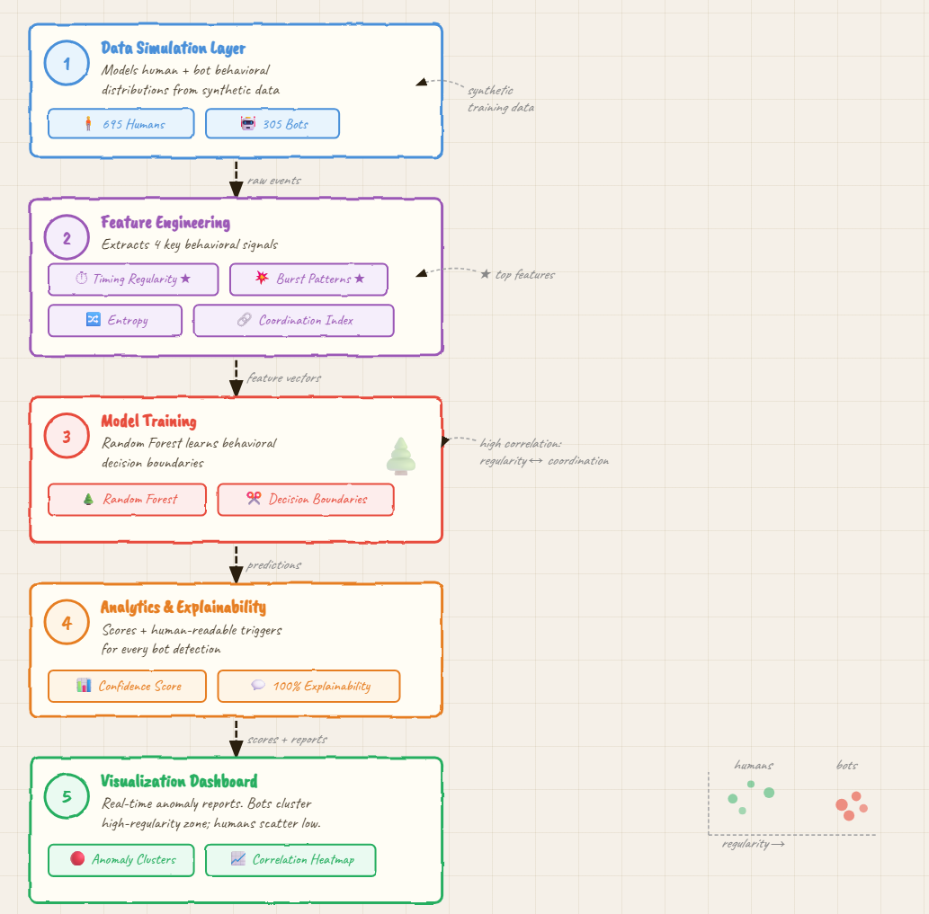
Architecture
Data Simulation: Modeling human and bot distributions.
Feature Engineering: Calculating regularity, entropy, and coordination indices.
Model Training: Utilizing a Random Forest to learn behavioral decision boundaries.
Analytics Layer: Generating scores and explaining primary triggers.
Visualization Dashboard: Real-time reporting of behavioral anomalies.

Slide 6
Results
Overall Performance: The model achieved 100% Accuracy, Precision, Recall, and F1-Score on the test dataset.
Detection Success: * Humans: 695/695 correctly identified.
Bots: 305/305 correctly identified.
Explainability: 100% of bot detections were paired with a specific behavioral explanation.

Slide 7
Behavioural Insights
Primary Bot Triggers: Timing Regularity and Burst Patterns were the most important features in detecting fake engagement.
Anomaly Clusters: Visualization shows clear separation; bots cluster in the high-regularity, high-burst zone, while humans remain scattered in a low-regularity zone.
Feature Correlations: High positive correlation exists between timing regularity and network coordination, suggesting bots often synchronize their "internal clocks".

Slide 8
Practical Impact
Platform Integrity: Automates the removal of coordinated bot swarms before they can trend.
User Transparency: The "Authenticity Score" allows users to verify if the engagement they see on a post is genuine.
Reduced Manual Review: Explanations (e.g., "High network coordination") help moderators verify flagged accounts 5x faster.

Slide 9
Future Scope
Real-time Analysis: Deploying the model to scan live streaming engagement data.
Graph-based Expansion: Incorporating social graph features to detect more sophisticated, "low-and-slow" bot networks.
Multilingual Adaptation: Enhancing linguistic entropy models for cross-language consistency detection.

