Slide 1
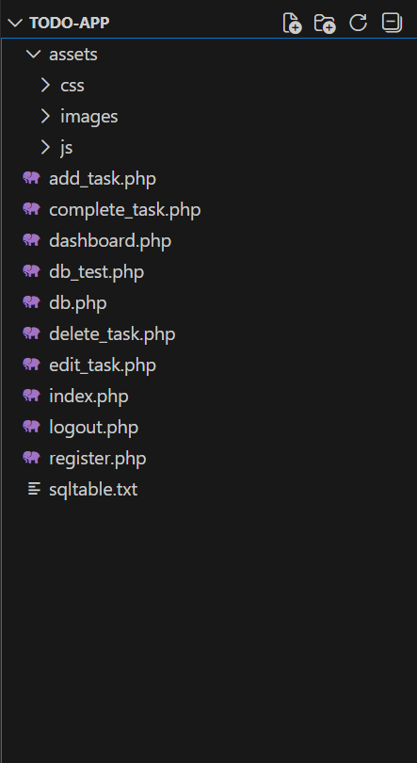
Project Folder Structure.
Index.php: Login page register.php: New user signup dashboard.php – Displays the user’s tasks after login CRUD operations for tasks: add_task.php, edit_task.php, delete_task.php, complete_task.php db.php : Central database + session connection (PDO) logout.php : Ends the user session assets/ folder : Contains CSS, JS, and images used in the app
Notes:
This slide shows the structure of our project files.
Each file has a specific role to keep the application organized and easier to maintain.
The index.php file handles user login, while register.php allows new users to create accounts.
Once logged in, dashboard.php displays the user’s tasks.
We separated task actions like adding, editing, deleting, and completing tasks into their own files so the code is cleaner.
We also use a central db.php file so all pages share the same database connection and session setup.
The assets folder stores styling and front-end resources like CSS.

Slide 2
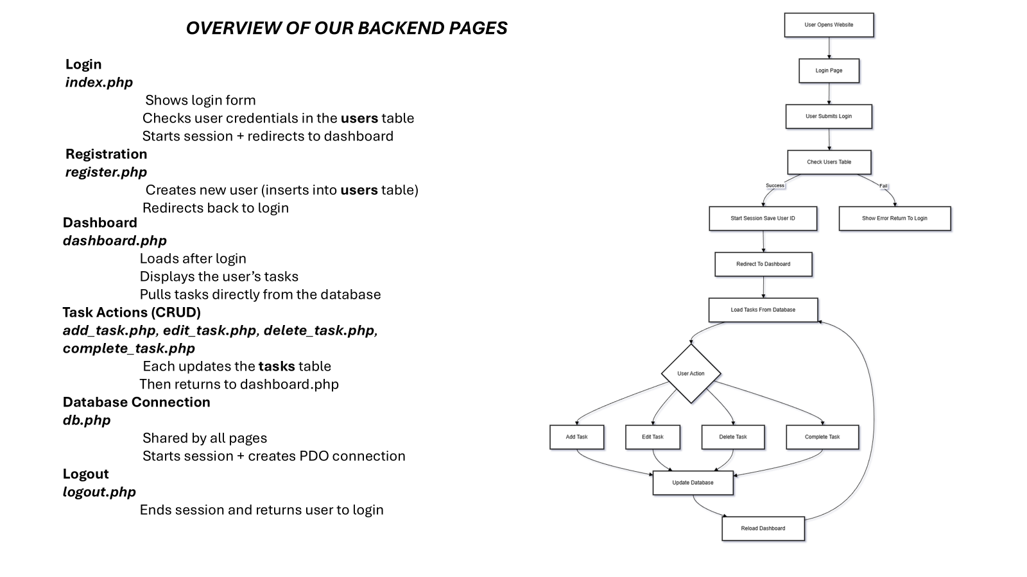
Notes:
Intro (point to the whole chart): “This diagram shows the backend flow — how the app handles a user from opening the site to updating the database and returning to the dashboard.”
Top — User opens website (point to top box): “First, the user opens the website in their browser.”
Login page (point to Login Page box): “The site shows the login page where the user types their email and password.”
User submits login (point to Submit box): “When the user submits the form, the server receives the credentials and checks the users table.”
Check users table (point to the check box): “The backend queries the database to find a matching email and compare the stored password hash.”
Decision — Success or Fail (point to the branch): “If the credentials are correct we follow the success path; if not, we go to the error path.”
Fail path — show error and stay on login (point to error box): “On failure the app returns an error message and asks the user to try logging in again.”
Success path — start session (point to start session box): “On success the server starts a session and saves the user id in $_SESSION so we know who is logged in.”
Redirect to dashboard (point to redirect box): “Then the user is redirected to the dashboard page.”
Load tasks from database (point to load tasks box): “The dashboard loads tasks by querying the tasks table for rows where user_id equals the logged-in user’s id.”
User action decision node (point to the diamond/user action): “From the dashboard, the user can perform an action — add, edit, delete, or complete a task. The flow branches to each action.”
Add Task (point to Add Task box): “If they add a task, the app takes the form data, validates it, and inserts a new row into the tasks table with the current user’s id.”
Edit Task (point to Edit Task box): “If they edit a task, the app first confirms the task belongs to this user, then updates the task row with the new values.”
Delete Task (point to Delete Task box): “If they delete, the server runs a DELETE query using both the task id and the user id to make sure they can only delete their own tasks.”
Complete Task (point to Complete Task box): “If they mark a task complete, the app updates the completed column for that task row (again checking user ownership).”
Update database (point to Update Database box): “All of those actions update the database using prepared statements to protect against SQL injection.”
Reload / return to dashboard (follow arrow back to dashboard): “After the update, the app reloads the tasks and returns the user to the dashboard so they see the changes immediately.”
Logout / end session (if shown on your chart, point to logout): “When the user logs out, the session is cleared and they’re redirected back to the login page.”

Slide 3
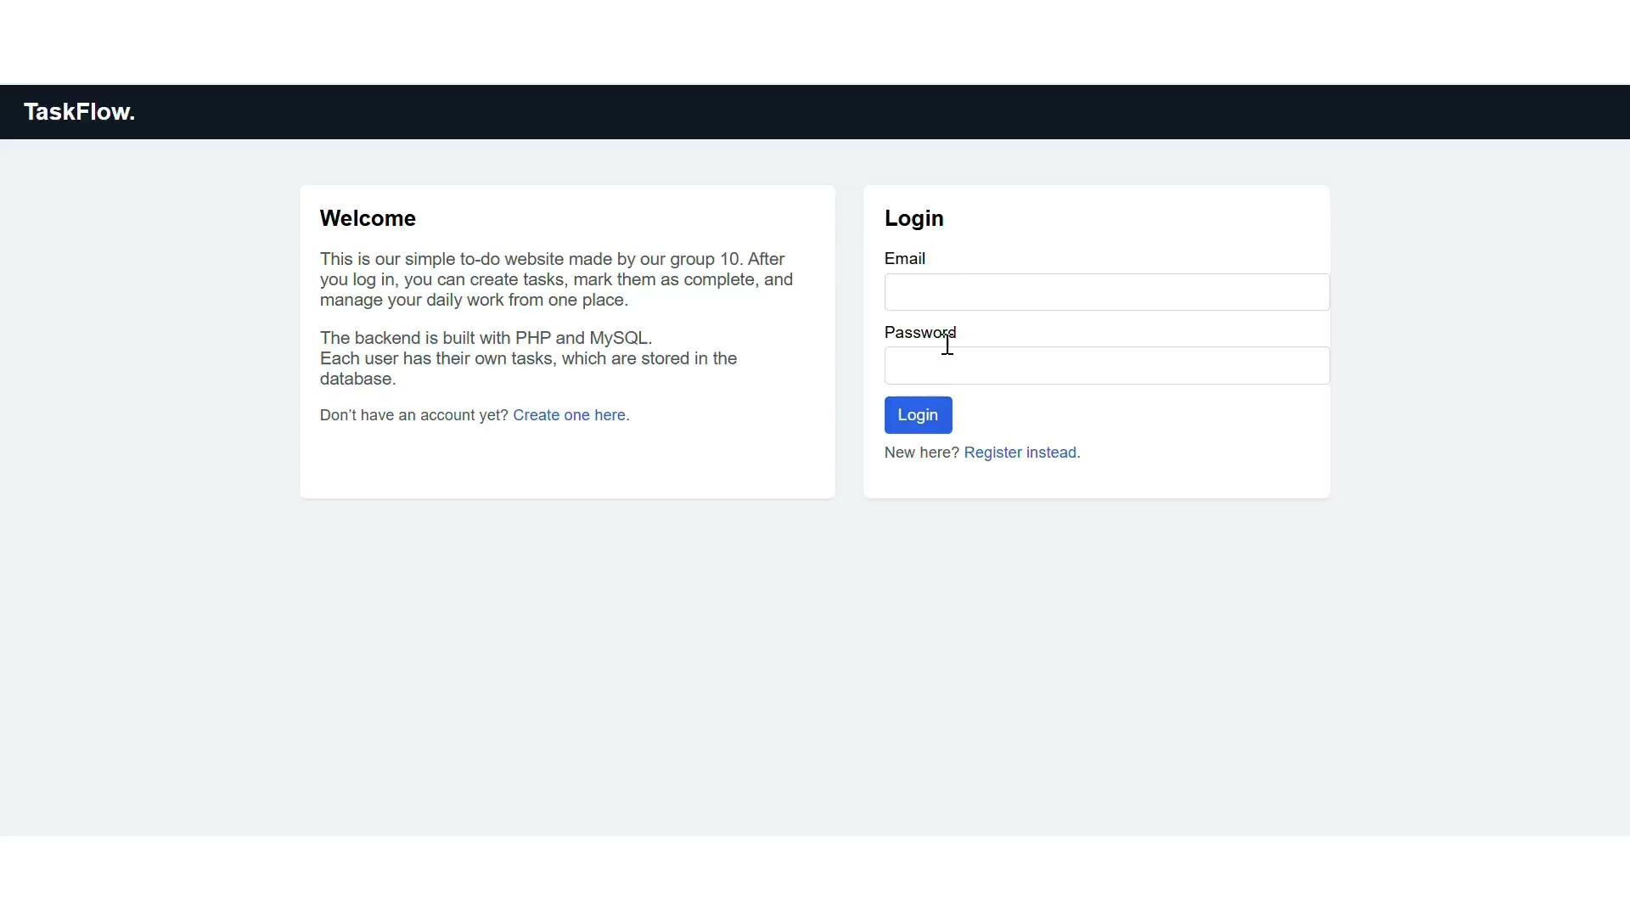

Slide 4
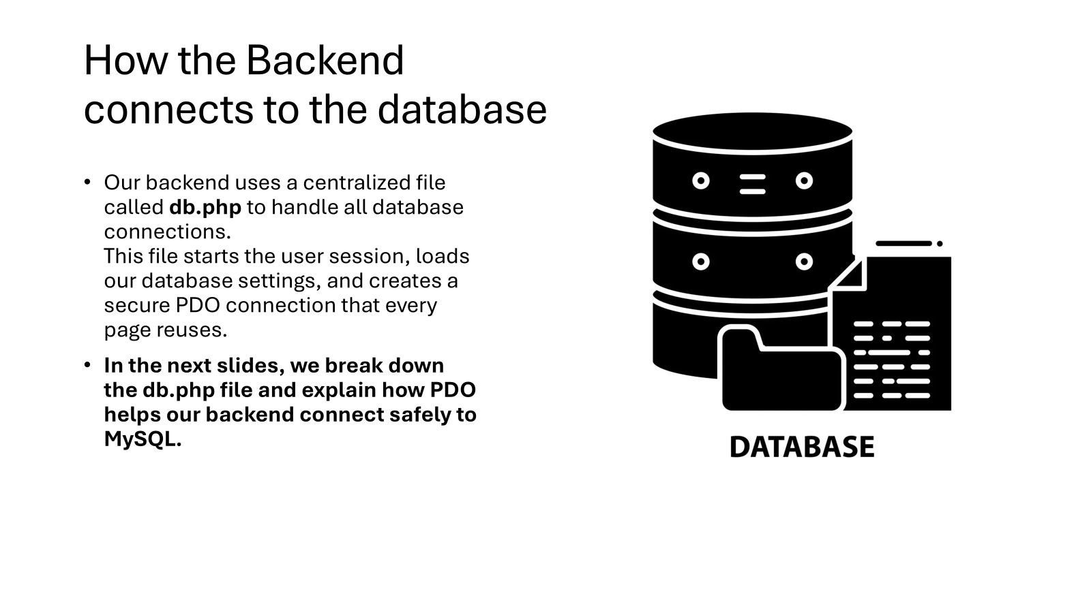

Slide 5
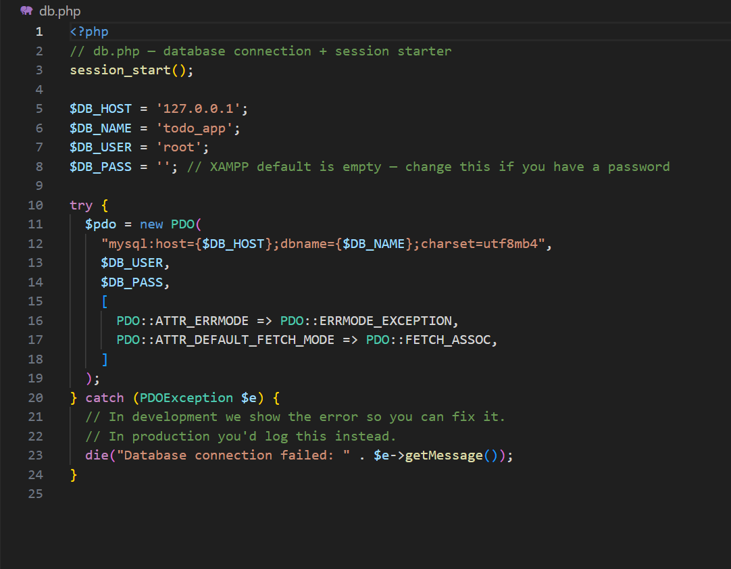
Database connection
The backend handles login validation, saving tasks, updating tasks, and retrieving all user data.
To keep the code organized , db.php was created. The db.php is a file made that starts a session and creates a secure PDO connection all pages include this file to access the same database.
Key Features of the Code
Session_start() keeps the user logged in across all pages
Database settings (host, name, username, password) define how PHP connects to MySQL
PDO is used to create a safe and modern connection to the database
ERRMODE_EXCEPTION makes debugging easier by showing helpful error messages
FETCH_ASSOC returns results as clean associative arrays (no numeric duplicates)
Centralized connection file — all pages use db.php instead of repeating connection code

Slide 6
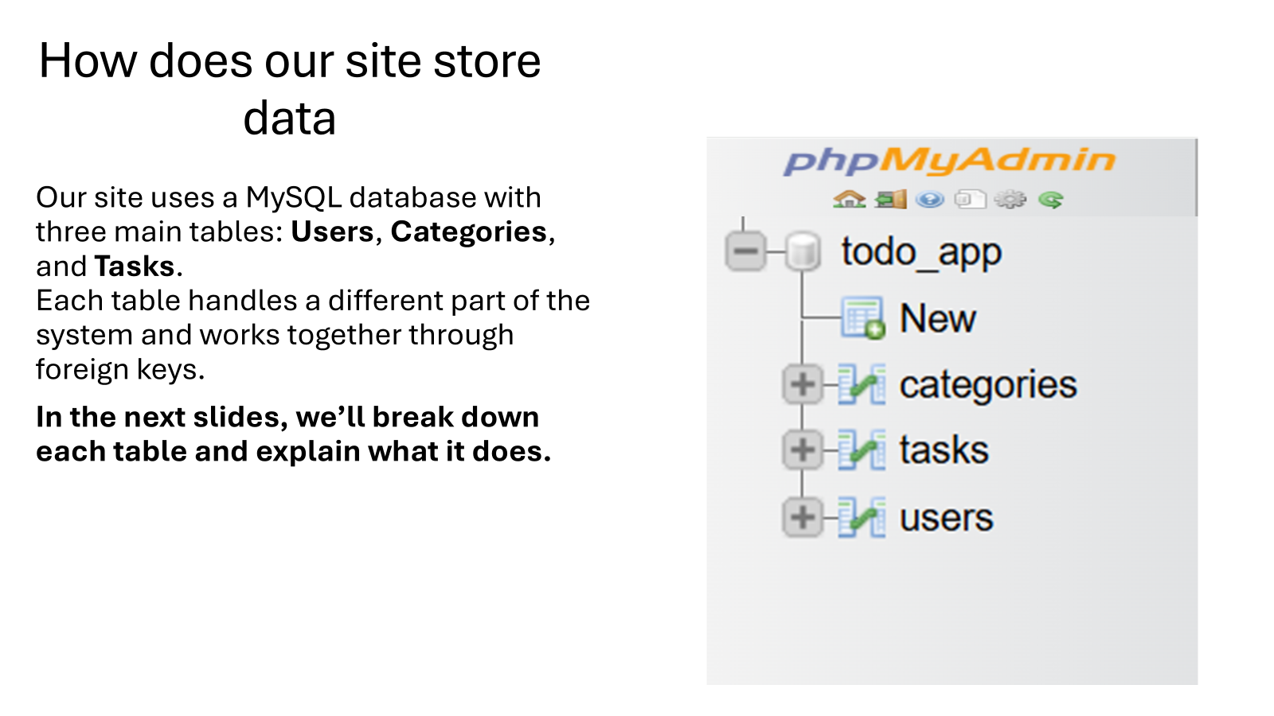

Slide 7
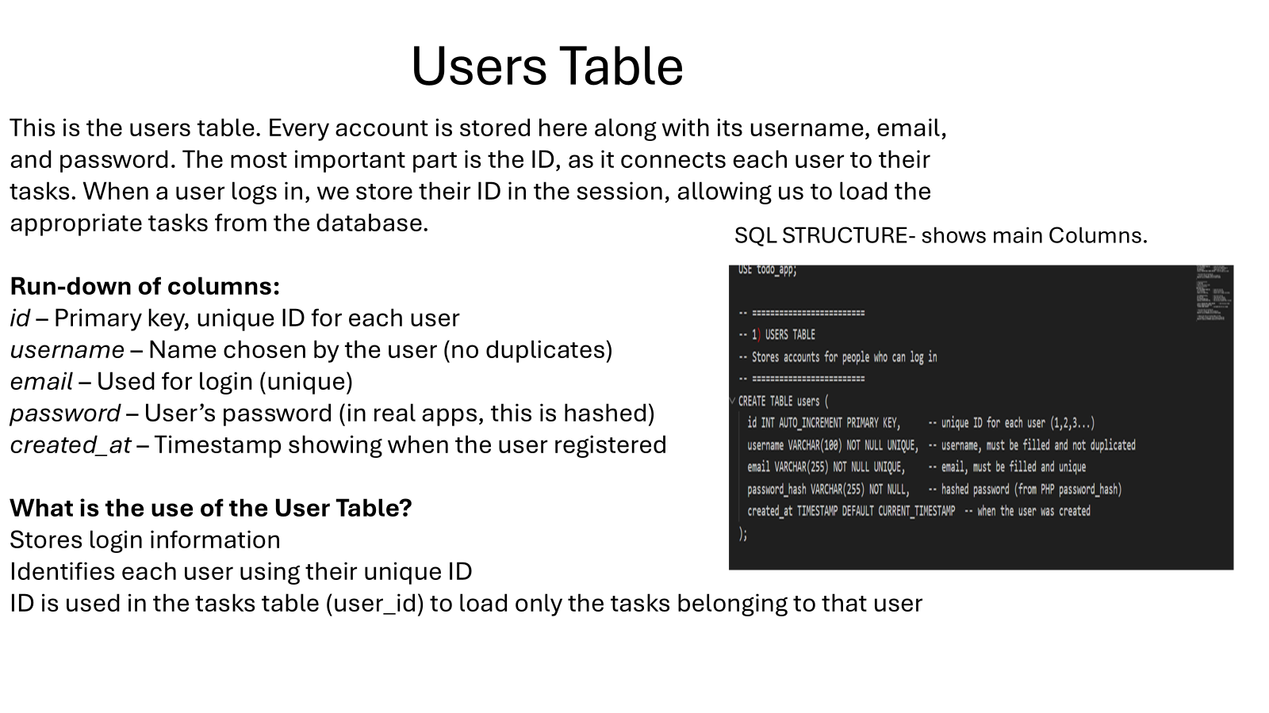

Slide 8
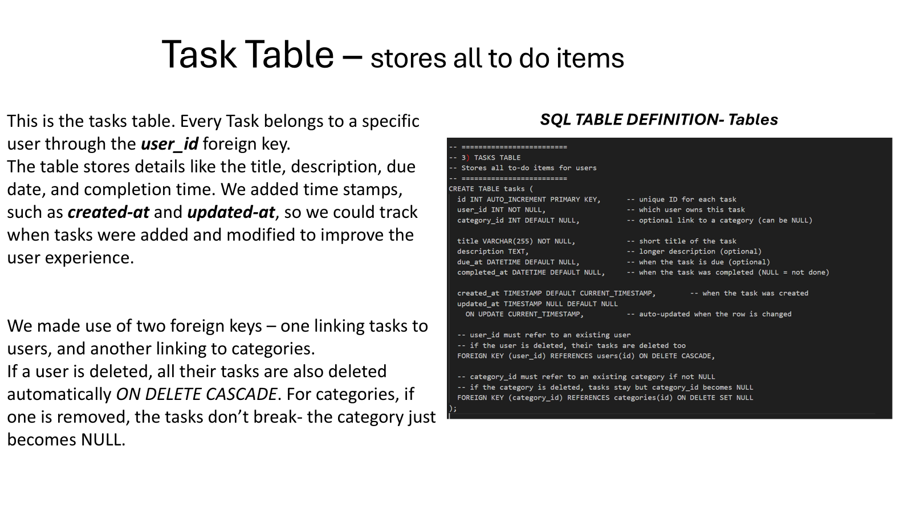

Slide 9
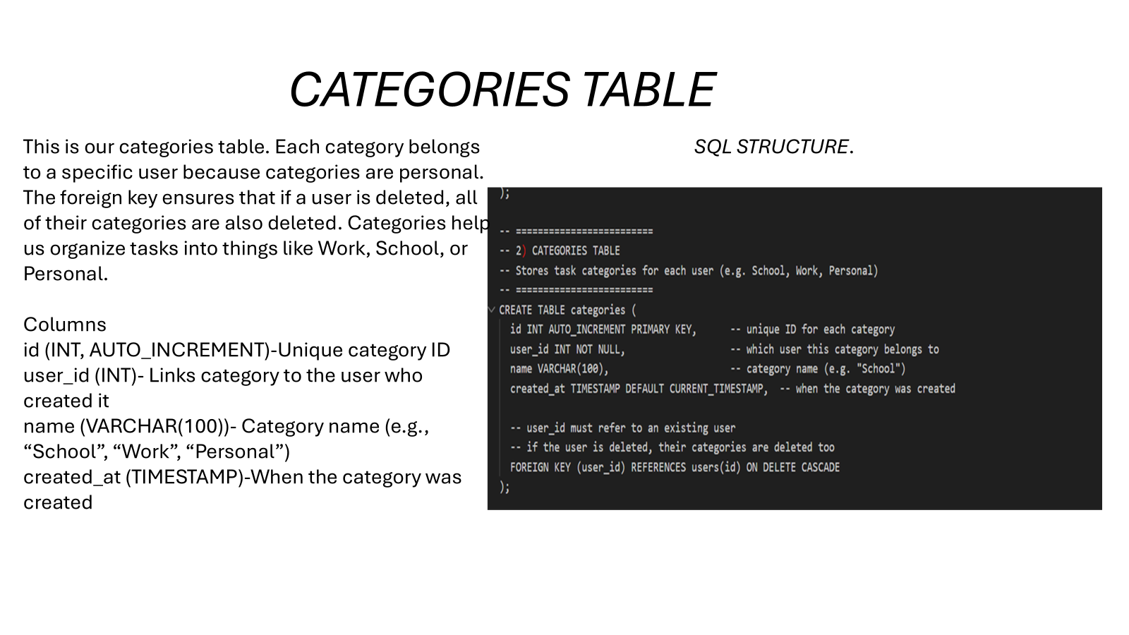

Slide 10
What works well?
User authentication (register, login, logout) works smoothly
Tasks are linked to individual users using sessions
Full CRUD functionality for tasks (add, edit, delete, complete)
Centralized database connection using db.php keeps code organized
Use of PDO improves security and prevents SQL injection
Simple and clear user interface that is easy to navigate
Notes:
Several parts of the application work well.
User authentication is functional, allowing users to register, log in, and log out securely.
Tasks are properly linked to individual users, so users only see their own data.
The app supports full CRUD operations, meaning tasks can be added, edited, deleted, and marked as completed.
Using a centralized database file reduces repeated code and improves organization.
Overall, the application is stable, easy to use, and follows good backend practices

Slide 11
What can be improved?
Add task categories or priority levels
Improve UI with better styling and animations
Add password reset and email verification features
Implement search and task filtering options
Notes:
In the future, there are several improvements we could make to enhance the application.
We could add task priorities, categories, or due dates to improve organization.
The user interface could also be improved with better styling and animations.
Additional features like password recovery, email verification, and task searching would make the app more complete.
Finally, performance and security could be further improved for larger-scale usage

