Slide 1
Economy data visualization
A tool to visualize the economy

Slide 2
objective
The main objective of this project is to create a software which can explain the complex parameters of economy to normal people easily using data visualization technology.
This project will have many function to compare data of different economies as well as of different era.
Apart from visualization this project will have many functions to add, delete and modify data.

Slide 3
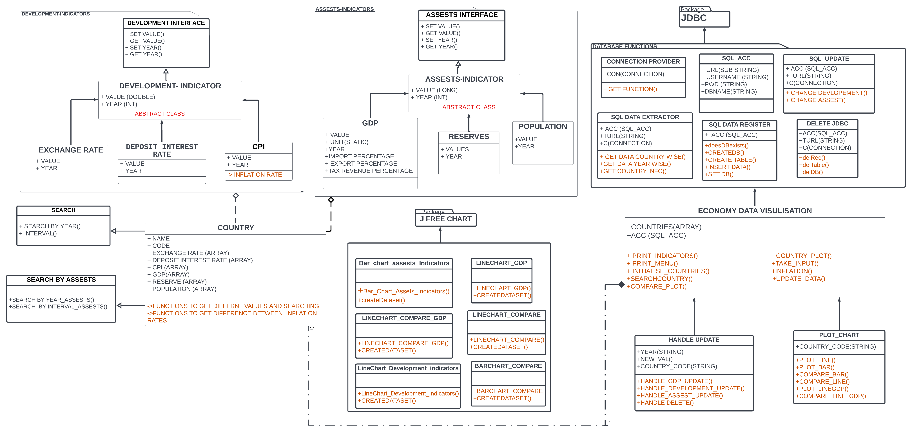
Uml diagram of project

Slide 4
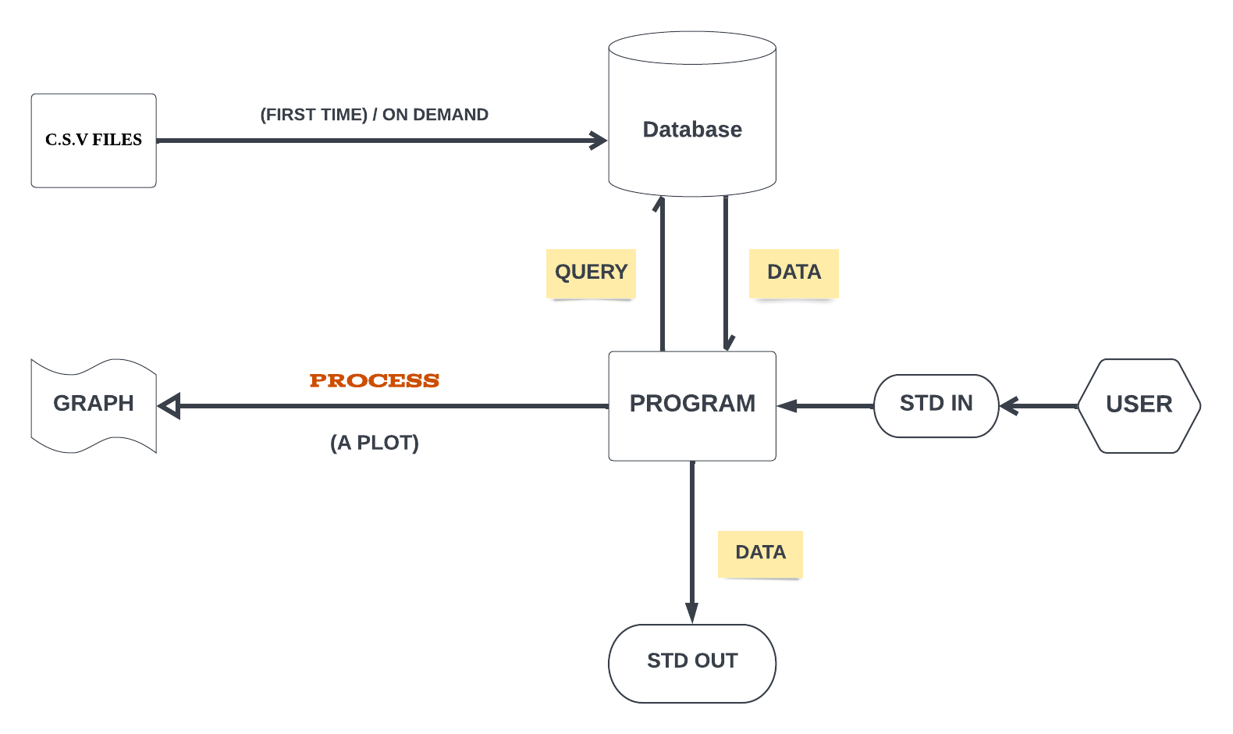
WORKING OF PROGRAM

Slide 5
Team Members and their roles
1) AARAV NIGAM (S20210010002)
Schema Structuring,
- I designed the whole structure of the Project for proper and smooth functioning.
- I distributed specific roles to each collaborator so that we always work in sync.
Implementing The UI Classes,
- I implemented the classes which make User Interaction easy and smooth. It includes the
following classes:
a)Economy Data visualization Class,
b) Plot Chart Class,
c)Handle Update Class.
Integrating ,
- Our project was divided in 3 things:
a)Database Handling
b)Graph Plotting
c)Objects with Functions to handle data
---My main purpose was to integrate all these 3 sections so that these different subdomains can work together in sync.

Slide 6
2) PARTH BHANDARI (S20210010170)
GRAPH PLOTTING SCHEMA,
- Using Jfree chart and Swing for implementing Bar graph and Line chart.
- Modifying Dataset to implement comparisons.
- Implementing the graph plots for Import, Export, and Tax revenue for a specific GDP.
- Updating the plot name and description on the basis of provided data.
GENERIC CLASS IMPLEMENTATION,
-Problems faced in typecasting subclass as superclass (in method parameter).
- Solution of above problem using Generic classes(Wildcards).
Schema Structuring,
-Helped in designing the Schema (Pillars of OOPS part).

Slide 7
3) PRATYUSH SINGH (S20210010183)
→ Handling Database Implementation,
- My work was establishing a connection between our project and MySQL and managing DB credentials.
- Creation of DB schema and Tables with all the necessary columns.
→ Handling Data Import from CSV files,
- Inserting data from CSV FILES using Prepared Statement Class.
- It also involved extracting data from MySQL in all necessary formats required by other team members to
work with.
→ Implementing Functions to Update Data
- Updating Classes and DB tables.

Slide 8
4) Mohd. Rizwan (S20210010150)
→ Managing Packages,
- Made two Packages Assets Indicators And development Indicators. These are some parameters which
determine country economy.
- Made Three Interfaces and Implementing in a different packages.
→ Creating major Classes and Functions,
- Made Two Abstract Classes; one in Asset Indicator and other in Development Indicator packages.
- Made a Country Class by using Object Composition .
- Typecasting of a variable.

Slide 9
5)Rathod Harshan (S20210010189)
→Cleaning CSV,
- The CSV files downloaded from world bank website contains lots of unnecessary data, removing them is a
very important step for proper database implementation.
→Assets Indicator,
- I wrote the code of Assets Indicator package that holds data with long values and I helped in writing its
respective functions.
→Deletion From Database,
- Made a delete function to implement JDBC which can delete records, tables, and databases.
→Presentation Preparation,
- I made the presentation with all the flowcharts for better understanding for the user.

