Slide 1
Economy data visualization
A tool to visualize the economy

Slide 2
objective
The main objective of this project is to create a software which can explain the complex parameters of economy to normal people easily using data visualization technology.
This project will have many function to compare data of different economies as well as of different era.
Apart from visualization this project will have many functions to add, delete and modify data.

Slide 3
Classes in our projects
1) Development Indicator(Abstract Class)
- Value(Double)
-Year(Int)
2) Assets Indictor(Abstract Class)
-value(long)
-year(Int)
3) Exchange Rate
-value(Double)
-year(Int)
-Functions
4) Deposit Interest Rate
-value(Double)
-year(Int)
6) GDP
-Value(long)
-Unit(Static)
-Year(int)
-Import percentage (double)
-Export percentage (double)
-Tax-Revenue Percentage (double)
5) CPI
-Year(Int)
-Value(Double)
-Inflation-Rate(Function)

Slide 4
7) Reserves
-Year(Int)
-Value(long)
8) Population
-Year(Int)
-Value(long)
9) Country
-Name(String) -Code (String)
- Exchange Rates (Array of Object) - CPI’s (Array of Object)
- Interest Rate (Array of Object) -GDP’s(Array Of Object)
-Reserves(Array Of Objects) -Population’s(Array Of Object)
-Functions to Get Data of Different Objects at different intervals of time.

Slide 5
10) Economy Data Visualization
-Array Of Country Object
-Function to take input from csv, implement database
-Implement GUI
-Function to Plots Graph for various parameters at different intervals of Time.
-Methods to take input from user to update database
-Functions of Searching and Sorting.

Slide 6
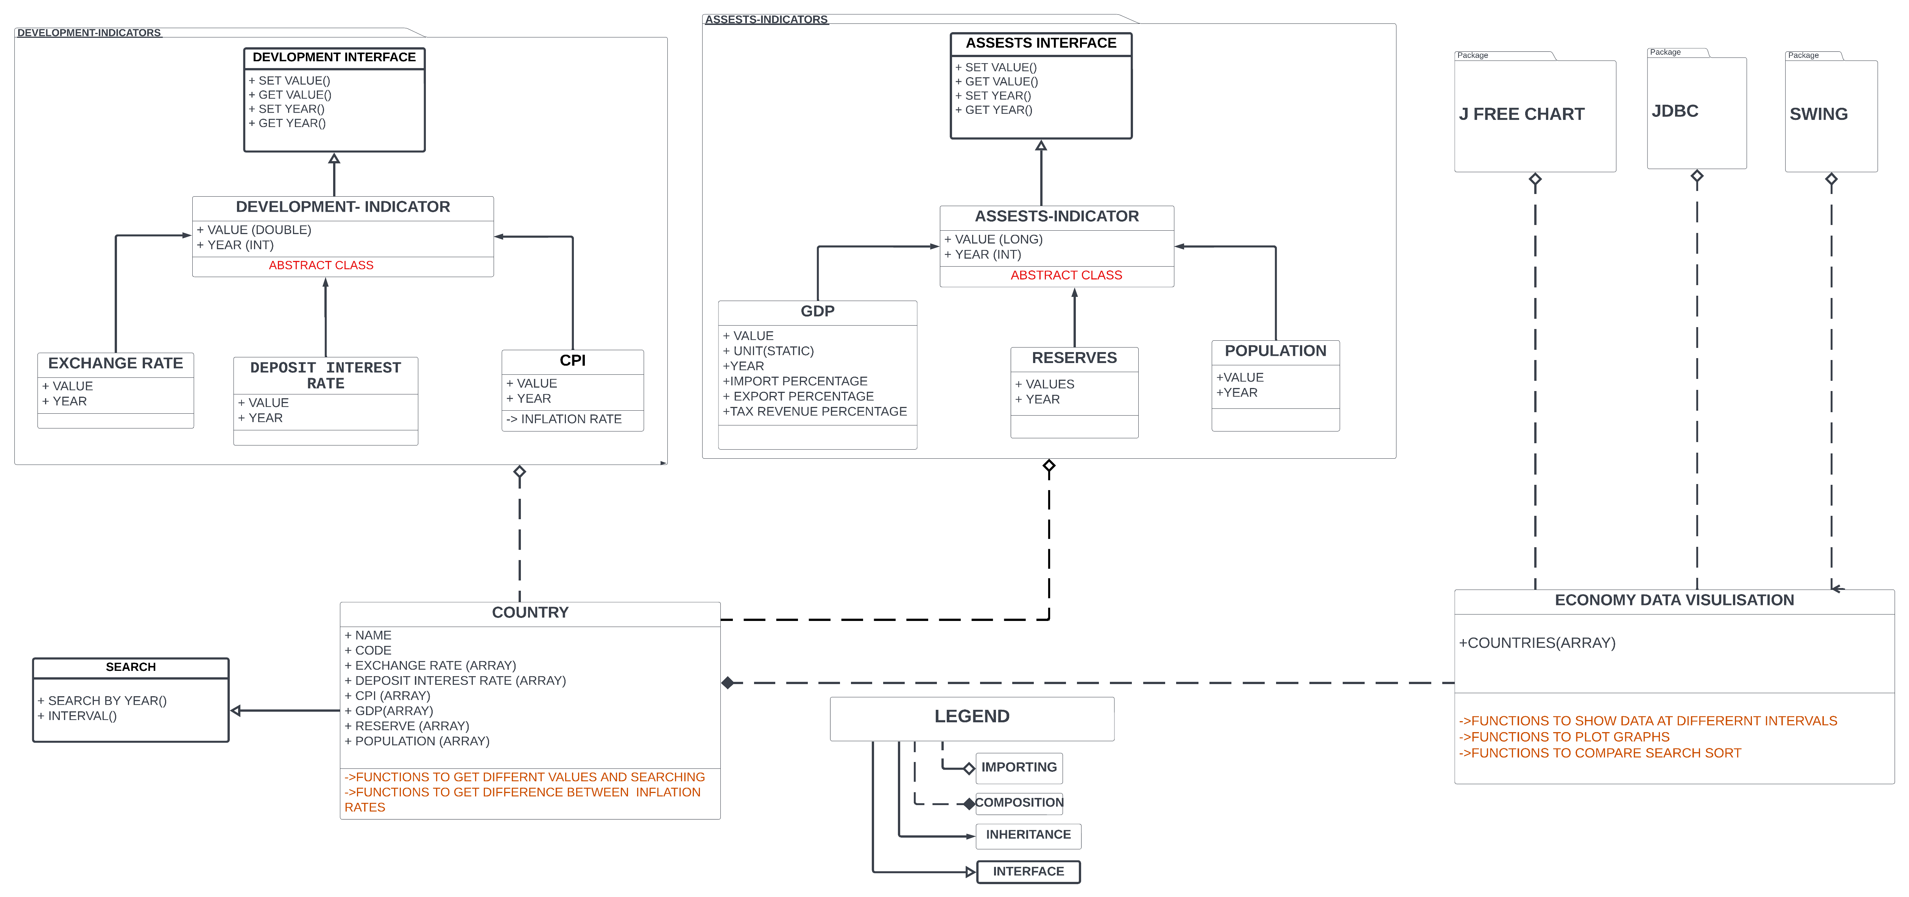
Uml diagram of project

Slide 7
Team Members and their roles
-> Aarav Nigam (S20210010002)
-Database Implementation
-GUI and Graph Plotting
-Implementation Of Data-Visualization Class
-> Parth Bhandari (S20210010170)
-GUI and Graph Plotting
-Schema Structuring
-Implementing Searching and Sorting Functions

Slide 8
-> Pratyush Singh (S20210010183)
-Handling Database Implementation
-Handling Data Import from CSV files
-Implementing functions to Update Data
-> Mohd Rizwan (S20210010150)
-Handling all Packages
-Creating major classes and its functions (Country Class, GDP class, Reserves class, CPI class etc.)
-Writing Documentation
-> Rathod Harshan (S20210010189)
-Creating Reserves, Interest Rate, Development Class
-Writing Documentation
-Creating Diagrams and Presentation.

