Slide 1
The Generic Types
/**
* @author Avatcher#0546
*/
JavaTalk 2022

Slide 2
The Sub-themes
When it’s needed
Multiple bounds
The Type Erasure
The Bridge Methods
The Wildcards

Slide 3
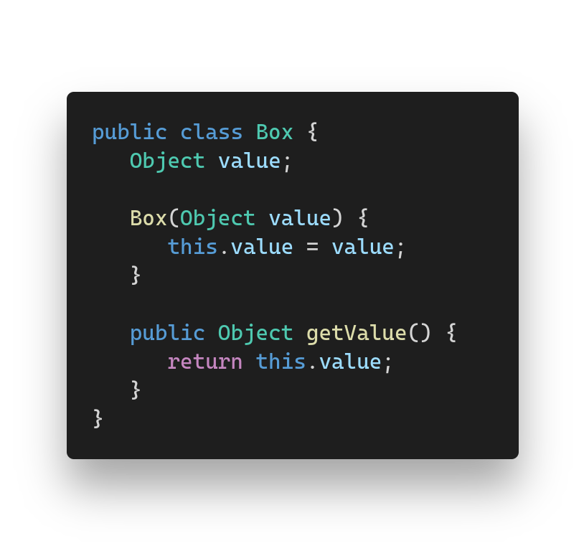
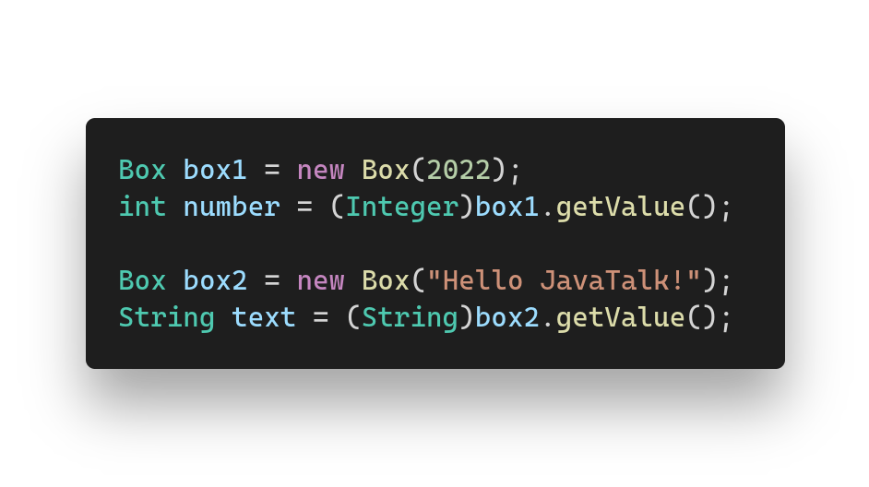
The goal
Sometimes we need a class, what can work with a multiple different types.

Slide 4
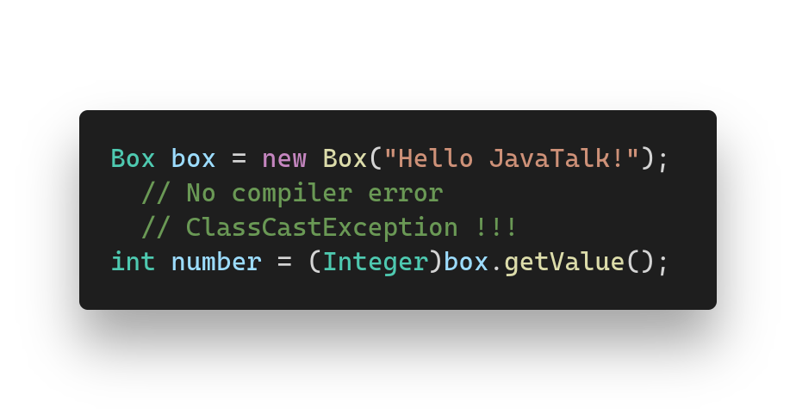

The problems
We have to write an additional code every time.
-
-
It’s unsafe. We can cast to a wrong type.

Slide 5
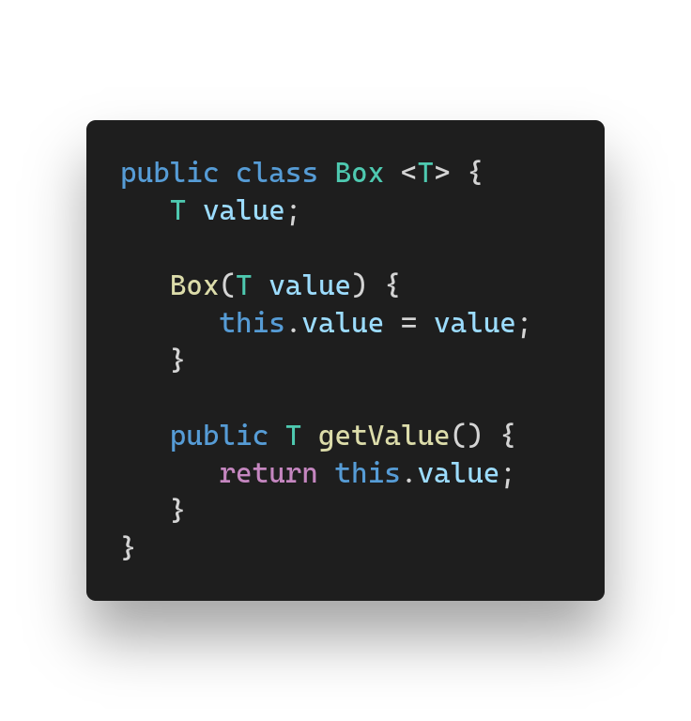
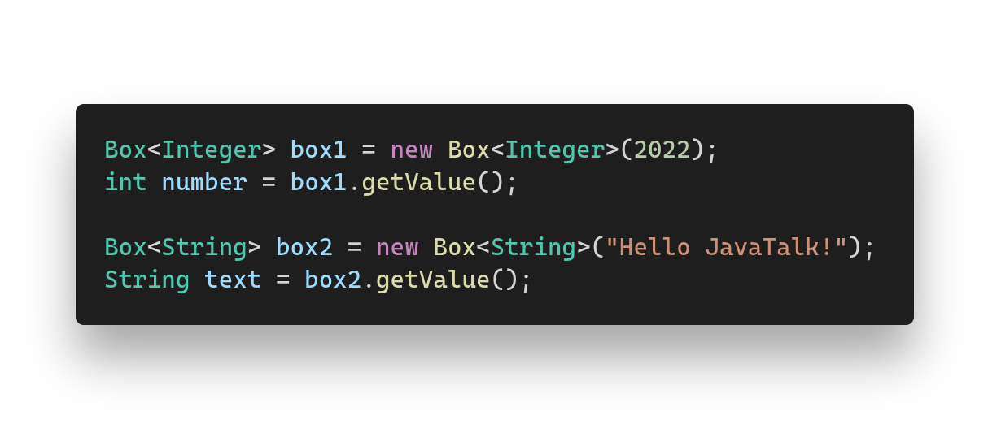
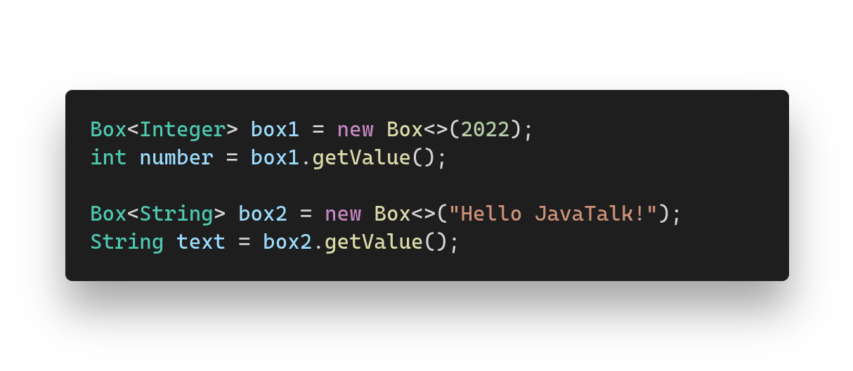
The solution
Allow the compiler to do all instead of you.

Slide 6
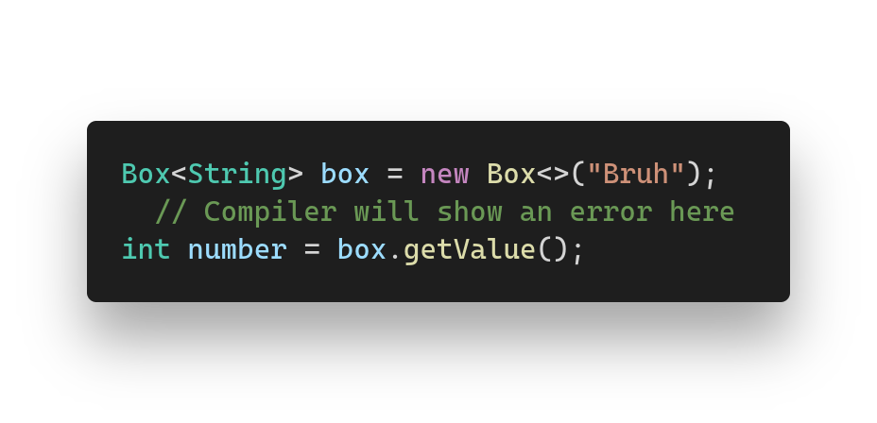

It’s safe!
The compiler will end the compilation with an error, if code contains illegal conversion.

Slide 7
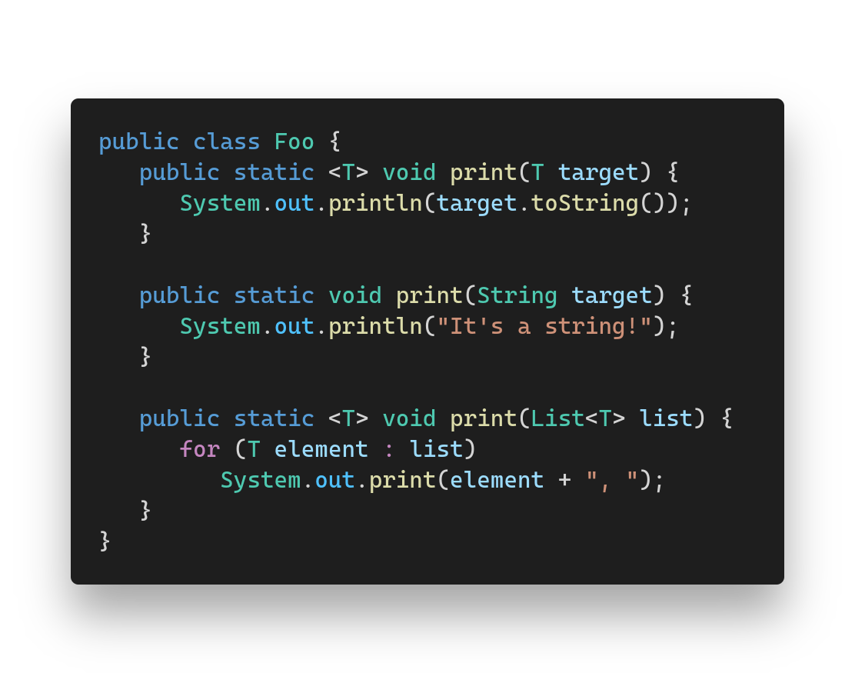
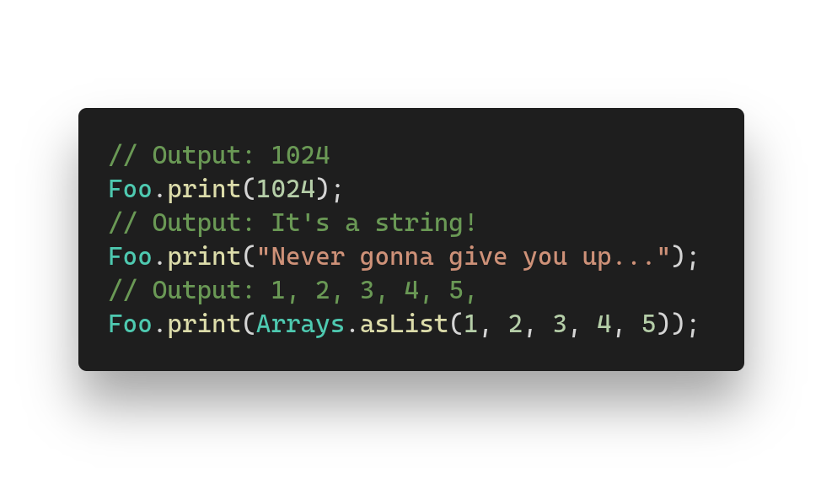
The generic methods
Methods are also allowed to have a generic types. Even with a custom overloads!

Slide 8
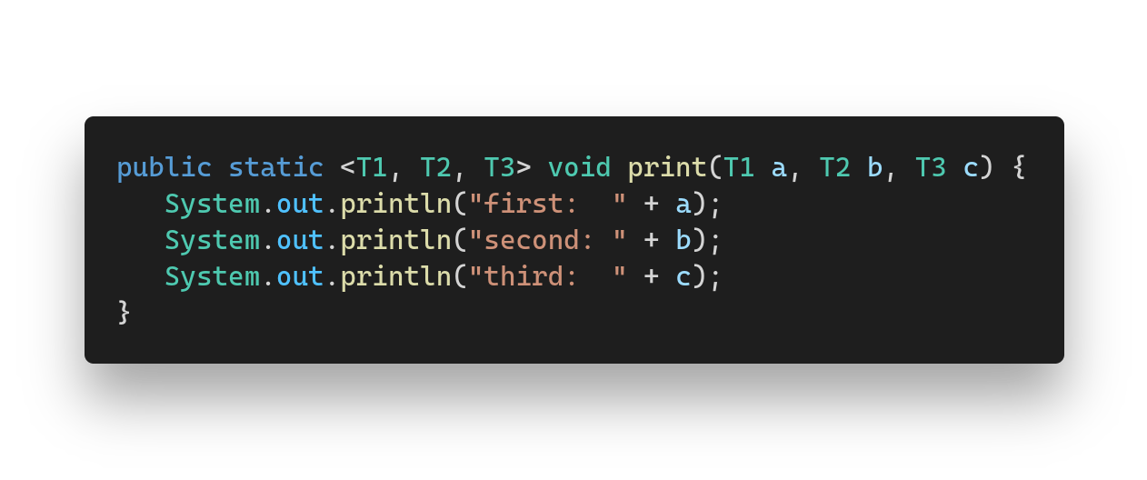
Multiple generic types
Classes and methods are also allowed to have multiple generic types.

Slide 9
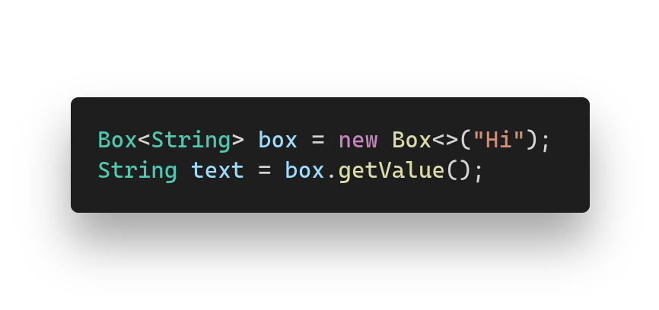
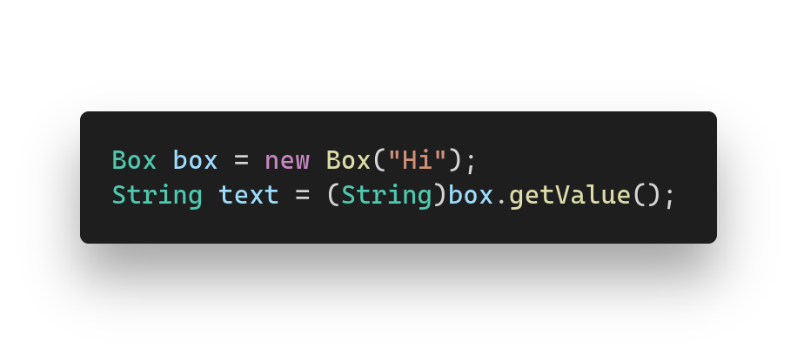

The type erasure
Generic types are only compilation-time feature.
They will disappear when program will be built.

Slide 10
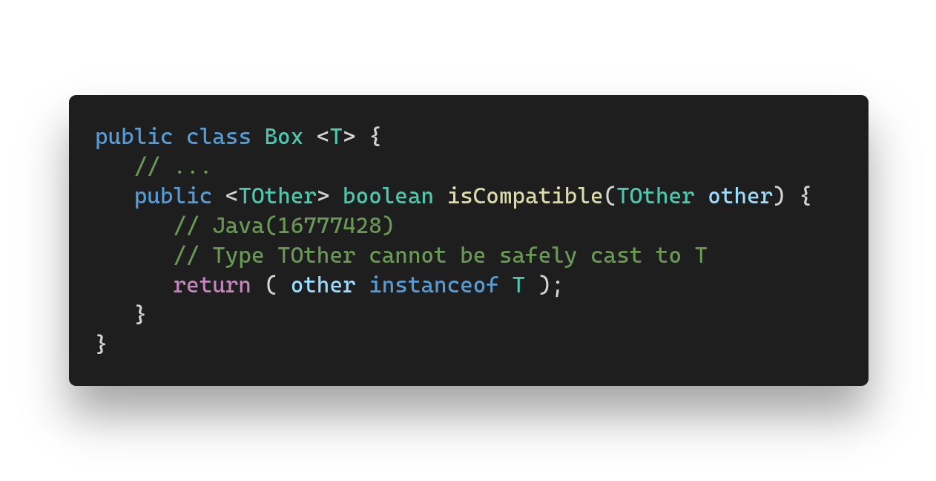
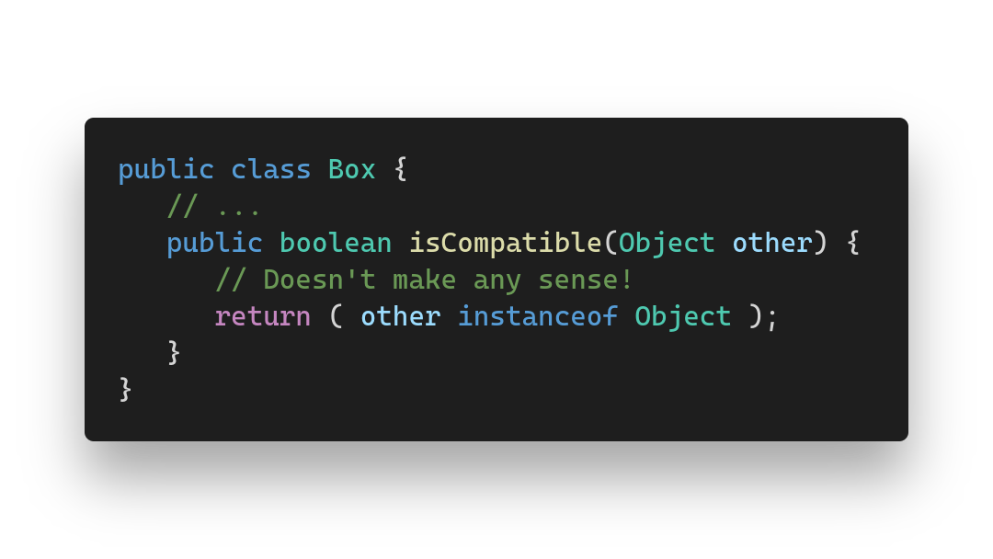
That means all types will disappear too and it will make some code not make sense.

Slide 11
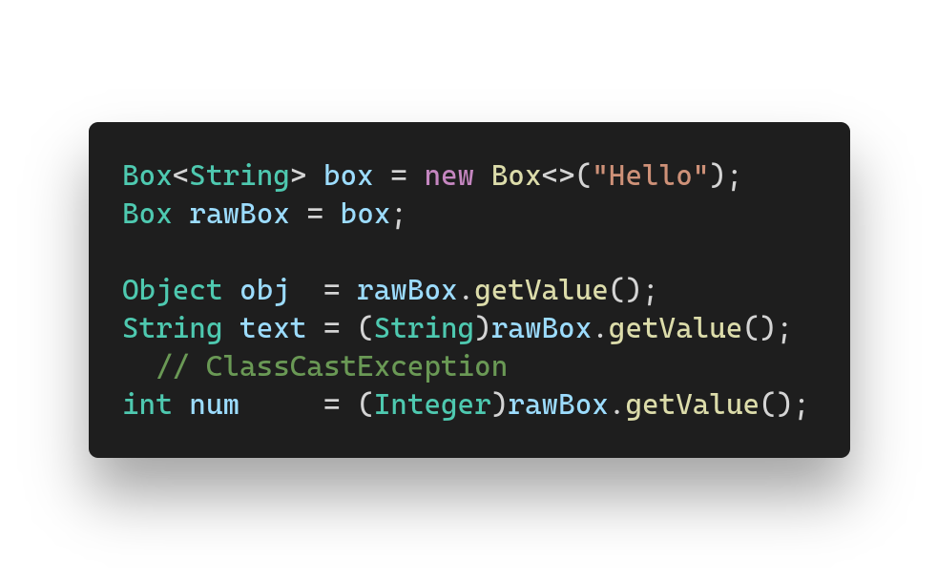
The raw types
We can store generic type without generics.

Slide 12
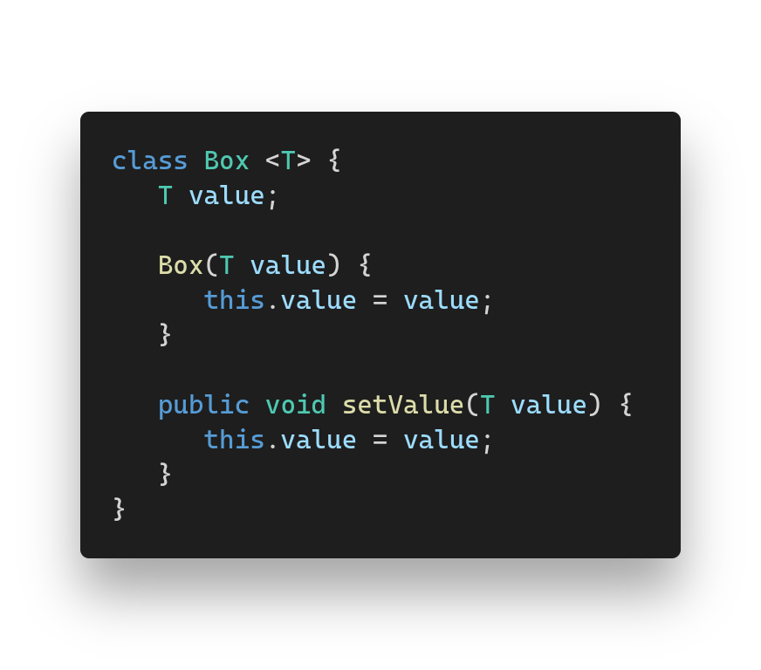
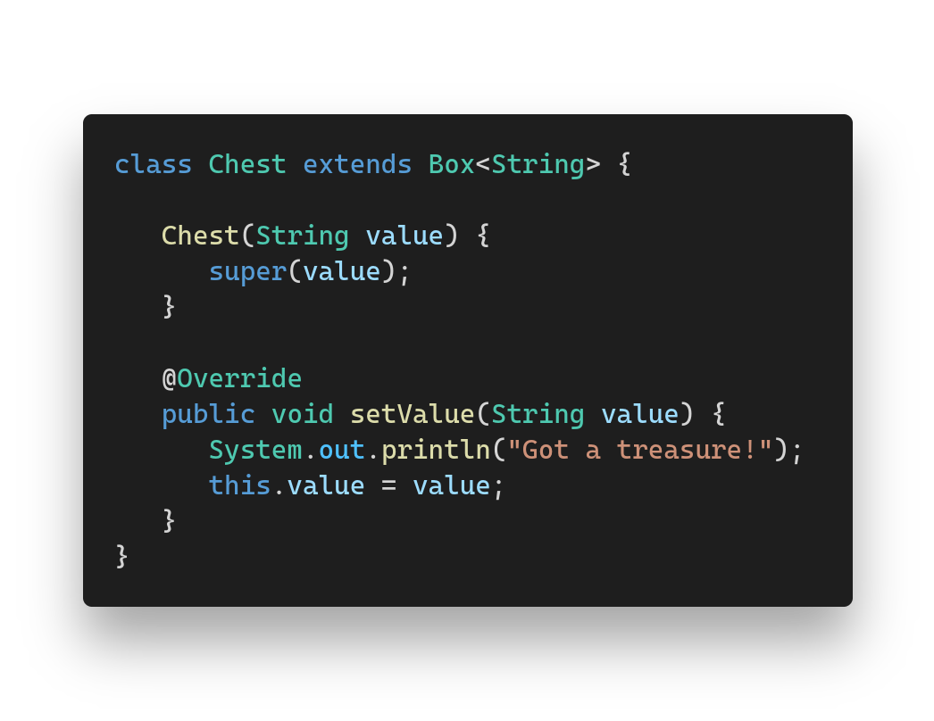
The bridge methods
The compiler generates additional methods, to override old ones in the inheritance.

Slide 13
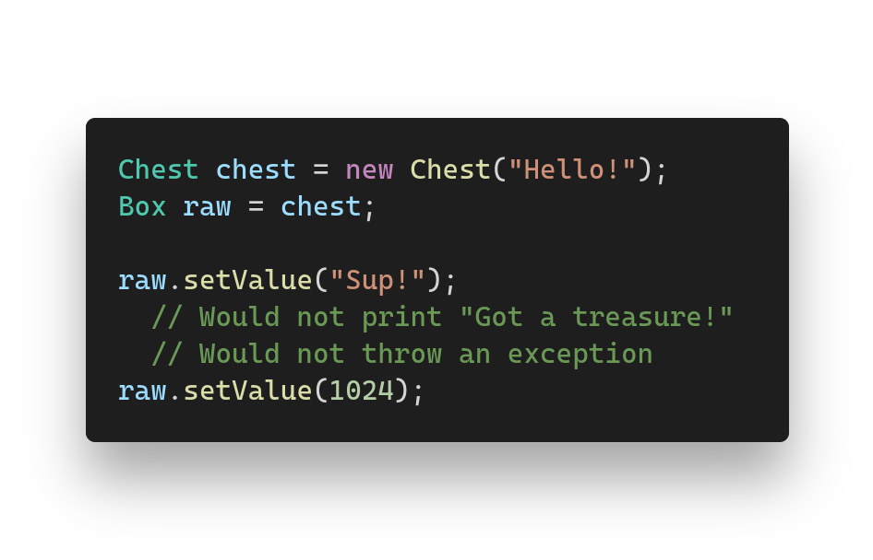
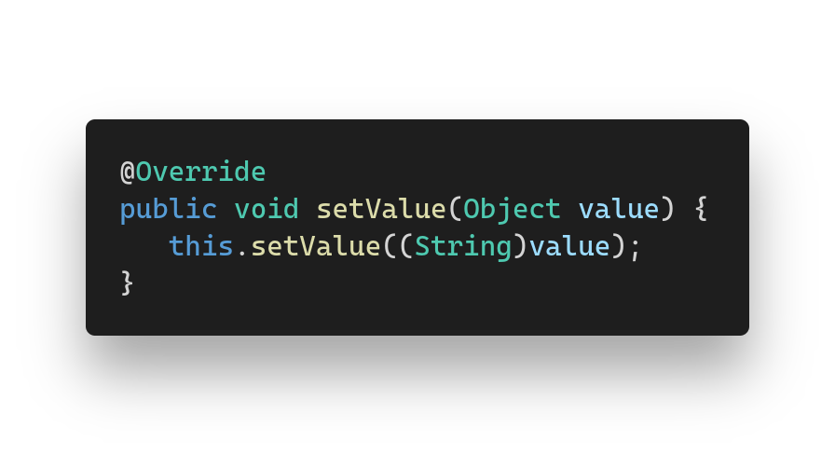
If they would not exist.

Slide 14
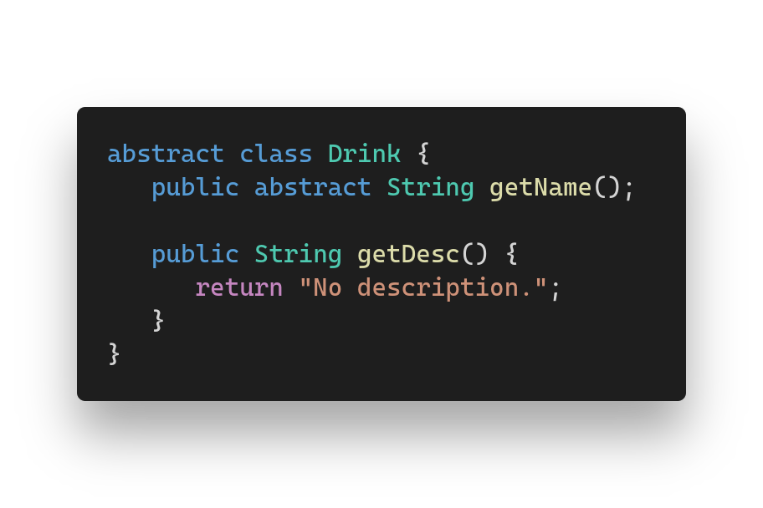
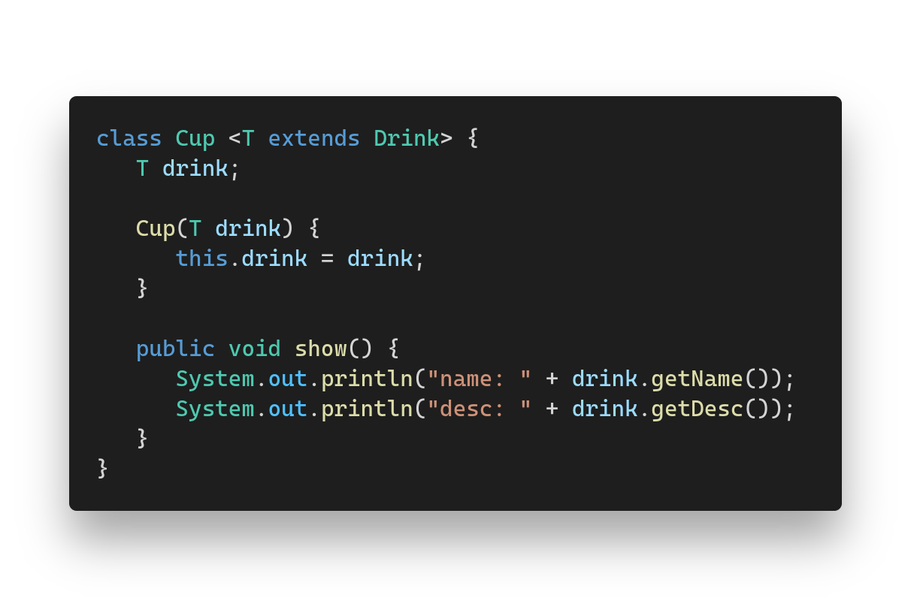
The type parameters
Sometimes we need the generic type would extend some other type.

Slide 15
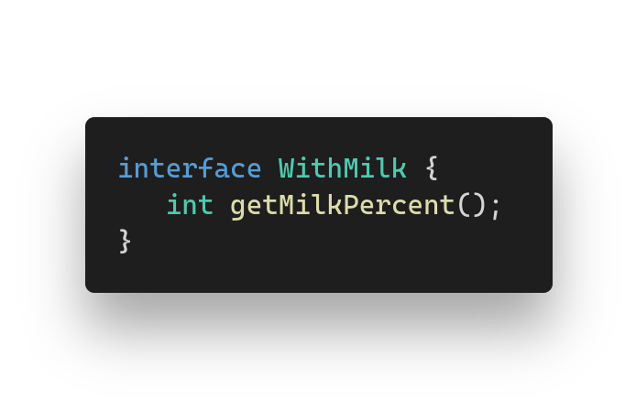
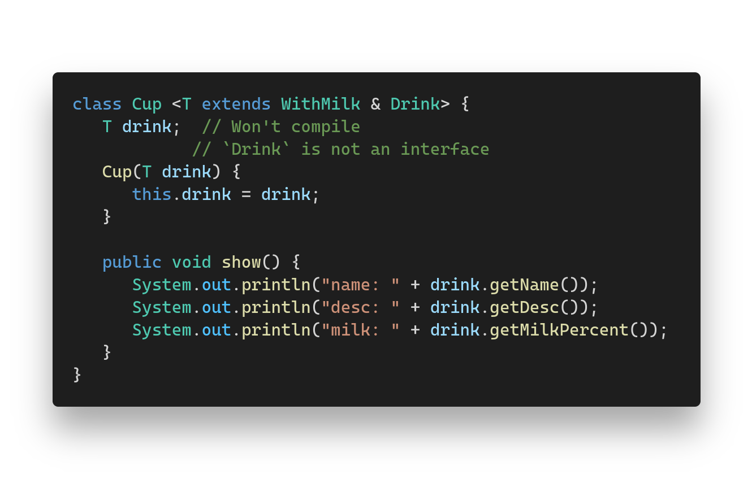
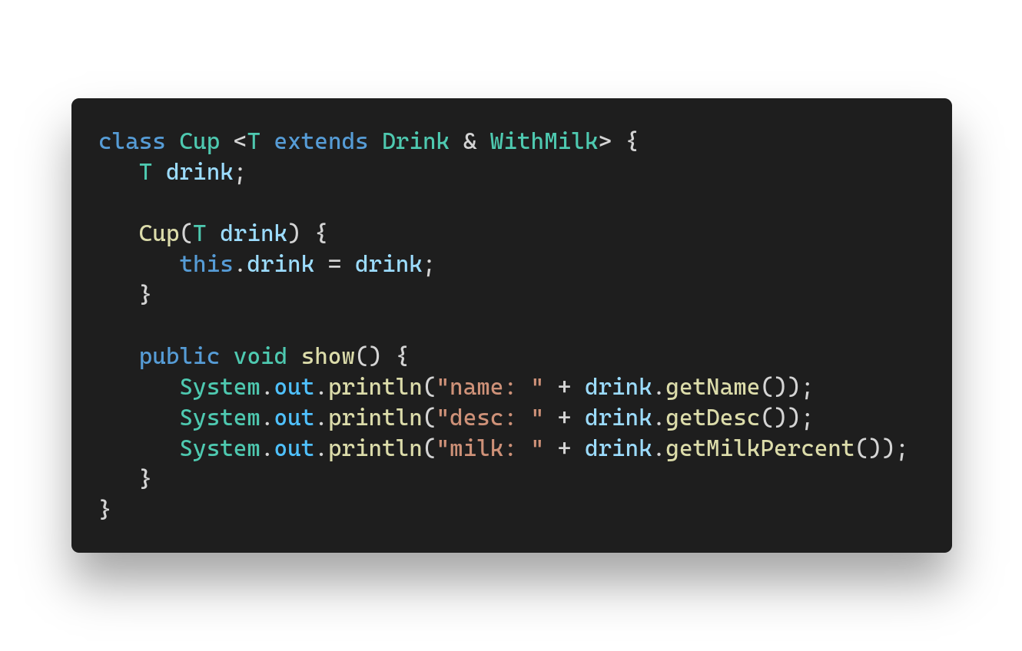

Slide 16
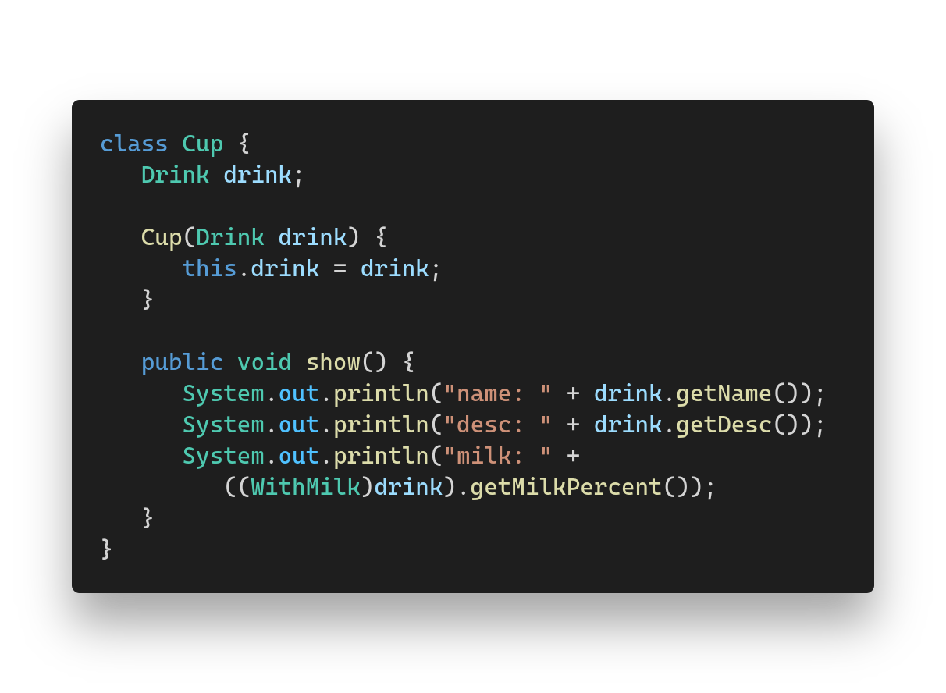

After the type erasure past generic type transforms to first type bound.

Slide 17
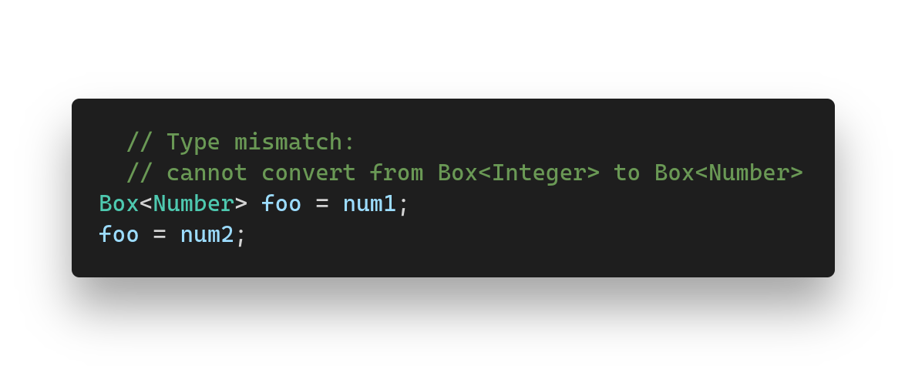
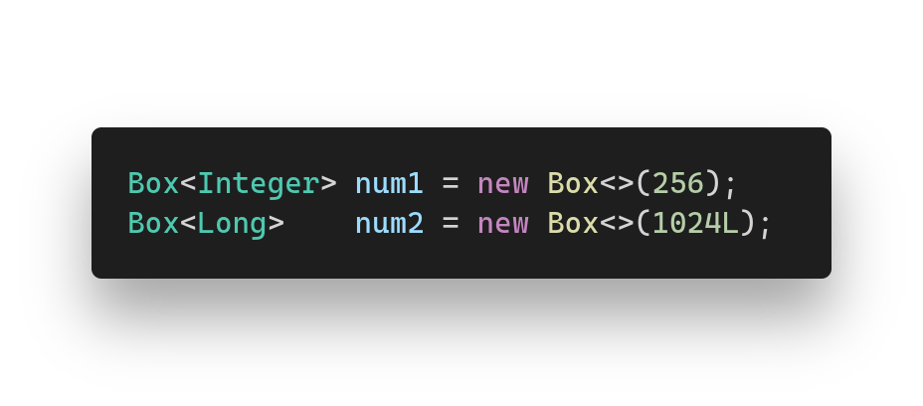
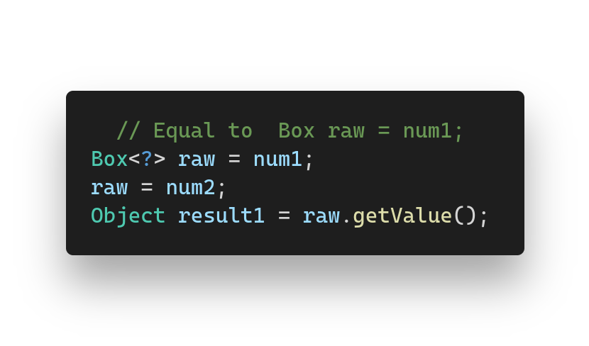
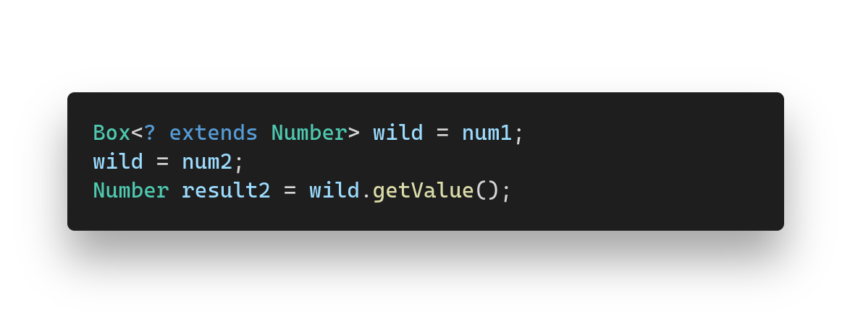
The wildcards
We can sometimes even do not know the type of the generic!

Slide 18
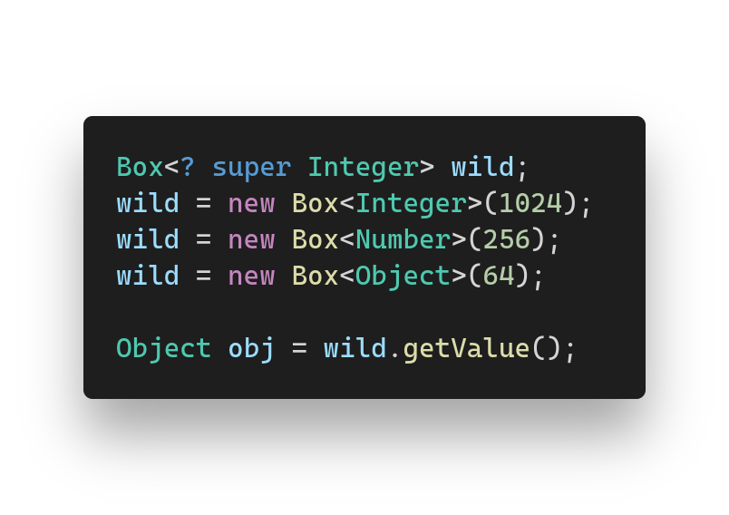
The wildcards “super”
Super allows to store type who’s generics are superclasses of selected bound.

Slide 19

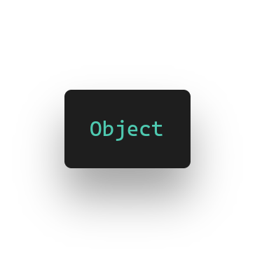
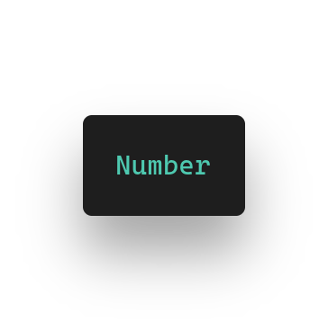

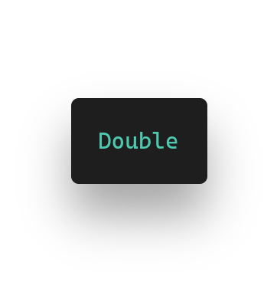
Wildcard “extends”, “super”
By choosing “extends” or “super” in wildcard’s bound, we can choose the direction of the available inheritance.

Slide 20

Thanks you all!

