Slide 1
Demo time

Slide 2
A Workflow
Data profiling -> notebook
Data cleaning -> dataset
Model 1 -> notebook, model_obj
Model 2 -> notebook, model_obj
Model 3 -> notebook, model_obj
…
Ensemble -> notebook, model_obj

Slide 3
on tidymodels
👍Function APIs are neat, super intuitive
👍Flexible to mix existing R universe to build a pipeline
👍Integrate well with infrastructures eg. rmarkdown, notebooks, shiny, rsudio connect
👎 No function to revert scaling (normalisation, standardisation)
👎parsnip cannot cope with all existing packages (variable importance cannot be extracted from ranger)
👎Function APIs constantly evolve

Slide 4
on Recipes
recipe(target ~.)
update_role() # update role e.g. id
step_date() # Date Feature Generator
step_unknown() # Assign missing categories to "unknown"
step_*impute() # Impute for numerical
step_naomit() # Remove observations with missing values
step_nzv() # remove zero variance
step_discretize()
step_num2factor()
Sep_log()

Slide 5
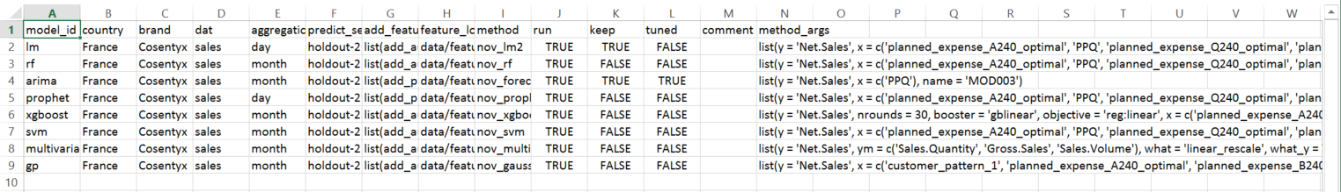
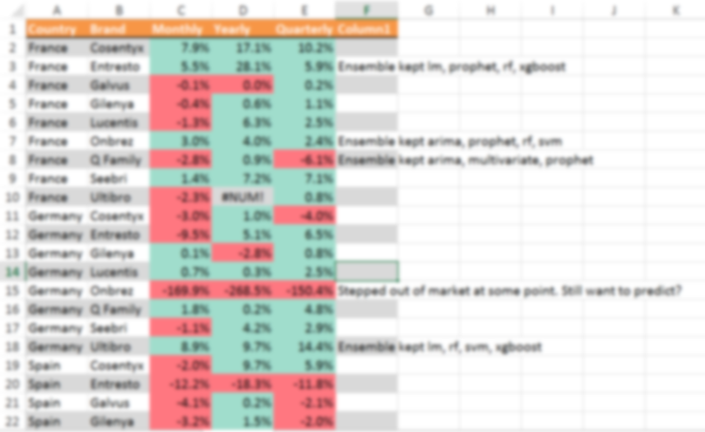
Sharing Recipes – Option 1 Flat files
Configurations
Performance Metrics

Slide 6
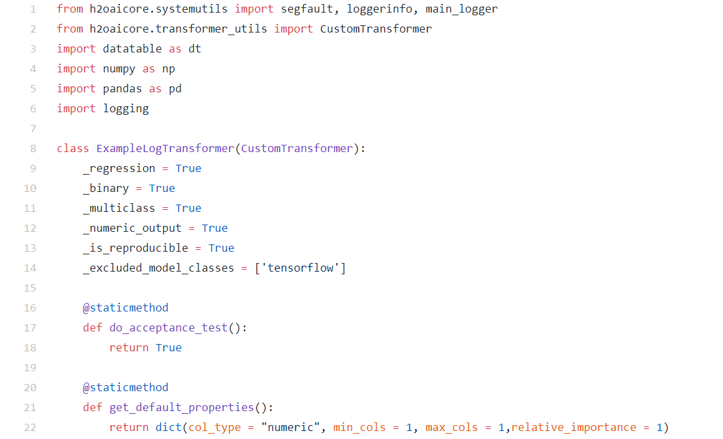
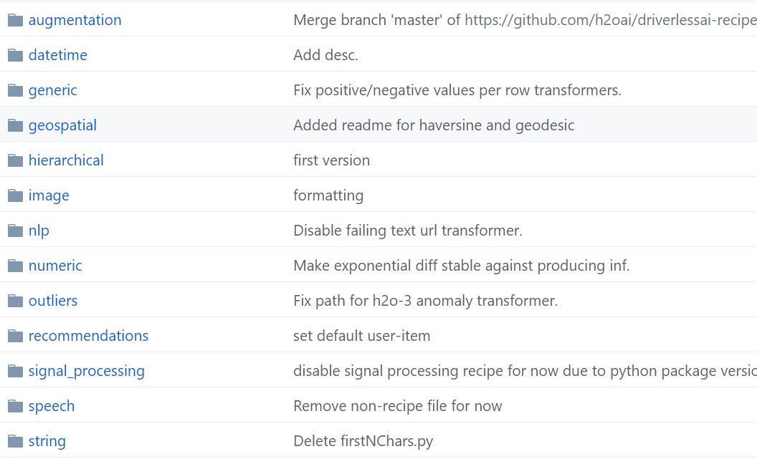
Sharing Recipes – Option 2 Repo to host recipes
Source: https://github.com/h2oai/driverlessai-recipes/tree/rel-1.8.0

Slide 7
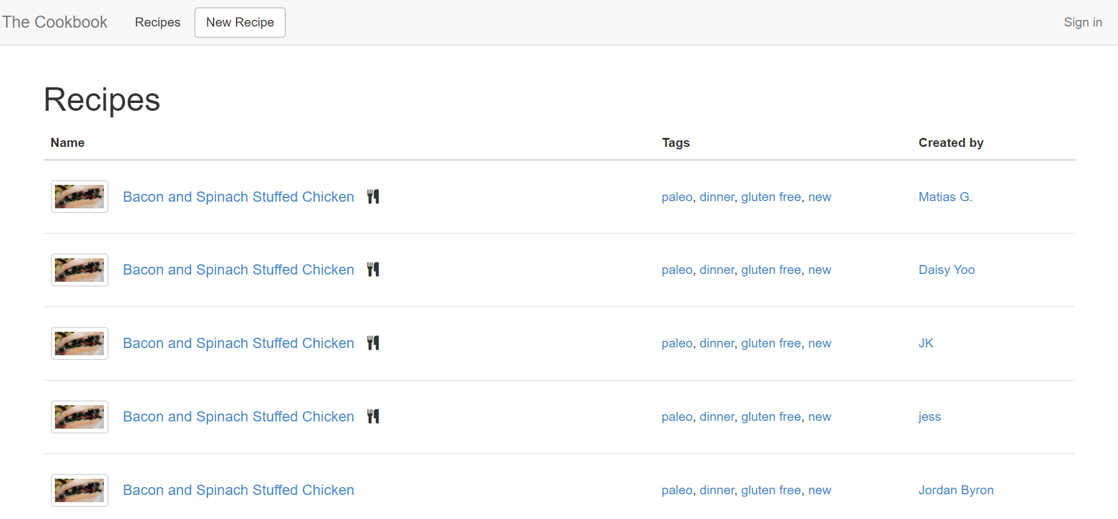
Sharing Recipes – Option 3 Create recipe from frontend
Source: https://thecookbook.herokuapp.com/

Slide 8
What’s Next?
Unify recipe functions
Cross validation
Grid search (hyperparameter tuning)
Ensemble (average, weighted average, stacking)
Collaboration!

Slide 9
Further Reading 📚
Recipes function reference
Using the recipes package for easy pre-processing
Recipes vignettes
Render website by Rmarkdown

