Slide 1
Avaya Americas Marketing Experience
William Ballesteros wballesteros@avaya.com
Peeter Moreno morenop@avaya.com

Slide 2
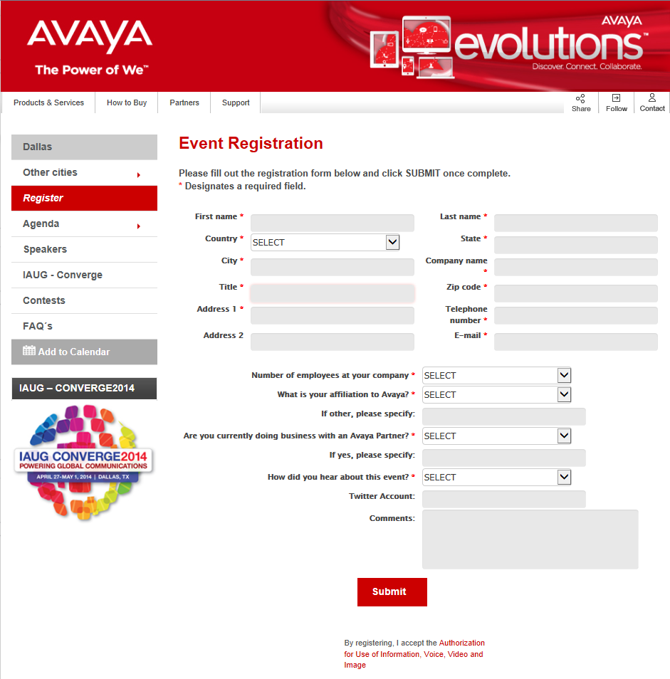
Avaya Evolutions – Dallas
Creation Registration Page
Request Date:
Monday, February 17, 2014
Requested By:
Maria Jose Bermudez
URL Location:
http://www4.avaya.com/usa/events/Evolutions/Dallas/Evolutions-Dallas/dal_register.aspx
Developed By:
Peeter Moreno

Slide 3
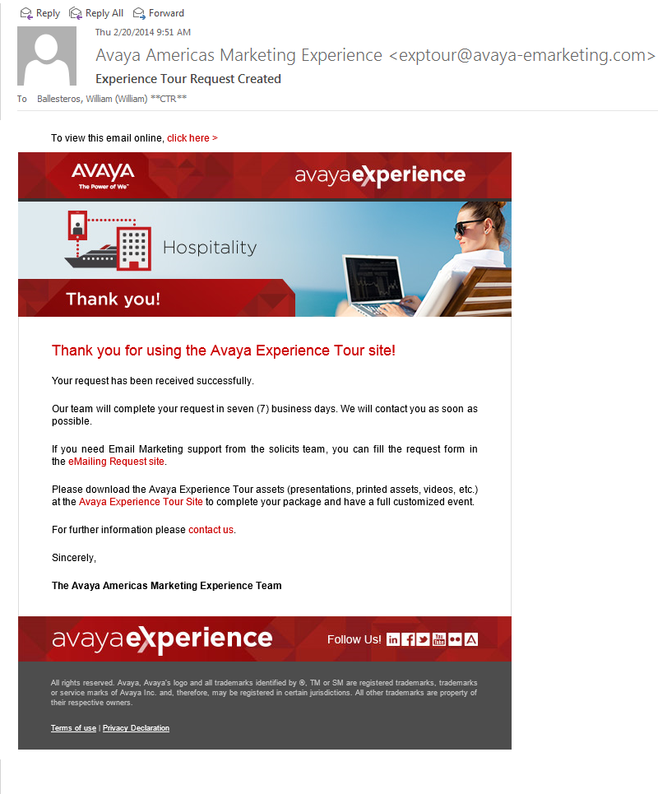
Avaya Experience – New Item
Add Hospitality item
Request Date:
Tuesday, February 18, 2014
Requested By:
Sylvia Hernandez
URL Location:
http://www.avaya-emarketing.com/ExperienceTour/solicits.php?topicvalue=hospitality&requesterlang=ENG
Developed By:
William Ballesteros Blanco

Slide 4
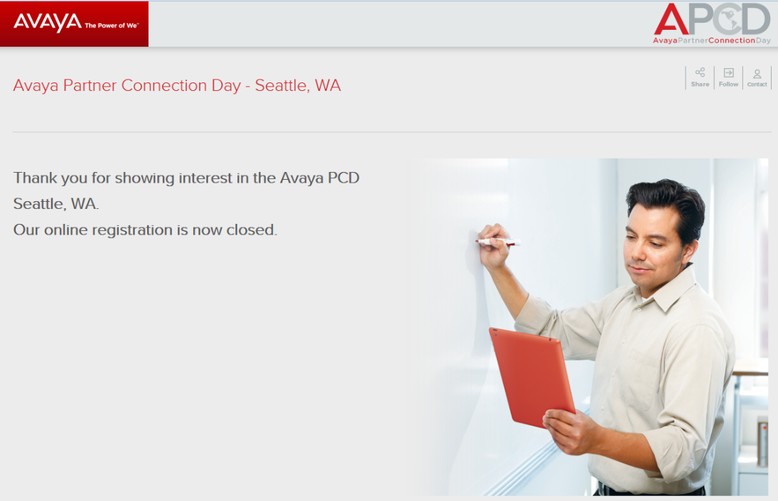
APCD 2014 – Close Registration page Seattle
Close Registration page Seattle
Request Date:
Tuesday, February 18, 2014
Requested By:
Maria Jose Bermudez
URL Location:
http://www4.avaya.com/usa/events/APCD-2014/register-close.html?city=Seattle,%20WA
Developed By:
William Ballesteros

Slide 5
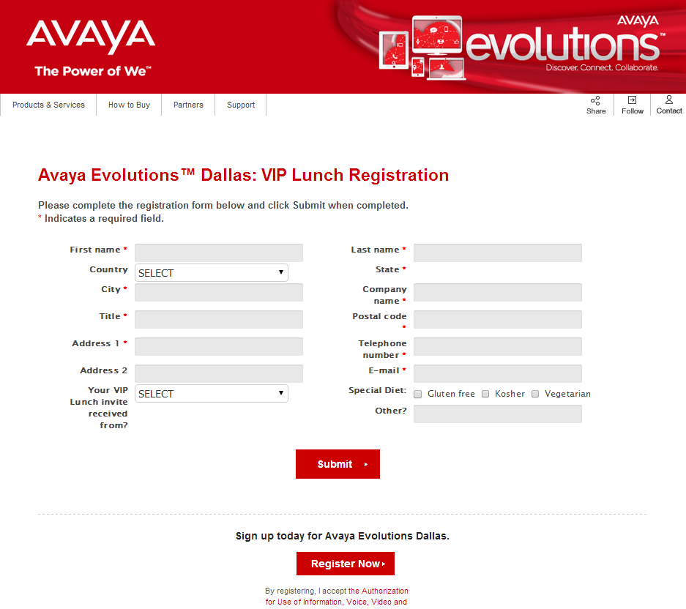
Avaya Evolutions - Dallas
Creation Registration Page VIP Lunch
Request Date:
Wednesday, February 19, 2014
Requested By:
Maria Jose Bermudez
URL Location:
http://www4.avaya.com/usa/events/Evolutions/Dallas/Dll_VIP_Lunch/dll_register_viplunch.aspx
Developed By:
Peeter Moreno

Slide 6
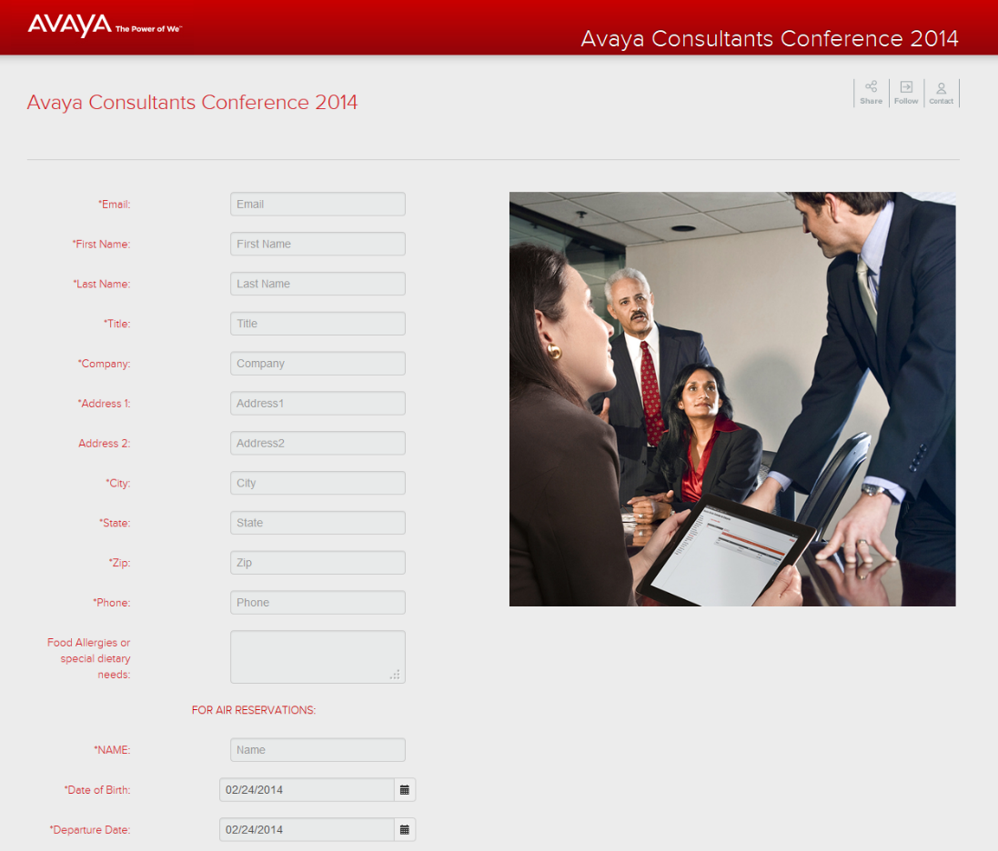
Avaya Consultant Conference 2014
Creation Registration Page ACC2014
Request Date:
Wednesday, February 19, 2014
Requested By:
Boris Corredor
URL Location:
http://www4.avaya.com/usa/events/acc2014/inv/register.aspx
Developed By:
Peeter Moreno

Slide 7
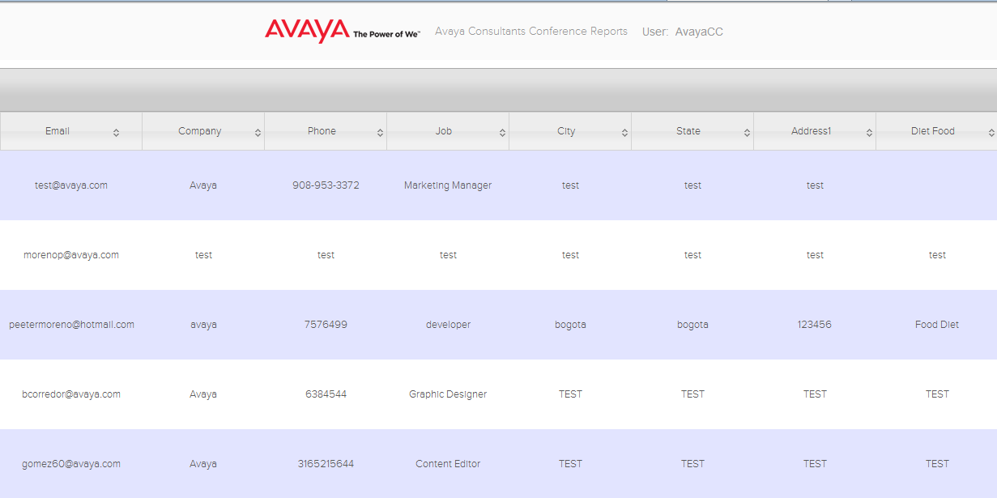
Avaya Consultant Conference ACC2014
Creation Report Page
Request Date:
Wednesday, February 19, 2014
Requested By:
Boris Corredor
URL Location:
http://www4.avaya.com/usa/events/acc2014/inv/Reports/admin.aspx
Developed By:
Peeter Moreno

Slide 8
What’s Coming?
What’s Coming?

Slide 9
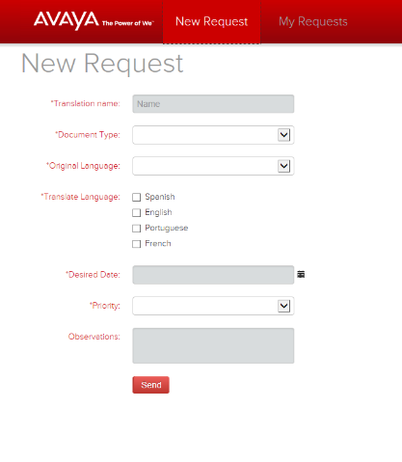
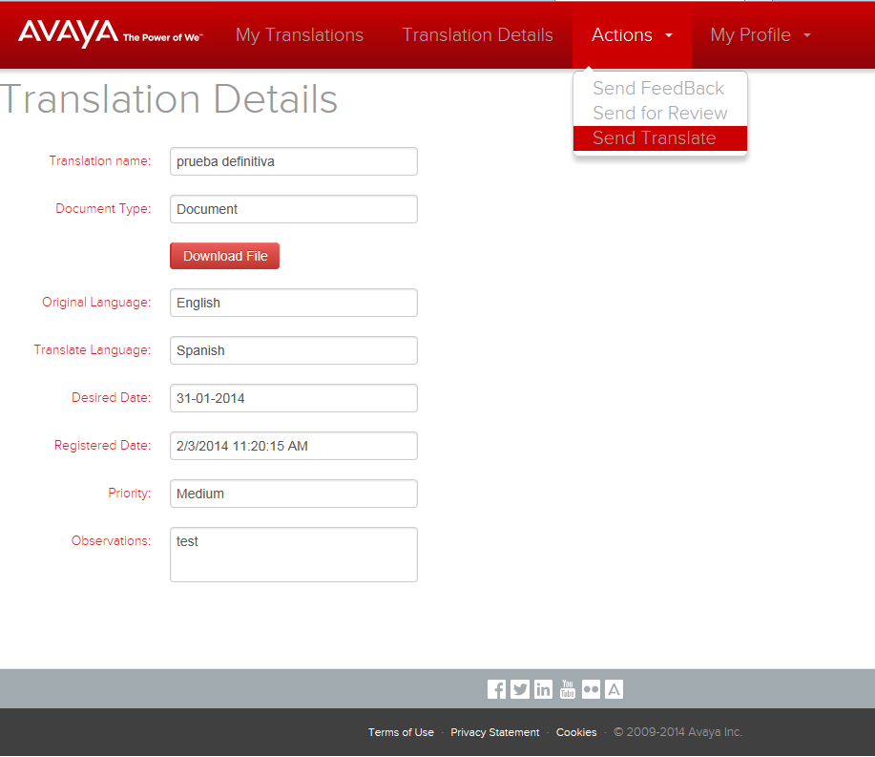
Avaya Translation Request - MicroSite
Avaya Translation Request - MicroSite
Request Date:
Monday, January 13, 2014
Requested By:
Bladimyro Velasco
URL Location:
Developed By:
William Ballesteros

Slide 10



